Slide 1
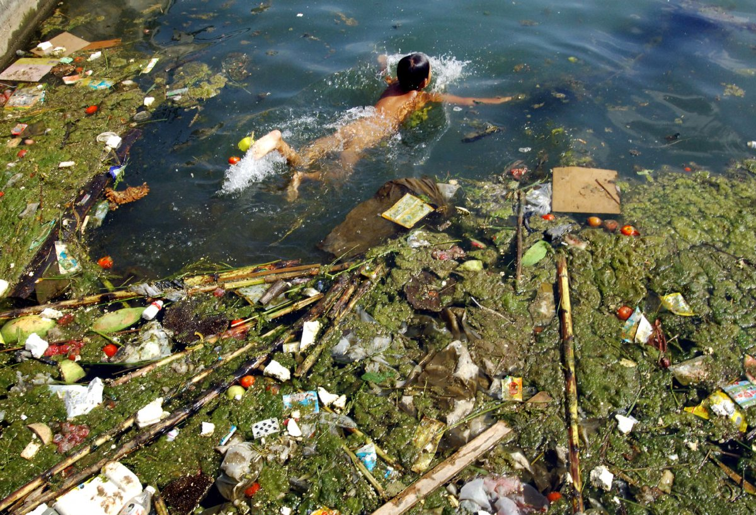
Chapter 14
Water Pollution

Slide 2
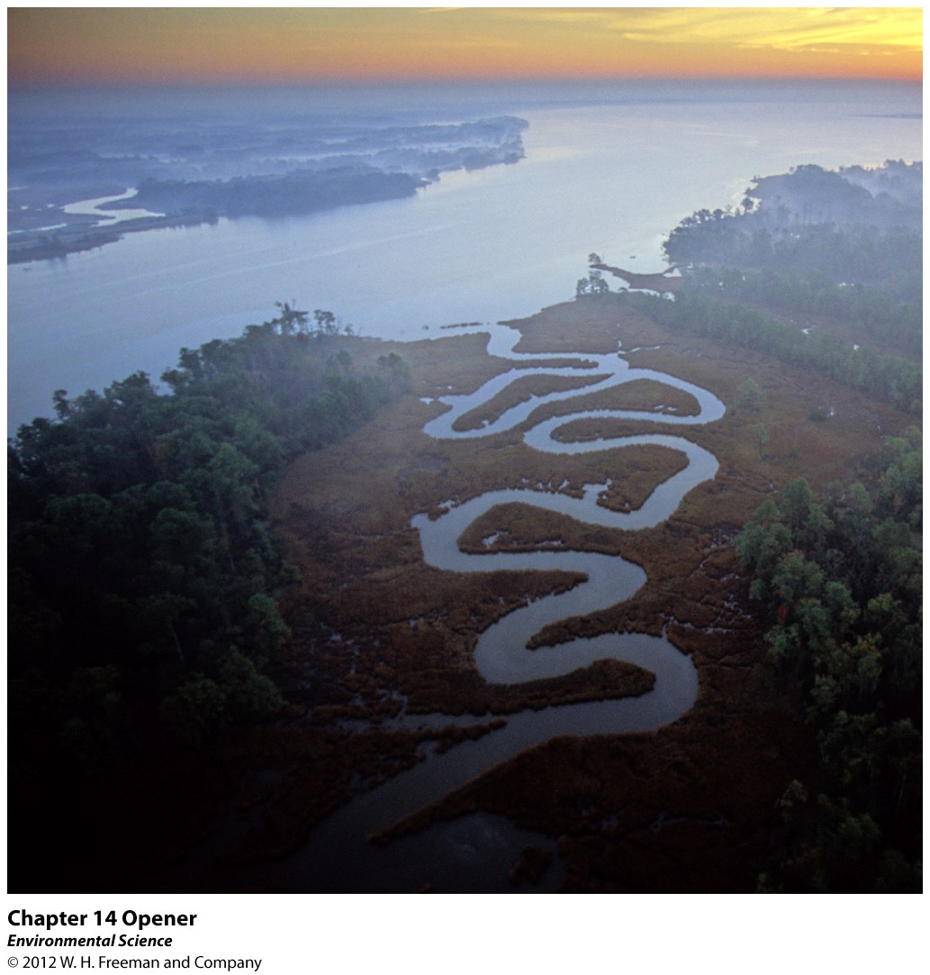

Slide 3
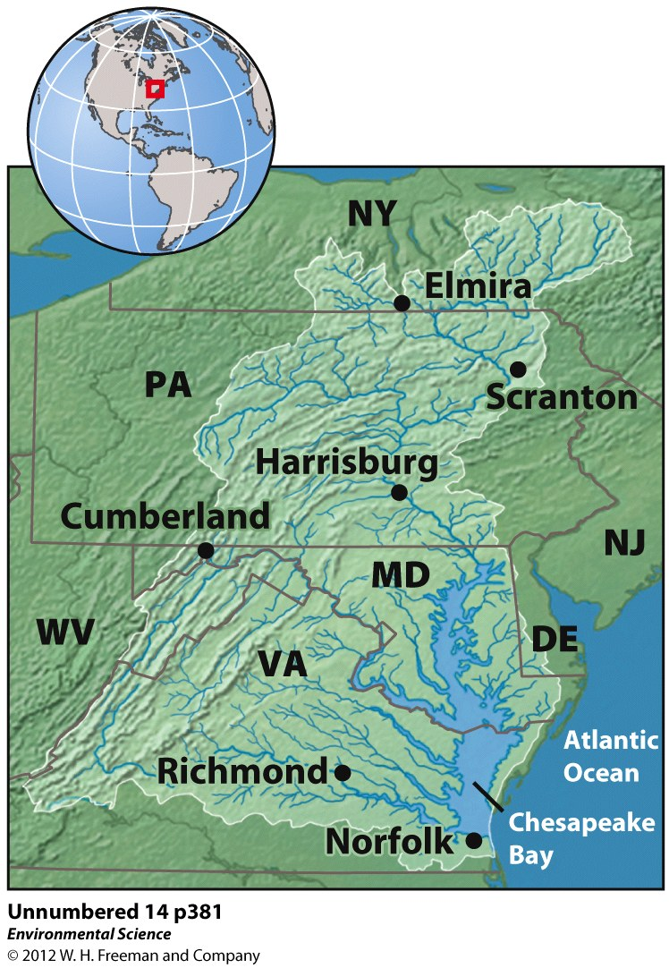

Slide 4
The Chesapeake Bay
Largest estuary in the US.
Millions of tons of N, P are dumped into the tributaries.
Sewage waste, animal waste, and fertilizer run off all contribute to the pollution.
Algal blooms in the bay occur.
Sediments also wash into the bay making the water cloudy.
Millions of tons of pesticides, and pharmaceuticals are washed into the bay.

Slide 5
Pollution: Specific or Broad Areas
Water Pollution: contamination of streams, rivers, lakes, oceans or groundwater with substances produced through human activities.
Point Source: Comes from distinct places.
Example: sewage treatment plant
Nonpoint Source: More diffuse, large areas.
Example: farming region

Slide 6
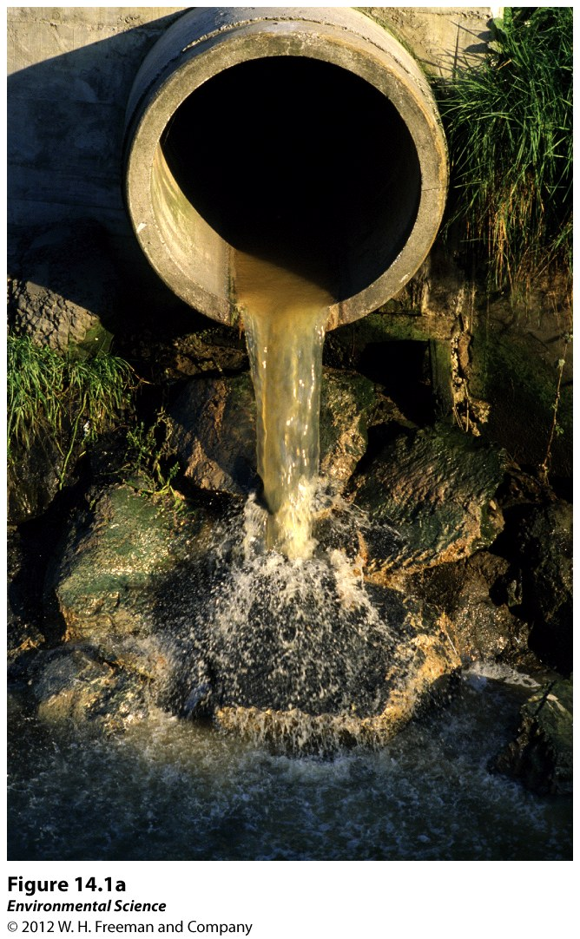

Slide 7
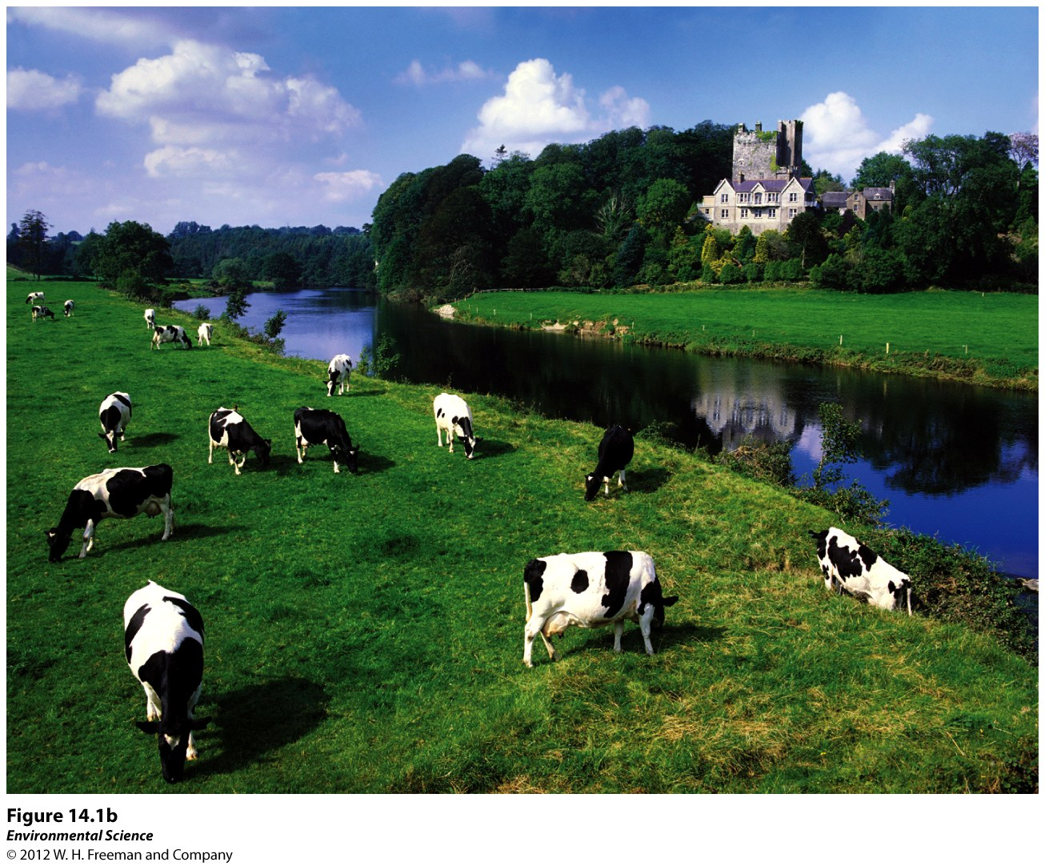

Slide 8
Human Wastewater
Human wastewater: produced by human activities including sewage from toilets and gray water from washing clothes and dishes.
Oxygen Demanding Waste: organic matter that feeds the growth of microbes that are decomposers.

Slide 9
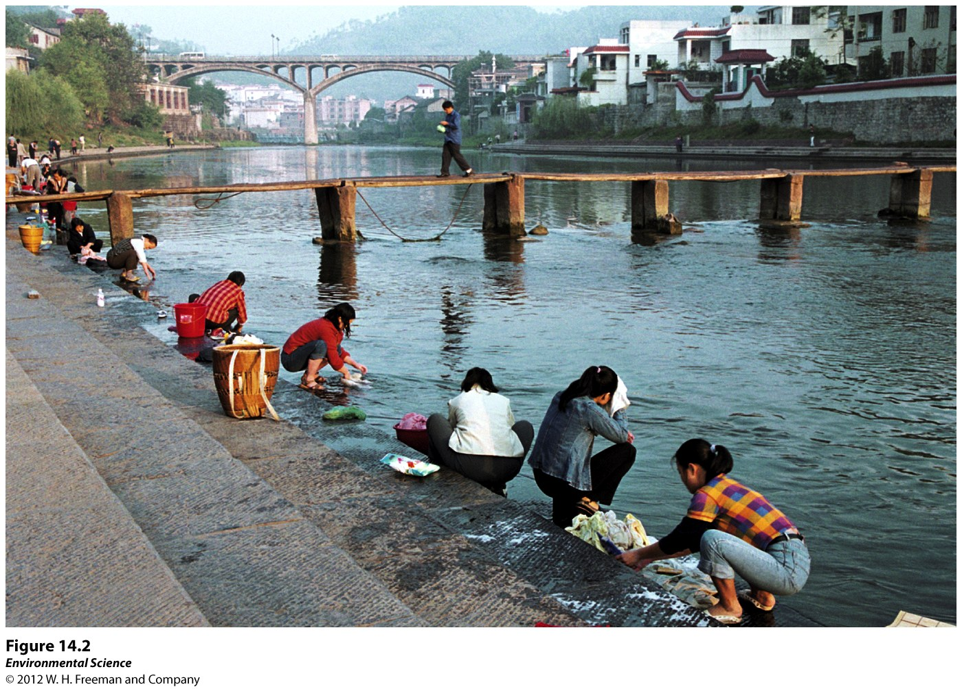

Slide 10
Biochemical Oxygen Demand (BOD): the amount of oxygen a quantity of water uses over a specific time at a specific temp.
Low BOD is less polluted (5-20mg of O₂)
High BOD such as wastewater(200mg of O₂)
Dead Zones: very little amount of oxygen therefore organisms die.

Slide 11
Nutrient Release
Nitrogen and Phosphorous can be released into bodies of water from agriculture run-off.
Eutrophication: an overabundance of growth due to excess nitrogen and phosphorous.
Causes algal blooms.
When the algae dies zooplankton feed off the dead algae.
Mississippi River receives water from 41% of the land in the US

Slide 12
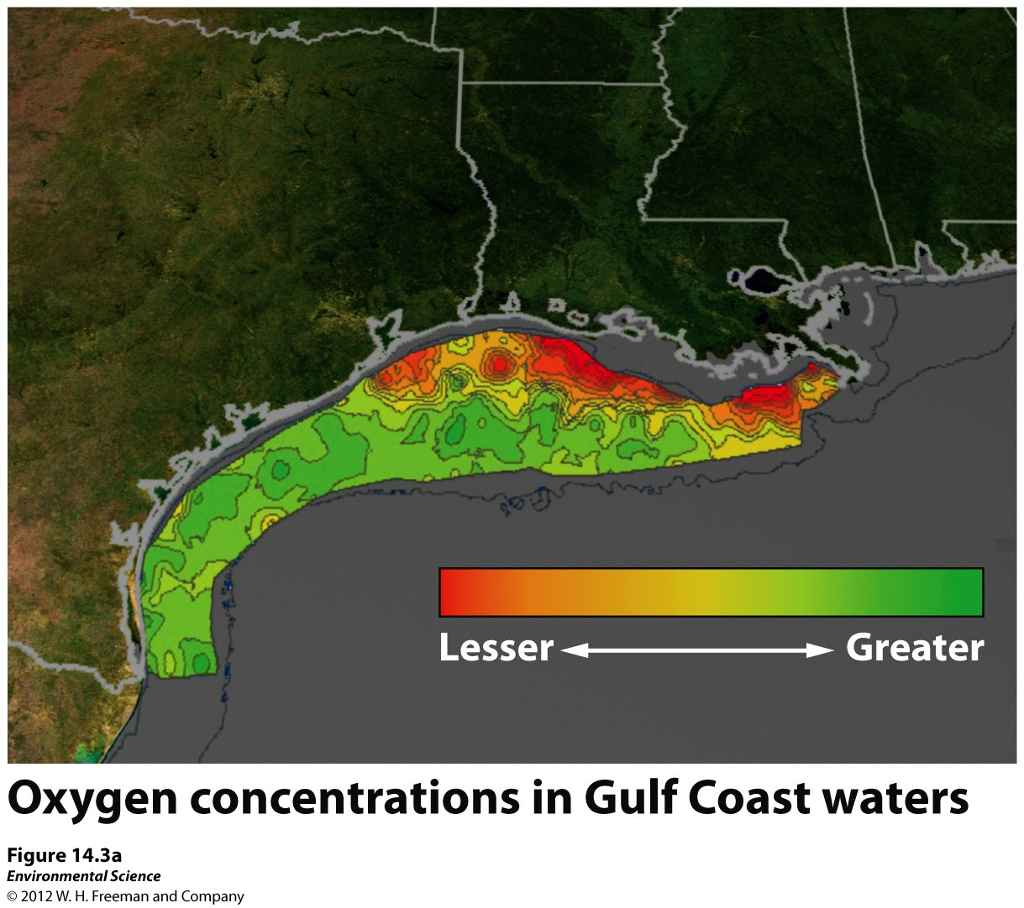

Slide 13
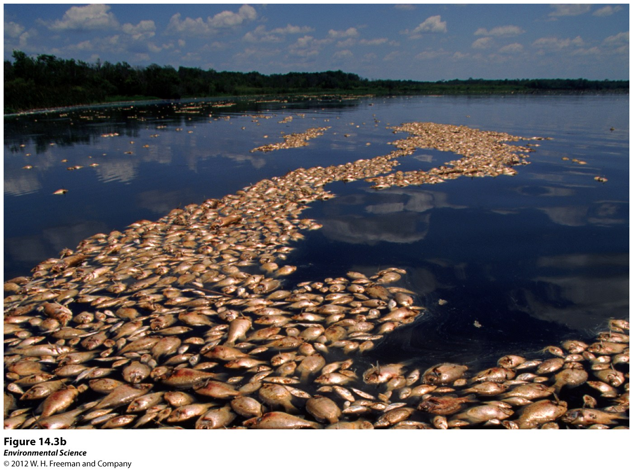

Slide 14
Disease-Causing Organisms
Pathogens: parasites, bacteria, viruses, that cause illnesses.
Examples: Cholera, Hepatitis, and Typhoid Fever
1.1 billion people do not have access to clean drinking water.
42% of the world’s population lacks proper sanitation and over half live in China and India.

Slide 15
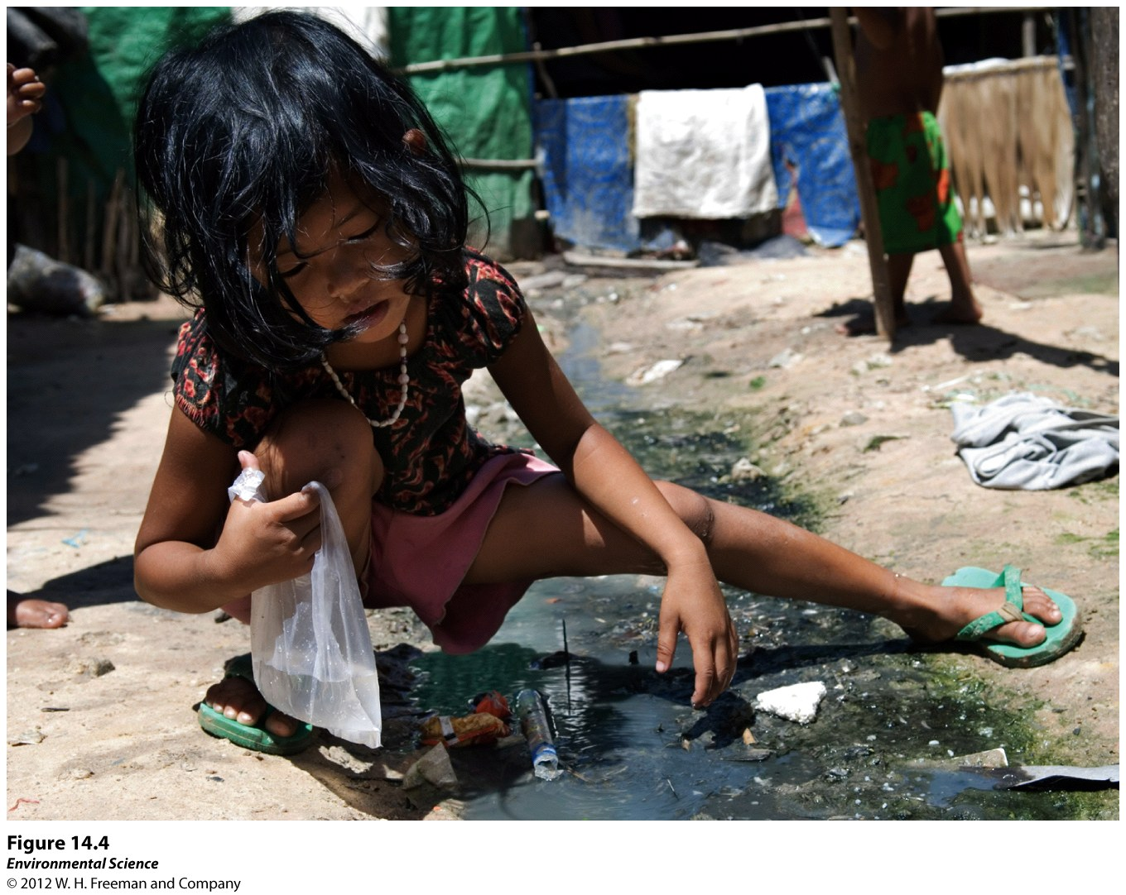

Slide 16
Testing Water
Use indicator species to determine if there are pathogens in the drinking water.
Indicator Species: indicates whether or not disease-causing pathogens are likely to be present.
Fecal Coliform Bacteria: live in the intestines of humans, generally harmless.
E. Coli is an indicator species.

Slide 17
Treating Wastewater
Basic Principle: bacteria break down the organic matter into carbon dioxide and inorganic compounds such as nitrate and phosphate.

Slide 18
Septic Systems
Septic Tank: large container that receives wastewater from the house.
Heavy material sinks, light material floats, and the fairly clear layer is septage.
Septage goes to a leach field where it slowly seeps out across the field. It is purified by the soil.
Uses no electricity but has to be pumped.

Slide 19
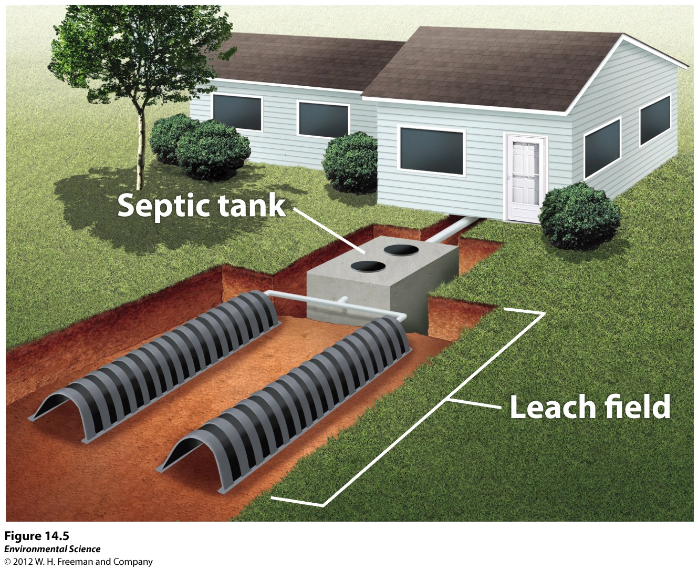

Slide 20
Sewage Treatment Plants
Good for large areas.
Series of underground pipes.
Primary Treatment:
Solid wastes settles out.
Dried and classified as sludge.
Sludge is exposed to bacteria to digest it.
Final form is placed in a landfill or burned.
Can be converted into fertilizer pellets.

Slide 21
Secondary Treatment
Bacteria breaks down 85-90% of all the organic matter into carbon dioxide, nitrogen and phosphorous.
Aeration to promote aerobic bacteria growth.
Remaining water is disinfected using chlorine, ozone, or ultraviolet light.
Placed into nearby river, lake, or ocean back to the water cycle.
Tertiary Treatment: takes out the nitrogen and phosphorus to prevent algal blooms.

Slide 22
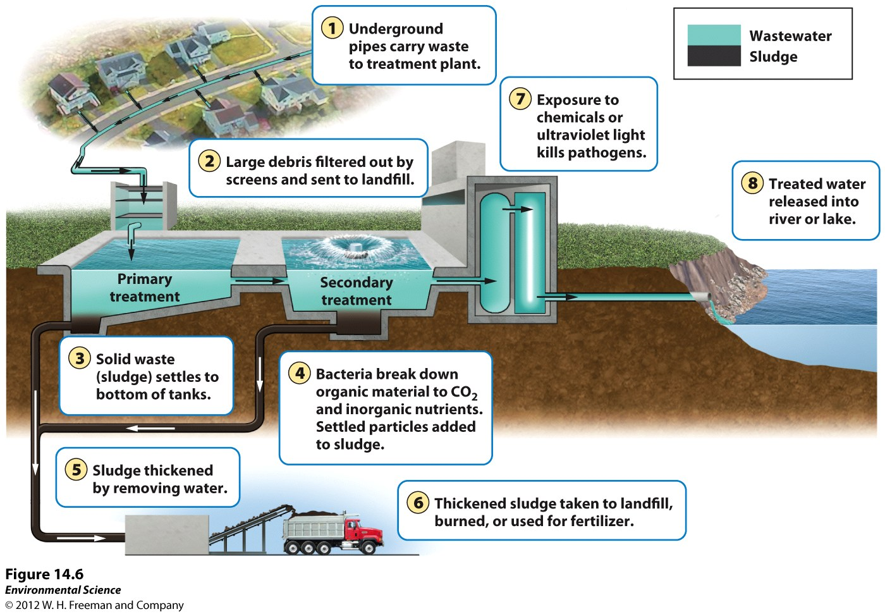

Slide 23
Legal Sewage Dumping
Older treatment plants receive water from storm-water drainage systems.
Heavy rains overwhelm the capacity of the plants.
Treatment plants are allowed to bypass the normal treatment protocol and pump sewer water directly into the adjacent body of water.
This happens 40,000x per year in the US.
500,000 illnesses per year are due to drinking sewage-contaminated water

Slide 24
Animal Feed Lots and Manure Lagoons
Manure contains bacteria, hormones, and antibiotics.
Manure Lagoon: large, human-made ponds lined with rubber to prevent the manure from leaking into groundwater.
After broken down by bacteria can be spread over the fields as fertilizer.
Can leak or overflow, fertilizer can run off. All present health issues and concerns

Slide 25
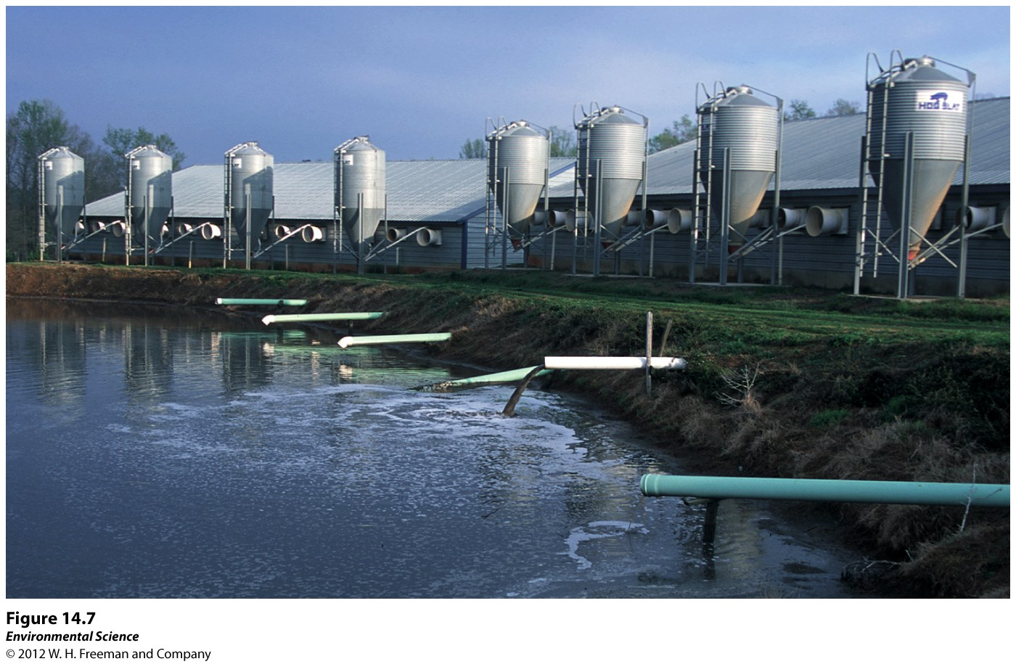

Slide 26
Heavy Metals and Synthetics
Lead
Found in old pipes.
Exposure to fetuses and infants can harm the nervous system, brain, and kidneys.

Slide 27
Arsenic
Occurs naturally in the Earth’s crust.
Can dissolve into the groundwater.
Mining can release arsenic.
Used in industry as a wood preserver.
Can be removed from water through filtration.
Associated with cancer to skin, lungs, kidneys, and bladder.
Upper limit recently set to 10ug/L.
Big issue in India.

Slide 28
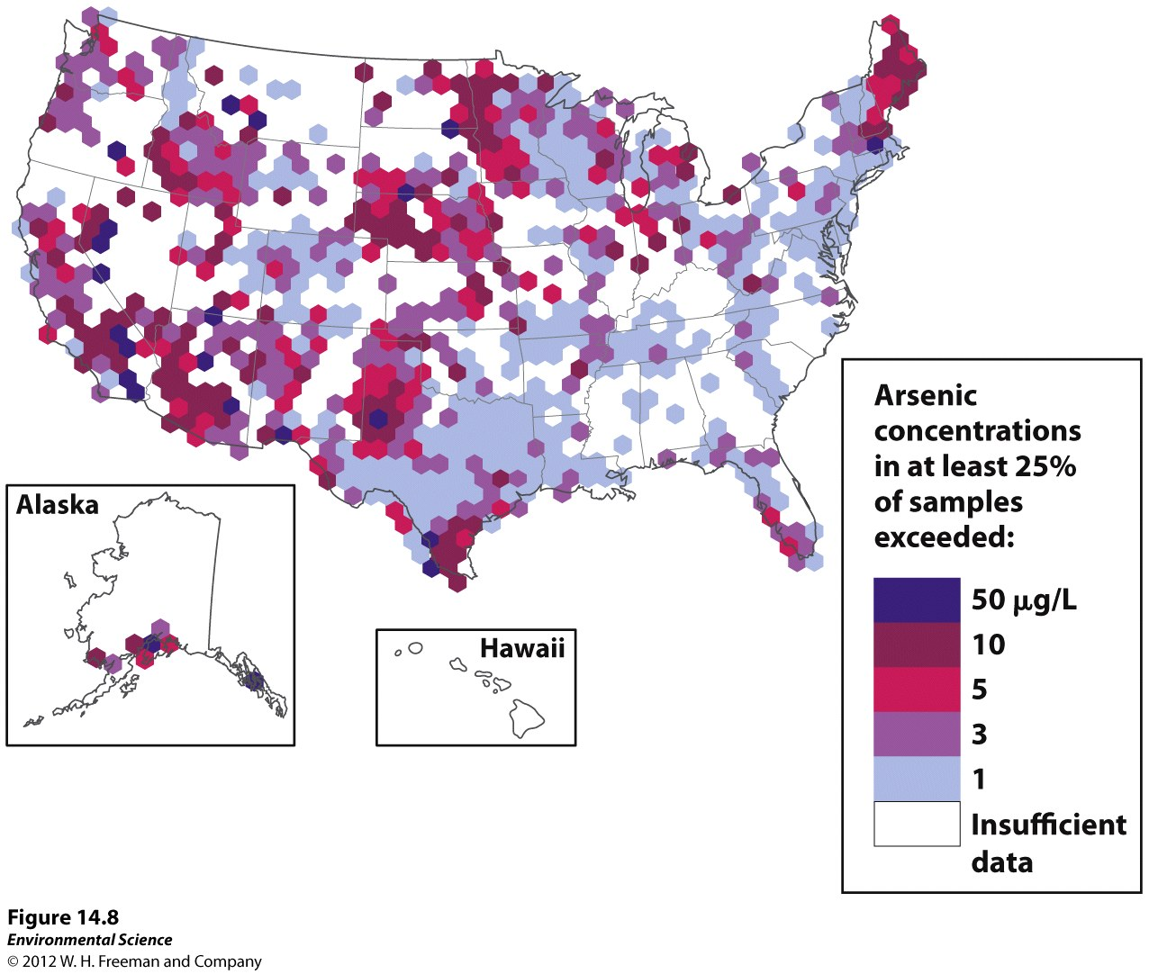

Slide 29
Mercury
Found in water due to increased human activities.
Released when burning coal.
Incinerating garbage, hazardous waste, medical supplies and dental supplies also contributes.
Raw materials from making cement also contains mercury.
Petroleum exploration leads to mercury and lead pollution

Slide 30
Mercury (Hg) is converted into methylmercury by bacteria.
Methylmercury is very harmful.
Bad for children and developing fetuses.
Developing a way to reduce mercury emissions.

Slide 31
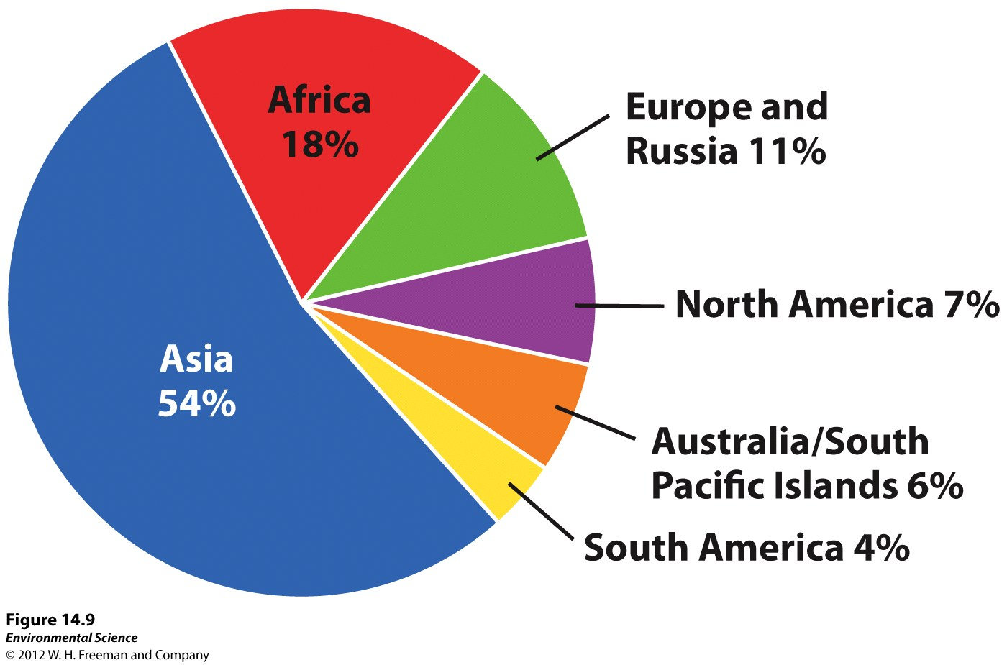

Slide 32
Acid Deposition & Acid Mine Drainage
Burning fossil fuels released sulfur dioxide and nitrogen dioxide into the air.
These were released into the atmosphere and converted into sulfuric acid an nitric acid.
They are transported to other areas (precipitation or dry particles) and released back into the environment.
Lowers the pH of water bodies from 5.5 or 6 to below 5!
Coal scrubbers pass the hot gases through limestone to remove the acidic gases.

Slide 33
Abandoned underground mines food with ground water producing acidic water.
Low pH harms organisms.

Slide 34
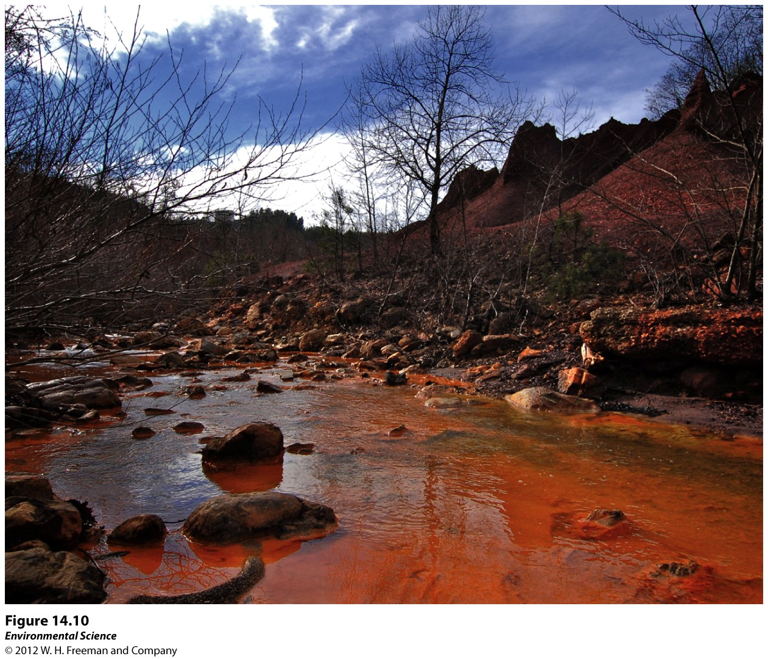

Slide 35
Synthetic Organic Compounds
Pesticides and Inert Ingredients
Pesticides control pest organisms.
Includes herbicides, fungicides, and insecticides.
Kill more than the intended organisms.
Pose side effects.
DDT!
Inert ingredients: Roundup Ready. Has an inert property that allows it to penetrate leaves but also damages tadpole cells.

Slide 36
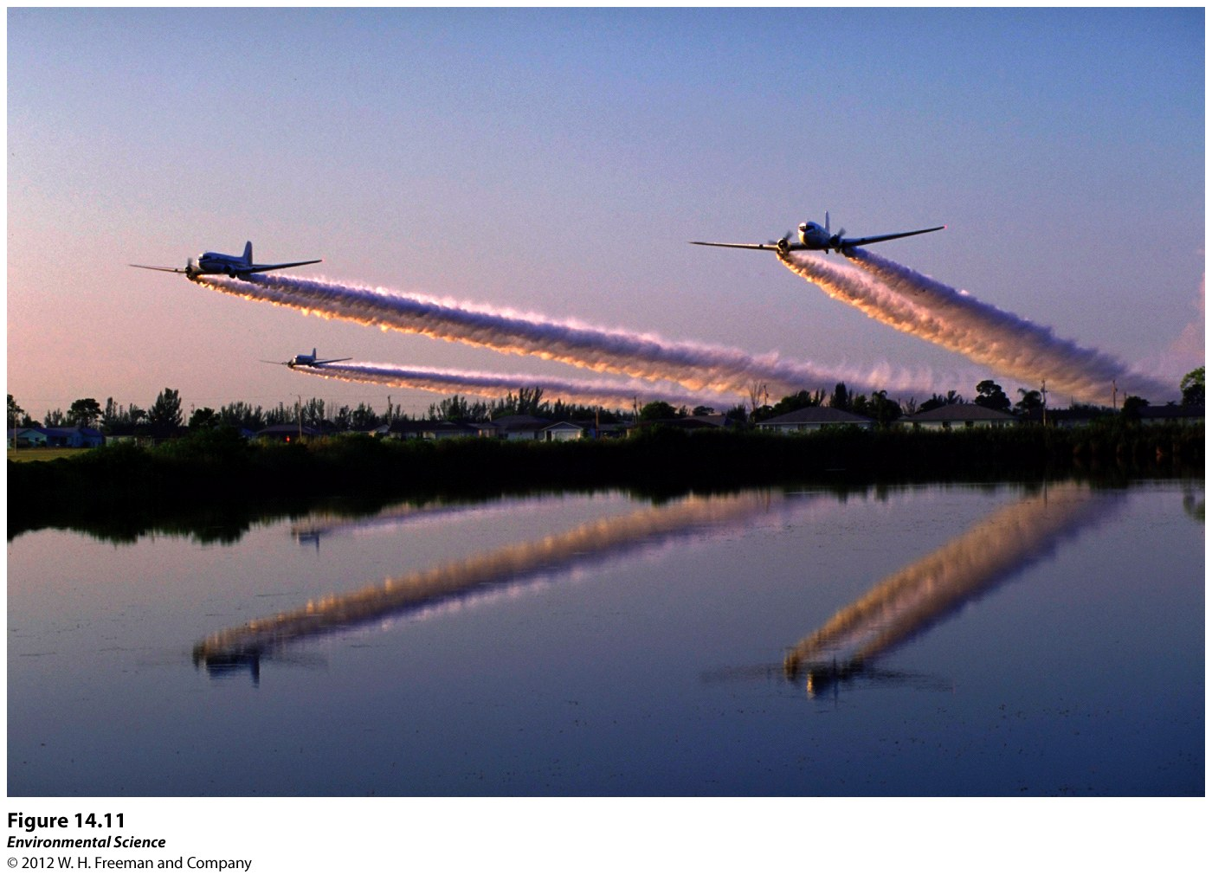

Slide 37
2. Pharmaceutical and Hormones
US Geological Survey tested 139 streams across the US for various chemical.
50% contained antibiotics and reproductive hormones, 80% contain non prescription drugs, and 90% contained steroids.
Low amounts were detected.

Slide 38
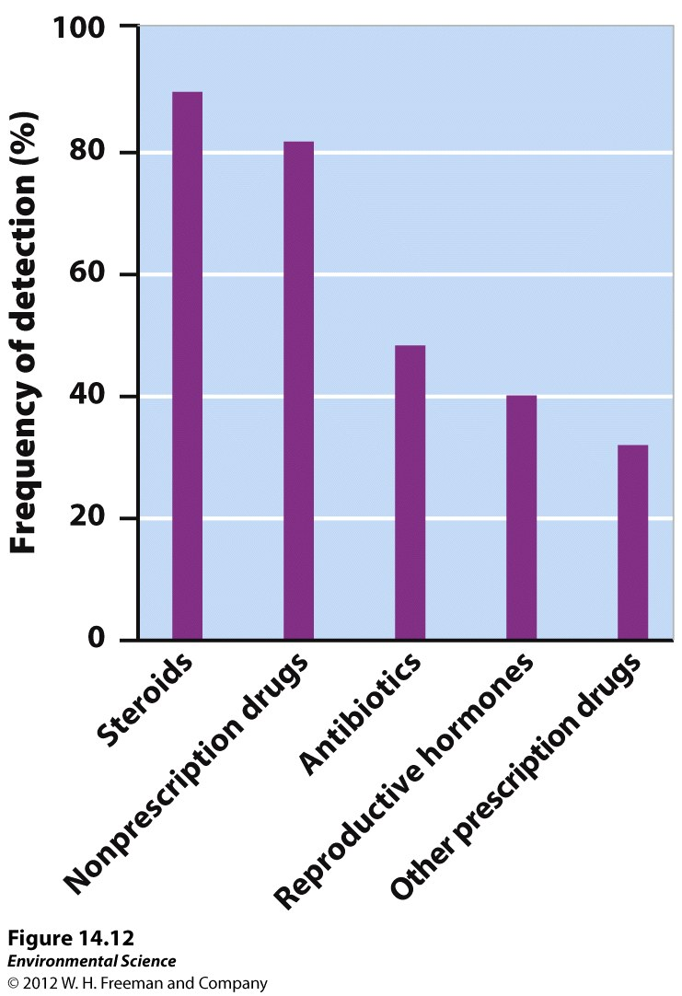

Slide 39
Military Compounds
Perchlorates used for rocket fuel contaminate the soil and water.
Can effect thyroid gland and the amount of hormones.

Slide 40
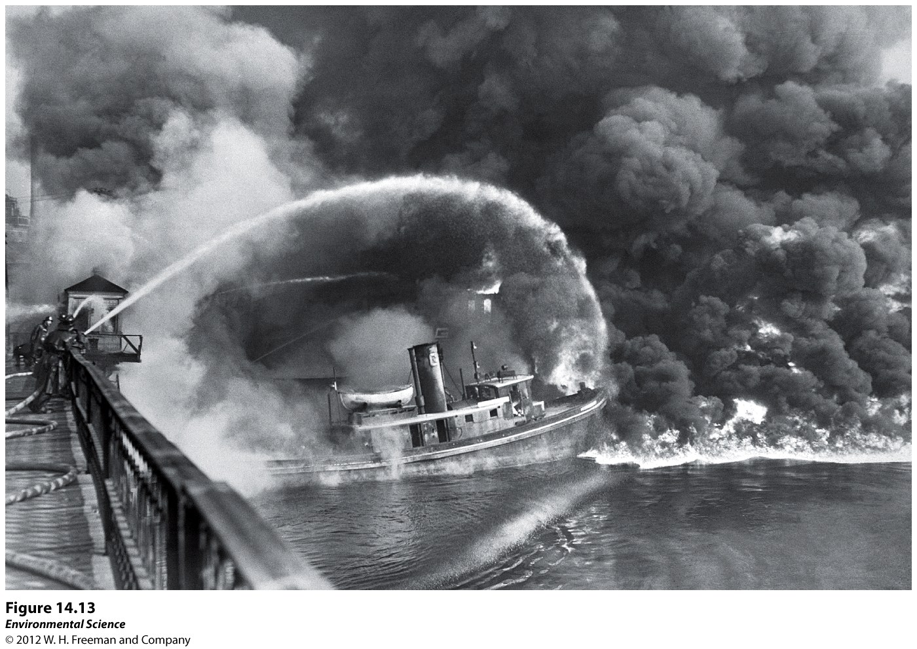
Industrial Compounds
Compounds used in manufacturing.
Dumped into rivers.
Cuyahoga River in Ohio caught on fire in 1969!

Slide 41
PCBs: polychlorinated biphenyls. Used in manufacturing plastics and insulating electrical transformers until 1979.
Ingested PCBs are lethal and carcinogenic or cancer causing.
General Electric dumped 1.3 million pounds of PCBs into the Hudson River from 1947-1977.
EPA ruled that the company had to dredge and remove 2.65 million cubic yards of PCB sediment. Removal began in 2009.

Slide 42
PBDEs: polybrominated diphenyl ethers. Flame retardants added to a variety of items.
Since the 1990s scientists have been detecting PBDEs in unexpected places such as fish, aquatic birds, and human breast milk.
Exposure to some types can cause brain damage.
Banned in the European Union and several states including Washington and California.

Slide 43
Oil Pollution
Oil is toxic to many marine organisms including fish, birds, mammals, in addition to algae and microorganisms at the bottom of the food chain.
Oil is viscous and can spread below and across surfaces.

Slide 44
Source: off-shore oil drilling (drilling under the sea).
About 5,000 off shore oil drilling platforms in the US.
3,000 in the rest of the world.
Can experience leaks.
Estimated 146,000 Kg of oil leaking just in the US.
Foreign: 0.6 million to 1.4 million Kg per yr.

Slide 45
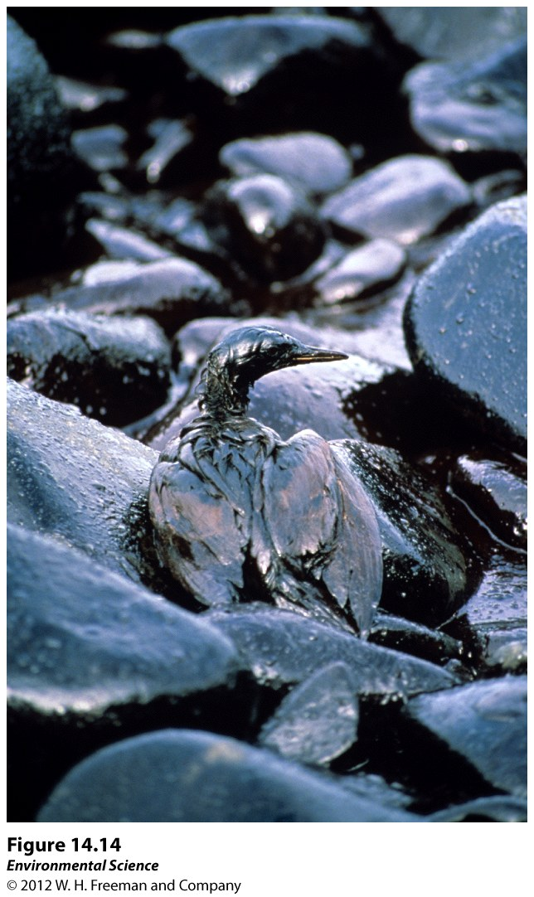

Slide 46
BP Oil Spill- 2010
Deepwater Horizon platform caused a pipe to break about 1 mile down.
Pipe was open from April to August.
Estimated 206 million gallons of oil was leaked disrupting beaches, wildlife and estuaries.

Slide 47
Exxon Valdez- 1989
Ran aground off of the coast of Alaska.
Spilled 11 million gallons of oil.
Killed 250,000 seabirds, 2,800 sea otters, 300 harbor seals, and 22 killer seals.
20 years after research has indicated that some species such as bald eagles and salmon have rebounded.
Killer whales and sea otters have not : (
Could take 100 years for all the oil to break down.

Slide 48
Oil Remediation
Oil on feathers must be cleaned by hand.
Feathers covered with oil become heavy and do not insulate.
Plastic barriers can be used to contain oil in one area and then can be sucked off.
Chemicals can be used to break up the oil but these can be harmful to the environment.
Genetically engineered bacteria=s bioremediation.

Slide 49
No clear way of how to remove oil from the coastline.
High pressure hot water removes the oil but also the organisms that reside on the rocks and the sediments that contain valuable sediments.
Leaving it there results in most of it gone due to the action of the waves but a lot remains within tiny crevices harming wildlife.

Slide 50
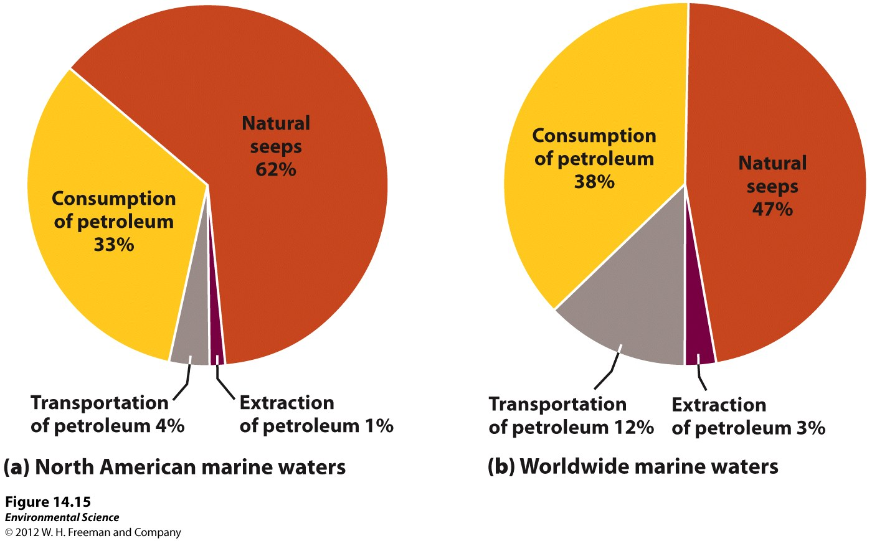

Slide 51
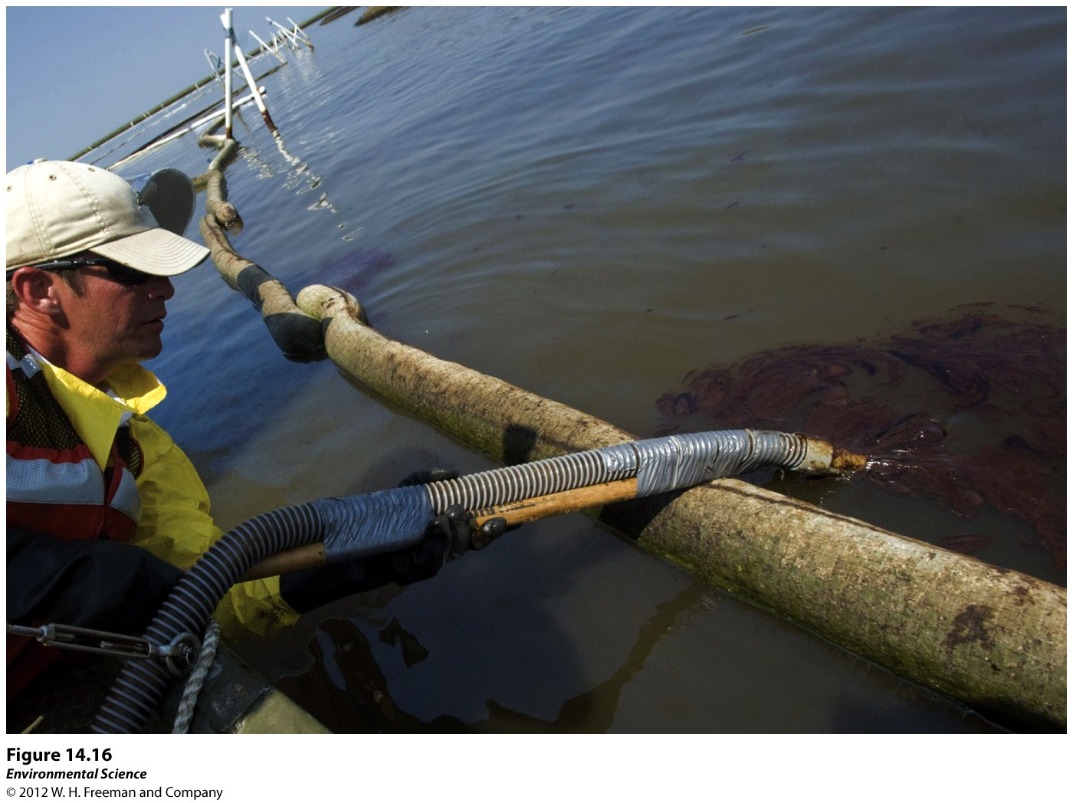

Slide 52
Non-Chemical Pollutants
Solid Waste Pollution
Garbage!
Great Pacific Garbage Patch: ocean gyre that collects garbage.
Due to rotating currents collects garbage in one concentrated area.
About the size of Texas.
Coal and ash slag that remains when coal is burned (mercury, arsenic, and lead).

Slide 53
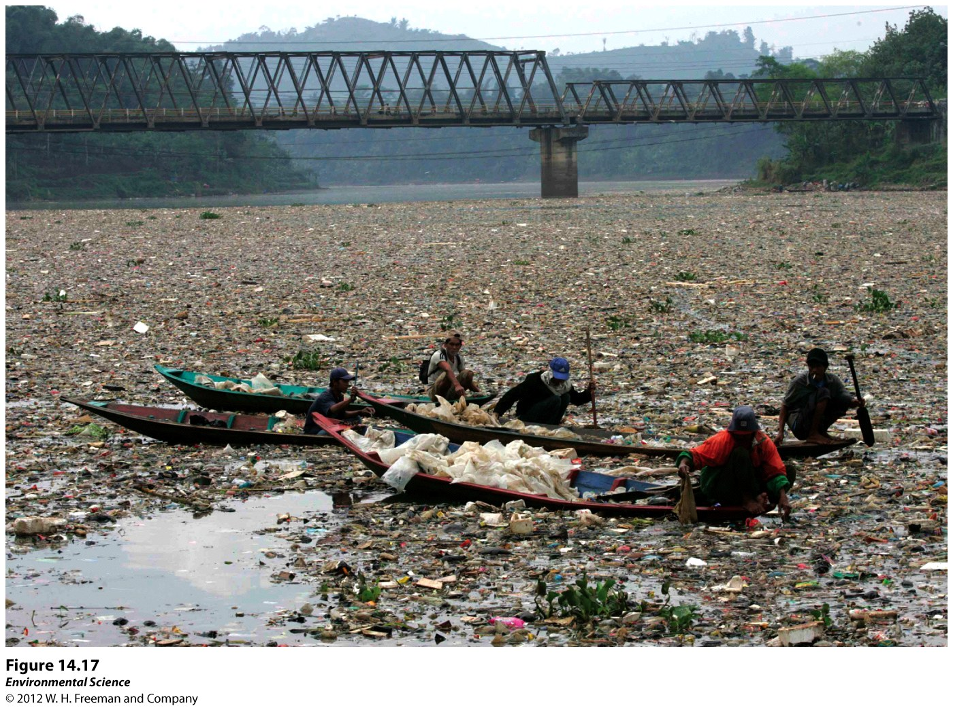

Slide 54
Sediment Pollution
House building, agriculture, and industrial building all increase sediment pollution.
Increases turbidity of water which decreases sunlight infiltration.
Can clog fish gills and inhibit the ability to obtain oxygen and catch prey.
Estimated $16 billion per year in the US due to sediment pollution.

Slide 55
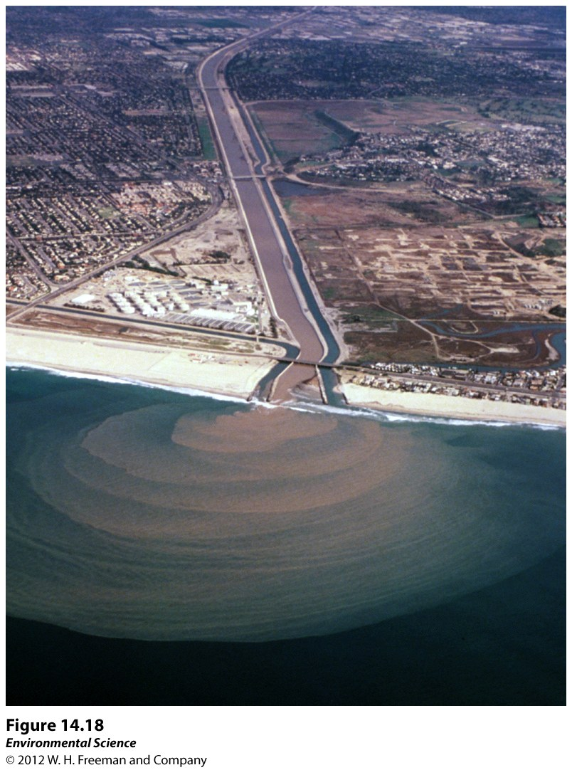

Slide 56
Thermal Pollution
Substantial change in the temperature of the water due to human activities.
Heating up fresh water to facilitate an industrial process then returning this warm water back to the original source.
Cooling machines.
Organisms can suffer thermal shock.
High temps cause organisms to increase their respiration and warmer water does not contain as much dissolved oxygen as cold water.

Slide 57
EPA regulates how much heated water can be returned to natural sources.
Challenging in the summer when temps are high, AC demands are high, and water levels are low.
Some industries use cooling towers(rely on evaporation) or recycles the water they utilize.

Slide 58
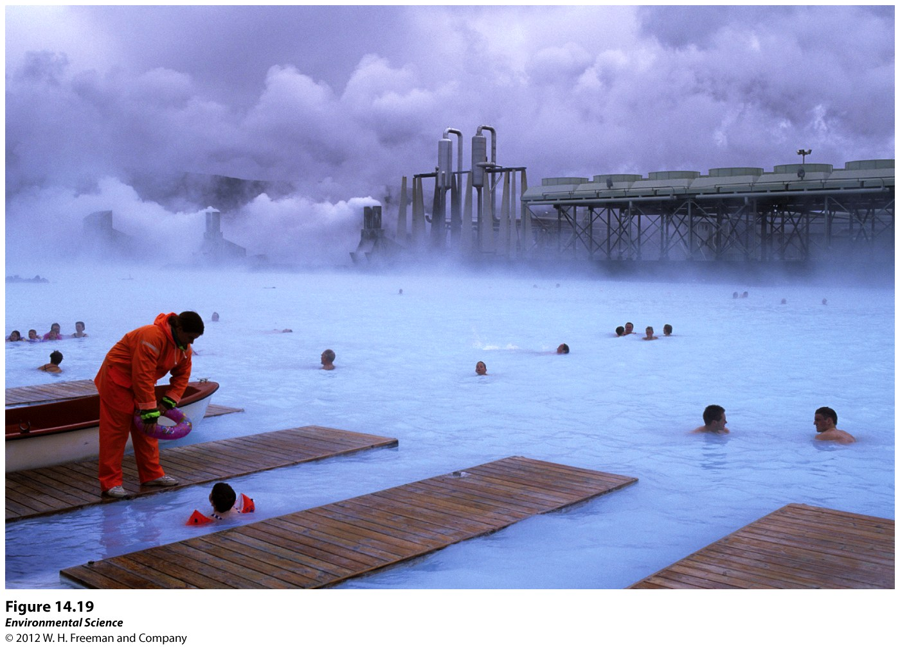

Slide 59
Noise Pollution
Sounds from ships and submarines disrupt sea life communication.
Sonar is especially bad.
Several beached whales have been connected to the use of military sonar and loud, underwater air guns.

Slide 60
Clean Water Act
The Federal Water Pollution Control Act of 1948 was the first major piece of legislation affecting water quality.
Expanded in 1972 to the Clean Water Act.
Supports the “protection and propagation of fish, shellfish, and wildlife and recreation in and on the water” by maintaining and when necessary, restoring the chemical, physical, and biological properties of natural waters.
Does not include groundwater.

Slide 61
More recently includes the diversity of living organisms.
Issues water quality standards that define acceptable limits of various pollutants in US waterways.
EPA and state governments can issue permits to control how much pollution industries can discharge into the waters.

Slide 62
Safe Drinking Water Act
Sets the national standards for safe drinking water.
EPA is responsible for establishing maximum contamination levels (MCL) for 77 different elements or substances in both surface water and groundwater.
Subject to political pressures.
Expensive for communities to afford.
Successful program but could use some improvements.

Slide 63
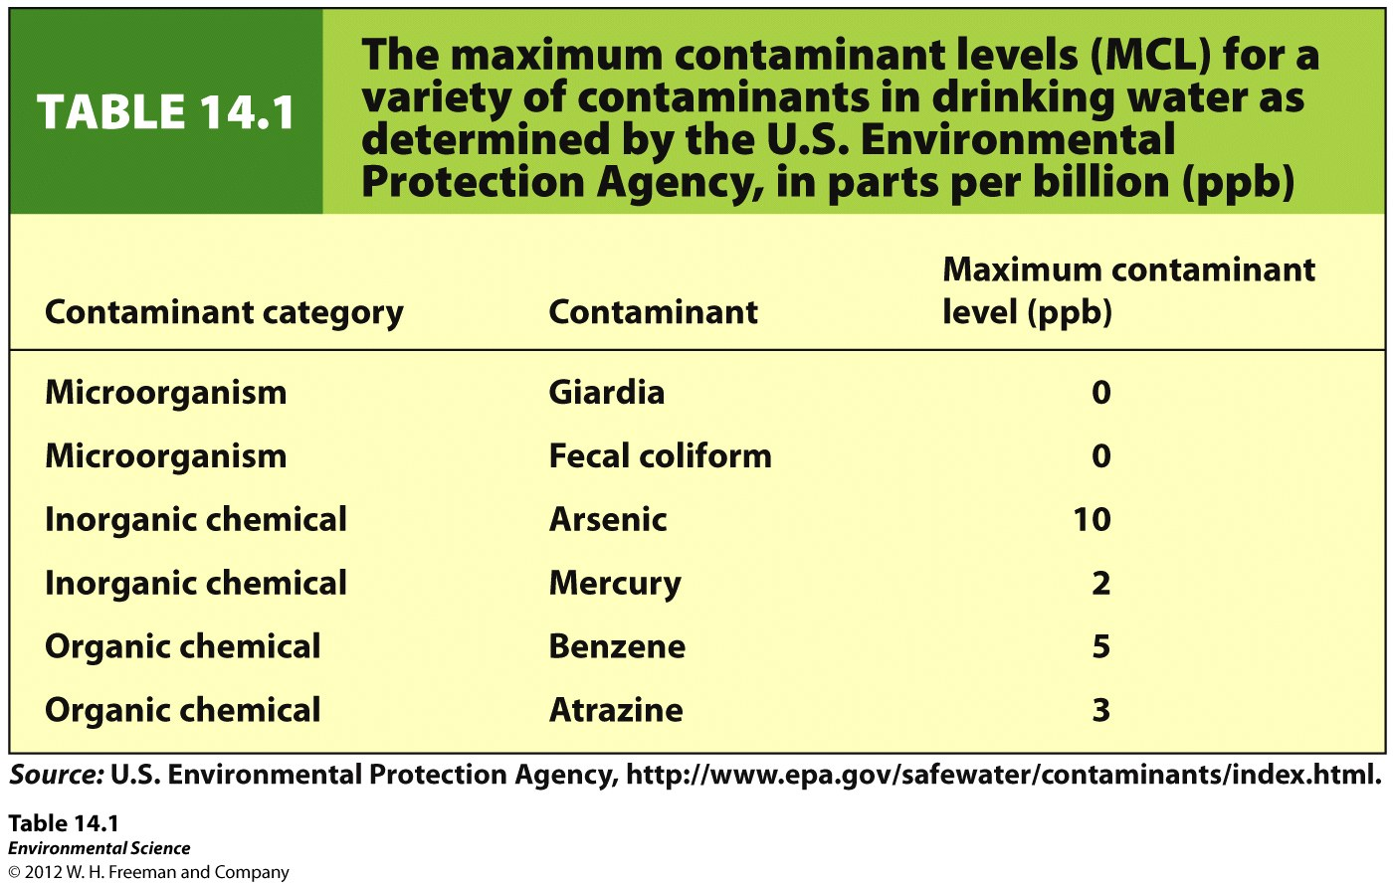

Slide 64
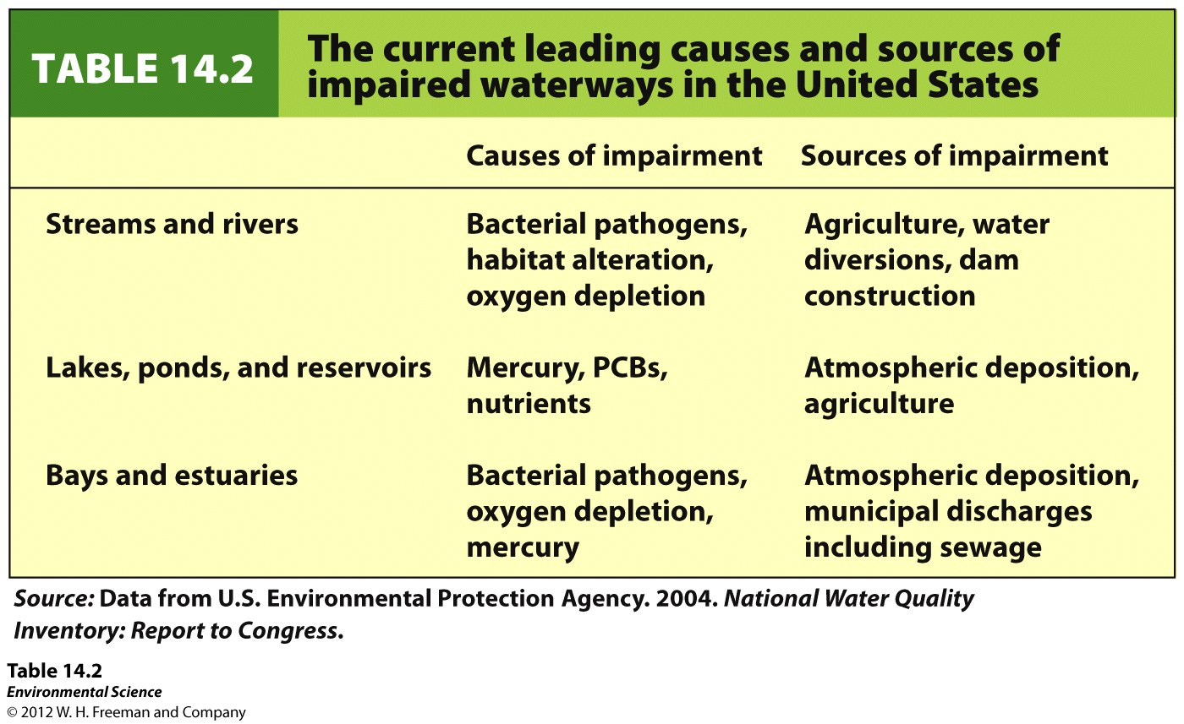

Slide 65
Legislation in the Developing World
Clear difference between developing world and developed nations.
In developed worlds industrialization occurred 100s of years ago with high amounts of pollutions, focus now is for regulation and clean up.
Developing countries are still within industrialization so suffer higher amounts of pollution.
India, China, Africa, are undergoing rapid industrialization.

