Slide 1
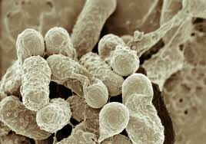
Bacterial Transformation
IV: addition of plasmid
DV: growth or no growth
A.Title:
Be descriptive!!!

Slide 2
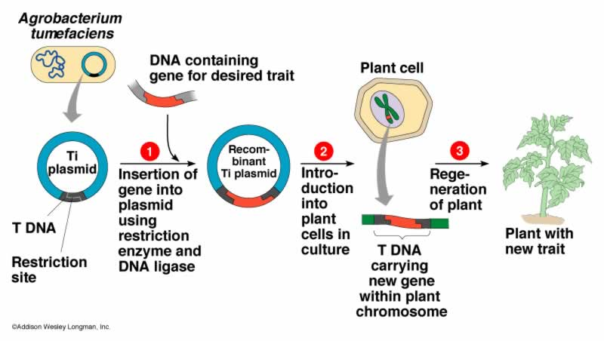

Slide 3
B. Members of the group.
C. Major Goal: why did we
do this lab? What were we
trying to accomplish?
D. Hypothesis: What will
happen on each of the plates
and why? (need 3)!
E. Materials and procedure in your own words. List or illustrate all materials. Strategies you used, what controls did you use.

Slide 4
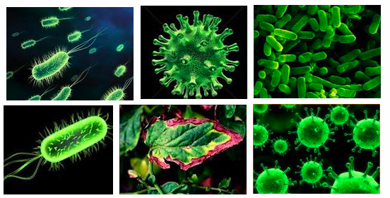
F. Data/Results
No graphs
No calculations
Table

Slide 5
Table
Growth No Growth
(lawn or
colonies )
LB-
LB/Amp-
LB/Amp+

Slide 6
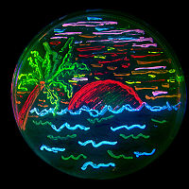
G. Analysis
Answer all analysis questions.
Include the questions (you may cut and paste)!

Slide 7
H. Conclusions/Discussions
Describe the experiment (1-2 sentences)
What were the controls?
Accept or reject your hypothesis. Explain why.
What are some real life applications of this process?
If results did not come out as predicted, discuss possible sources of human error by your group and the creators of the lab.
If hypothesis were proven correct, explain what parts of the lab needed special attention to prevent error.

Slide 8
Bacterial Transformation Lab Questions
1. What are you selecting for in this lab (what tells you the transformation has been successful)?
2. What does the phenotype (physical appearance) of the transformed colonies tell you?
3. What one plate would you first inspect to conclude that the transformation occurred successfully? Why?
4. In the first control you placed E. coli onto plates with NO ampicillin. What does this tell you? (LB/-)
5. In the next control, you placed E. coli that went through the transformation process without addition of a plasmid onto an LB/amp plate (LB/AMP-) What does this tell you?
6. On the test plate we added transformed bacterial with the plasmid (LB/AMP+). What would the results of this tell you?
7. What genes were added to the bacteria that caused it to change color?

Slide 9
Grading Rubric (70pts)
Title: +3
Members +2
Major Goal +3
Hypothesis +6
Materials +2
Procedure +6
Controls +2

Slide 10
Grading Rubric (70pts)
Data Table +6
Analysis Questions +3 each: 21 total points
Conclusion +20
Describe Lab +3
Controls + +3
Accept/Reject Hypothesis and explain why +5
Real Life Applications +6
Error or Special Attention +3

