Slide 1
Chapter 15
Air Pollution and Stratospheric Ozone Depletion

Slide 2
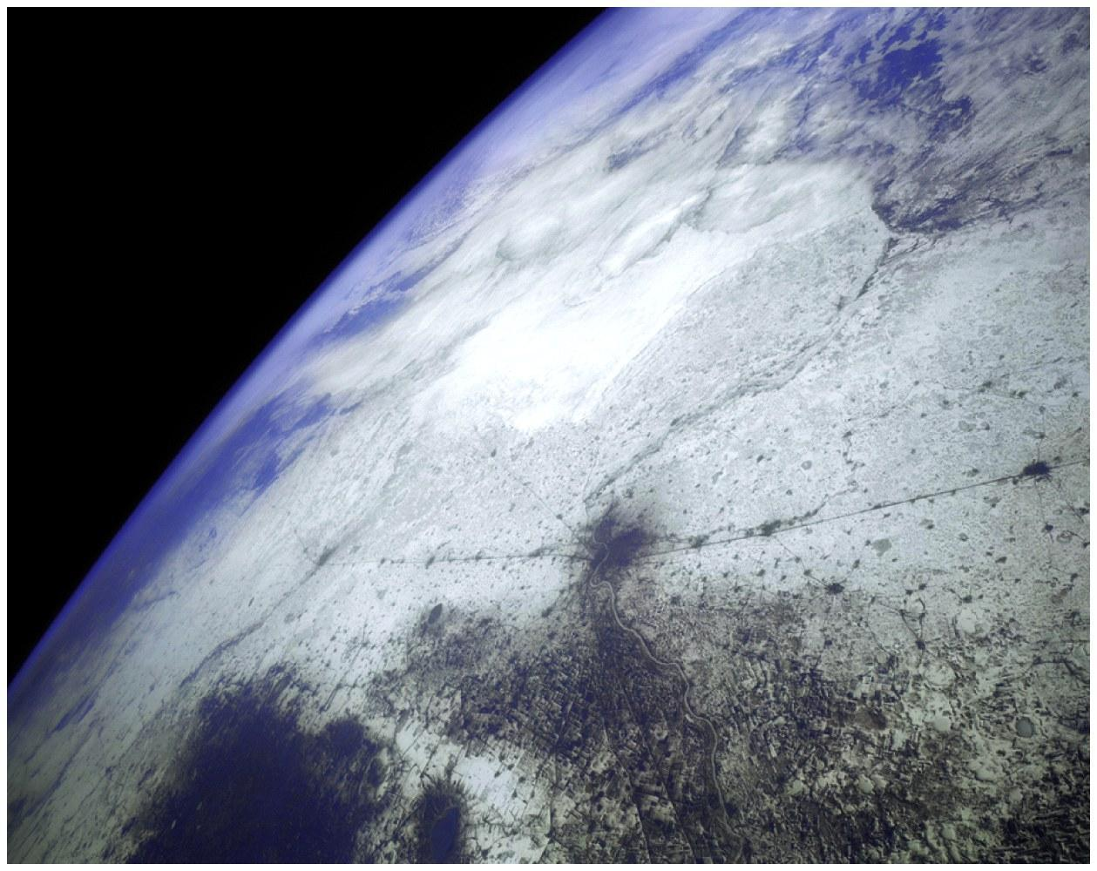
Our Atmosphere IS a Resource
Atmospheric Composition
N₂ 78.08%
O₂ 20.95%
Argon 0.93%
Carbon dioxide 0.04% (400 ppm)
Ecosystem services
Blocks UV radiation
Moderates the climate
Redistributes water in the hydrologic cycle

Slide 3
Air Pollutants: Found Through the Entire Global System
Air Pollution: Found in troposphere. Introduction of chemicals, particulate matter, or microorganisms into the atmosphere at concentrations high enough to cause harm.
Connected system.
Natural or anthropogenic.

Slide 4
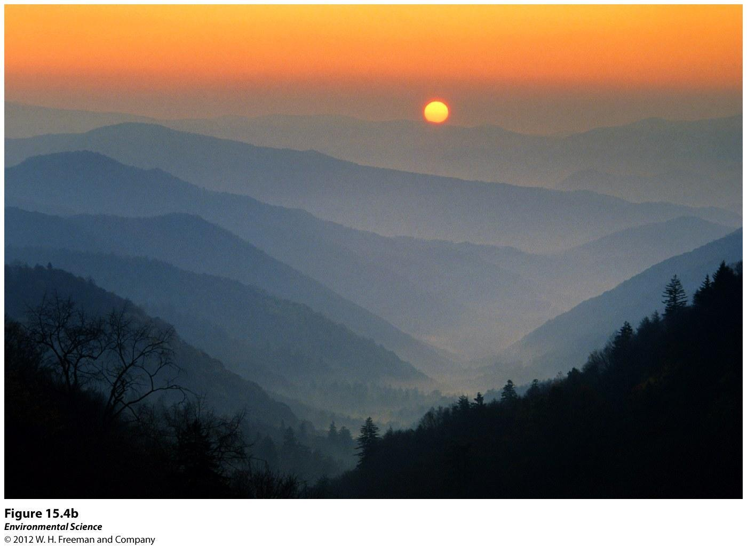
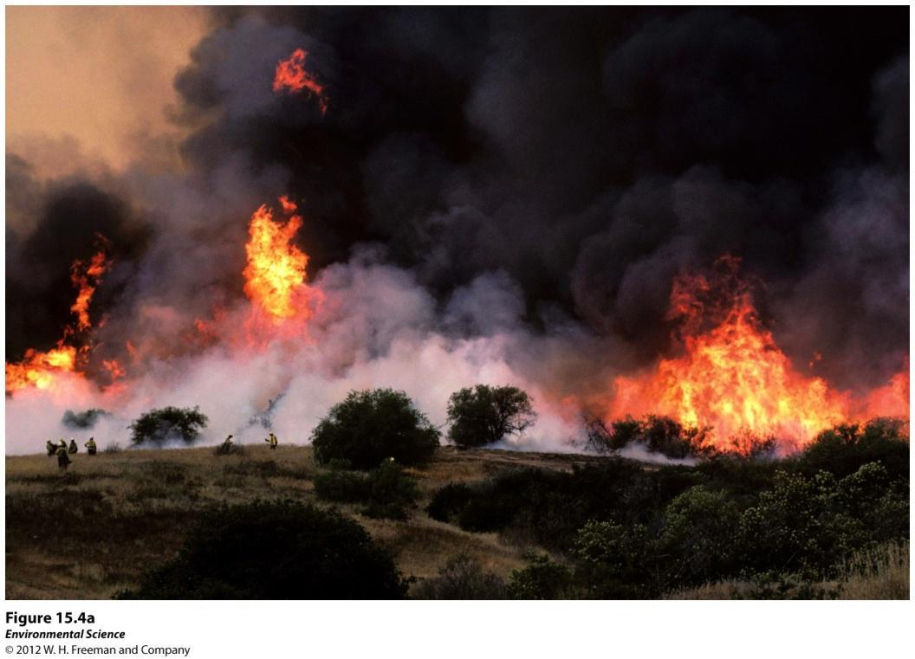
Natural Sources of Air Pollution
Volcanoes
Lightning
Forest fires
Plants

Slide 5
Pollution: Natural and Human Made
Natural
Volcanoes: sulfur dioxide, particulate matter, carbon monoxide, and nitrogen oxides.
Forest Fires: particulate matter, nitrogen oxides, and carbon monoxide.
Living plants: VOCs (ethylene and terpenes).
Sulfur dioxide emissions are 30% natural, nitrogen oxide are 44% natural, and VOCs are 89% natural.

Slide 6
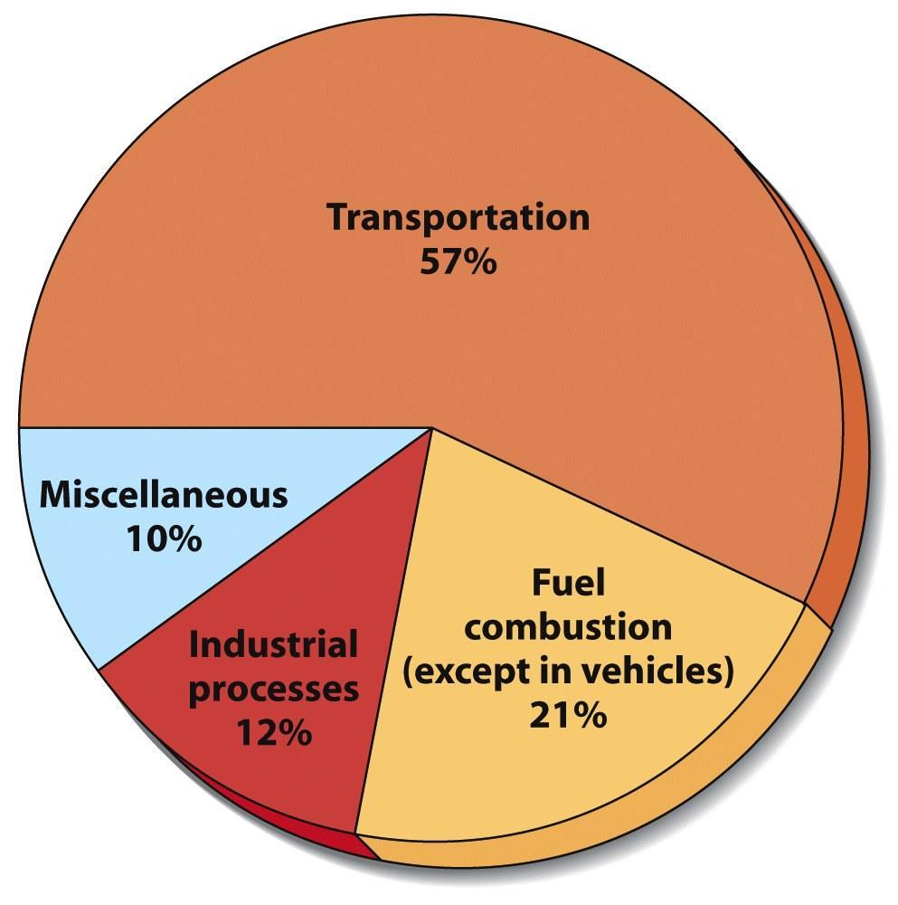
Anthropogenic Sources of Air Pollution
On-road vehicles
Power plants
Industrial processes
Waste disposal (incineration)

Slide 7
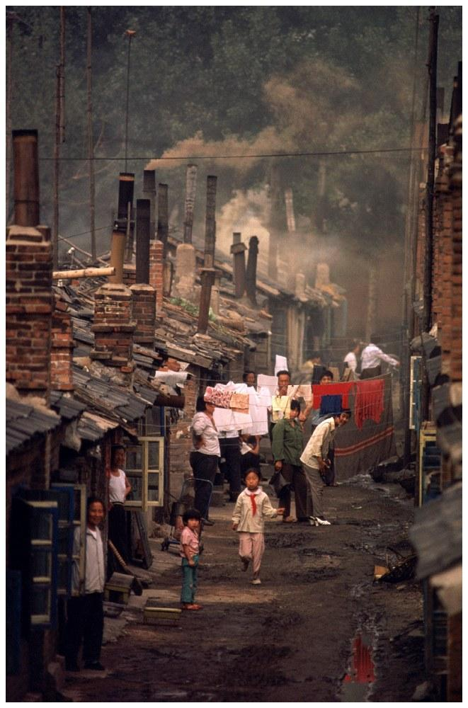
Air Pollution Around the World
Air quality is deteriorating rapidly in developing countries
China has an especially bad problem with Particulate Matter & smog
Developing countries have older cars
Still use leaded gasoline
5 worst cities in world
Beijing, China; Mexico City, Mexico; Shanghai, China; Tehran, Iran; and Calcutta, India

Slide 8
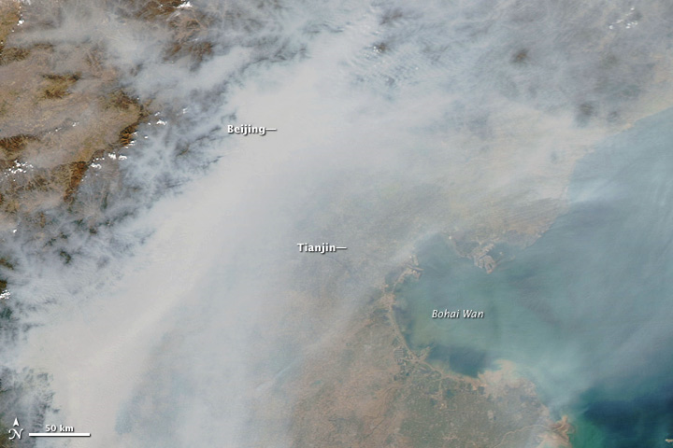

Slide 9
Major Air Pollutants
There are six Criteria Pollutants that are regulated by the Clean Air Act(1970) under National Ambient Air Quality Standards (NAAQS)
SO₂ (Sulfur Dioxide) Primary
NO_{x} (Nitrogen Oxides) Primary
CO (Carbon Monoxide) Primary
PM (Particulate Matter) Primary
O₃ (Ozone) Secondary
Pb (Lead) Primary

Slide 10
Anthropogenic Emissions
Monitored by the EPA.
Clean Air Act and amendments require that the EPA establish standards to control pollutants.
All criteria air pollutants have decreased in the US over the last two decades.

Slide 11
Other air pollutants not on the NAAQS list (but still important):
CO₂ (Carbon Dioxide)
Hg (Mercury)
VOC’s (Volatile Organic Chemicals)

Slide 12
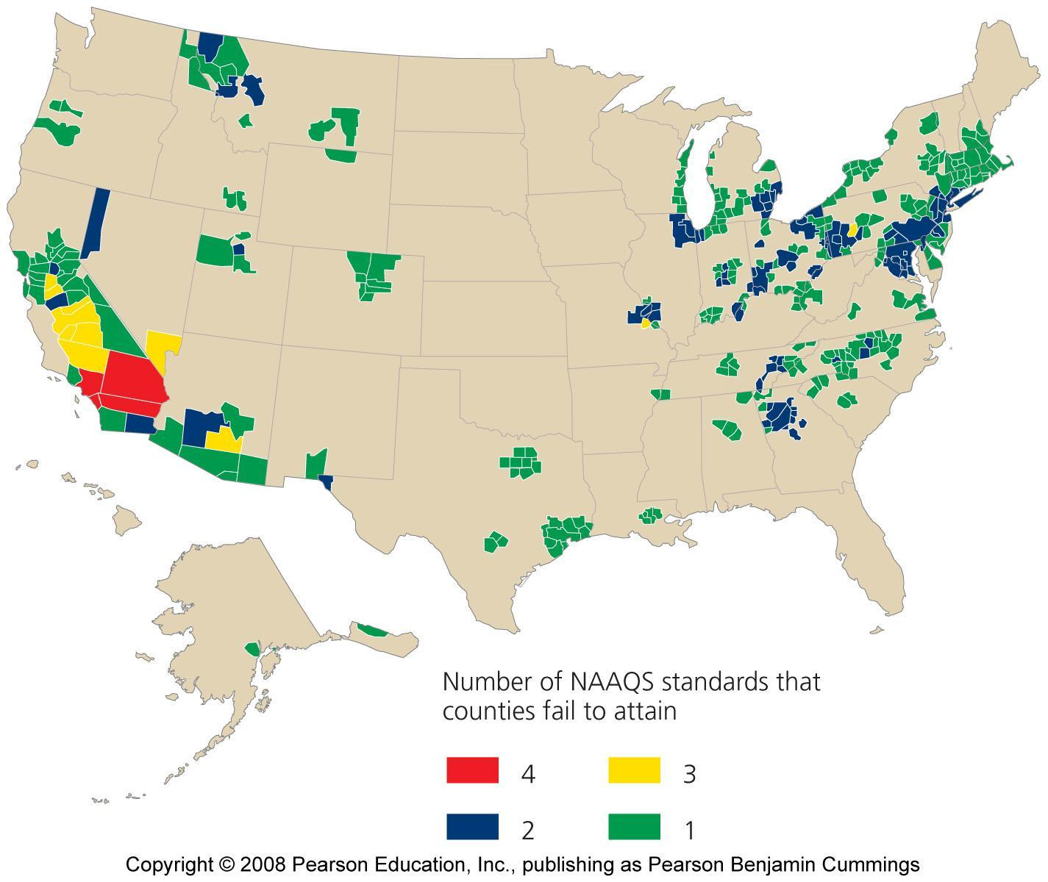
17_11.JPG
Notes:
Figure 17-11
Title:
EPA's national ambient air quality standards.
Caption:
Roughly 122 million Americans live in counties that in 2005 failed to meet the EPA's national ambient air quality standards (NAAQS) for at least one criteria pollutant. This map shows counties that failed to attain the standards for one (green) through four (red) of the six criteria pollutants. Data from U.S. EPA.
Notes:
Keywords:
atmosphere, air pollution, criteria pollutants

Slide 13
Primary and Secondary Pollutants
Primary Pollutants
Come directly out of the smokestack, exhaust pipe or natural emission source.
CO, CO₂, SO₂, NO_{x} and most suspended particulate matter.
Includes many VOCs

Slide 14
Secondary Pollutants
Primary pollutants that have undergone transformation in the presence of sunlight, water, oxygen and other compounds.
Occurs more in the day within wet environments.
Ozone: Formed as a result of the emission of the primary pollutants NO_{x} and VOCs in the presence of sunlight.
Sulfate (SO₄²⁻) and nitrate (NO₃⁻) the main components of acid deposition are secondary pollutants.

Slide 15
Major Air Pollutants
Sulfur dioxide (SO₂) and sulfuric acid:
About 1/3 of SO₂ occurs naturally (volcanoes & fires)
About 2/3 from human sources (mostly metal production & combustion of coal and oil).
S + O₂ = SO₂ (Primary Air Pollutant)
2 SO₂ + O₂ = 2 SO₃ (Secondary Air Pollutant)
SO₃ + H₂O = H₂SO₄ (Sulfuric Acid – Acid Rain)

Slide 16
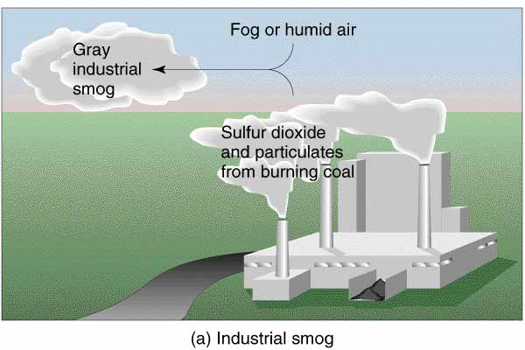
SO₂ leads to formation of Industrial Smog

Slide 17
Major Air Pollutants
Carbon oxides:
Carbon monoxide (CO) is a highly toxic gas that forms during the incomplete combustion of carbon-containing materials.
93% of carbon dioxide (CO₂) in troposphere occurs as a result of the carbon cycle (7% anthropogenic)

Slide 18
Major Air Pollutants
Suspended particulate matter (PM):
Consists of a variety of solid particles and liquid droplets
Natural sources: Volcanoes, fires, pollen, dust
Anthropogenic sources: FF combustion, agriculture
The most harmful forms of PM are fine particles (“PM-10”, with an average diameter < 10 micrometers) and ultrafine particles (“PM-2.5”).
PM causes ~60,000 premature US deaths per year

Slide 20
Major Air Pollutants
Nitrogen oxides and nitric acid:
Nitrogen oxide (NO) forms when nitrogen and oxygen gas in air react at the high-combustion temperatures in automobile engines and coal-burning plants. NO can also form from lightening and certain soil bacteria.
NO reacts with air to form NO₂.
NO₂ reacts with water vapor in the air to form nitric acid (HNO₃) and nitrate salts (NO₃⁻) which are components of acid deposition.

Slide 21
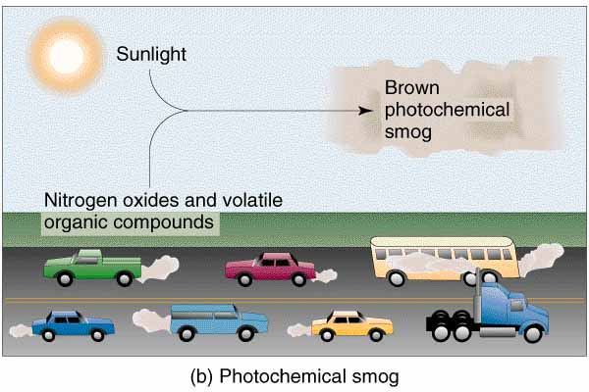

Slide 22
Major Air Pollutants
Ozone (O₃):
Is a highly reactive gas that is a major component of photochemical smog.
It is a secondary air pollutant
It can
Cause and aggravate respiratory illness (soft tissues).
Aggravate heart disease.
Damage plants, rubber in tires, fabrics, and paints.

Slide 23
Lead (Pb)
Trace metal, occurs naturally in rock and added to gas and oil.
Traveled in the air and was deposited all over the globe.
Phased out in gas and oil from 1975-1996.

Slide 24
Mercury (Hg)
Found in coal and oil.
Toxic to to central nervous systems.
Subject to bioaccumulation.
Coal fired electricity generation present the largest source of mercury release.

Slide 25
Major Air Pollutants
Volatile organic compounds (VOCs):
VOCs include industrial solvents such as acetone, trichloroethylene (TCE), benzene, paints, vinyl chloride and fuels like gasoline.
Contribute to formation of Photochemical Smog

Slide 26
Smog
Photochemical Smog: oxidants such as ozone, also know as LA-type smog or brown smog.
Sulfurous Smog: sulfur dioxide and sulfate compounds also known as London-type smog or gray smog.
Atmospheric Brown Cloud: combination of ozone and particulate matter. Comes from combustion of fossil fuels and burning biomass.

Slide 27
Photochemical Smog
Smog and Ozone still present problems in the US.
Sunlight + Nitrogen Oxides + Few VOCs (forms) =s Ozone
When sunlight dies down nitrogen oxide is still present and ozone combines with the NO and reforms into O₂ and NO_{2.}

Slide 28
When VOCs are present they combine with nitrogen oxide.
This means the nitrogen oxide is not available to break down ozone by recombining with it.
Ozone then accumulates.
Emissions of VOCs from vegetation increase as temperature increases.
NO_{x} increase as air-conditioning demands increase.

Slide 29
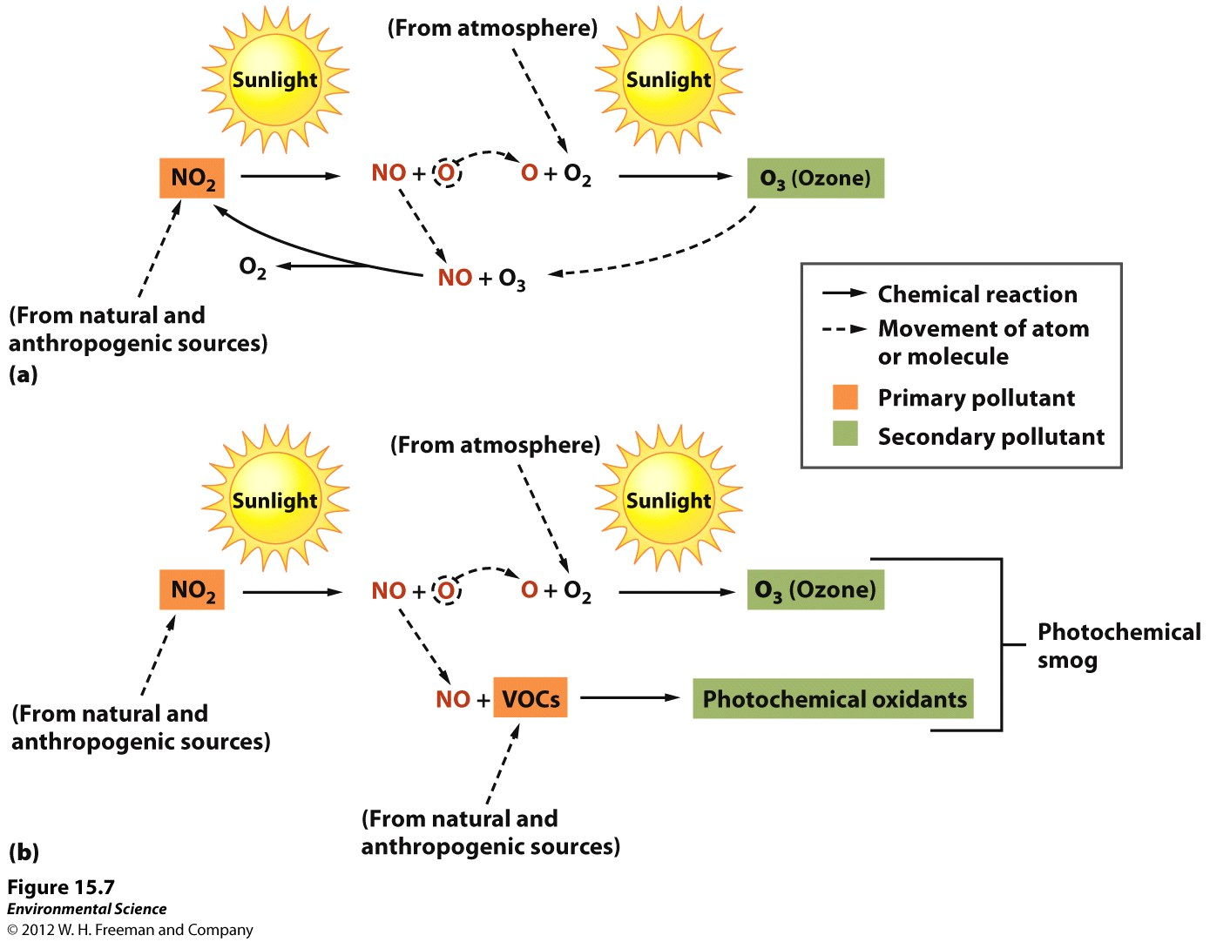

Slide 30
Thermal Inversions
When a layer of warm air covers cold air.
Emissions can be trapped in the lower layer.
Chinese city of Tianjin: turned off their central heating then suffered a cold spell. Emissions got trapped. Over 1,000 people suffered carbon monoxide poisoning. 11 people died.

Slide 31
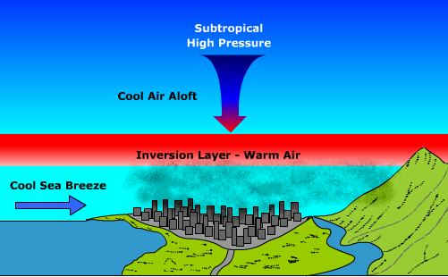
Thermal Inversions make smog worse by trapping it under a layer of cold air

