Slide 1
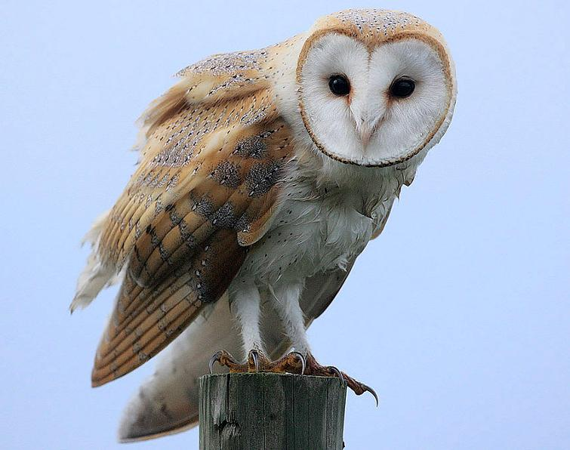
Owl Pellet Lab Write Up
Title: tells the reader what we did in the lab.
Group Members Names
C. Purpose: Why we did this lab
Example:
Investigation of an owl’s feeding habits/trophic levels/food chain position.

Slide 2
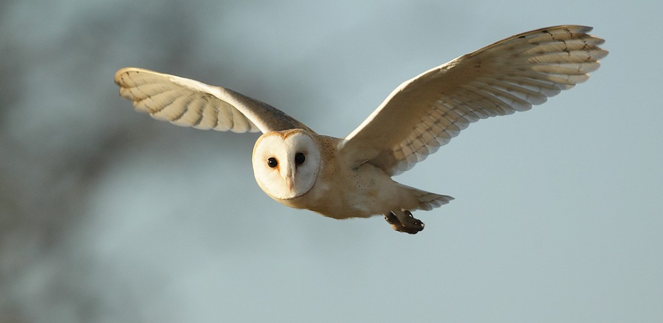
D. Introduction Paragraph:
Basic owl information.
Feeding Habits (what kind of organisms are they?)
How pellets are formed.

Slide 3
E. 2 Data Tables

Slide 5
F. Create a Numbers Pyramid
Number of eaten per year.
Owl on top, total annual number of prey below.
G. Draw a food web.
Include the ultimate source of energy
Use the general term “plant” rather than specifics
H. Create a Biomass Pyramid
Mass of owl on top.
Mass of herbivores (total Mass of Prey (kg).
Producer level (total Biomass Eaten(kg)).

Slide 6
I. Analysis Questions (Write out the questions)!
Use the video to answer the first 3 questions.
Seven questions at the end.
J. Conclusion Paragraph
3-5 sentences describing the purpose of this lab and revisiting what you learned.

