Slide 1
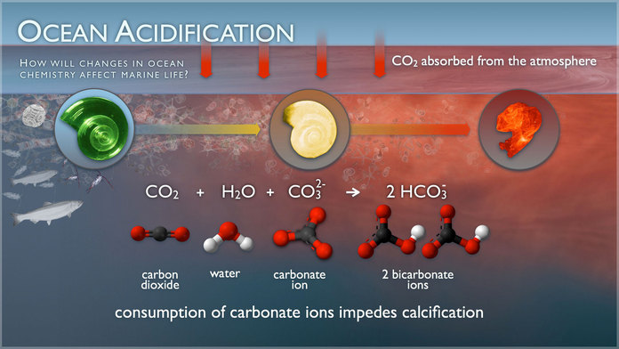
Ocean Acidification Lab Write Up

Slide 2
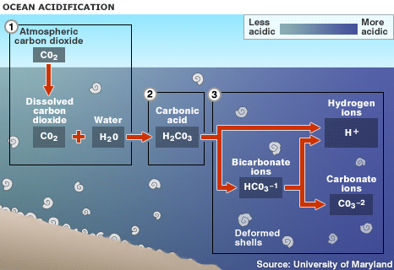

Slide 4
Specific Title! What are you investigating or analyzing?
Example: Analyzing the Effects of Acid on the Decomposition of Oceanic Shells
B. Members
C. Primary Question of the Investigation: goals for the experiment

Slide 5
D. Hypothesis: What do you think would happen in your investigation and WHY do you think that will happen?
E. Materials and Experimental Design: How did you set up your lab? How did you make measurements? What constraints did you use? How long did it last? What was your control?
F. Data and Results: Organize your data on a chart. Show calculations where necessary. Include the formula.

Slide 6
G. Analysis: No Questions!
H. Graph your data.
I. Conclusion:
Describe the experiment your performed.
Explain your results, was your hypothesis supported? Why or why not.
What were some possible sources of error?
What would you do different next time and why OR what would be the next experiment you would perform?
Explain in detail the process of ocean acidification, including: the complete chemical formula, what it is caused by, what/who it effects, and the possible outcome of this process (be detailed)!!

