Slide 1
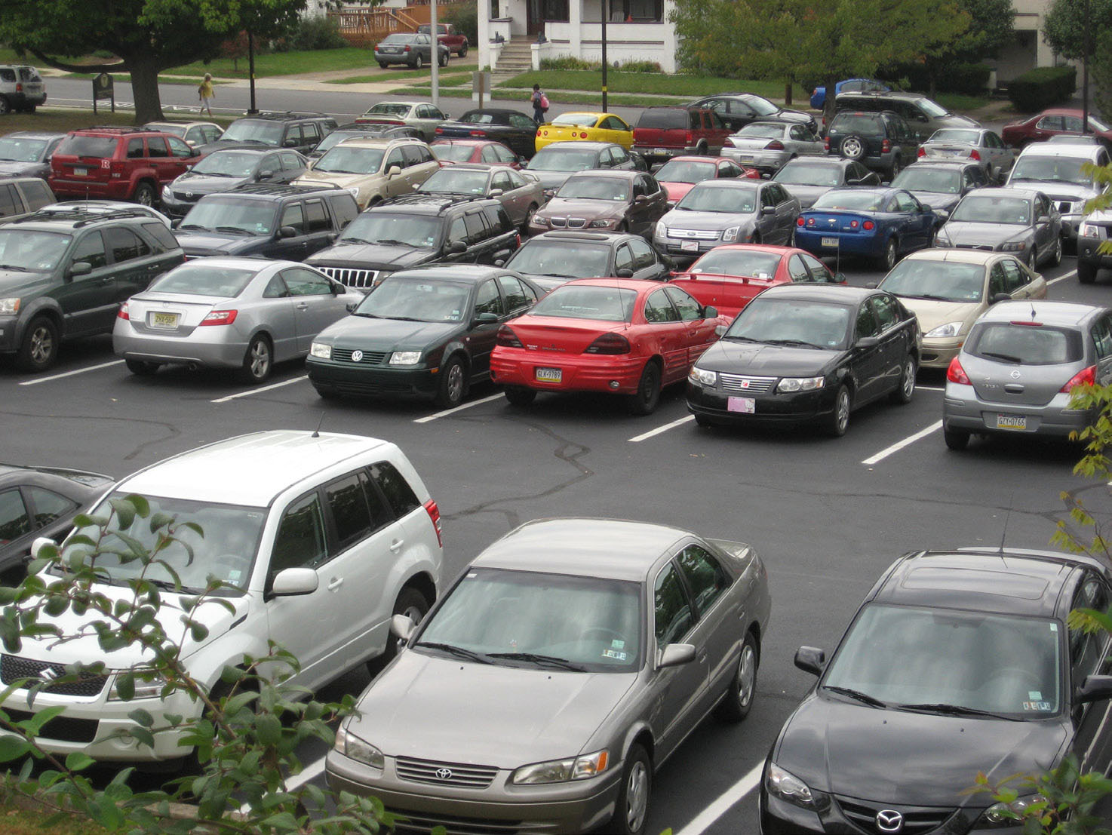
Diversity Lab

Slide 2
Title: DESCRIPTIVE! What are we doing??Comparing???
Members of the Group
1-2 sentences describing the major goal. Specific!
Hypothesis: which community (A:Teachers or B: Students) do you think will be more diverse considering both richness and eveness and WHY!

Slide 3
E. Experimental Design and Materials: Explain how did you conducted your data collection. Describe the strategies you implemented to ensure accurate data collection. Discuss the species type and different areas you surveyed.
F. All 5 tables(Shannon-Wiener x2, Simpsons x2 and final chart) must be put into your lab notebook. Include the formulas. Make sure to follow the examples!!

Slide 4
G. Answer the 5 analysis questions. Do not forget to include the questions.
H. Describe what you did and why you did it.
Define biodiversity. Include the definition of species richness and species evenness.
For each measure of diversity (Shannon-W and Simpsons) Explain the values you calculated (for both communities A&B) and what they mean.

