Slide 1
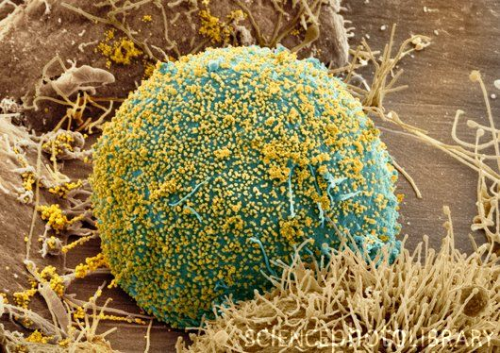
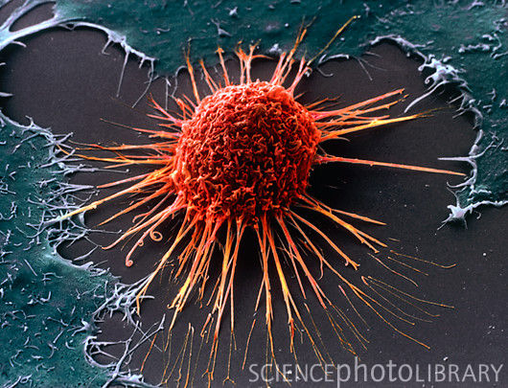
Diffusion, Osmosis, and the Plasma Membrane

Slide 2
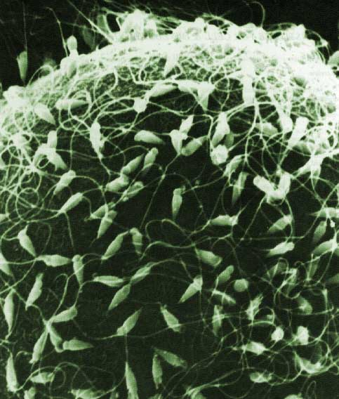
Prefixes, Suffixes, and Vocabulary
Diffusion = the movement of particles from a high concentration to a low concentration.
Osmosis = The diffusion of water.
Hyper = high, over.
Hypo = low, under.
Iso = equal.

Slide 3
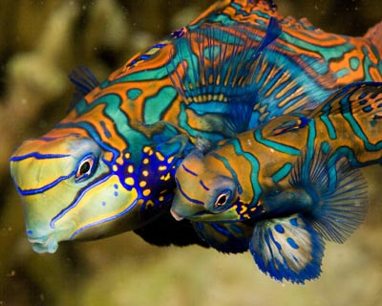
What we already know…..
All living things have 7 common characteristics.
All living organisms have cells and DNA.
DNA contains all the genetic information for living organisms.
Homeostasis is maintaining a stable, internal environment.
How do living organisms maintain homeostasis?

Slide 4
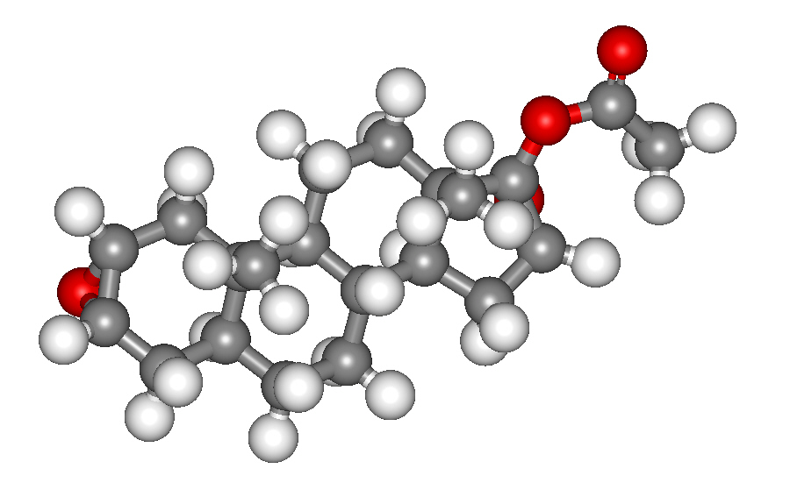
First, lets talk some chemistry….
All particles have kinetic energy.
Particles spread out by moving into available space.
The movement is random.
The ultimate “goal” is for the particles to be evenly spread out in the space available.
The particles want to reach equilibrium.
Equilibrium = all particles are equally distributed within a particular medium.

Slide 5
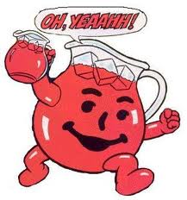
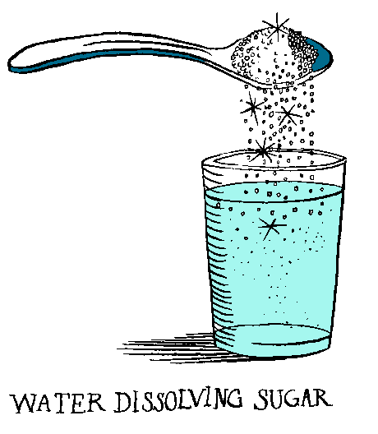
A little more chemistry…..
A solution contains two basic parts:
Solute: the particles or “stuff” being dissolved.
Solvent: dissolves the solute.
Solute + Solvent = Solution

Slide 6
Salt and sugar are separated by a barrier..
What would happen if the barrier is removed?

Slide 7
The final result is a completely homogenous mixture.
The salt and sugar concentrations are spread evenly throughout the solution.
What if the barrier was a membrane?

Slide 8
The molecules of salt and sugar would move back and forth eventually evening out to equal concentrations on both sides.
The solutions are called isotonic.
Isotonic = have an equal concentration on both sides of the membrane.

Slide 9
What if the molecules are too big to fit through the membrane?
If the particles cannot move, then the solvent (usually water) will move.
The solute stays on one side or the other side of the membrane.
This is a special type of diffusion called osmosis.
Osmosis = the diffusion of water.

Slide 10
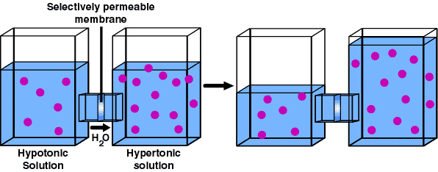
Osmosis Explained
Water moves from an area of low solute concentration (high water) to an area of high solute concentration (low water) until both solutions are isotonic.

Slide 11
Hypertonic Solutions: have more dissolved solute and less water.
Hypotonic Solutions: have less dissolved solute and more water.
Isotonic: equal amount of solute on each side of a membrane.

Slide 12
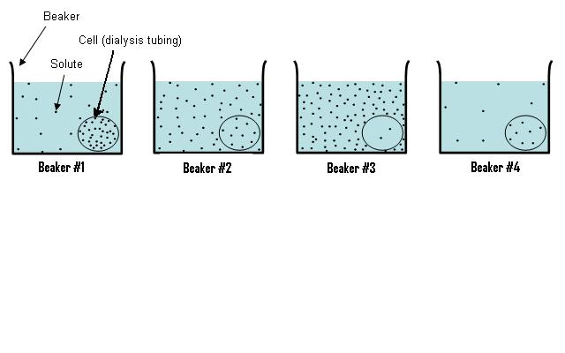
DRAW the three beakers and the “cells”.
LABLE each hypertonic, hypotonic, or isotonic (both the solution in the bag and the cell).
WRITE arrows indicating which way the water will move.
PREDICT what will happen to the “cell’s”(size).
.9 M
.3 M
.6 M
.2 M
.6 M
.8 M

Slide 13
.3 M
Hypotonic
.9 M
Hypertonic
Water moves into the cell.
Cell gets bigger.

Slide 14
.6 M
Isotonic
.6M
Isotonic
Solutions are isotonic.
No net movement of water.
Cell size remains the same.

Slide 15
.8 M Hypertonic
.2 M Hypotonic
Water moves out of cell.
Cell gets smaller.

Slide 16
.3 M
Draw picture.
Label hypertonic, hypotonic or isotonic.
Draw arrows for which way water will move.
What will happen to the size of the cell?

Slide 17
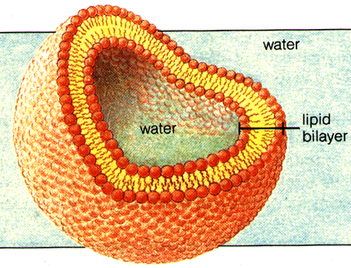
Cell Membrane
Function
Also called the plasma membrane.
“Semi” or selectively permeable = regulates what goes in and out.
Keeps the inside in and the outside out.

Slide 18
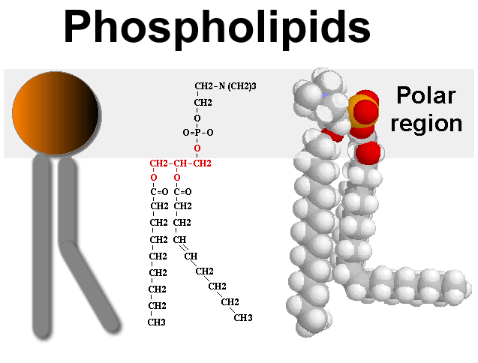
Structure
Composed of a phospholipid bilayer with proteins.
Each phospholipid has a hydrophillic head (water loving) and a hydrophobic (water fearing) tail.

Slide 19
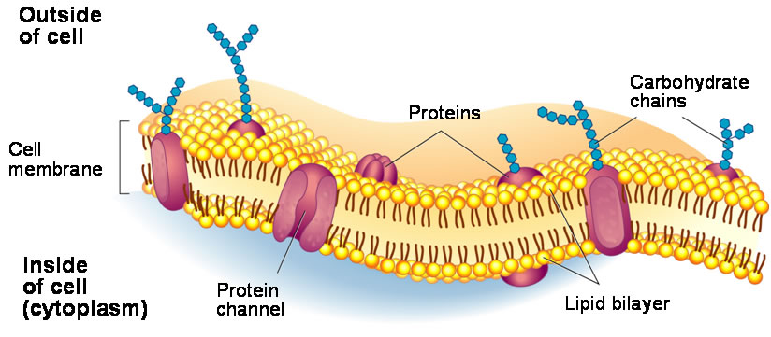
Proteins are used to transport large molecules across the membrane.

