Slide 1
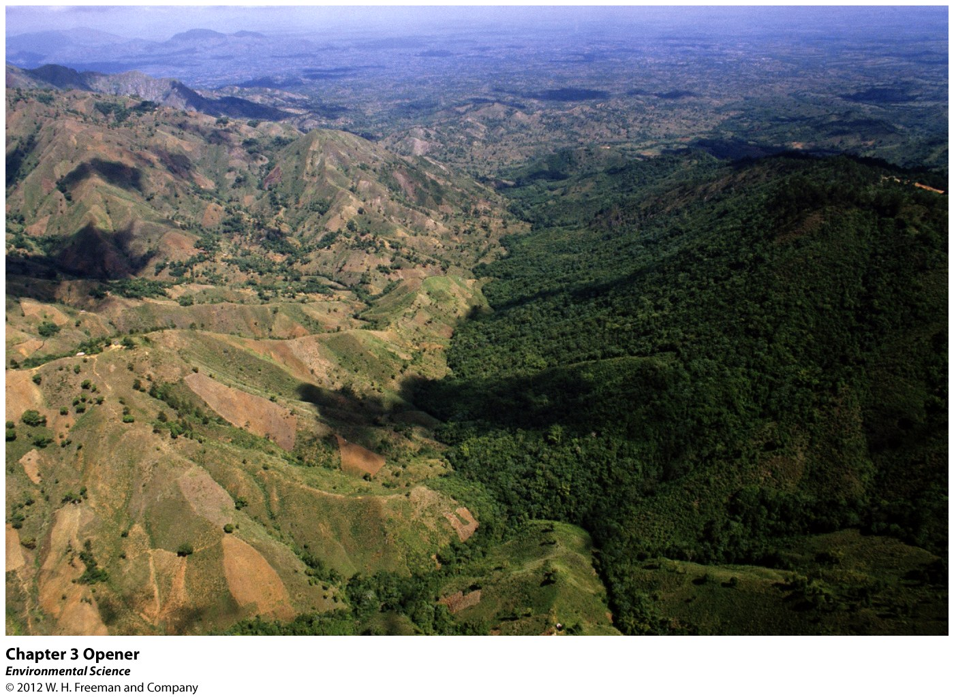
Chapter 3
Ecosystem Ecology

Slide 2
Deforestation of Haiti
Haitians rely on charcoal for cooking.
Forests are cut down before they can be replenished.
Deforestation disrupts the ecosystem by eroding the earth and disruptions of the natural cycles of water and soil nutrients.
Ecosystems influenced by human decisions.

Slide 3
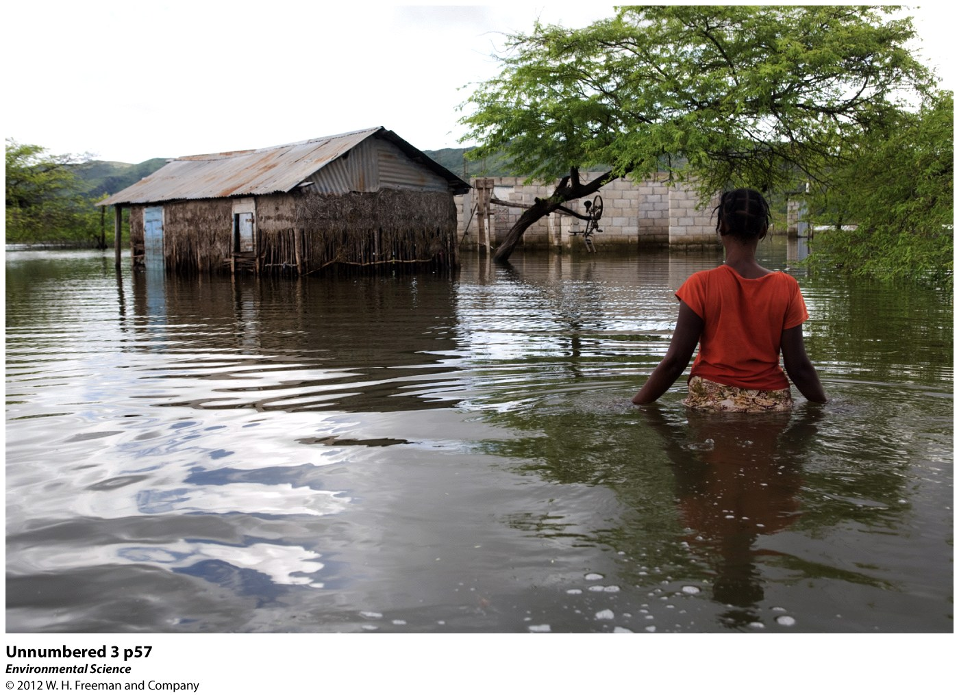

Slide 4
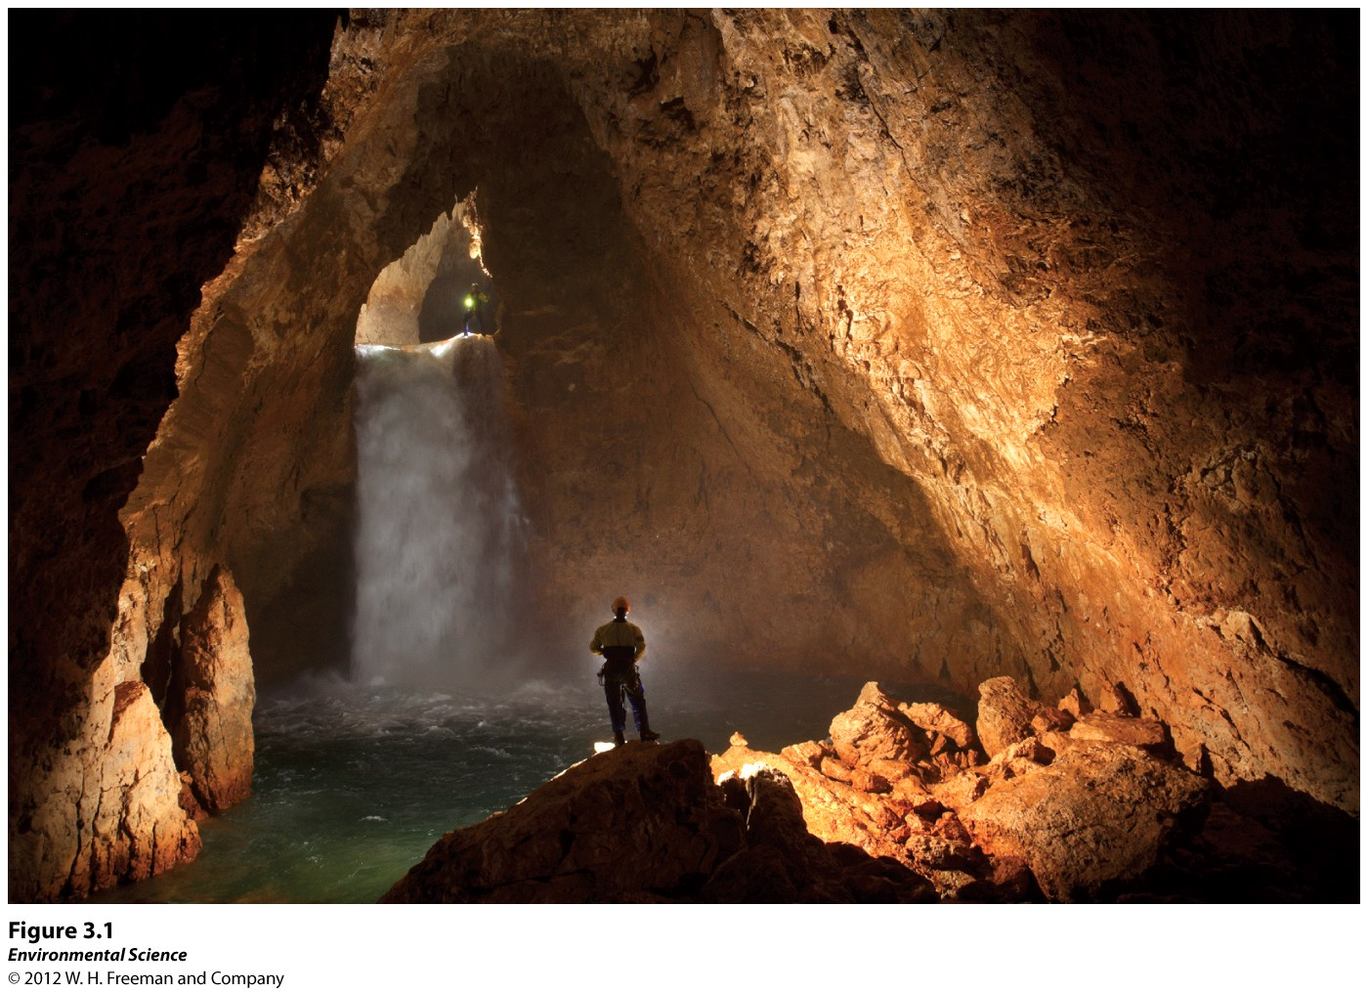
Ecosystems
Ecosystem: a particular location on Earth distinguished by its mix of biotic and abiotic factors.

Slide 5
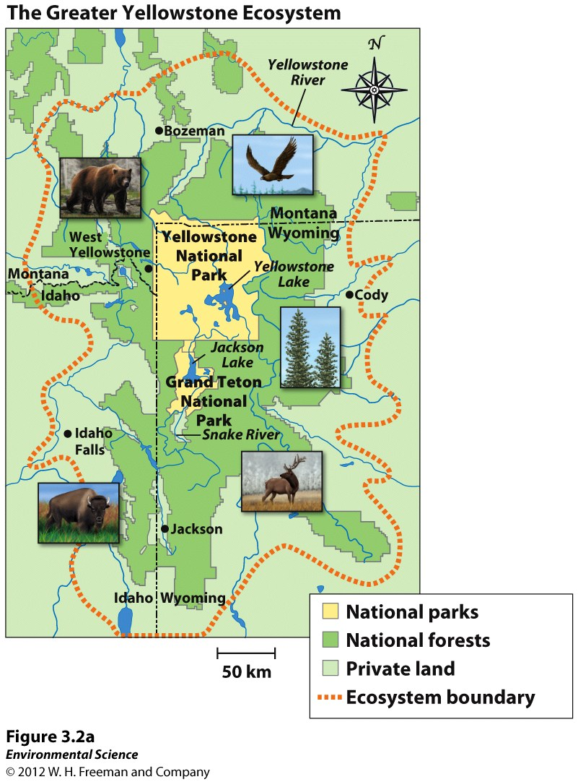

Slide 6
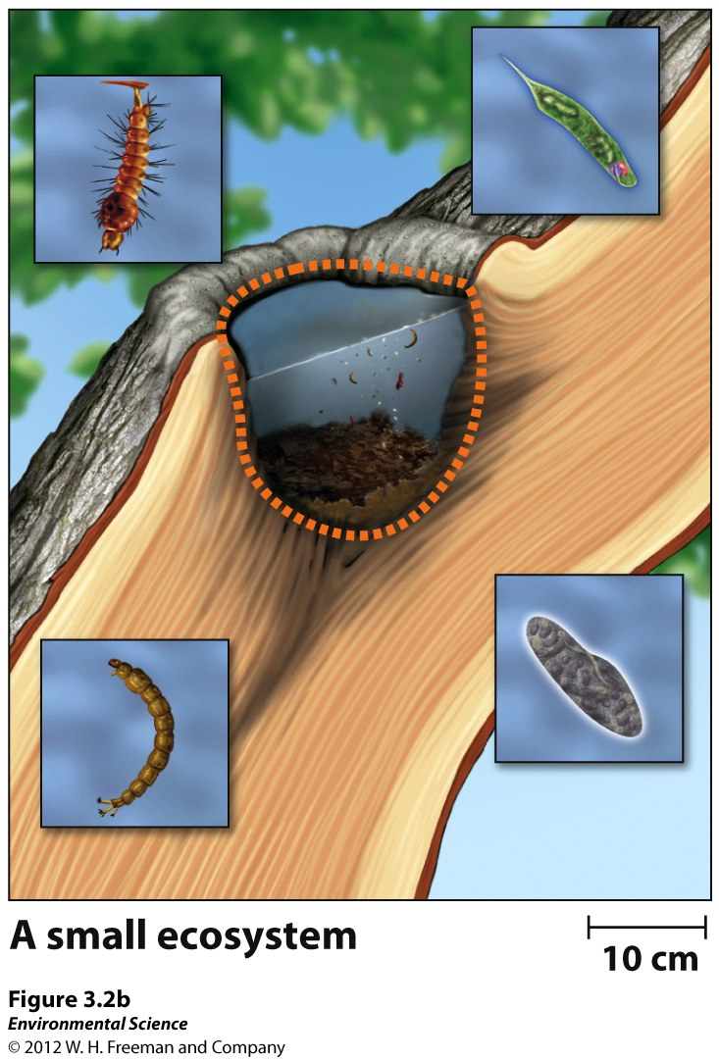

Slide 7
Energy Flows Through Ecosystems
All energy comes from the SUN!
Herbivores: eat plants.
Carnivores: eat animals.
Omnivores: eat both.

Slide 8
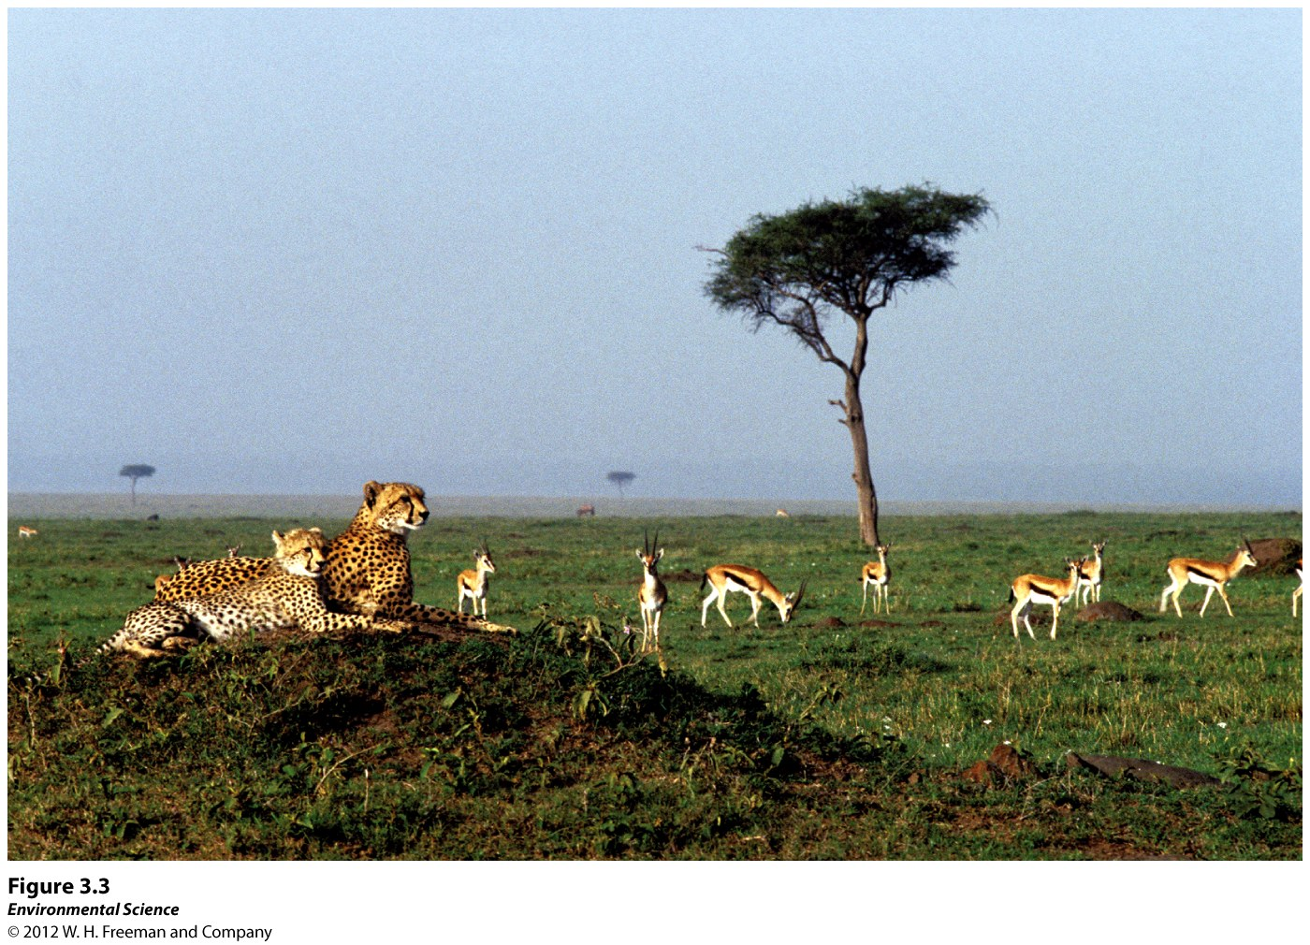

Slide 9
Photosynthesis
Producers/Autotrophs: use the Sun’s energy to produce usable sources of energy.
Solar Energy + 6H₂O + 6CO₂----→ C₆H₁₂O₆ + 6O₂
Plants & algae!!

Slide 10
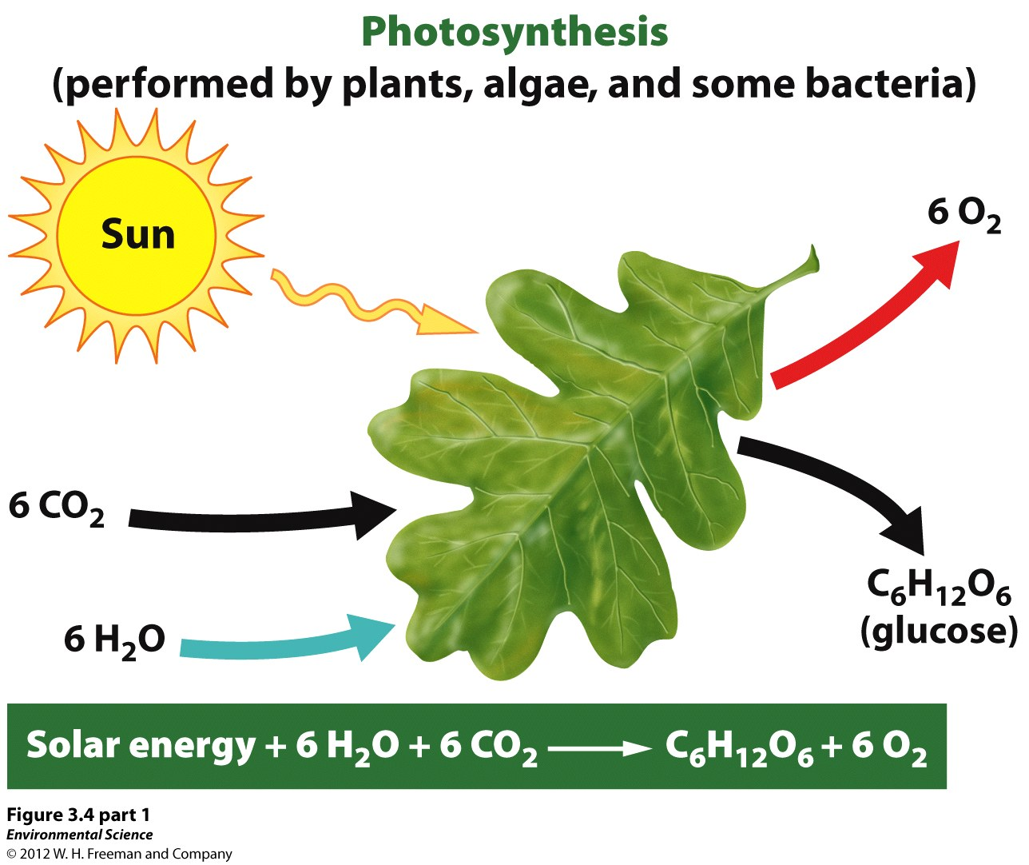

Slide 11
Cellular Respiration
Consumers/Heterotrophs eat plants and other animals and gain energy from the chemical energy.
6O₂ + C₆H₁₂O₆ ----→ 6H₂O + 6CO₂

Slide 12
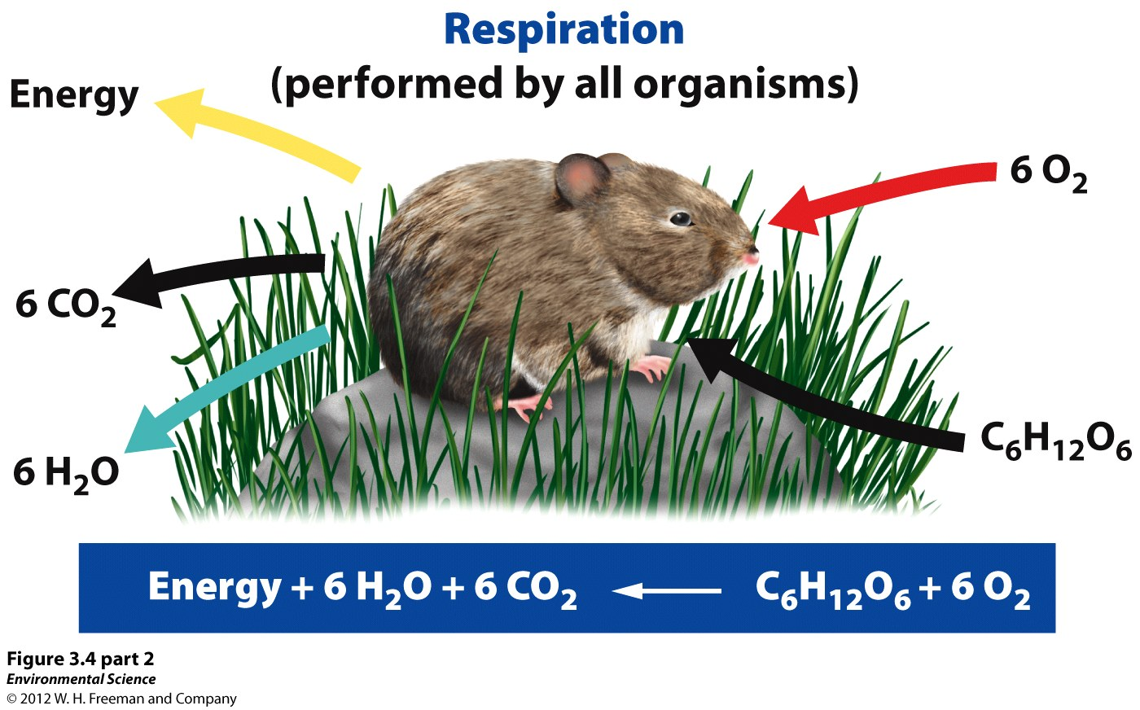

Slide 13
Trophic Levels
Successive levels of organisms consuming each other.
Primary Consumers: Herbivores that consume producers.
Secondary Consumers: Carnivores that eat primary consumers.
Tertiary Consumers: Carnivores that eat secondary consumers.

Slide 14
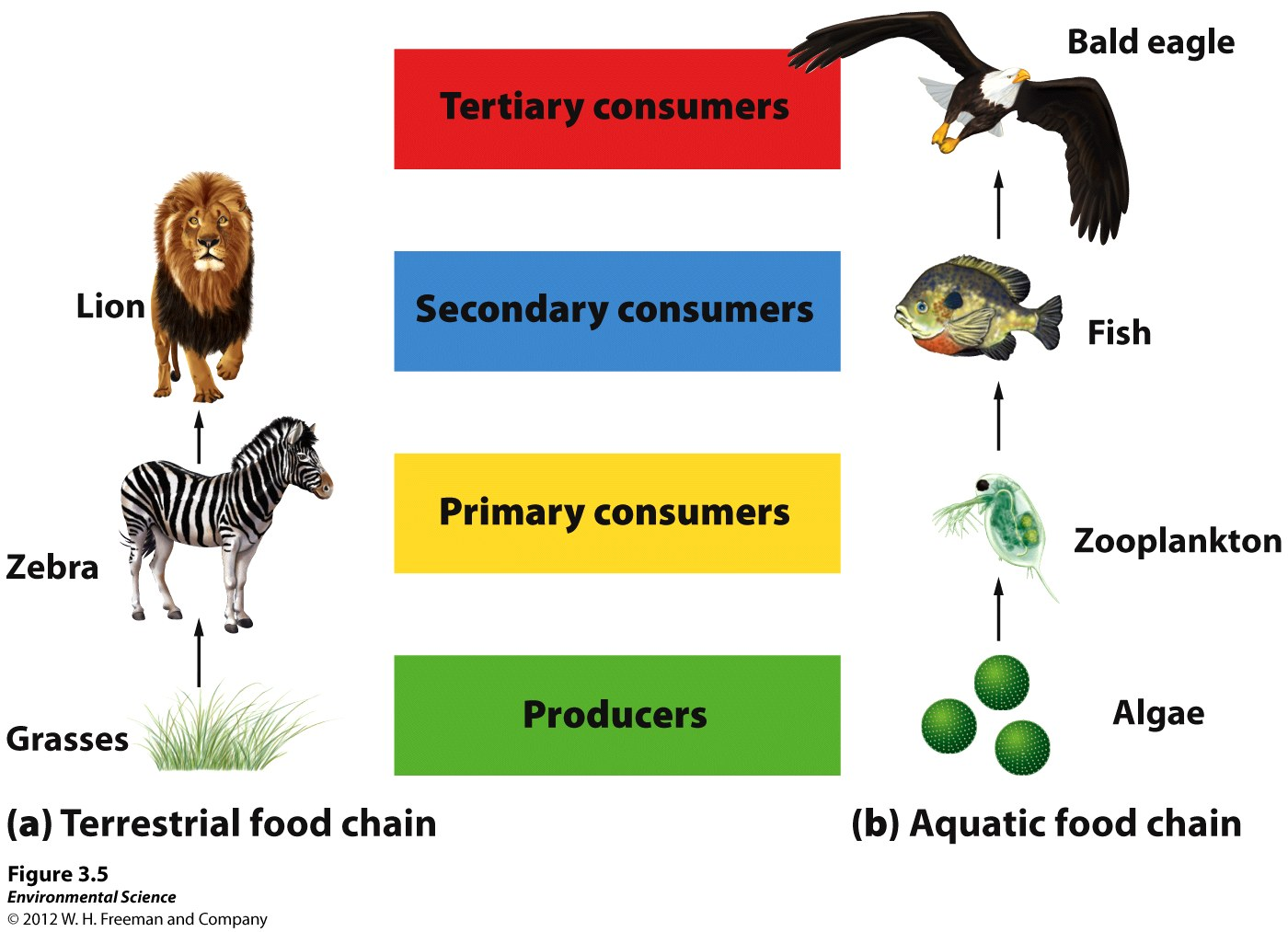

Slide 15
Detritivores: break down dead tissues and waste products.
Scavengers: carnivores that consume dead animals.
Decomposers: fungi and bacteria that complete the breakdown process by recycling nutrients.
Very important to an ecosystem. They recycle organic matter and energy. They also and get rid of dead animals and waste products.

Slide 16
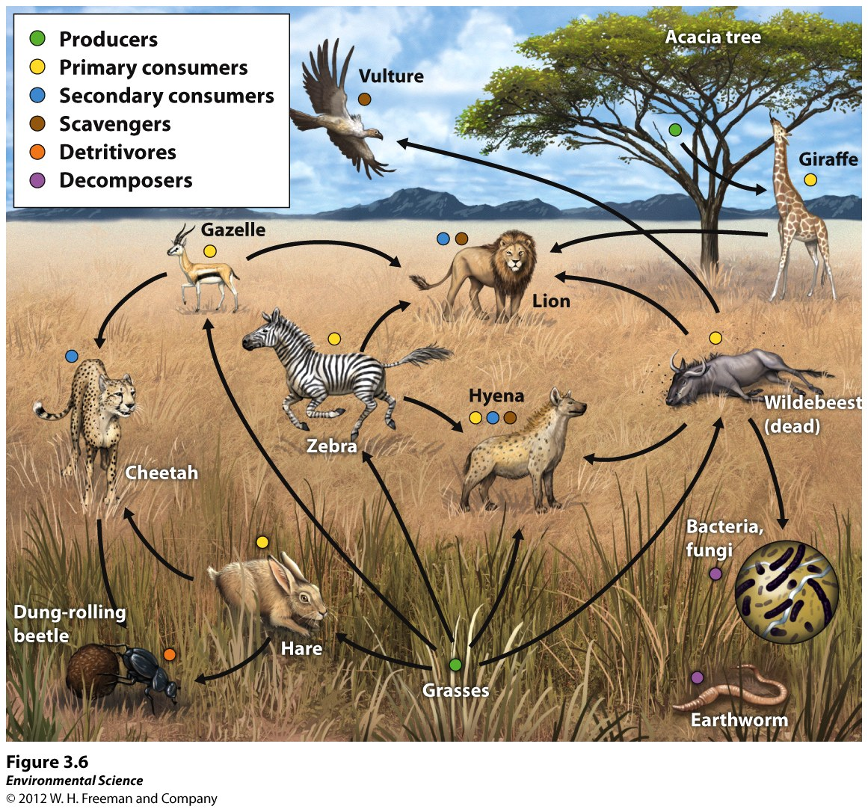

Slide 17
Food Chains vs. Food Webs
Food Chain: shows 1 interaction of the flow of energy and matter move through trophic levels.
Food Web: shows all possible interactions within an ecosystem. Illustrates the interconnectedness between all organisms.

Slide 20
Ecosystem Productivity
The amount of energy available in an ecosystem determines how much life the ecosystem can support.
Gross Primary Productivity (GPP): the total amount of solar energy that the producers in an ecosystem capture (rate).
Net Primary Productivity (NPP): Energy captured minus the energy respired by producers.

Slide 21
This allows us to compare the productivity of different ecosystems.
Also a useful way to measure change in an ecosystem.
NPP =s GPP – Respiration by Producers

Slide 22
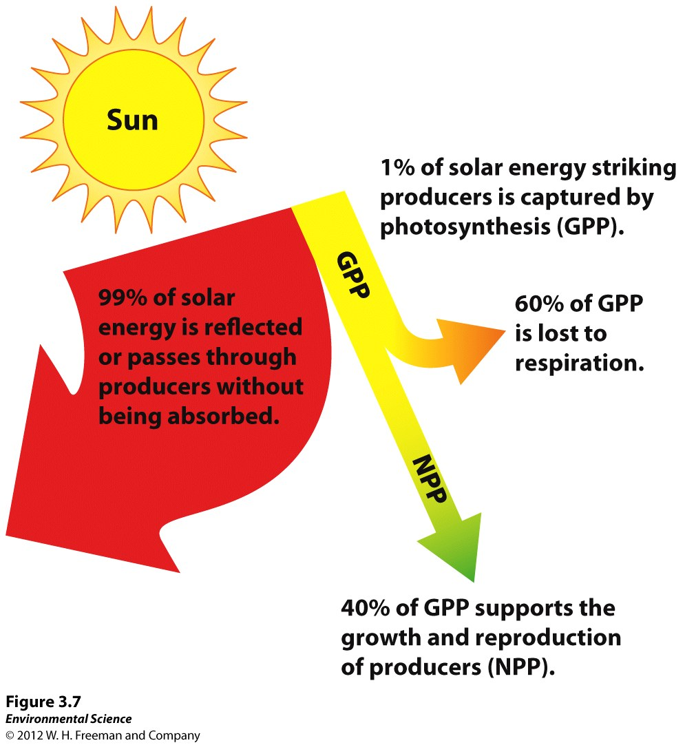

Slide 23
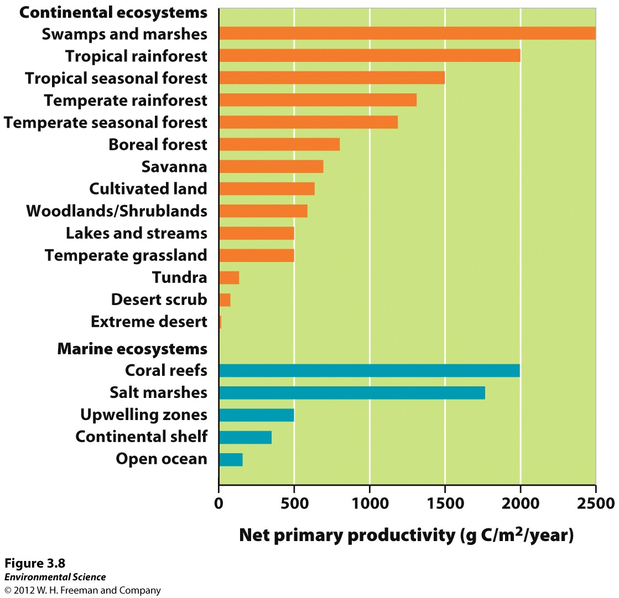

Slide 24
Energy Transfer Efficiency and Trophic Pyramids
Biomass: the total mass of all living matter in a specific area.
Standing Crop: amount of biomass present in an ecosystem at a particular time.
*NOT the rate of energy production!!

Slide 25
Energy used by an organism is given off as heat. Any left over that is converted into consumer biomass by growth and reproduction is available to the next trophic level
This is called ecological efficiency.
Only about 10% of biomass energy is converted into energy at the next higher trophic level.
Most energy and biomass is found at the producer level.

Slide 26
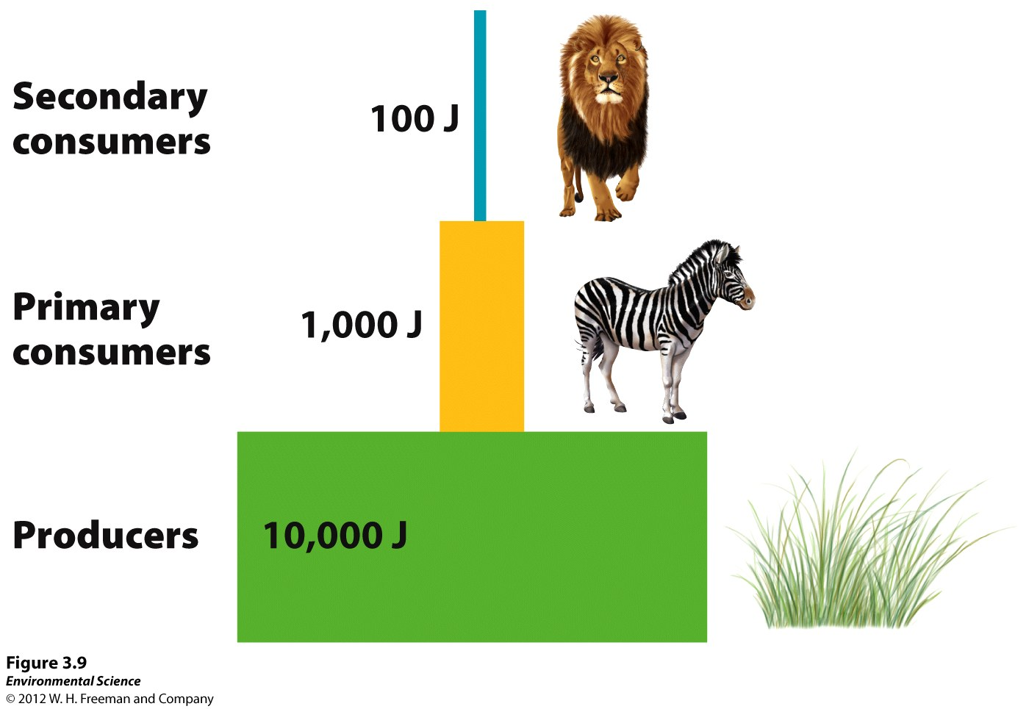

Slide 27
Matter Cycles Through the Biosphere
Biosphere: Region where life can possibly exist.
Energy flows through the atmosphere and is constantly replenished by the Sun.
Matter has to be recycled. It is within a closed system.
Biogeochemical Cycles: the recycling of elements through abiotic and biotic factors.

Slide 28
Hydrologic Cycle
Movement of water through the biosphere.
Evaporation: solar energy heats the Earth and evaporates rivers, lakes, streams, and oceans.
Transpiration: plants release water from their leaves.
Evapotranspiration: both!
Runoff: water moves across the land into bigger bodies.
Precipitation: rain, snow, hail.
Human Impacts!! (deforestation, paving roads, diverting water).

Slide 29
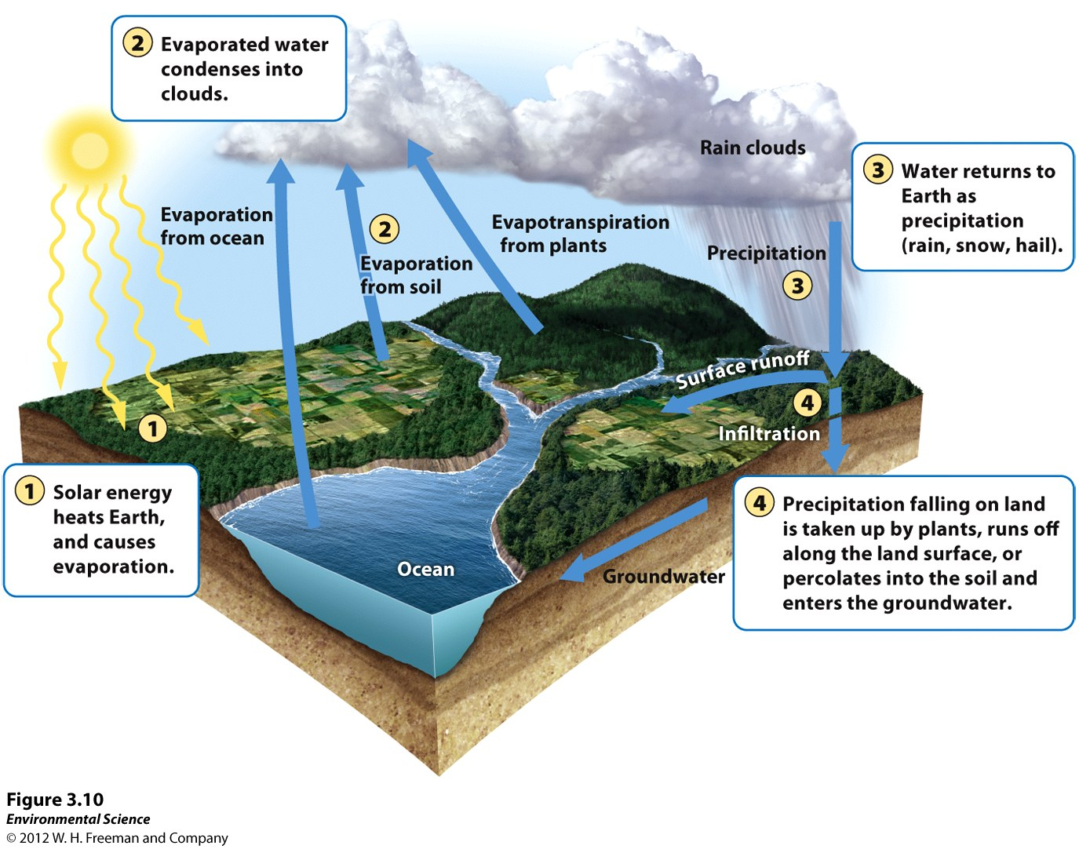

Slide 30
Carbon Cycle
Photosynthesis: take CO₂ and incorporate it into tissues. Some returned when they respire and die.
Sugars are converted back into CO_{2.}
Some CO₂ combines with Calcium ions and becomes calcium carbonate (buried limestone and sedimentary rock).
Buried dead organic matter and turned into fossil fuels.
Extracting fossil fuels and combustion (into the atmosphere or soil as ash)!
6. CO₂ can dissolve directly into the ocean!

Slide 31
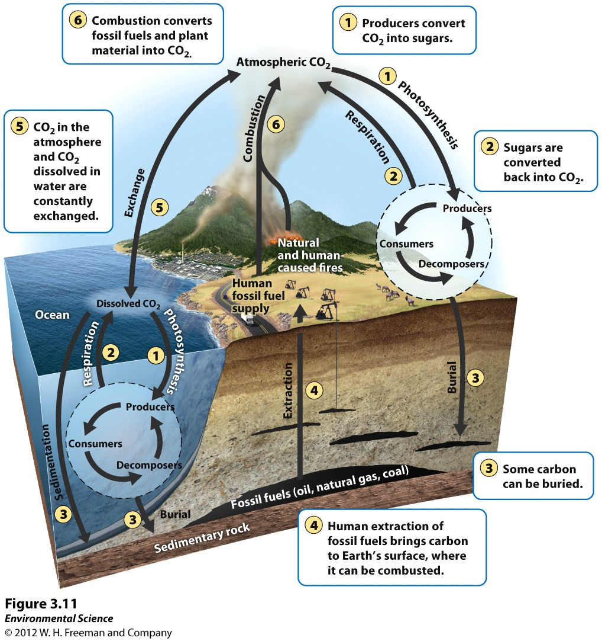

Slide 32
Macronutrients: organisms need relatively large amounts: Nitrogen, Phosphorous, Potassium, Calcium, Magnesium, and Sulfur.
Nitrogen Cycle
Often a limiting nutrient.
1. Nitrogen Fixation: converting N₂ directly into ammonia (NH₃) done by cyanobacteria and bacteria in the roots of legumes.
NH₃ is readily formed to NH₄ (ammonium) in the soil.
This can also happen abiotically turning N₂ into nitrate (NO₃-)

Slide 33
2. Assimilation
Producers take up ammonium or nitrate.
Consumers assimilate nitrogen by eating producers.
3. Ammonification
Decomposers in soil break down N compounds into ammonium (NH₄+).
4. Nitrification
Nitrifying bacteria convert ammonium to nitrite(NO₂-) and then into nitrate(NO₃-).

Slide 34
5. Denitrification
Denitrifying bacteria convert nitrate (NO₃) into nitrous oxide and eventually nitrogen gas.
Leaching: Negatively charged particles repel soil so nitrate is transported through the soil with the water. These settle at the bottom of lakes, oceans, and swamps.

Slide 35
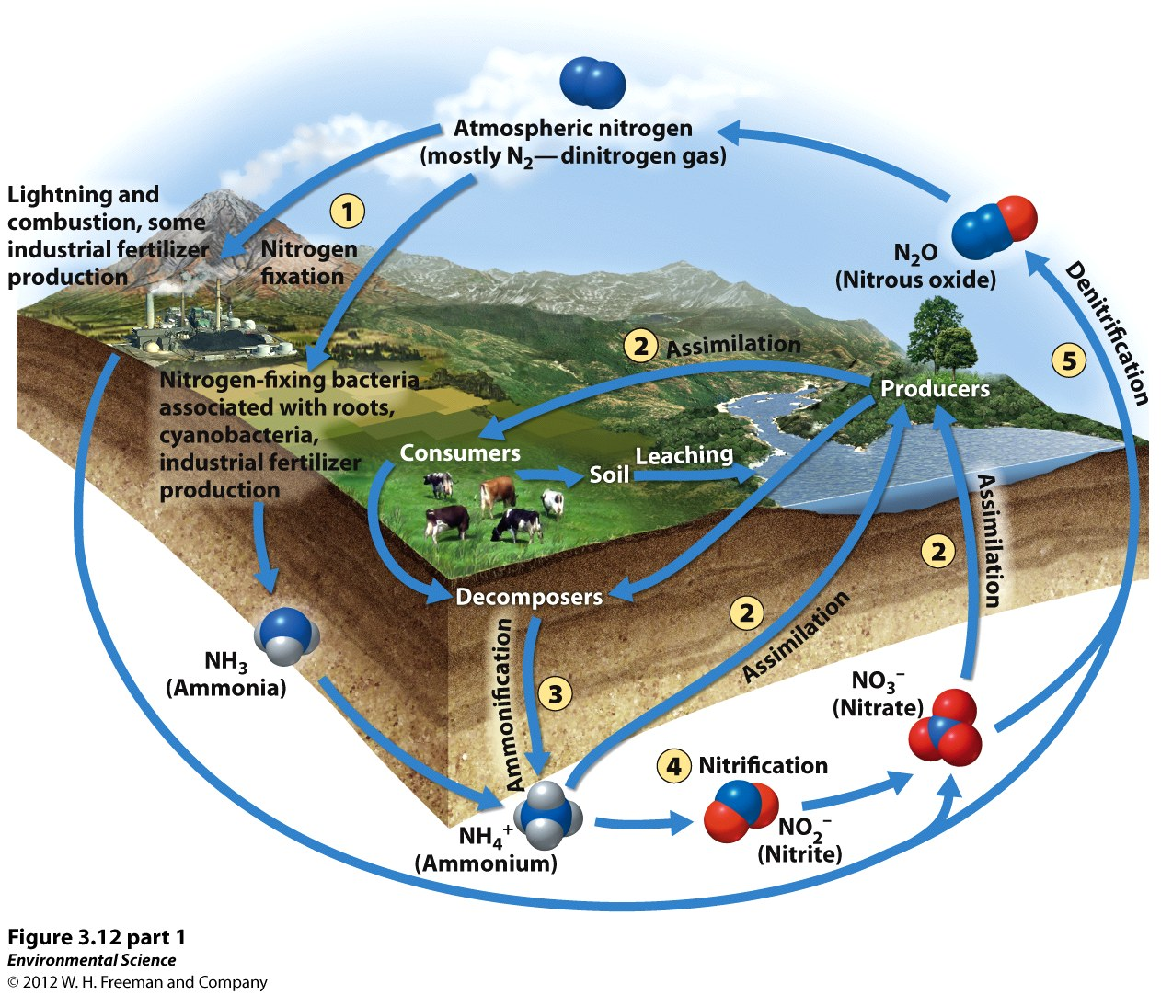

Slide 36
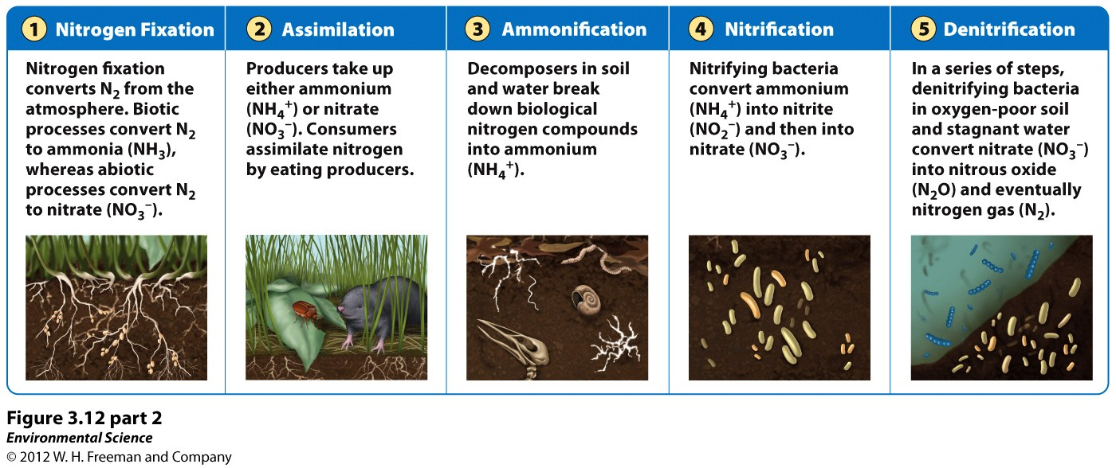
Nitrogen is a limiting factor. Excess nitrogen can alter the environment.

Slide 37
Phosphorus Cycle
Weathering of rocks.
Phosphorous fertilizer is added to farms and can run off into rivers, lakes, and streams.
Excretion of animals.
Dissolved phosphates precipitate out of solution and contribute to the ocean sediments.
Phosphate rocks uplift from the ocean floor.

Slide 38
Phosphorous dissolved is not available in streams and rivers.
When added to these systems there is huge growth of producers.
Algal Bloom: rapid growth of algae. When algae die their decomposition consumes large amounts of oxygen.
Results in hypoxic (low oxygen) conditions.

Slide 39
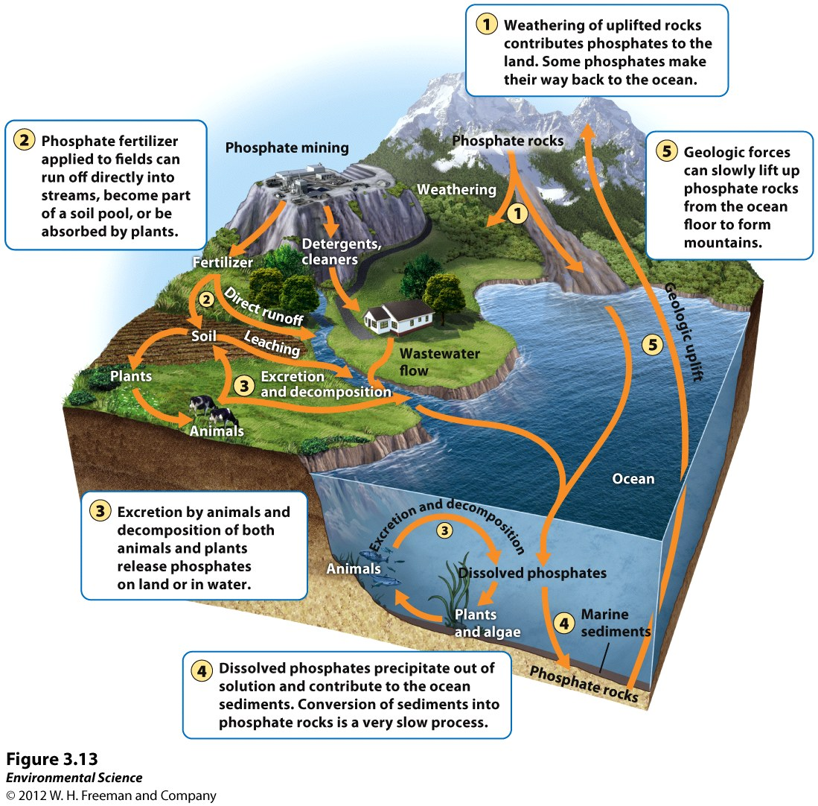

Slide 40
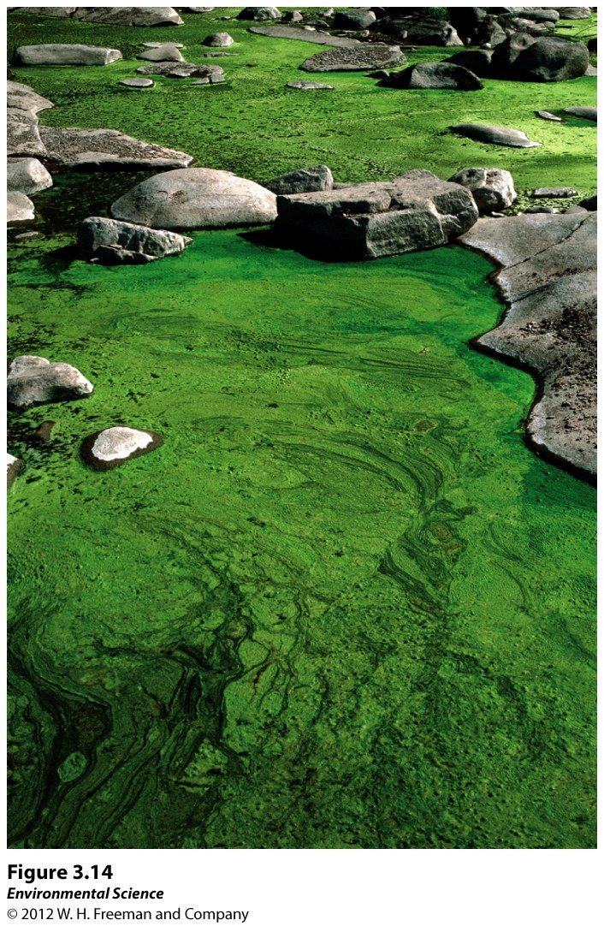

Slide 41
Calcium, Magnesium, Potassium, and Sulfur
Ca, Mg, S and K are derived from rocks.
Sulfur
Exists in rocks.
Plants absorb as sulfate ions (SO₄²⁻).
Burning fossil fuels release sulfur dioxide.
When mixed with water it is converted to sulfuric acid (H₂SO₄).

Slide 42
Ecosystems Respond to Disturbance
Disturbance: event caused by physical, chemical, or biological agents that cause a change in the population or community.
Watershed Studies: all of the land of a given landscape that drains into a particular river, lake or stream.

Slide 43
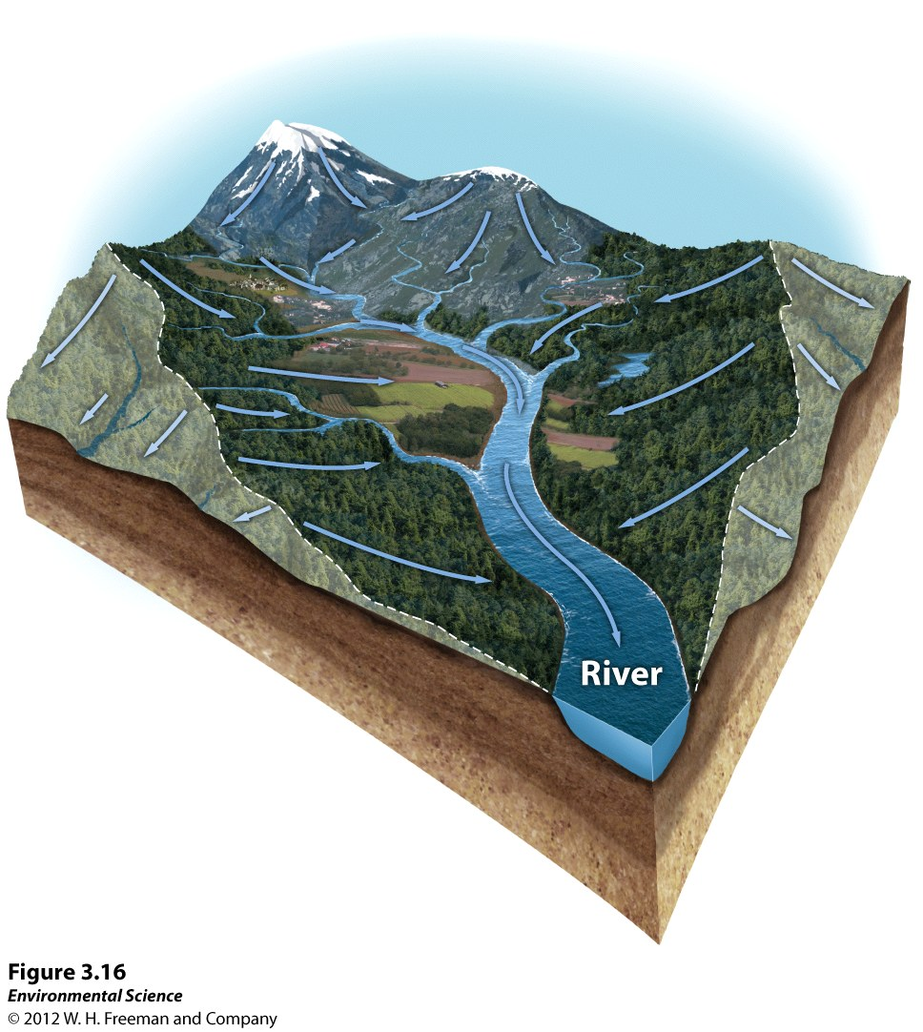

Slide 44
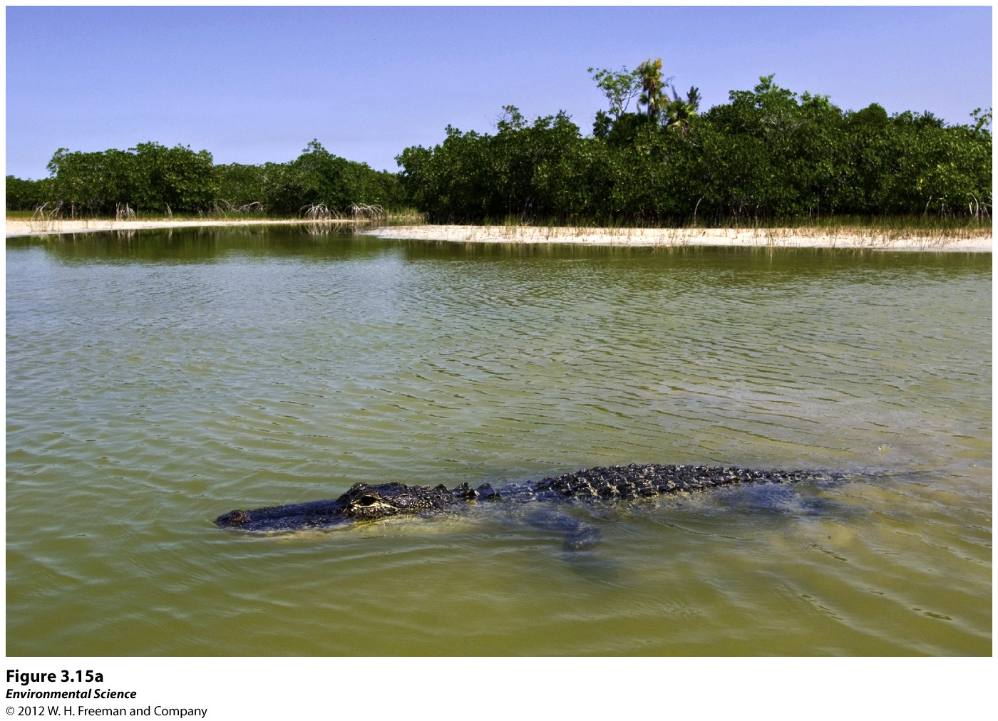

Slide 45
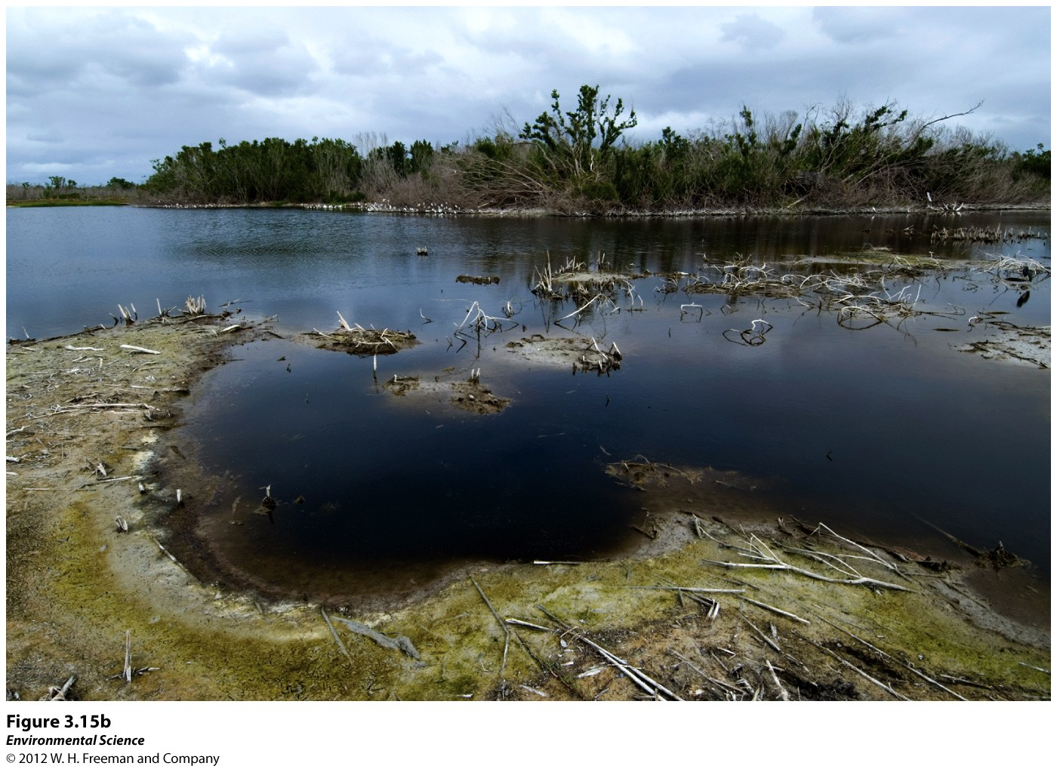

Slide 46
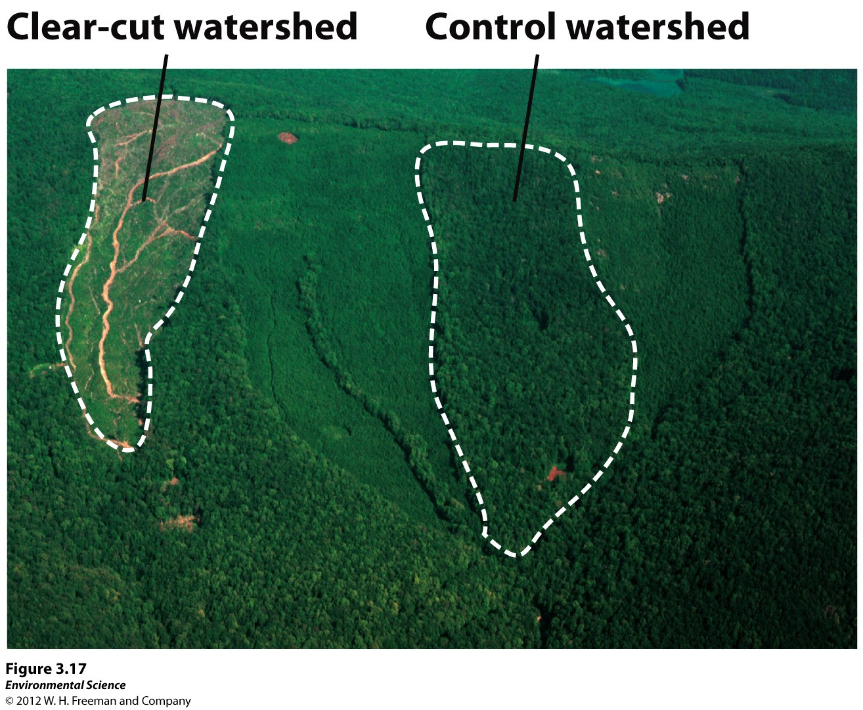

Slide 47
Resistance Vs. Resilience
Resistance: measure of how much an disturbance can effect flows of energy and matter.
Resilience: rate at which an ecosystem returns to its original state after a disturbance.
Restoration Ecology!
Intermediate Disturbance Hypothesis

Slide 48
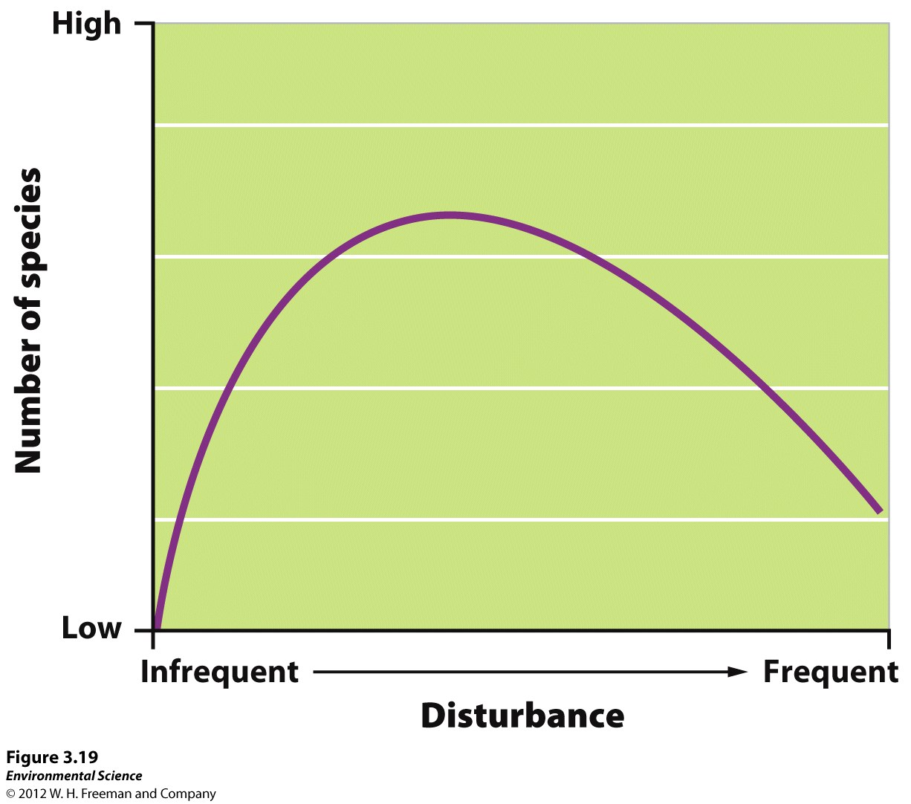

Slide 49
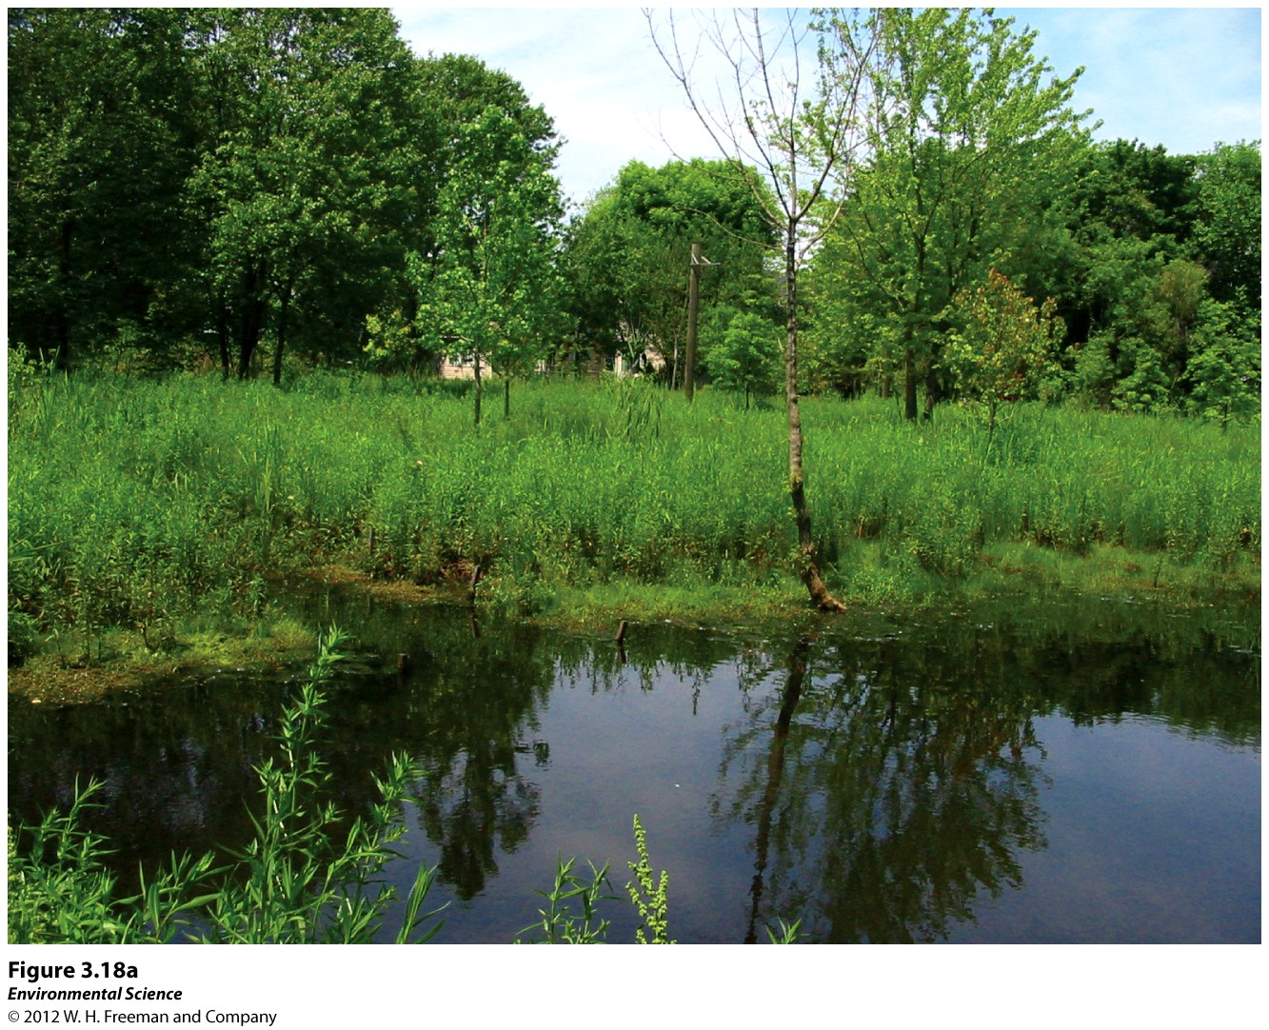

Slide 50
Ecosystems Provide Valuable Services
Instrumental Value: has worth as an instrument or tool.
Provisions
Regulating Services: nutrients and biogeochemical cycles
Support Systems: pollination
Cultural Services
Intrinsic Values: religious & philosophical convictions.

Slide 51
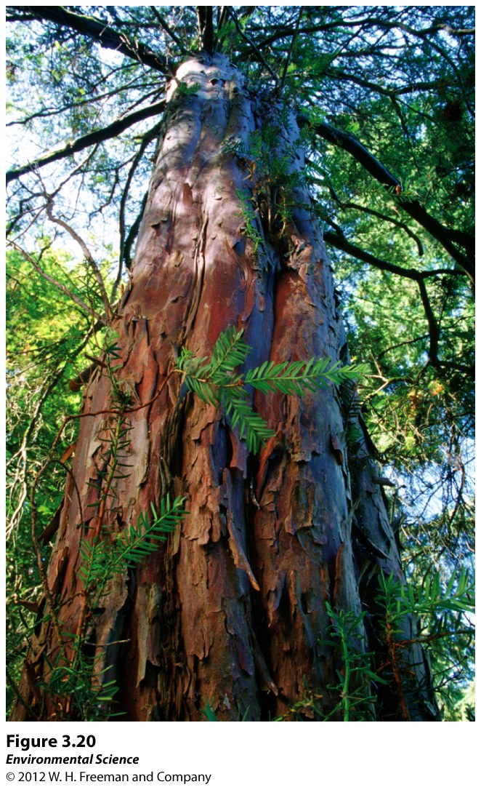

Slide 52
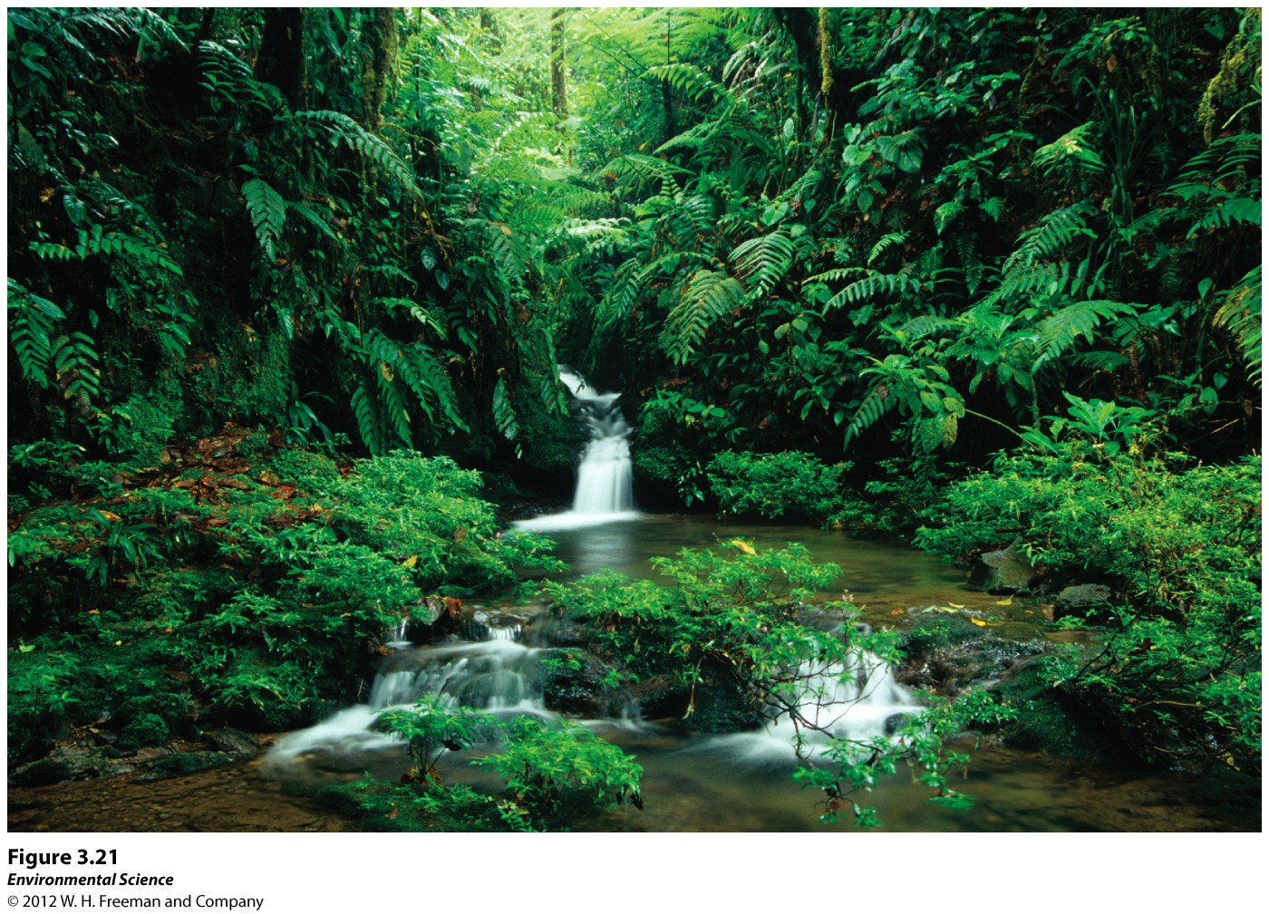

Slide 53
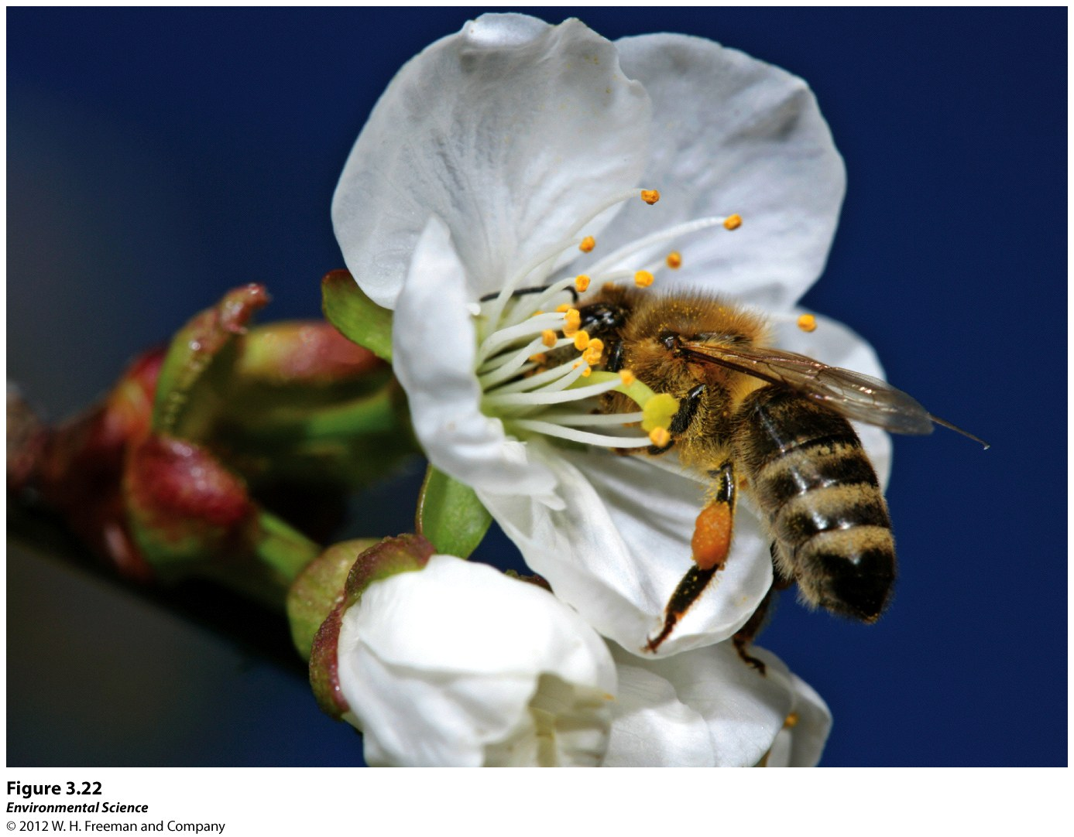

Slide 54
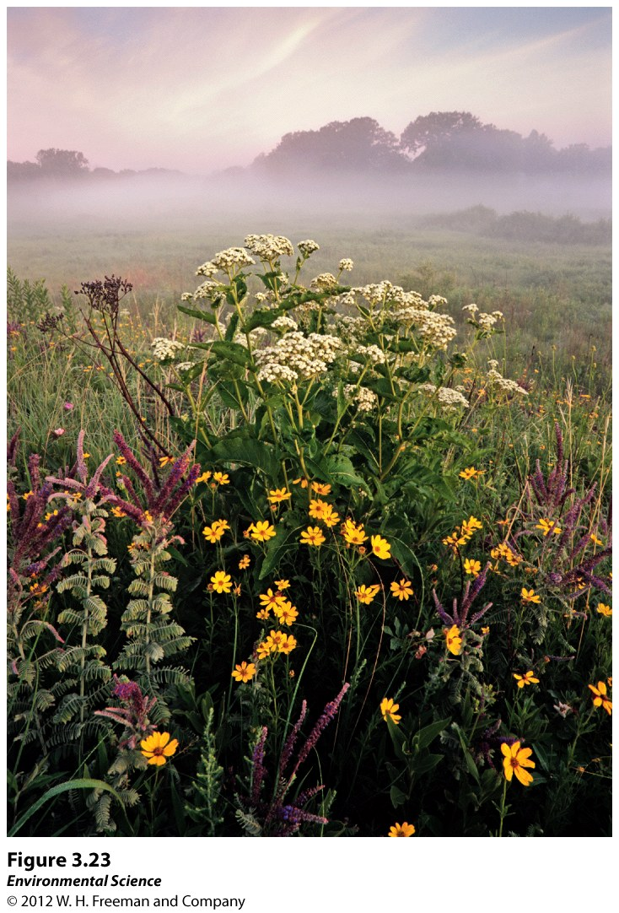

Slide 55
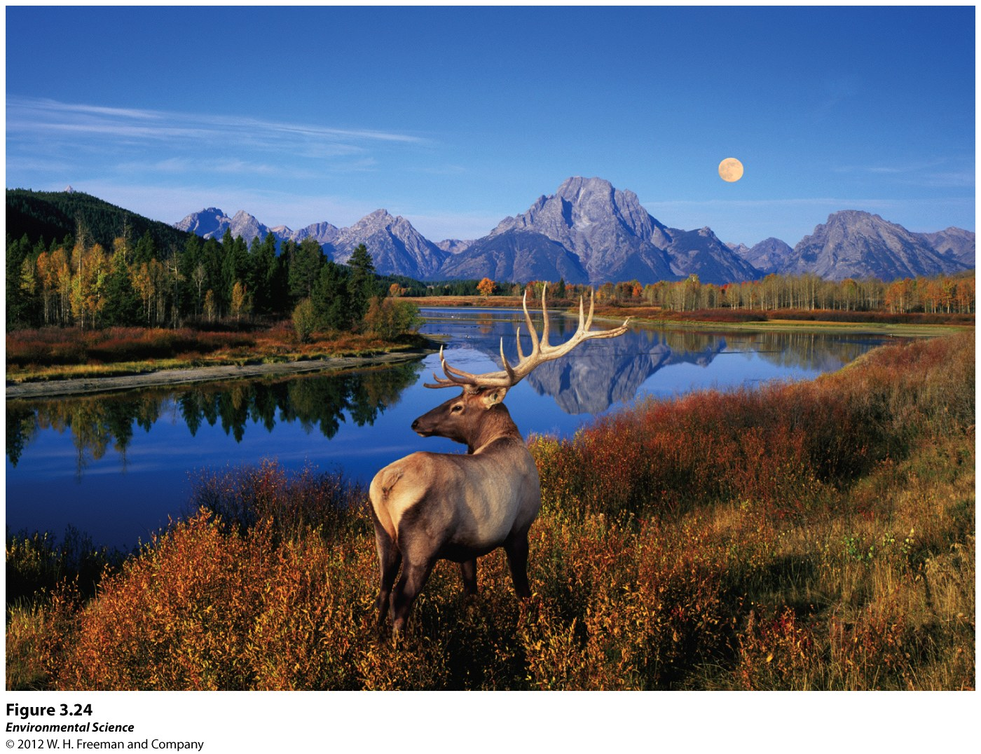

Slide 56
