Slide 1
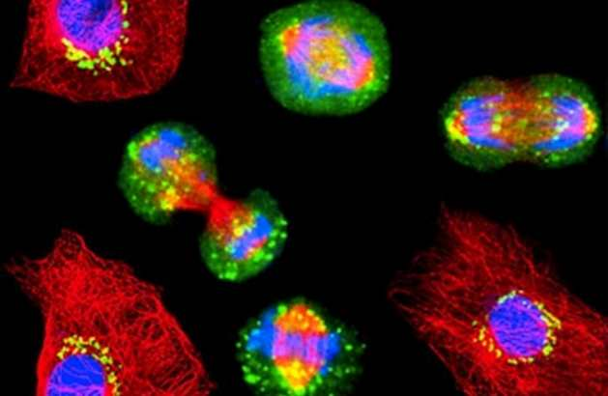
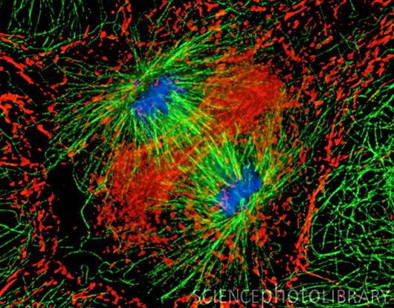
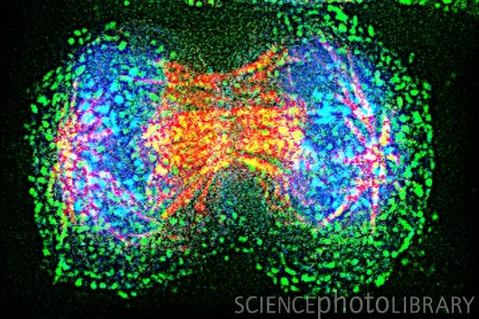
The Cell Cycle
And
Mitosis

Slide 2
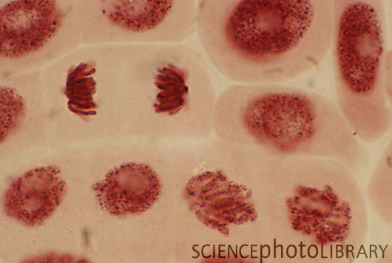
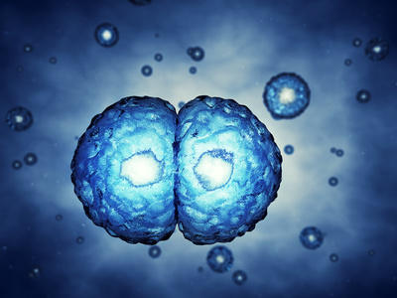
Prefixes, Suffixes and Vocabulary
Pro = before
Meta = middle
Ana = backwards
Telo = final
Cyto = cell
Kinesis = movement
Di = two

Slide 3
What we already know…
All living things are made of cells and have DNA.
Semi-conservative replication is how DNA copies itself.
Living things maintain homeostasis though diffusion and osmosis.
Living things reproduce themselves.
Next question you may have is how do cells replicate….

Slide 4
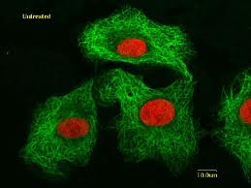
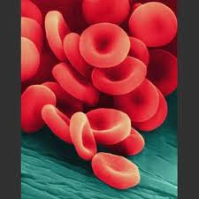
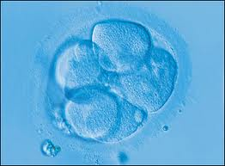
New Cells Must Be Made!!
Why????

Slide 5
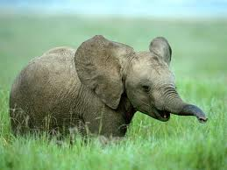
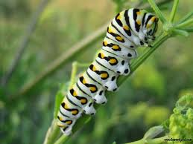
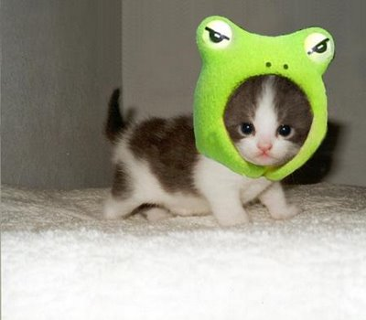
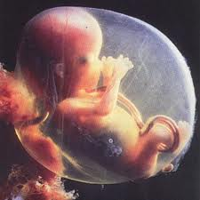
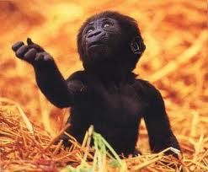
1. Living things grow and develop.

Slide 6
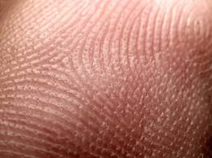
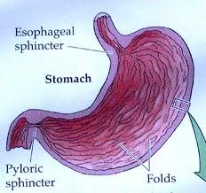
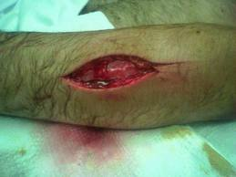
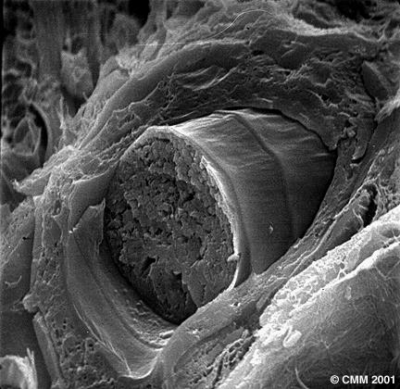
2. Old or damaged cells must be replaced.

Slide 7
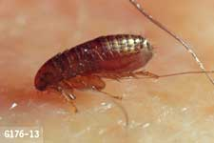
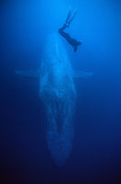
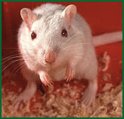
3. There is a size limit to cells.
Due to diffusion and osmosis cells must remain small.

Slide 8
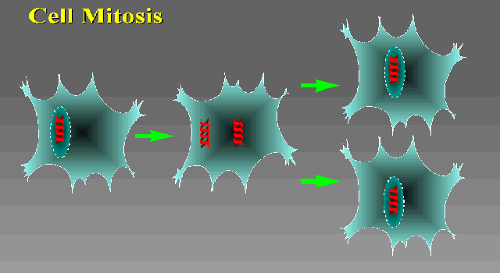
The Cell Cycle
The cell cycle is broken up into three separate sections:
Interphase: cell growth.
Mitosis: nuclear division.
Cytokinesis: entire cell division (cells pinch apart).

Slide 9
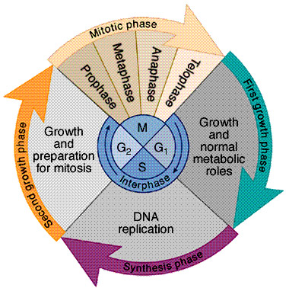
The Cell Cycle

Slide 10
New DNA Terminology
Each cell has a certain number of chromosomes.
Chromosomes = long strand of DNA. This number is called the “n” number.
All organisms have their own “n” number.
Diploid = 2 copies of each chromosome.

Slide 11
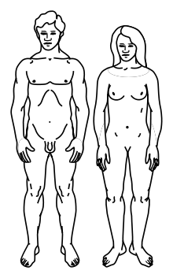
Humans
Humans have 23 different types of chromosomes (n =23).
Our diploid number(2n) = 46 chromosomes.
We get one set from our mom, and the other from our dad!

Slide 12
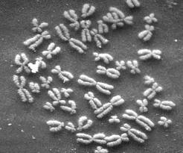
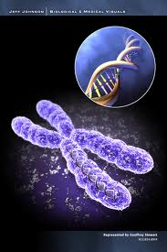
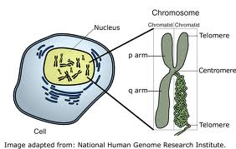

Slide 13
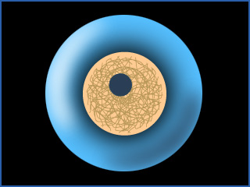
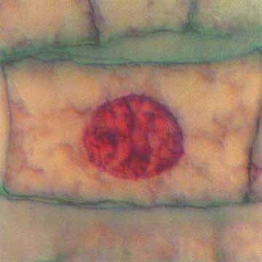
The Cell Cycle Starts with Interphase
Interphase is the time a cell grows and gets bigger.
Cell size increases.
Organelles are copied.
Enzymes increase in #.
Centrioles duplicate.
DNA replicates (semi-conservative replication).

Slide 14
After the cell maximizes its size, it begins to divide.
Mitosis Consists of 4 steps:
Prophase: “before”, “in front of”
Metaphase: “middle”
Anaphase: “denoting backward”
Telophase: “final”

Slide 15
Prophase
DNA becomes visible.
Centrioles begin to move apart.
Spindle fibers form.
Nuclear membrane breaks apart.
Centrioles: organize spindle fibers.
Spindle Fibers: ropes of proteins that move the chromosomes.

Slide 16
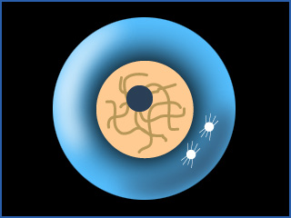
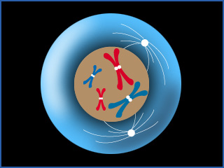
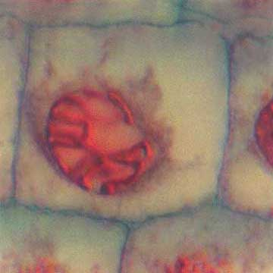

Slide 17
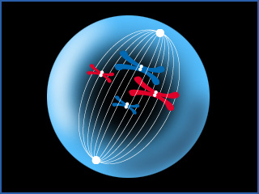
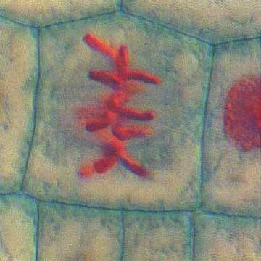
Metaphase
Chromosomes line up at the center of the cell.
Centrioles are at opposite ends of the cell.
Centrioles attach spindle fibers to the chromosomes (like attaching a rope).

Slide 18
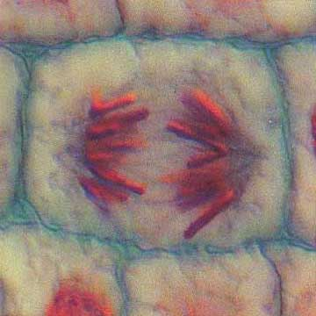
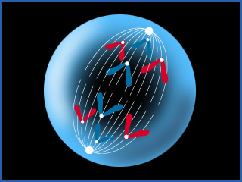
Anaphase
Sister chromatids begin to separate and move to opposite ends.
Spindle fibers shorten.

Slide 19
Telophase
Separation of chromatids is completed.
Nuclear membrane reforms.
Chromosomes become less visible (untangle).
Nucleolus reappears.

Slide 20
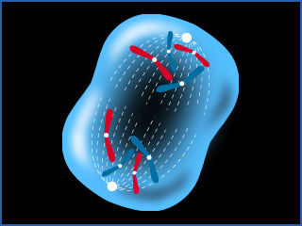
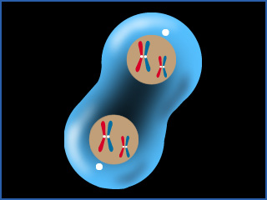
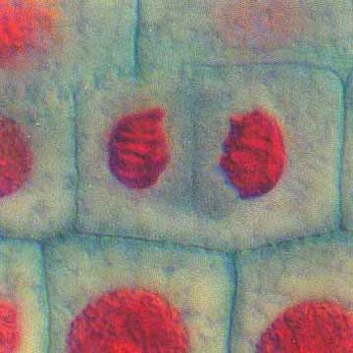
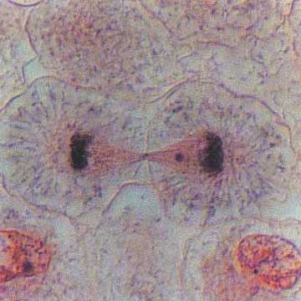

Slide 21
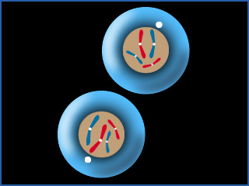
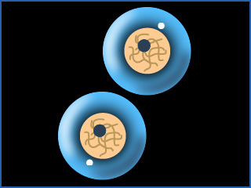
Cytokinesis
The cell squeezes itself in the middle.
Cyto= cell
Kinesis = movement
When the sides meet in the middle the membrane pinches together.
Two new daughter cells now exist.

Slide 22
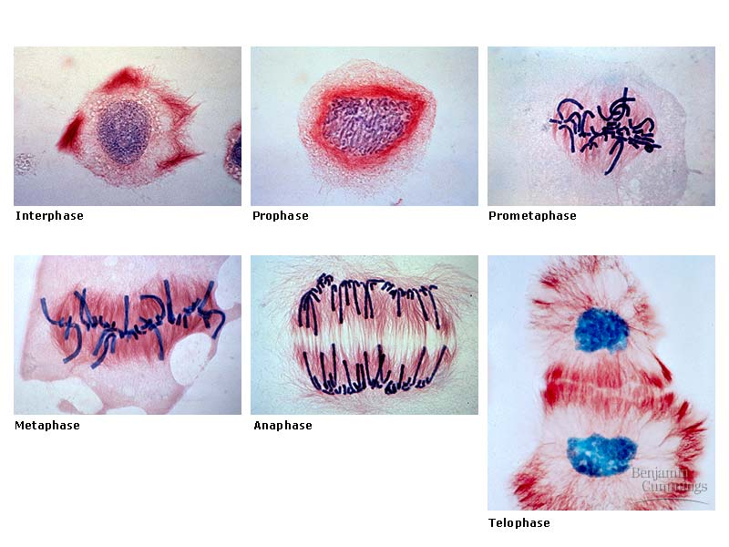
Actual Photos of the Mitotic Steps for a Plant Cell

Slide 23
A Quick Summary of the Cell Cycle
The process begins with 1 cell.
It grows (Interphase) until it gets to the maximum size.
The nucleus divides (mitosis).
The entire cell divides (cytokinesis).
The final product is 2 smaller identical cells called daughter cells.

