Slide 1
Diffusion/Osmosis Lab Write Up Hints

Slide 2
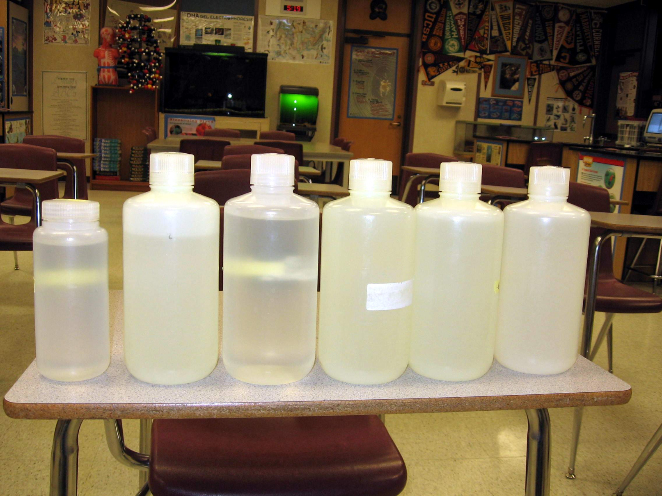
0
.2
.4
.6
.8
1.0
5 Different Concentrations of
Sucrose Solution

Slide 3
0
.2
.4
.6
.8
1.0
“Sweeter”

Slide 4
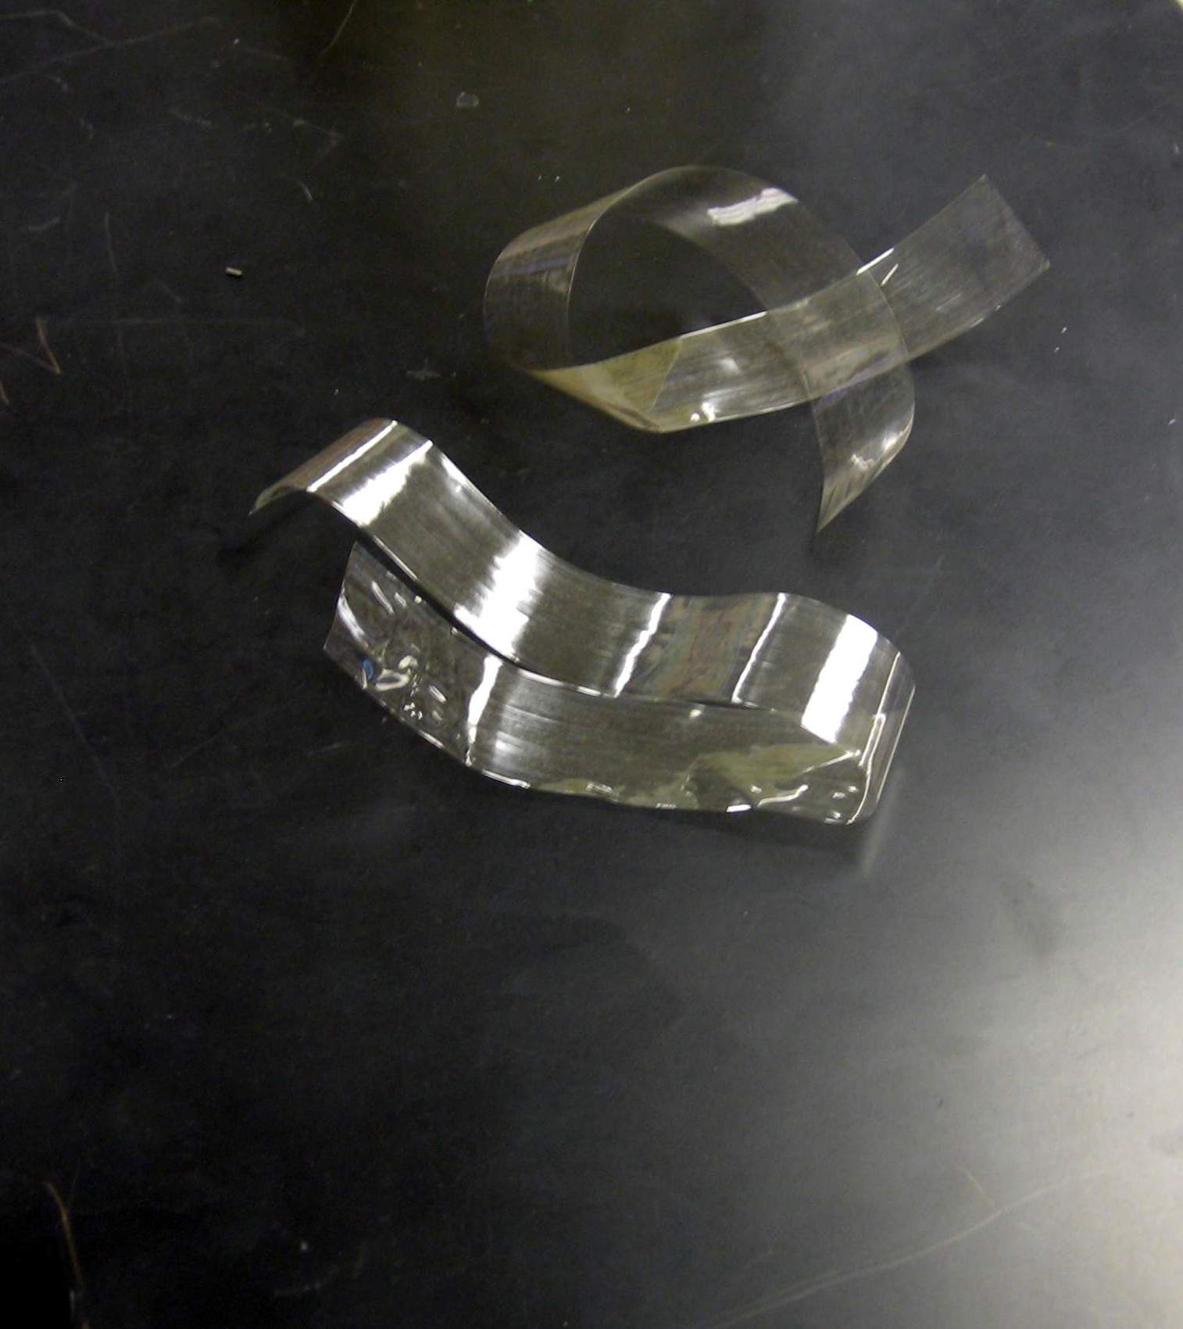
Dialysis Tubing

Slide 5
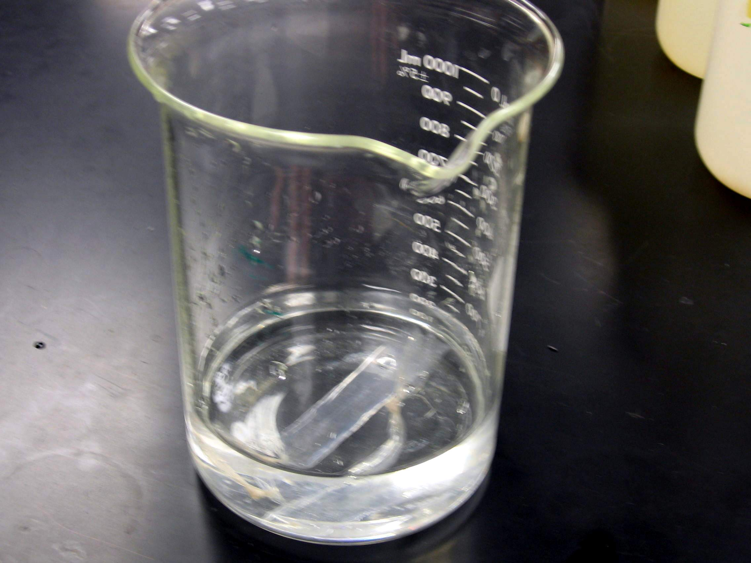
Soaking Dialysis Tubing

Slide 6
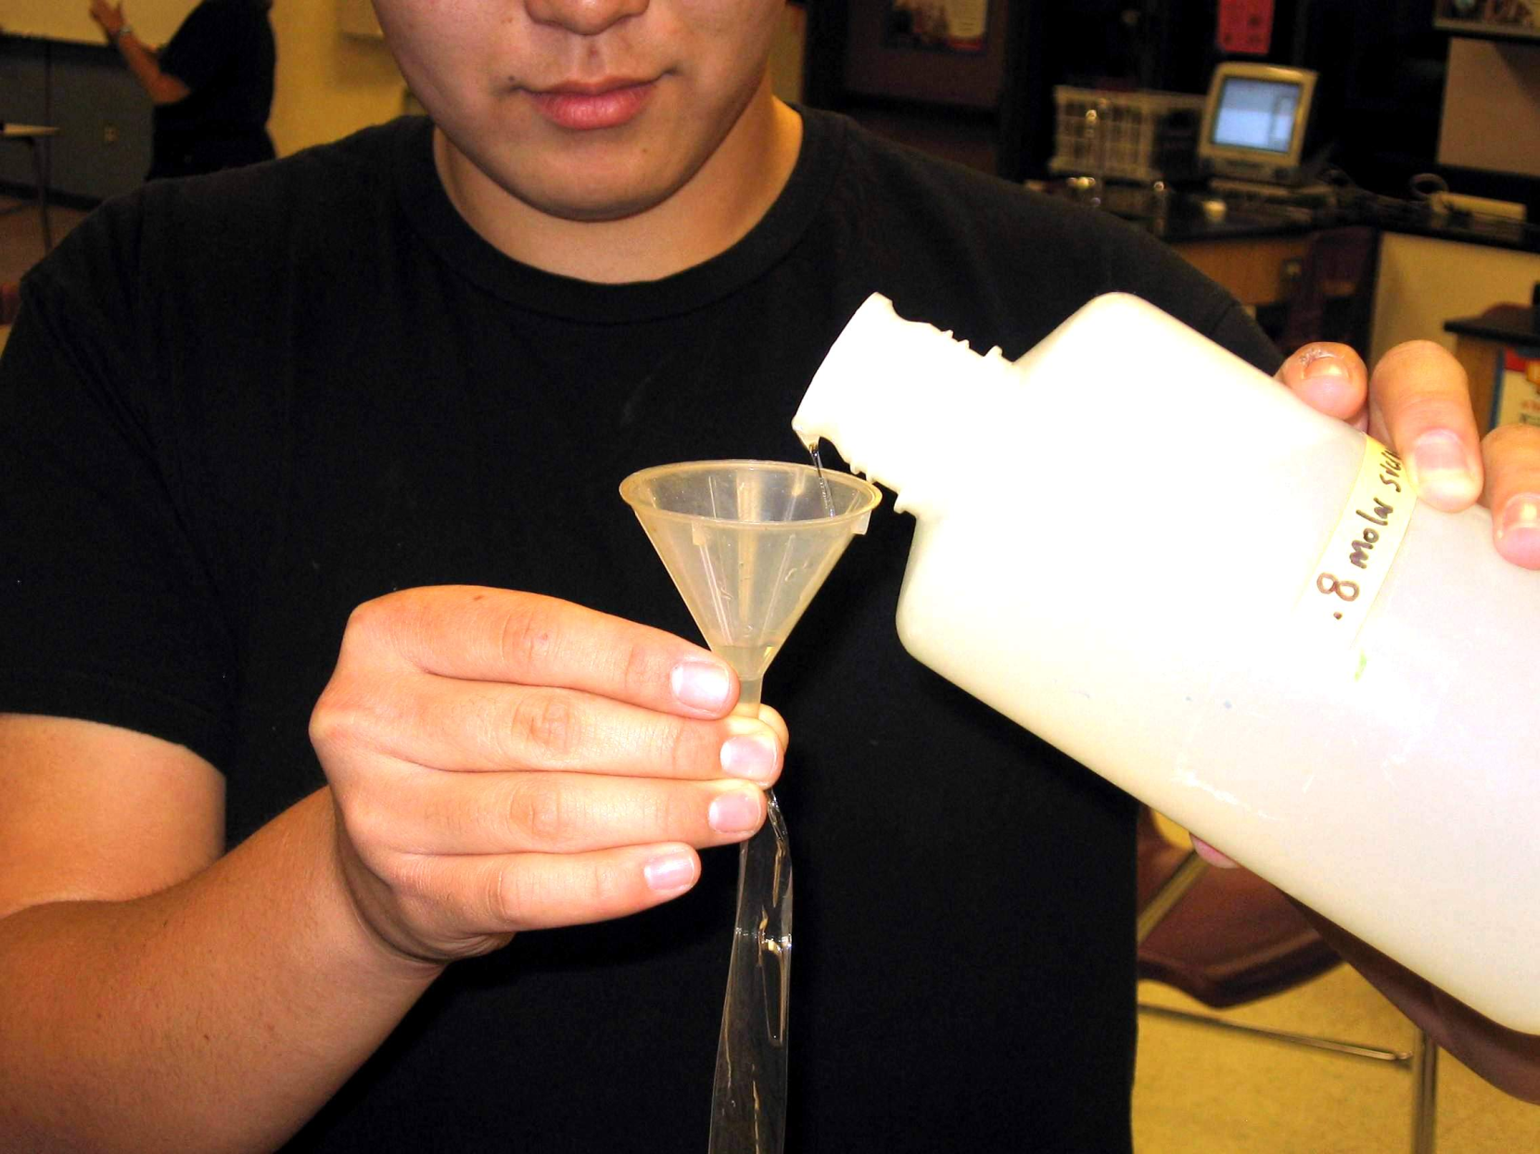
After Tying One End, Pour Solution
Into Dialysis Tubing

Slide 7
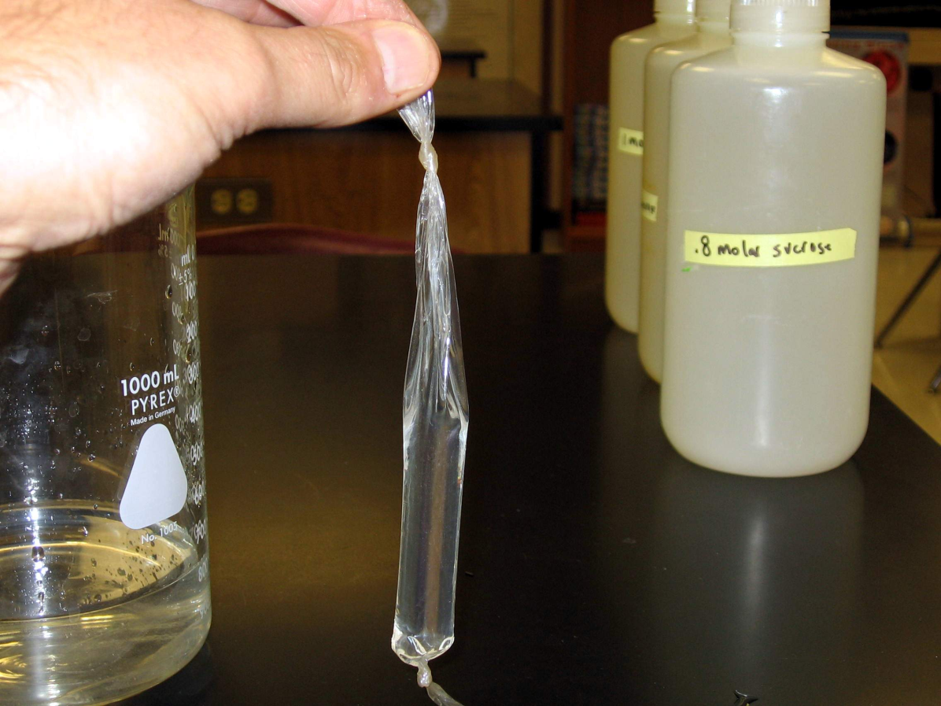
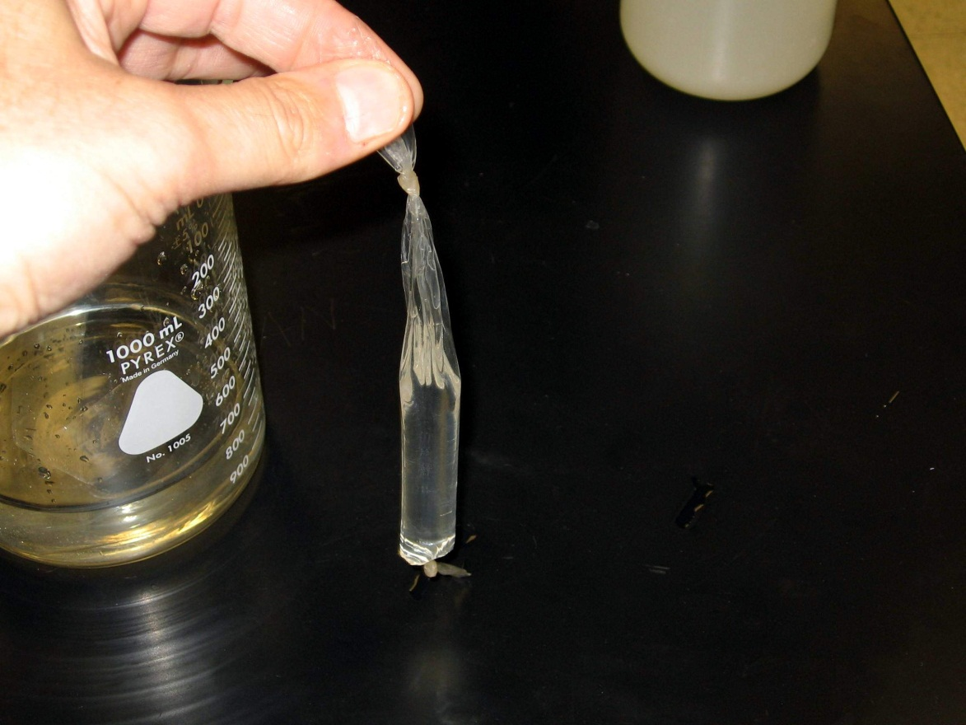
Pour Both Tubes With Assigned
Sucrose Concentrations.
Tie off other end.

Slide 8
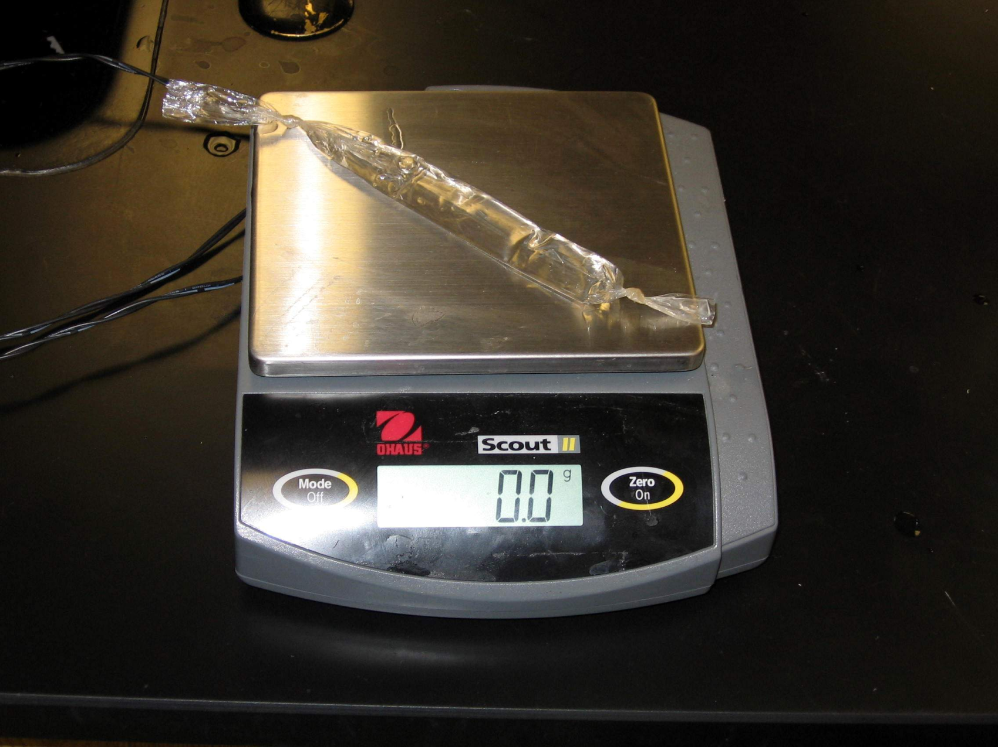
Weigh Tubing and Record “Initial mass”

Slide 9
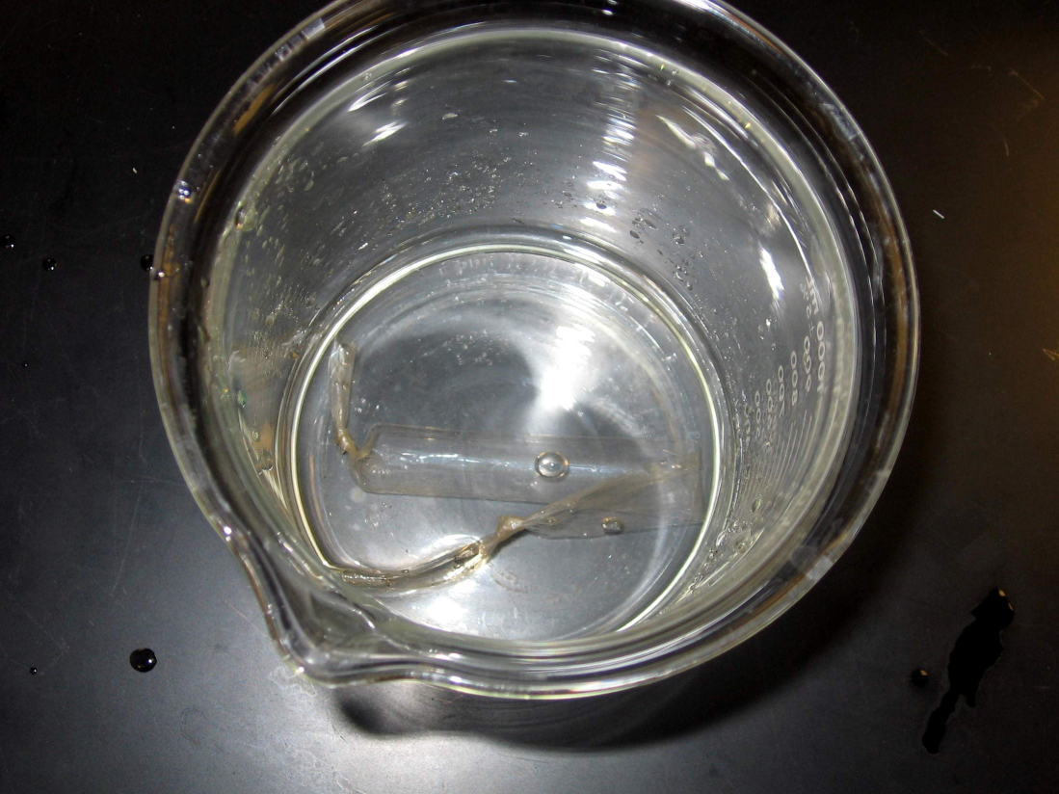
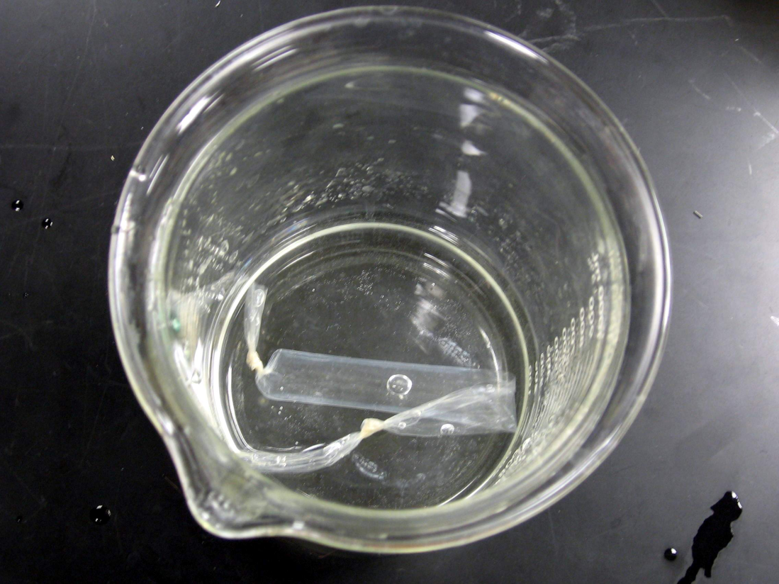

Slide 10
After 30 minutes, weigh “bags” again
and record “Final Mass”

Slide 11
Title:
Describe what we did in the lab.
“The Effect of the IV on the DV”.
B. Members of the Group
C. Primary Question
Major goal. State what we are trying to determine in this lab.

Slide 12
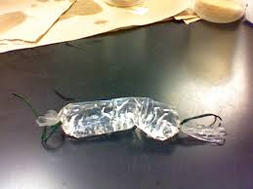
D. Hypothesis:
1 hypothesis
Must state WHY!
As the sucrose concentration increases the mass % change will __________ because…..

Slide 13
E. Experimental Design and Materials
List or illustrate materials.
Put procedure description in paragraph form.
Discuss strategies for testing your hypothesis.

Slide 14
F. Data and Results
Use a straight edge.
1 graph (label all axis, title)
Show your calculations from the 2 values you used (include the formula).
1 data table
G. Analysis Questions
Answer the questions provided.
Need both the question and the answer.

Slide 15
Sucrose Molarity | Mass % Change
0.0 | 0.0
.2 | 10.5%
.4 | 17.3%
.6 | 24%
.8 | 30.2%
1.0 | 34.7%
.

Slide 16
H. Conclusion/Discussion
Describe experiment.
Describe how you varied the IV and measured the DV.
LIST your data for each variable.
Accept/support or reject/do not support your hypothesis.
Major conclusions you have drawn from this lab (think about this could directly relate to homeostasis and cells).

