Slide 1
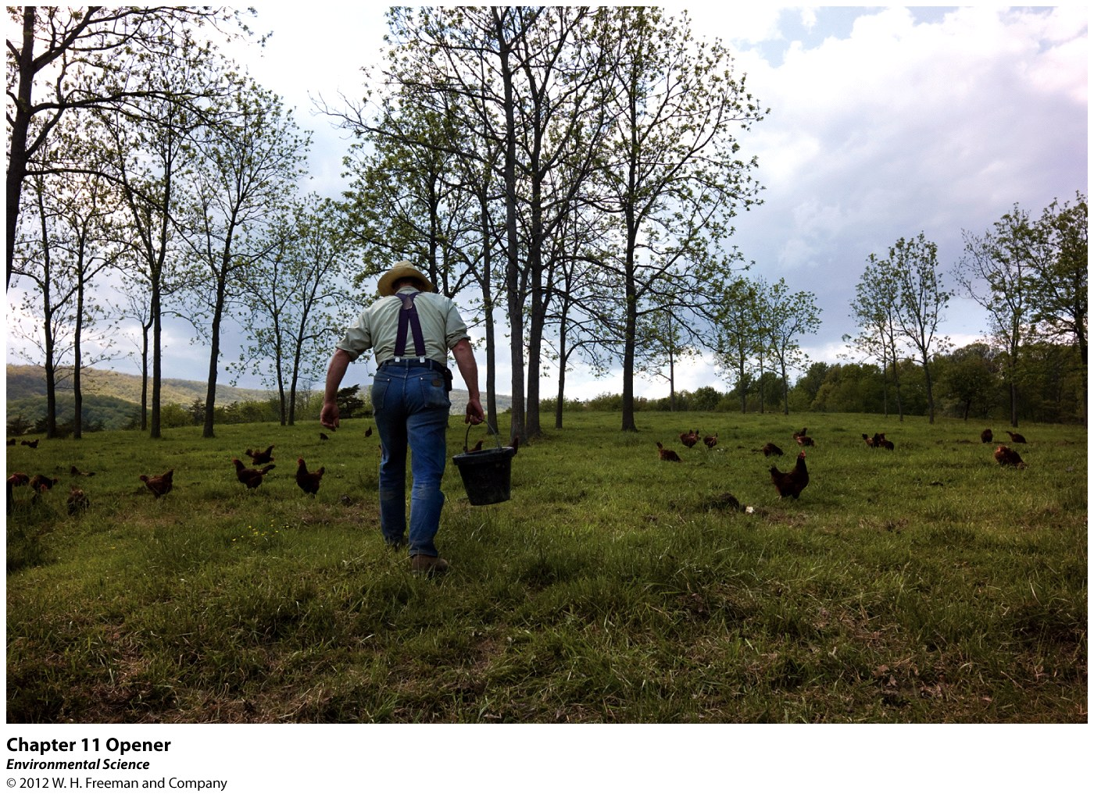
Chapter 11
Feeding the World

Slide 2
Farm Where Animals Do the Work
Joel Salatin of Swoope, Virginia raises vegetables and livestock in a sustainable, organic way.
Does not use chemical pesticides or synthetic fertilizers.
Uses the basics of ecology to successfully run a sustainable farm.
Reduces the pesticides and fertilizers in addition to fossil fuels usage.
Opens the door for future agriculture practices.

Slide 3
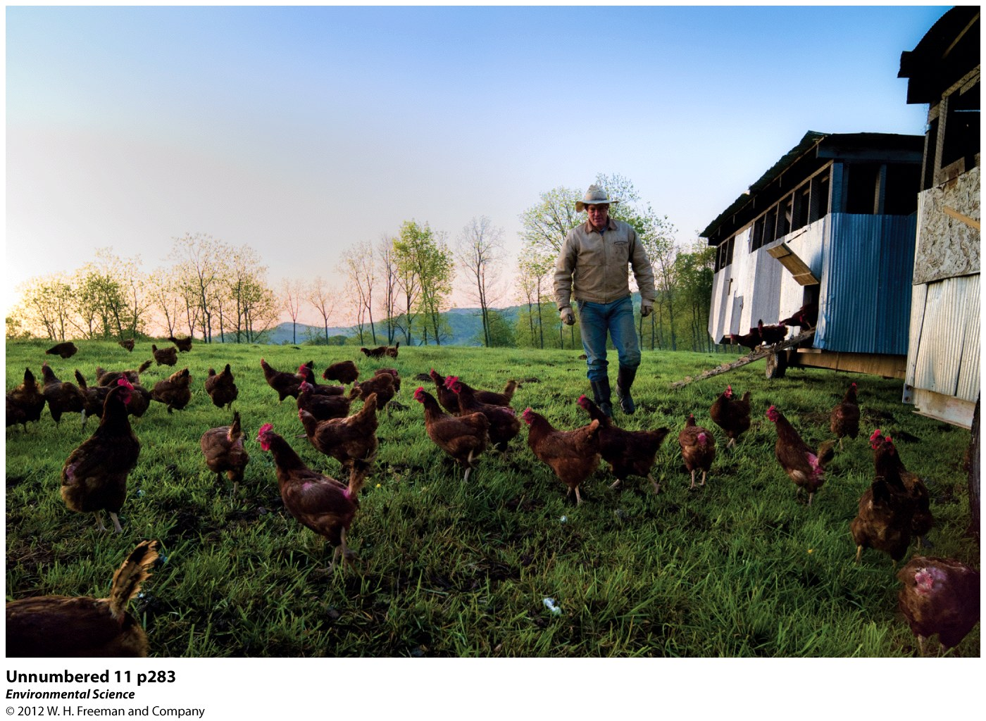

Slide 4
Human Nutritional Requirements are Not Always Satisfied
Advancements in agricultural methods have greatly improved the human dies over the last 10,000 yrs.
24,000 people starve to death each day.
1 billion people worldwide lack access to adequate amounts of food.

Slide 5
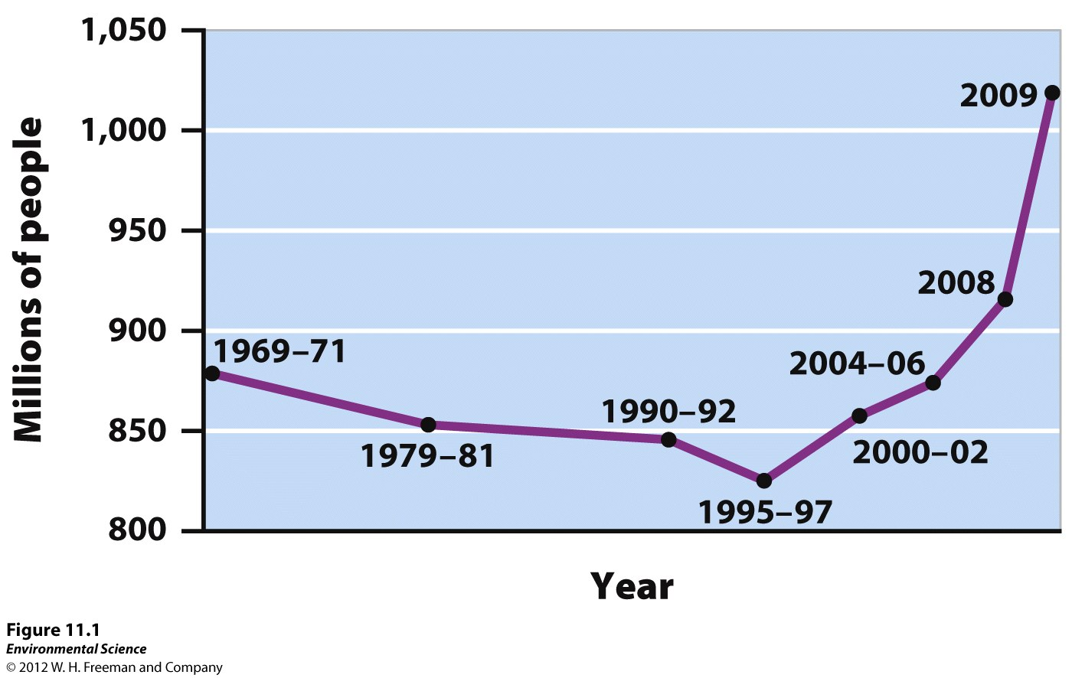

Slide 6
Nutritional Requirements
Undernutrition: not consuming enough calories to be healthy.
Malnourished: diets lack the correct balance of nutrients.
Famine: large amounts of death over a short period of time due to lack of food security.

Slide 7
Anemia: Iron deficiency, the largest deficiency in the world.
Overnutrition: ingestion of too many calories and improper foods.
1 billion people are overweight. 300 million are obese.

Slide 8
Grains (corn, rice, wheat and rye) make up the largest component of the human diet.
Meat comes in second!
Fish is last.
As income increases with economic growth people tend to add more meat to their diet.

Slide 9
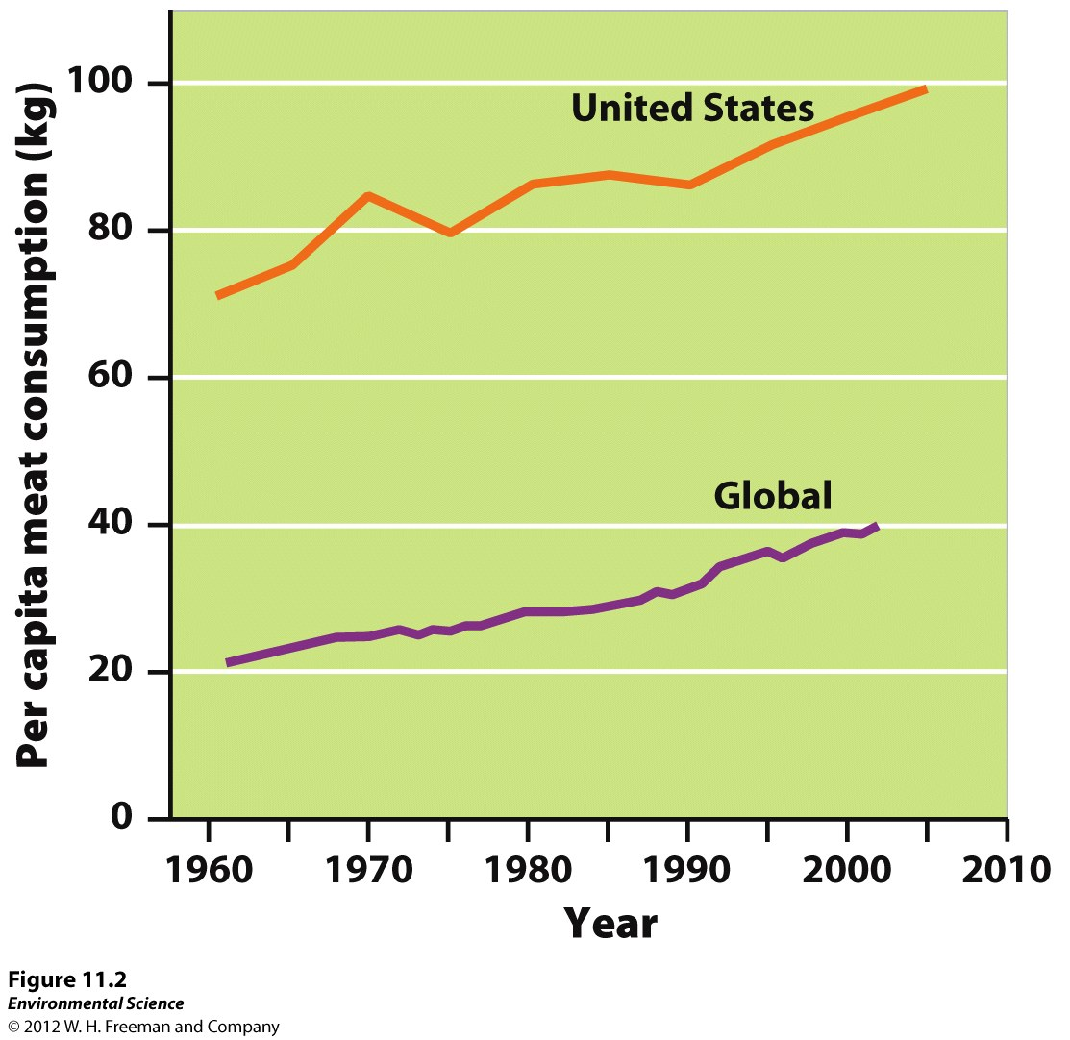

Slide 10
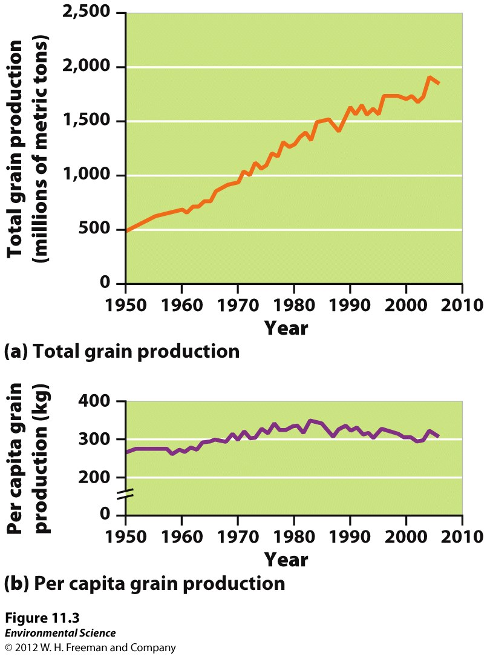

Slide 11
Reasons for Malnutrition
Poverty: lack of resources that allows one to access food.
Unequal food distribution.
Political and economic factors.
Resources diverted to feed livestock.

Slide 12
Green Revolution and Transformed Agriculture
Agriculture started 10,000 years ago.
Has lead to the exponential growth of the human population.
Industrial Agriculture (agribusiness): applies mechanism and standardization to the production of food.

Slide 13
The Energy Subsidy in Agriculture
Energy Subsidy: the energy input per calorie of food.
Most food travels 1200 miles to get to your plate.

Slide 14
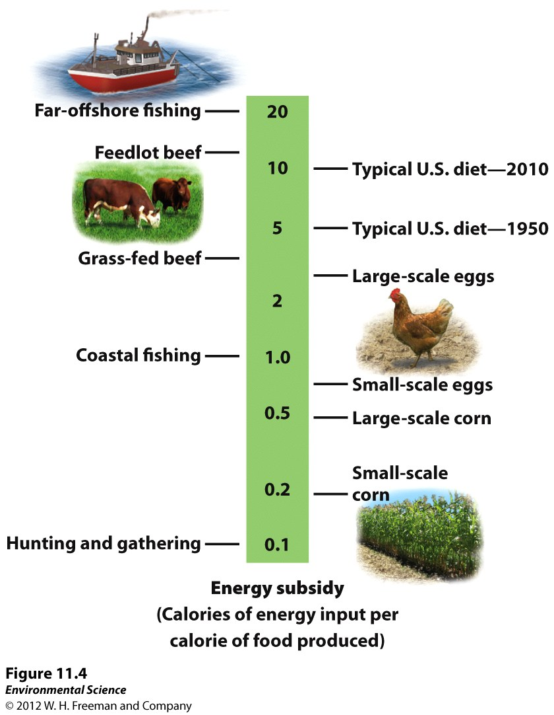

Slide 15
Green Revolution
A shift from a system that relied mainly on human labor and low fossil fuel inputs to a system of large industrial operations with fewer people and more machinery.
Increased production and the ability to feed more people.

Slide 16
The Green Revolution Techniques
Mechanization
Machines replacing human labor.
Developed countries with high wages tend to have less farmers(5%) where developing nations with low wages have many farmers (40-75%).
Small farms cannot afford large machines.
Single crop farms are generally more efficient.

Slide 17
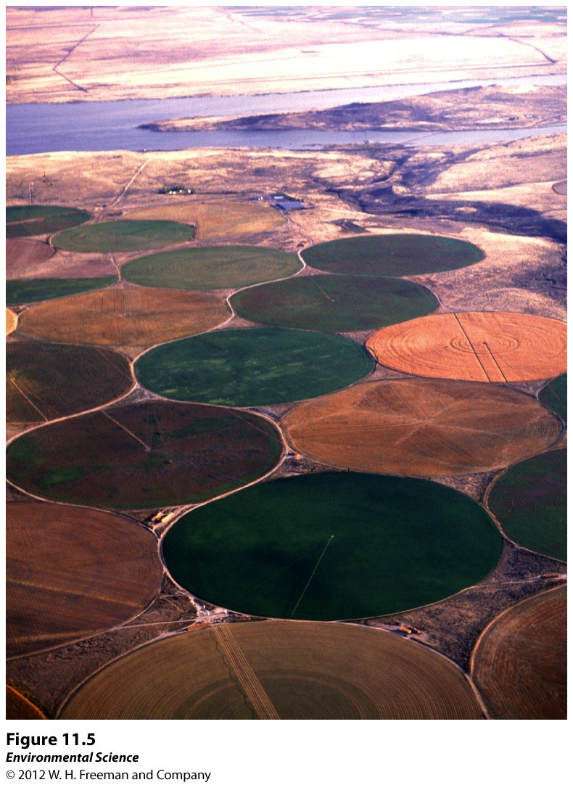
2. Irrigation
Irrigation is positive because it brings water to where it is needed.

Slide 18
Negatives:
Can deplete groundwater and draw down aquifers.
Can promote saltwater intrusion.
Can cause waterlogging or salinization.
Waterlogging: soil remains underwater for a long period of time and root growth is inhibited.
Salinization: occur when the small amounts of salts in irrigation water become highly concentrated on the soil surface through evaporation.

Slide 19
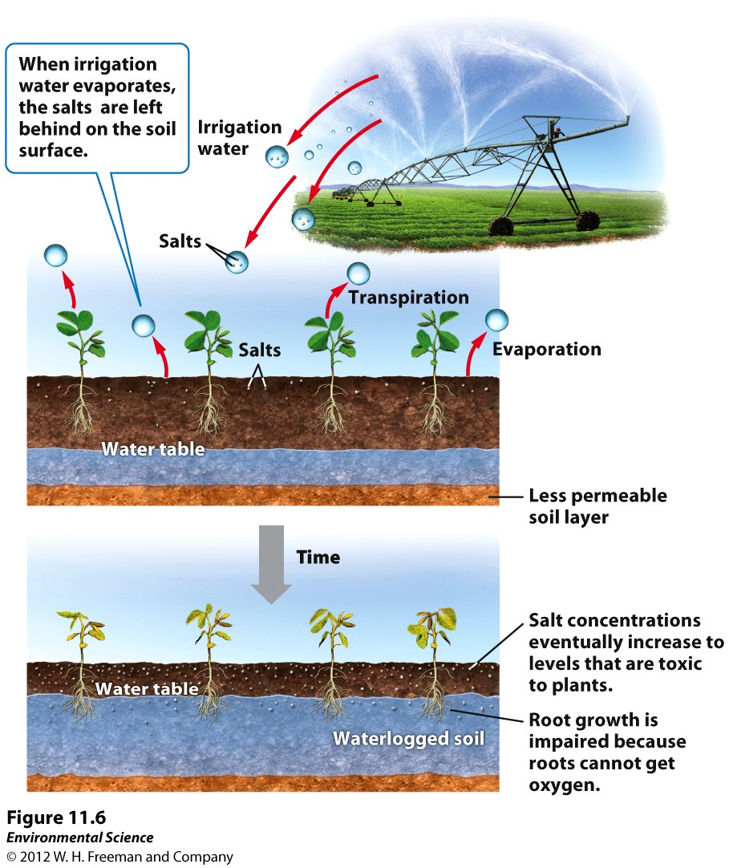

Slide 20
Fertilizers: replenish nutrients including Phosphorus, Potassium, and Nitrogen.
Organic: composed of organic matter from plants and animals. Mostly animal manure.
Synthetic/Inorganic: produced commercially. Produced by combusting gas which allows nitrogen to be fixed and captured in fertilizer.
They are easy to apply, easy to target particular plants, easy for plants to absorb.

Slide 21
Disadvantages
Uses fossil fuels to produce.
More likely to be carried off in run-off.
Can cause algal blooms which will cause “dead zones” which are hypoxic.
Do not add organic material to the soil.

Slide 22
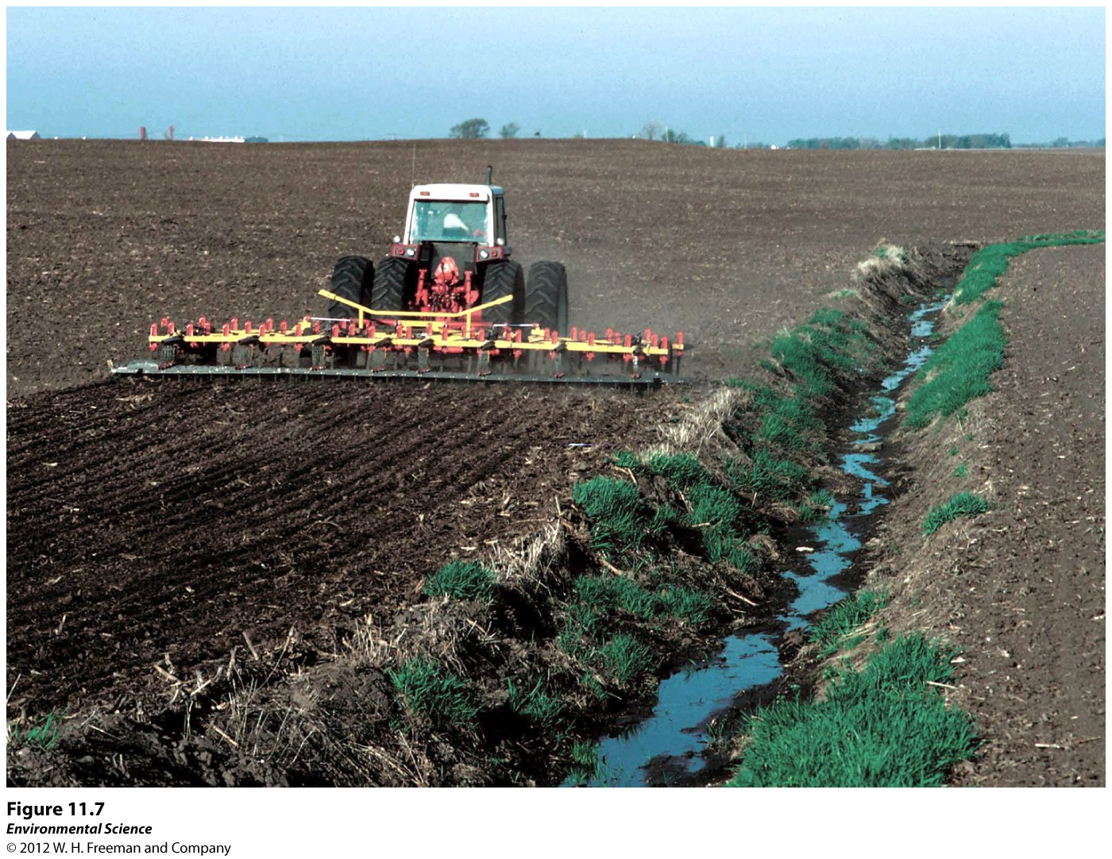

Slide 23
Monocropping
Mechanization and synthetic fertilizers encouraging the growth of one plant species.
The dominant agriculture practice in the United States.
Allows the plants to all be harvested at the same time .

Slide 24
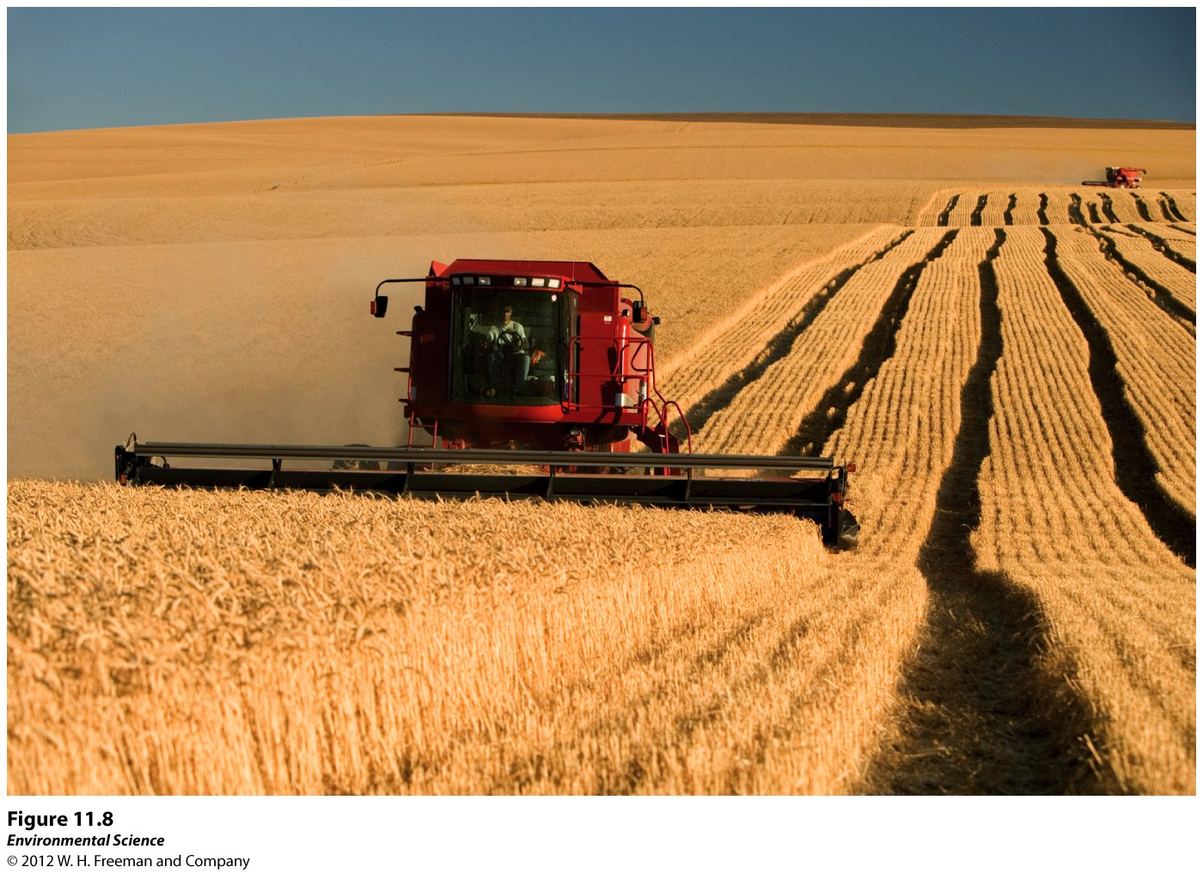

Slide 25
Disadvantages
Soil erosion.
Crops are more vulnerable to pests.
Removes habitat for predators that otherwise control pest populatiom.

Slide 26
Pesticides: Substances either natural or synthetic that kill or control organisms that people consider pests.
Insecticides: target species of insects and other invertebrates that consume plants.
Herbicides: target plant species that compete with crops.
Application is rapid and easy to apply.

Slide 27
Disadvantages
Persistent: they remain in the environment for a long time.
Bioaccumulation: build up over time in the fatty tissues of predators.
Non-persistent: break down relatively rapidly. Usually have to be applied more often.
Pests can build up a resistance.

Slide 28
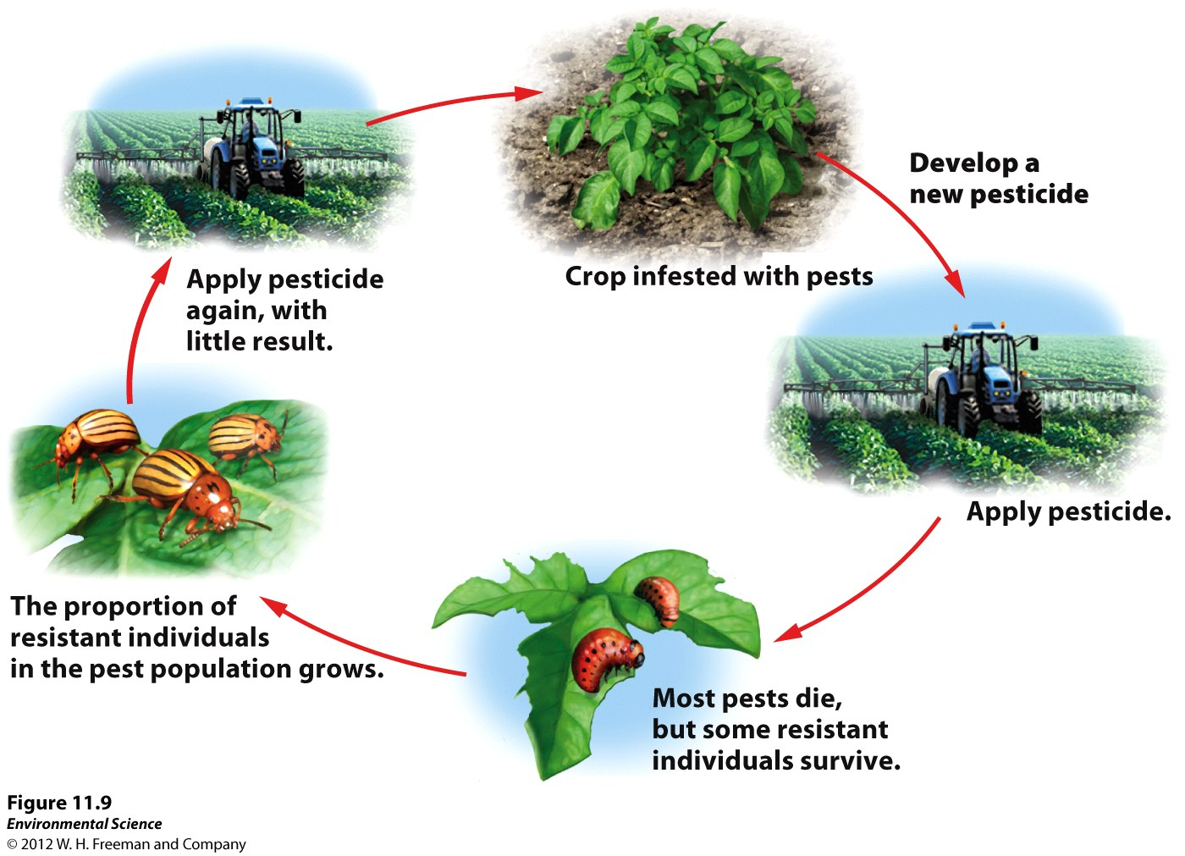

Slide 29
Genetic Engineering
Benefits:
Increased Crop Yield and Quality: Can create resistances (drought, pesticide)
Potential Changes in Pesticide Use: Round-up ready, Bt gene (natural insecticide).
Increased Profits: Can reduce expenses.

Slide 30
GMO Concerns
In 2009 63% of corn, 91% of soybeans, and 71% of cotton was from genetically modified seeds.
Safety for Human Consumption: Allergies?!
Effects on Biodiversity: GMOs may breed with wild relatives. May reduce biodiversity.
Regulation: Currently none.

Slide 31
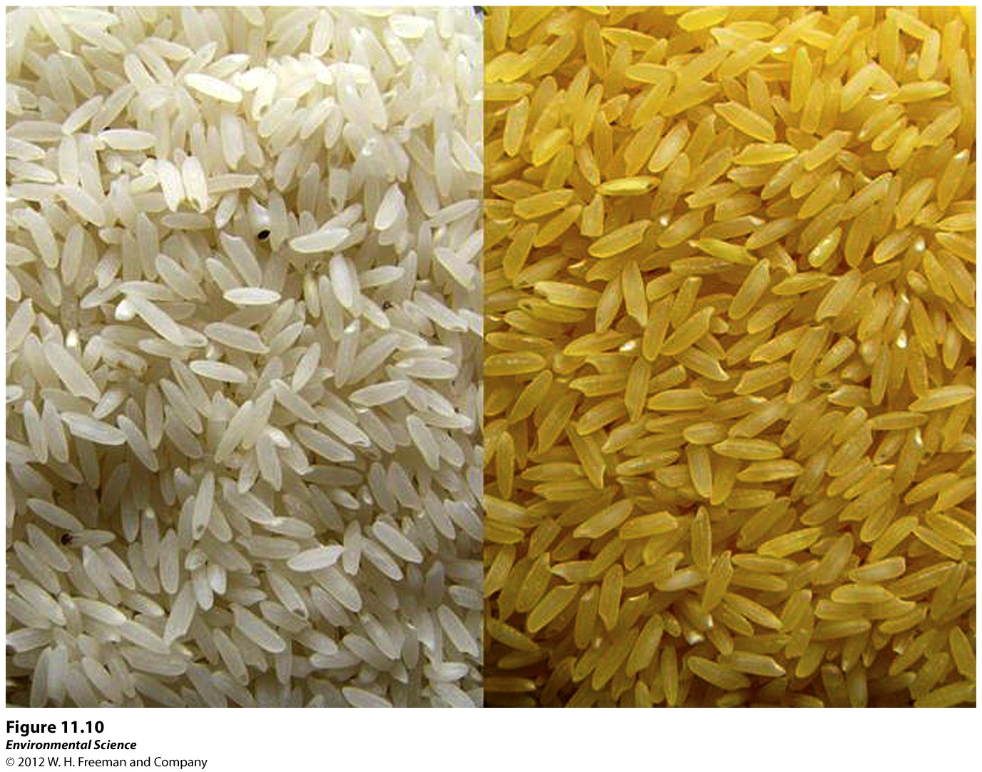

Slide 32
Alternatives to Industrial Farming
Conventional Agriculture: industrial agriculture.
Shifting Agriculture: clearing land, using it for a few years until the soil is depleted of nutrients. Then leaving it to replenish.
Desertification: Overuse of soil, salinization occurs and topsoil eroded away ultimately producing a desert.

Slide 33
Nomadic Grazing: used for soil types with low productivity. Moving herds of animals, often over long distances, to seasonally productive feeding grounds.

Slide 34
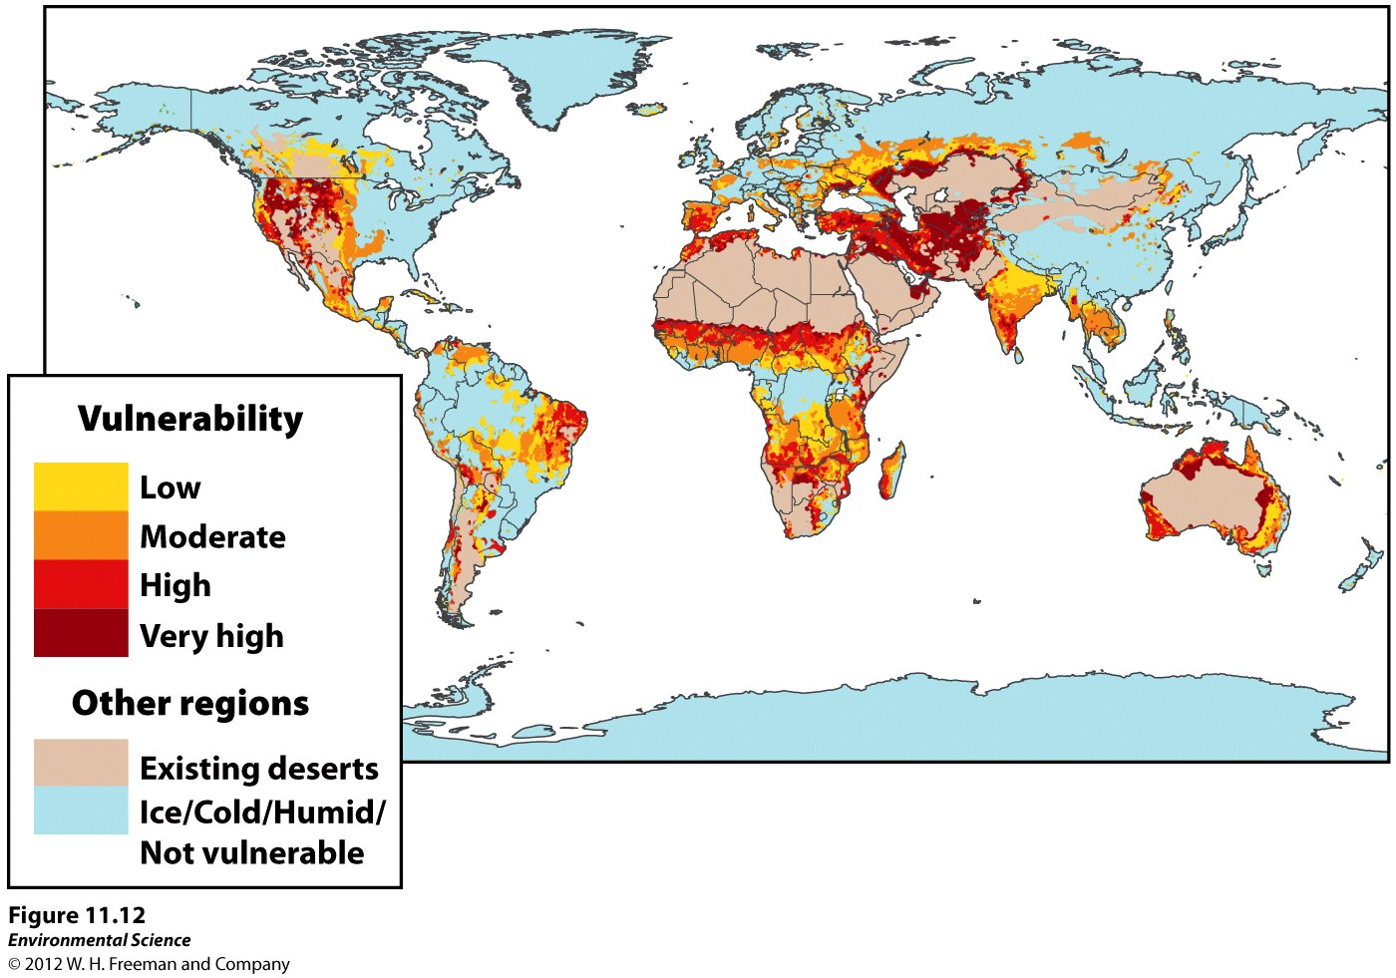

Slide 35
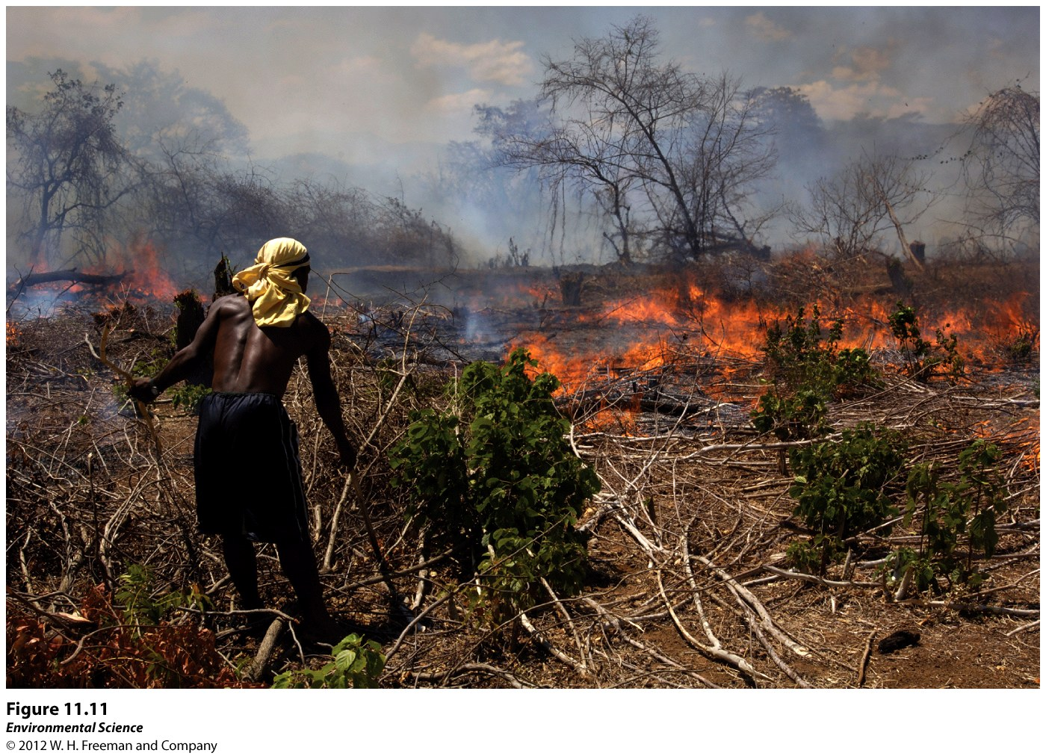

Slide 36
Sustainable Agriculture
Fulfills the need for food and fiber while enhancing the quality of the soil, minimizing the use on non-renewable resources, and allowing economic viability for the farmer.
Intercropping: two or more crop species are planted in the same field at the same time to promote a synergistic interaction between them.
Example: corn with peas(fixes nitrogen)

Slide 37
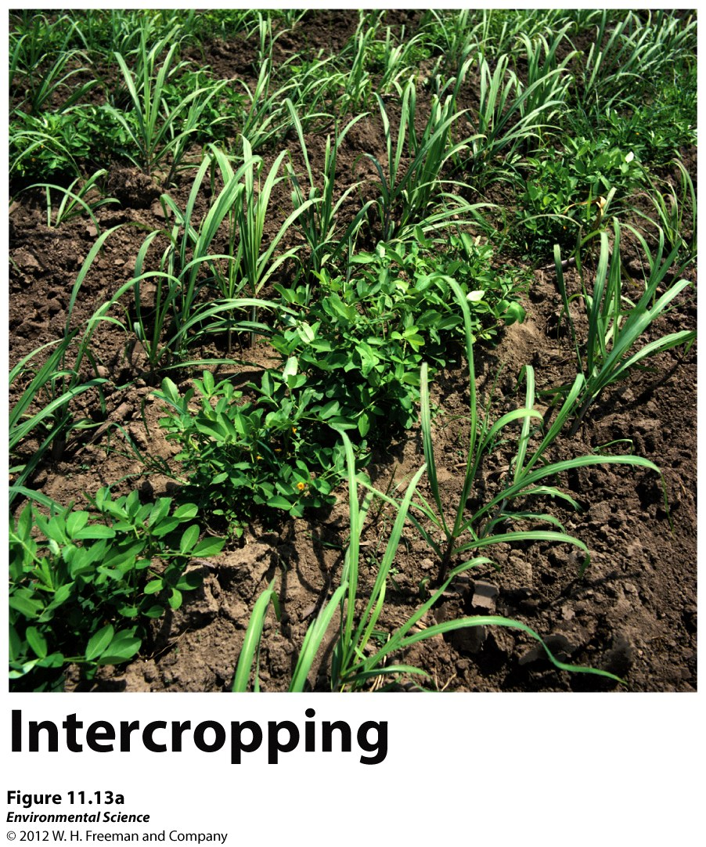

Slide 38
Crop Rotation: rotating the crop species in a field from season to season.
Agroforestry: Intercropping trees with vegetables. Prevents erosion by protecting. Alos has the benefits of the trees themselves.
Contour Plowing: Plowing and harvesting parallel to the topographic contours of the land. Prevents erosion.

Slide 39
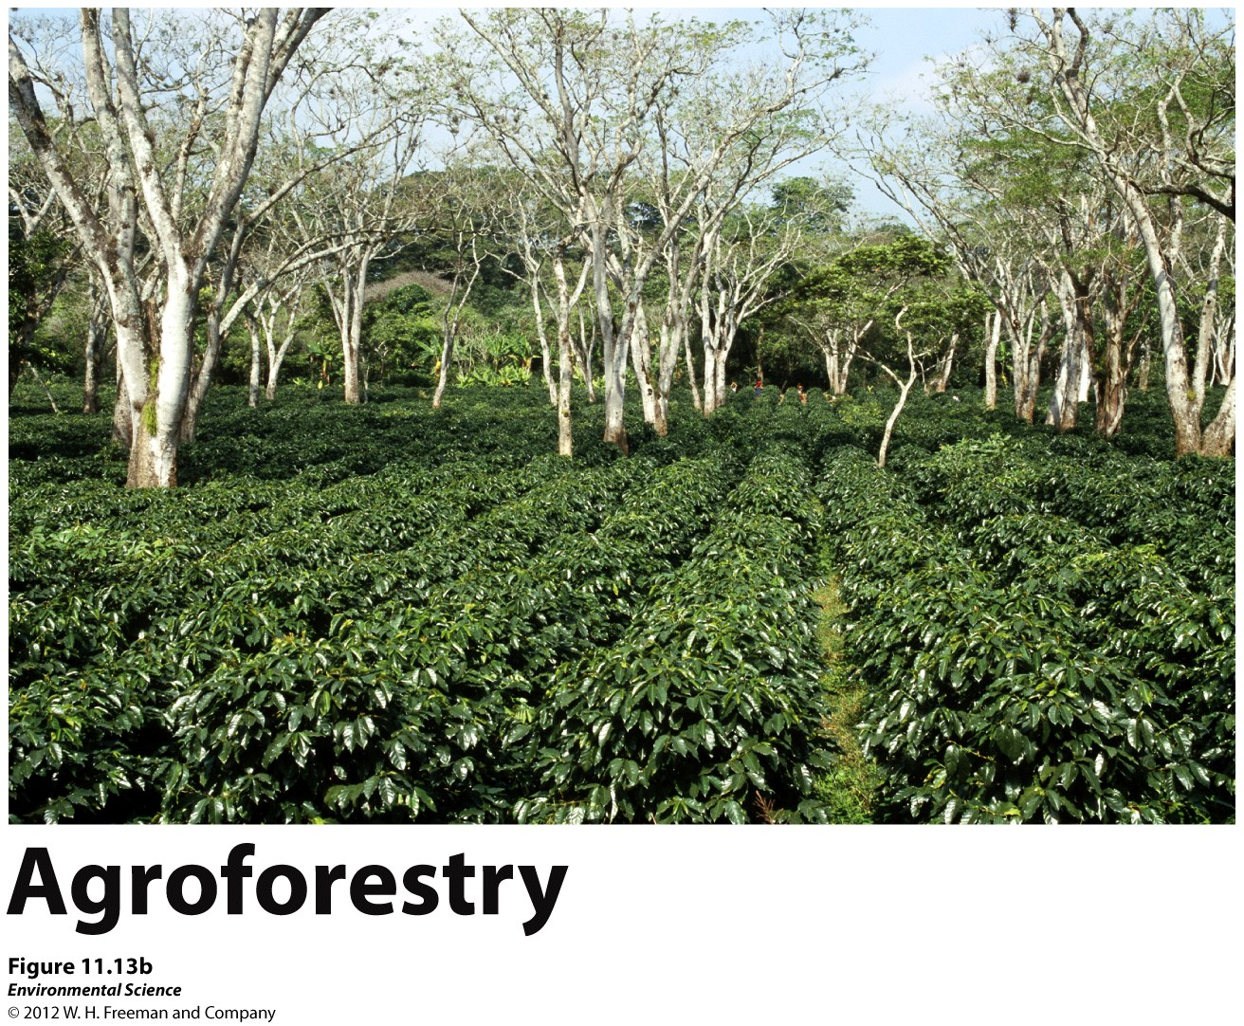

Slide 40
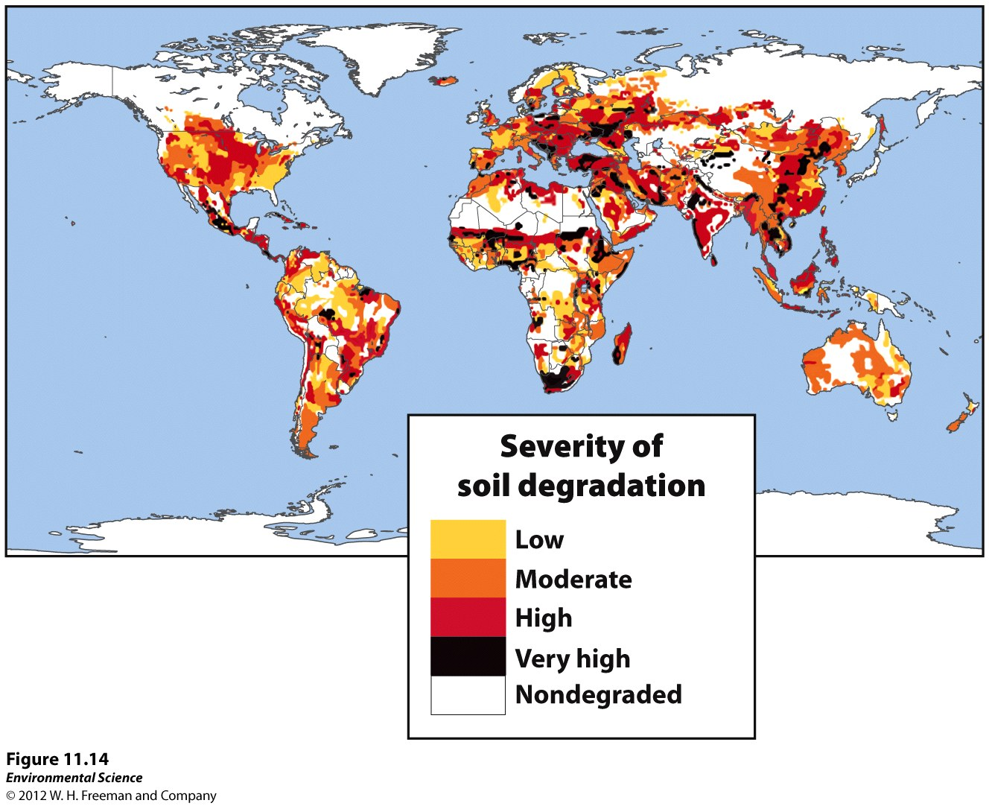

Slide 41
No-Till Agriculture
Tilling the land leads to erosion and oxidation.
No Till is designed to avoid the soil degradation that comes with tradition agriculture.
Leave the plants to decay. Reduces carbon dioxide emissions.
Pesticides must be used.

Slide 42
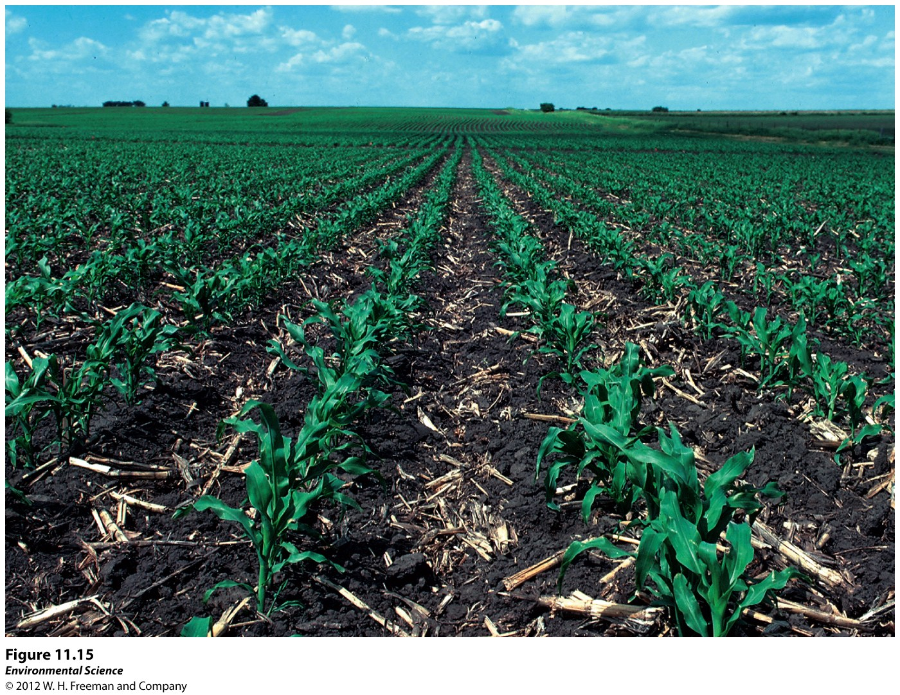

Slide 43
Integrated Pest Management
IPM: Purpose is to minimize pesticide inputs.
Crop rotation
Intercropping
Pest-resistant crop varieties
Habitats for predators of pests
Limited use of pesticides
Careful watch from the farmers

Slide 44
Crop Rotation/Pest Resistance: prevent pest infestations.
Crop Rotation can foil insect pests that are specific to one crop that have may laid eggs in the soil.
Intercropping: hard for insects to establish on only one crop.
Agroforestry: encourages the presence of birds.

Slide 45
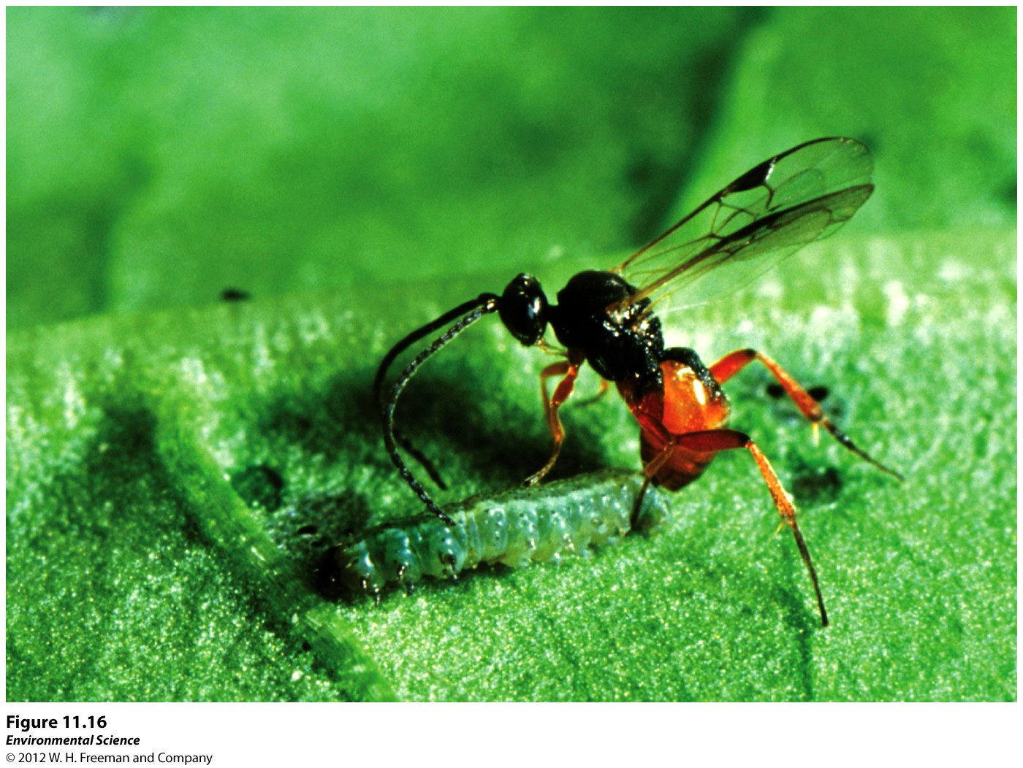

Slide 46
Organic Agriculture
The production of crops without the use of synthetic pesticides or fertilizers.
Basic Principals:
Use of ecological principles and work with natural systems rather than dominating them.
Keep as much organic matter and as many nutrients in the soil and on the farm as possible.

Slide 47
Avoid the use of synthetic fertilizers and pesticides.
Maintain the soil by increasing soil mass, biological activity, and beneficial chemical properties.
Reduce the adverse environmental effects of agriculture.
Disadvantages:
Expensive
Other methods are used (propane flamer)!
Less likely to use no-till methods.

Slide 48
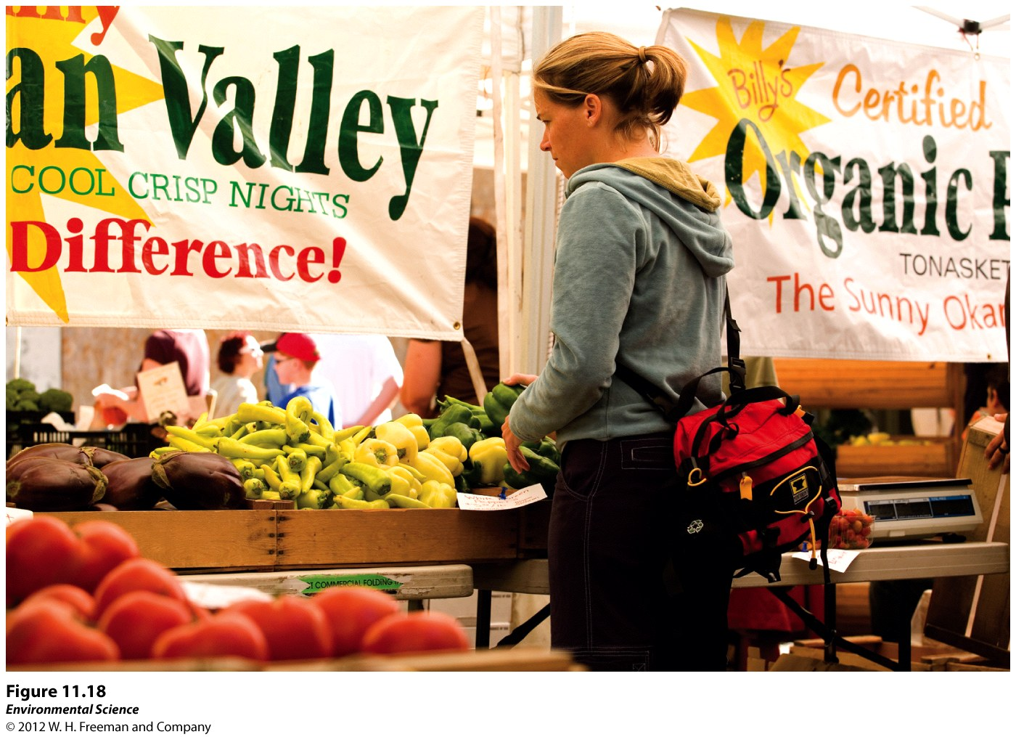

Slide 49
Modern Agribusiness: Meat and Fish Farming
High Density Animal Farming
Feedlots, Concentrated Animal Feeding Operations(CAFO): large structures designed for maximum output.
Pack them in! Give antibiotics and nutrient supplements to prevent illness. Up to 2500 hogs or 50,000 turkeys in one building!

Slide 50
Disadvantages:
Antibiotics are contributing to antibiotic resistant bacteria.
Waste disposal. Lots of manure causes pollution in nearby lakes and streams(causes algal blooms).

Slide 51
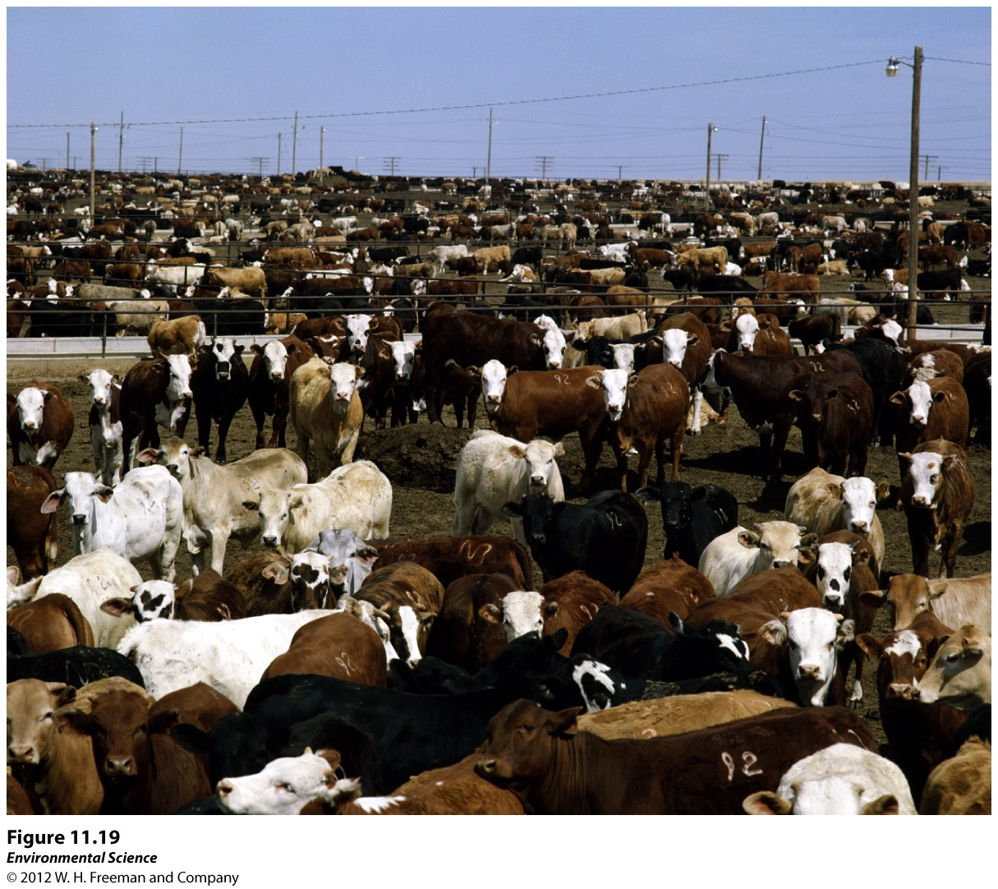

Slide 52
More Sustainable Animal Farming
Free range(wander around) chicken and beef!
Less likely to spread disease.
Less fossil fuels used (no supplemental feeding).
Waste is taken care of naturally.
Uses more land, more expensive!

Slide 53
Harvesting Fish and Shellfish
Since 1980 there has been a rapid increase in farmed fish production and a decrease in wild fish caught in the world’s oceans.
Fishery: commercially harvestable population of fish within a particular ecological region.
Tragedy of the Commons!

Slide 54
In 2006 it was determined that 30% of fisheries worldwide had experienced a 90% decline in fish populations.
More than 90% decline is called a fishery collapse.

Slide 55
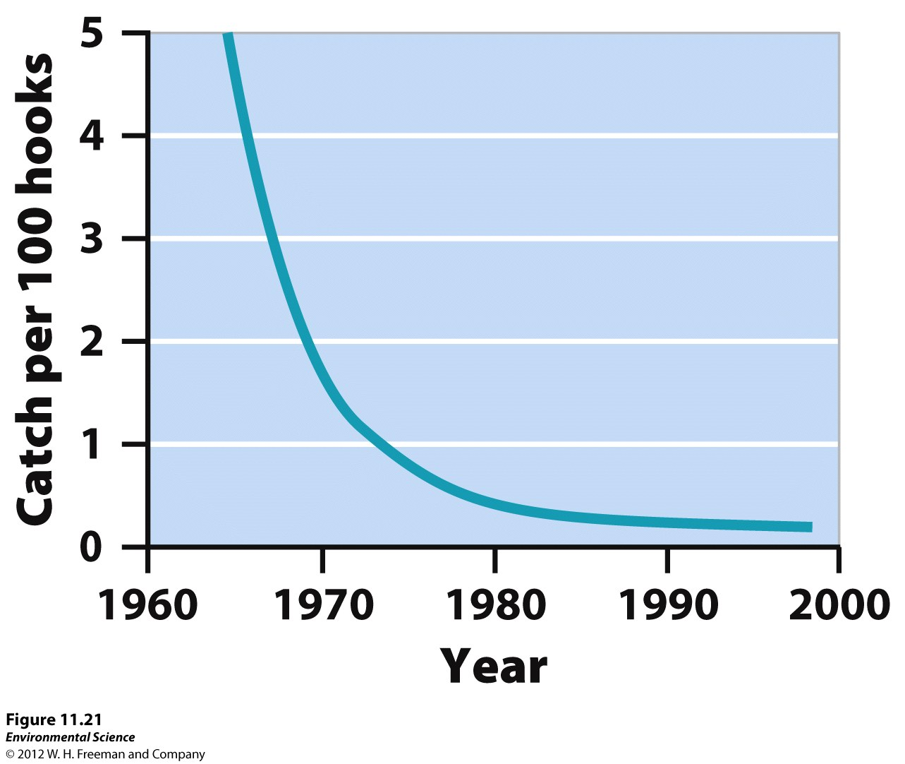

Slide 56
Fishing Methods
Boats can stay out to sea for months freezing what they have caught.
Using large nets pulled behind ships with 1000s of baited hooks.
Spotter planes and sonar is utilized for tuna.
“Purse-seine” nets can capture up to 3,000 adult tuna at a time (million lbs)!!
Dragnets are used for bottom feeders.

Slide 57
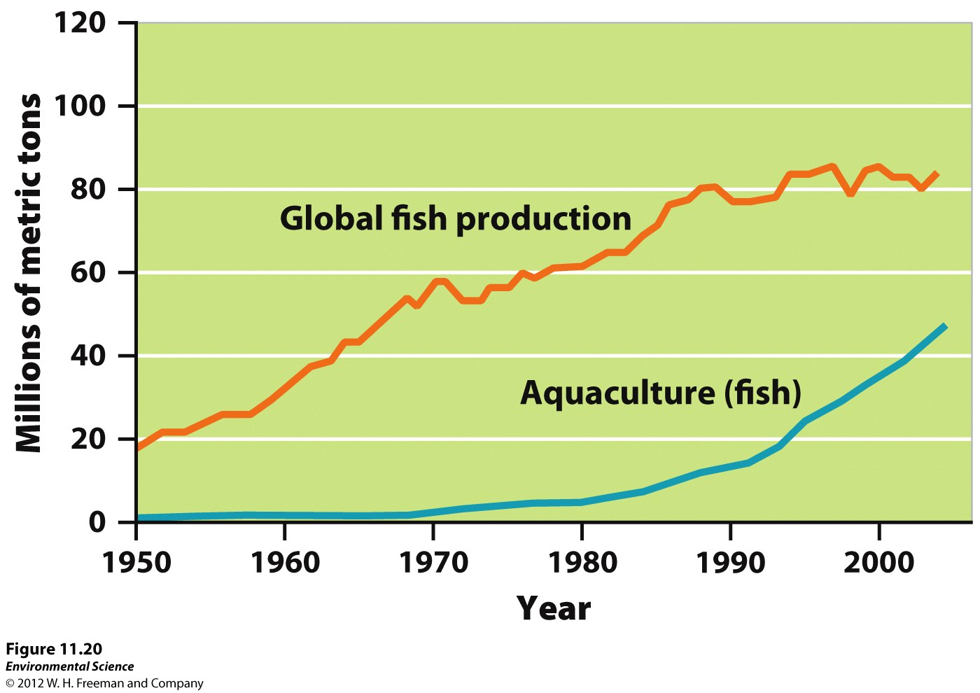

Slide 58
Harmful : (
Dragnets can damage ocean bottom habitats by ruining coral, sponges and plants.
Many commercially important fish are keystone species so a decline or loss of their populations can have cascading effects on other species.
Loss of juvenile fish.
Bycatch: reduces populations of species that may be endangered.

Slide 59
Sustainable Fishing
Fishery collapse in the Northwest Atlantic in 1990s.
Sustainable Fisheries Act 1996: Called for the protection of critical marine habitats.

Slide 60
Alaska and Salmon
Rapid decline in salmon between 1940-1970.
Limited the fishing season but numbers still were declining.
1973 Individual Transferable Quotas (ITQs) were implemented.
Includes a catch and distribute/sell quota.
Gives preferences to locals and companies that have a historical tie to the areas.

Slide 61
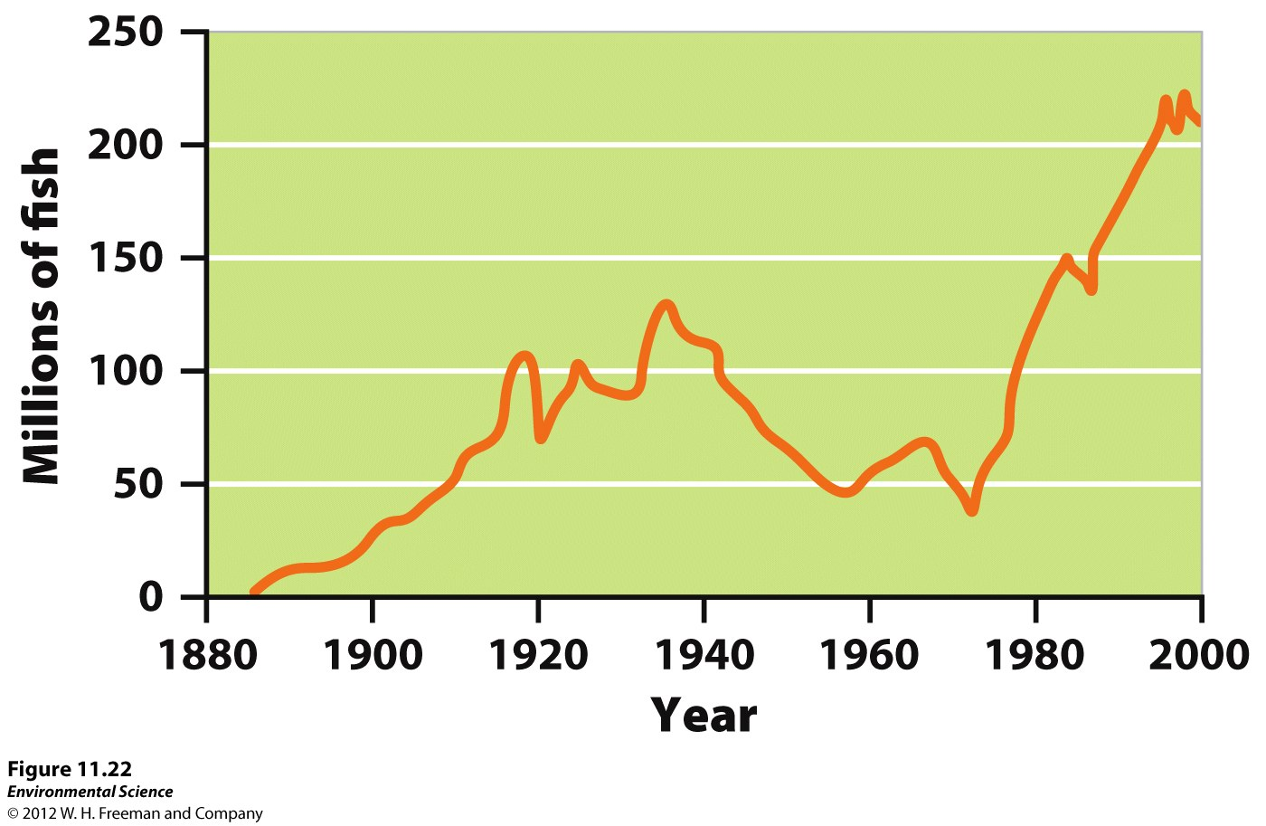

Slide 62
Aquaculture
The farming of aquatic organisms (fish, shellfish, and seaweeds).
Constructing an aquatic ecosystem by stocking the organisms, feeding them, and protecting them from disease and predators.
Usually keep the organisms enclosed.
Almost all the catfish and trout, half of the shrimp and salmon are produced by aquaculture.

Slide 63
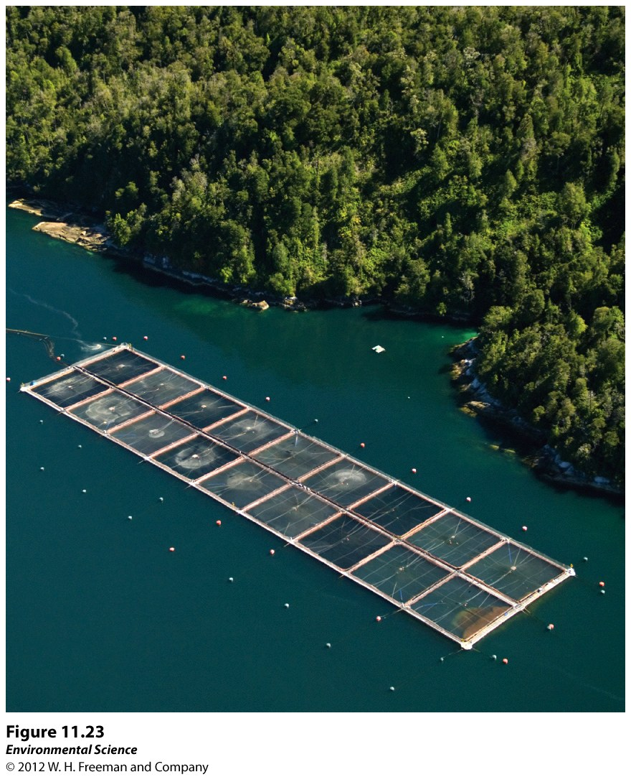

Slide 64
Good!
Alleviate some of the human caused pressures on overexploited fisheries while producing much needed protein for 1 billion undernourished.
Boost economies!

Slide 65
Bad!
Create environmental problems.
Waste water with unwanted food, antibiotics, waste is pumped back into the environment.
May contain bacteria, viruses, and pests.
Escaped fish may harm wild fish populations by competing with them, interbreed with them or spread diseases and parasites.

