Slide 1
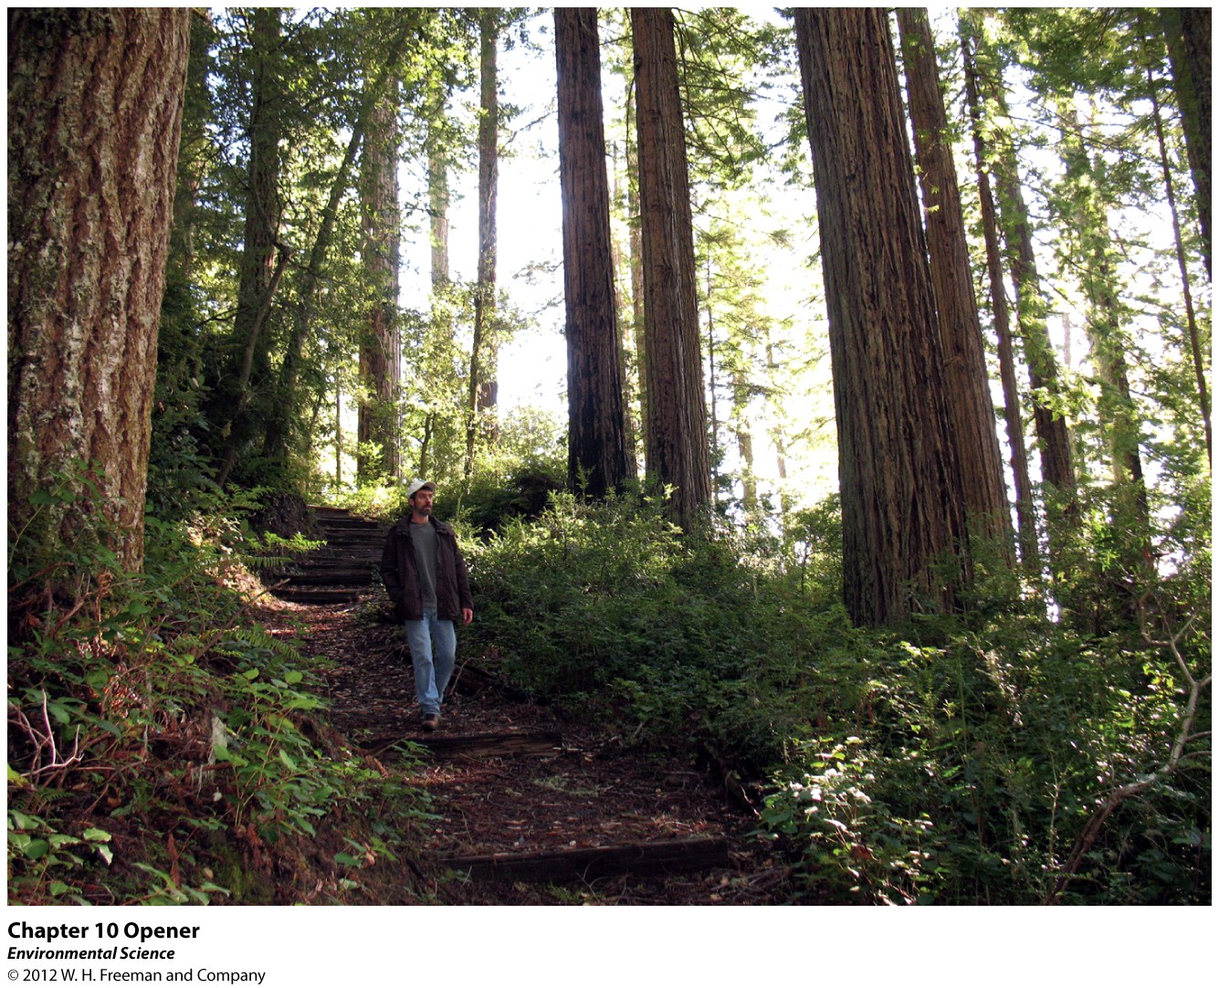
Chapter 10
Land, Public and Private

Slide 2
Who Owns a Tree? Julia Butterfly Hill Vs. Maxxam
Pacific Lumber would sustainably log areas in Northern California.
Maxxam bought out Pacific Lumber and clear cut large areas.
Led to high amounts of erosion and cutting of ancient trees.
Julia participated in a “tree sit” for 2 years.
The tree was preserved and the area was re-sold to the US government.

Slide 3
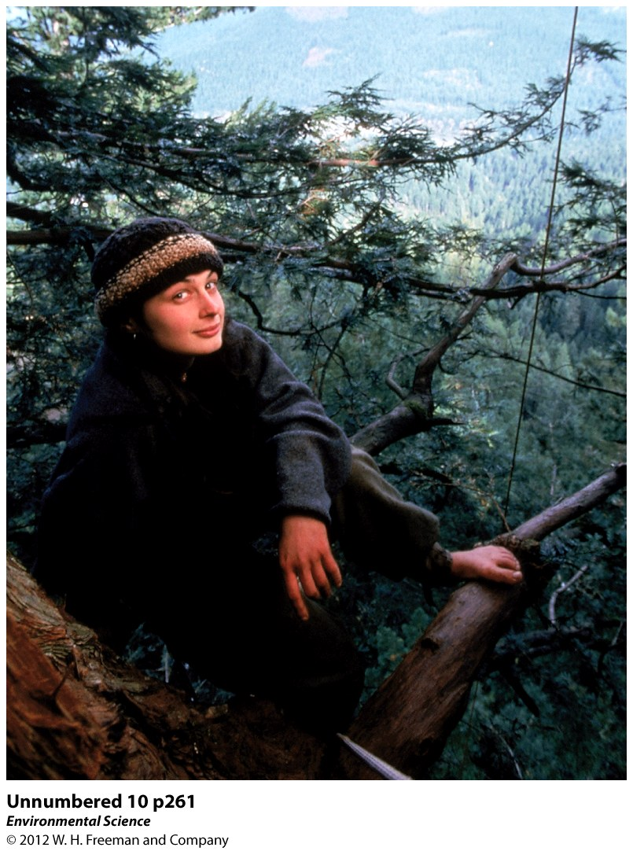

Slide 4
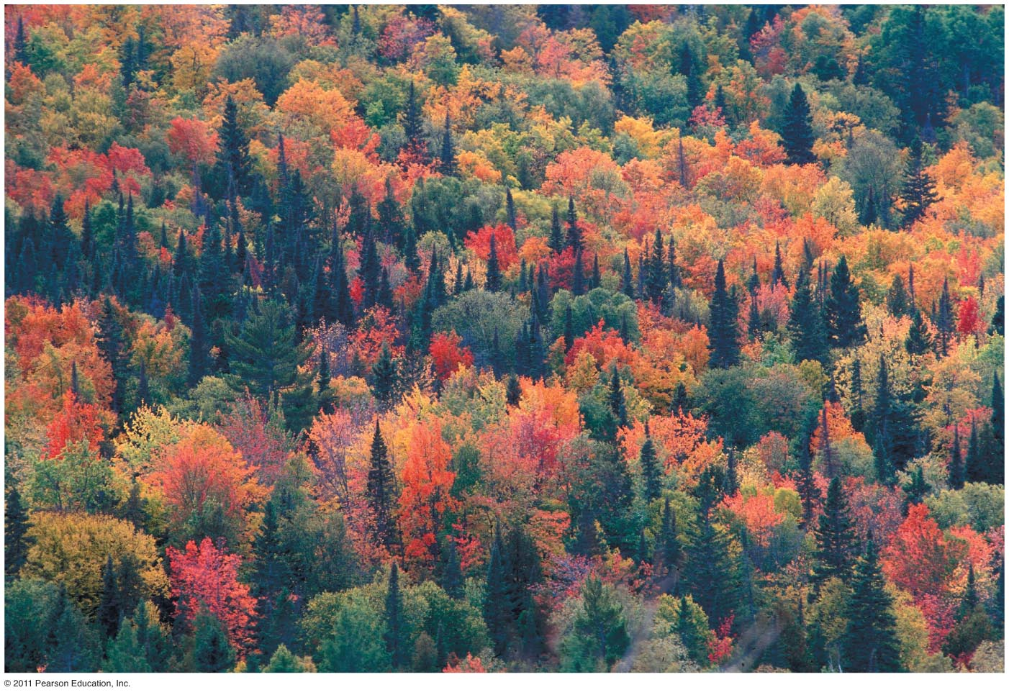
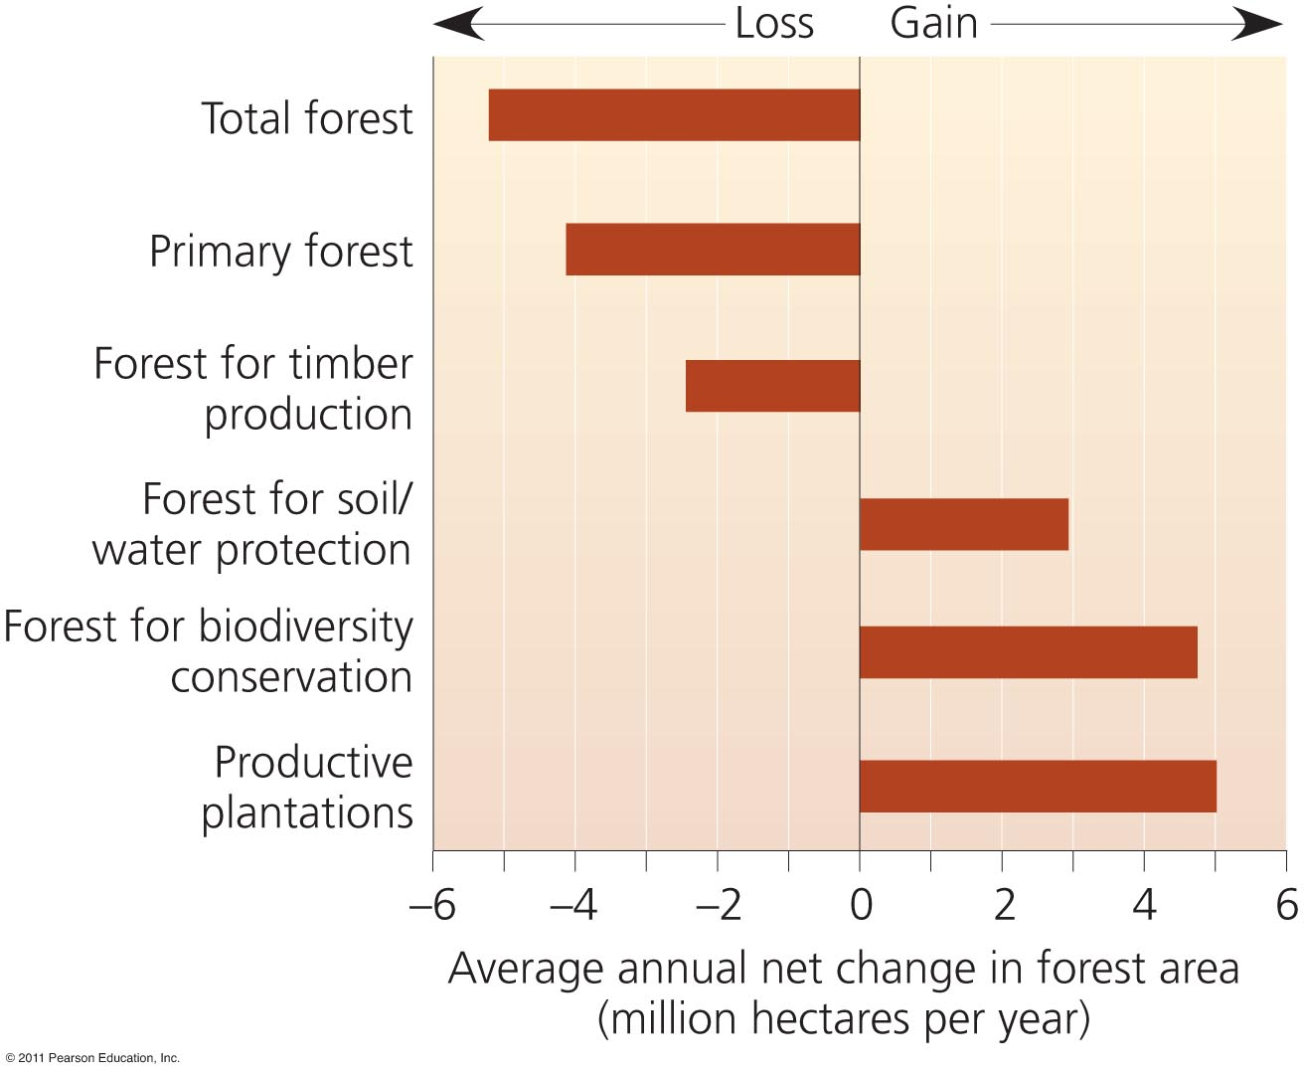
Overview:
Ecological and economic contributions of forests
History and scale of deforestation
Forest management and harvest methods
Fire’s ecological role & human fire policy
National parks and protected areas

Slide 5
Many kinds of forests exist
Forest = any ecosystem with a high density of trees
Boreal forest = in Canada, Scandinavia, and Russia
Tropical rainforest = South and Central America, Africa, Indonesia, and southeast Asia
Temperate deciduous forests, temperate rainforests, and tropical dry forests also exist
Woodlands = ecosystems with lower density of trees
Plant communities differ due to soil and climate
Forest types = subdivided by predominant tree species

Slide 6
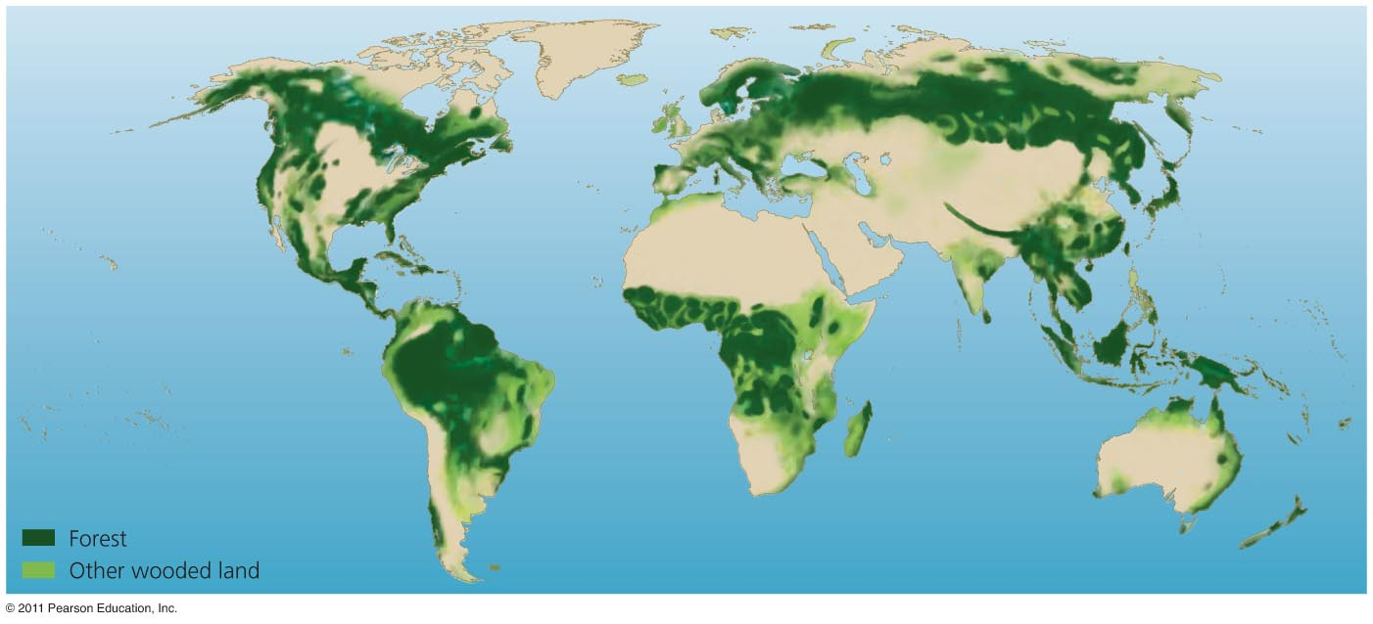
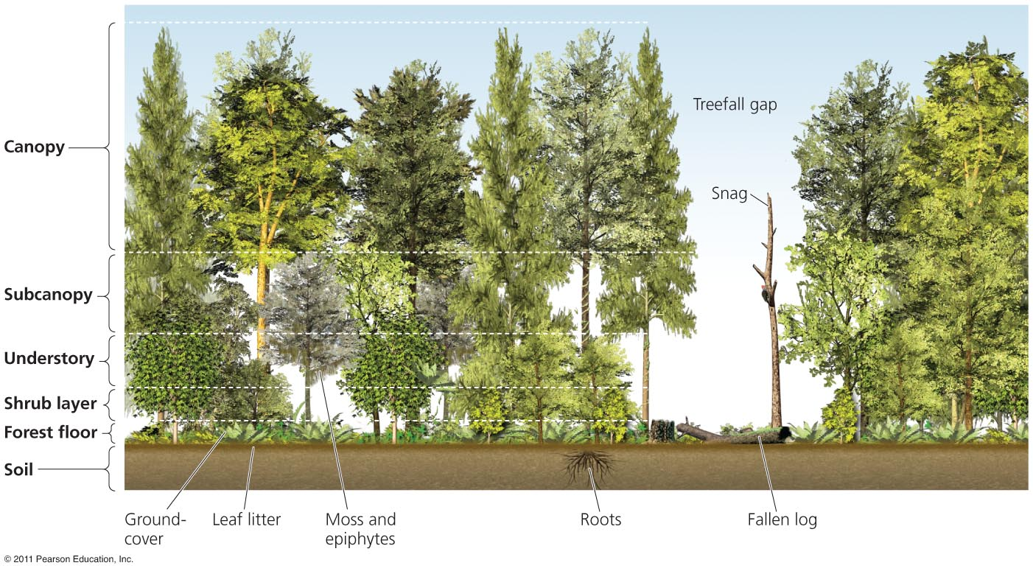
-Forests provide rich variety of ecological habitats & niches (snags, floor, canopy, etc)
-Forests cover 31% of Earth’s surface

Slide 7
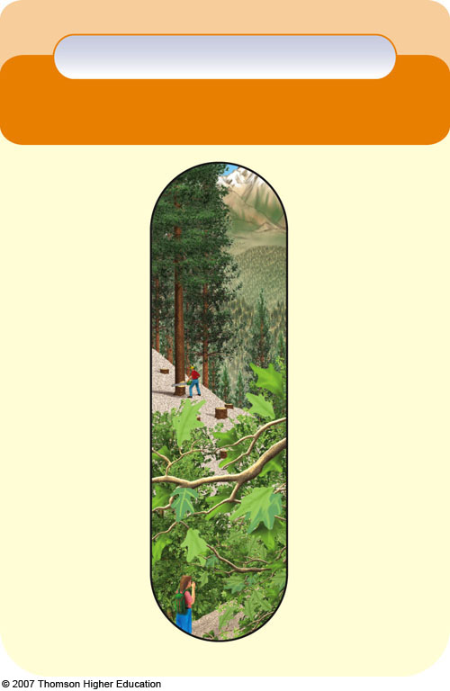
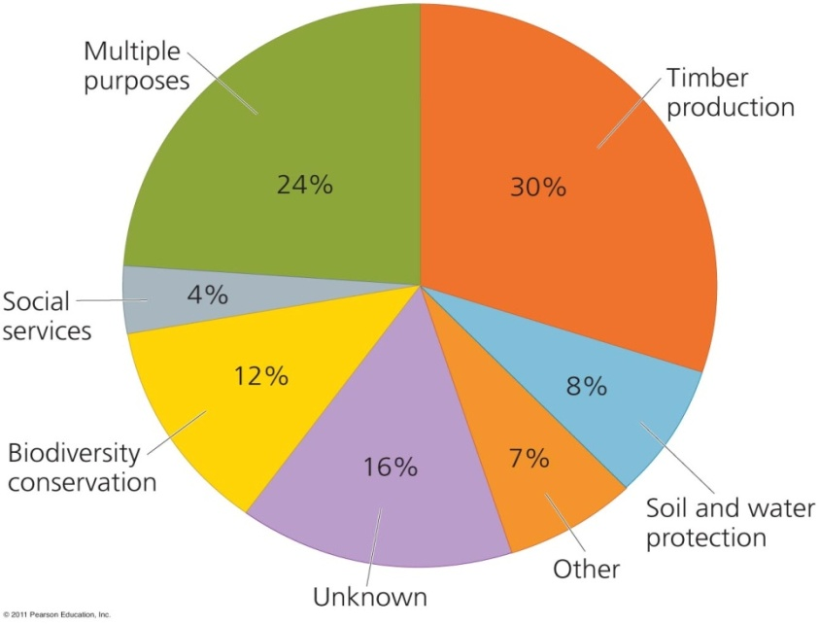
Natural Capital
Logging locations:
Boreal forests: Canada, Russia
Rainforests: Brazil, Indonesia, Congo
Conifer forests & Pine plantations: U.S.A.
Current US Forest Usage:
Forests
Ecological
Services
Economic
Services
Support energy flow and chemical cycling
Reduce soil erosion
Absorb and release water
Purify water and air
Influence local and regional climate
Store atmospheric carbon
Provide numerous wildlife habitats
Fuelwood
Lumber & Paper
Medicines & Food
Recreation
Jobs
Convert to:
-Farming
-Livestock
-Mining
-Industry
-Settlement
Notes:
Figure 10.4
Natural capital: major ecological and economic services provided by forests. QUESTION: Which two ecological services and which two economic services do you think are the most important?

Slide 8
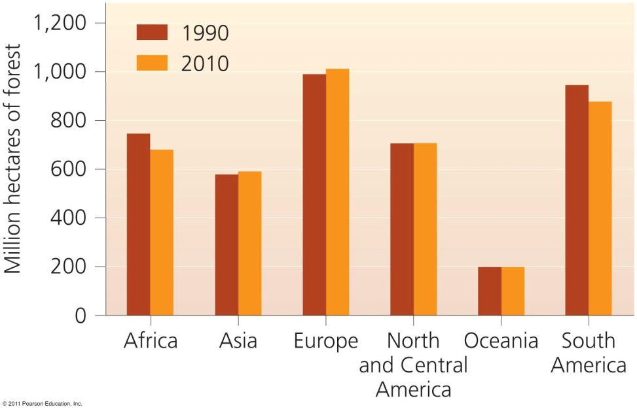
Demand for wood leads to deforestation
Natural Capital Degradation
Deforestation’s Effects:
• Decreased soil fertility from erosion
• Runoff of eroded soil into aquatic systems
• Loss of biodiversity in habitats, niches & species
• Regional climate change from extensive clearing
• Release of CO₂ (& loss of carbon storage)
• Acceleration of flooding (less rain capture)
Disruption to ecosystem services/resources
Notes:
Figure 10.7
Natural capital degradation: harmful environmental effects of deforestation that can reduce biodiversity and the ecological services provided by forests (Figure 10-4, left). QUESTION: What are the two direct and two indirect effects of your lifestyle on deforestation?

Slide 9
Human Land Use Affects the Environment
Agriculture
Housing
Recreation
Industry
Mining
Waste Disposal
Logging
Deforestation
Paving
Overuse of Land

Slide 10
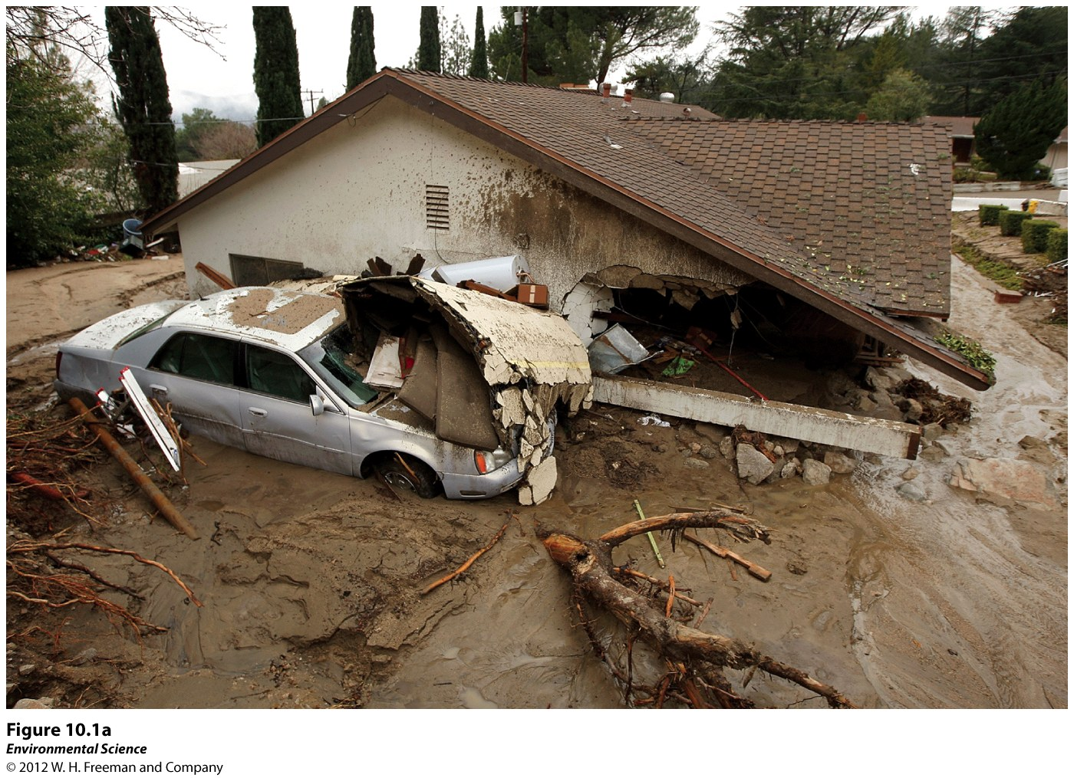

Slide 11
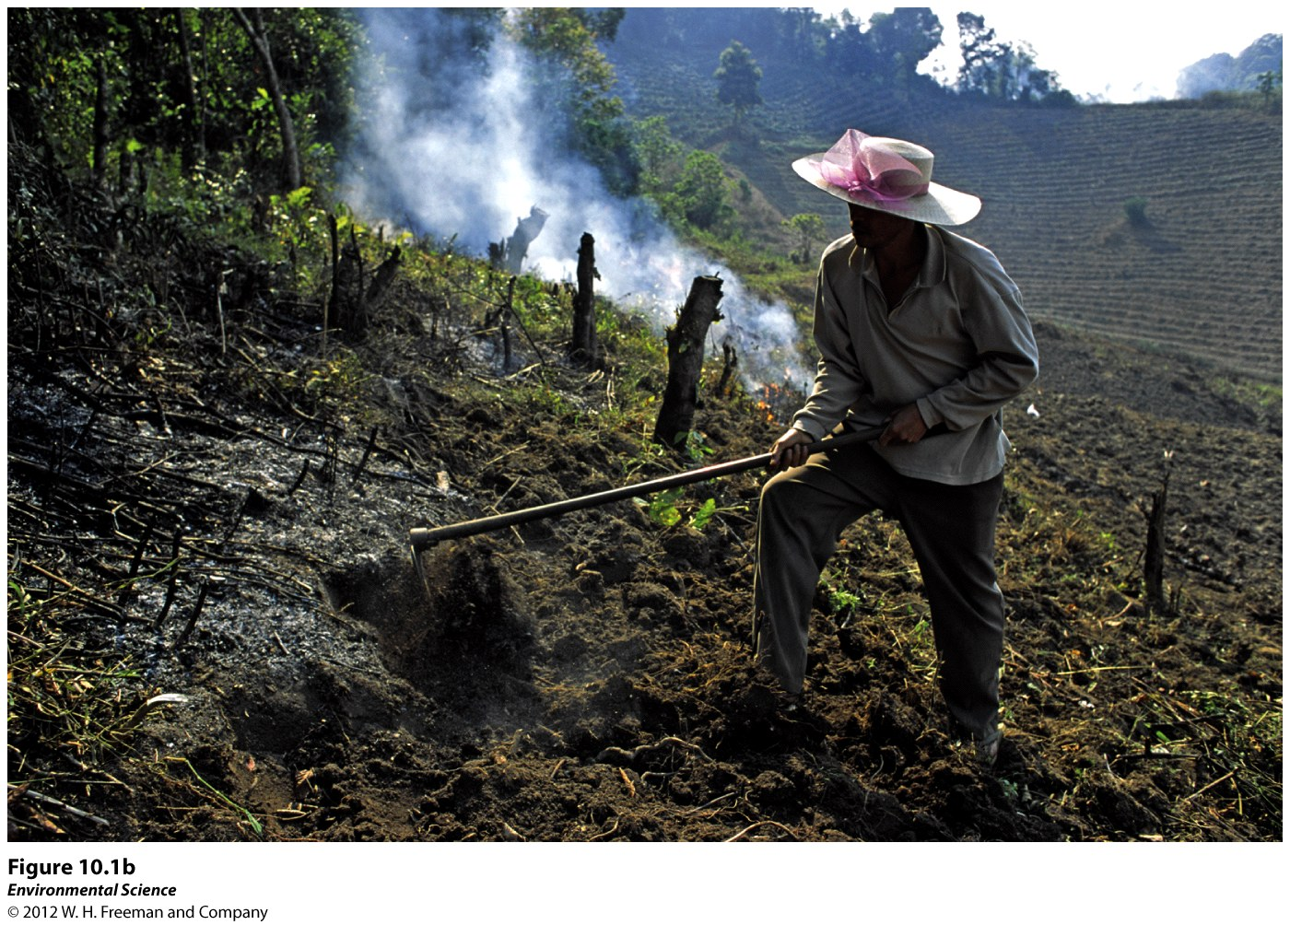

Slide 12
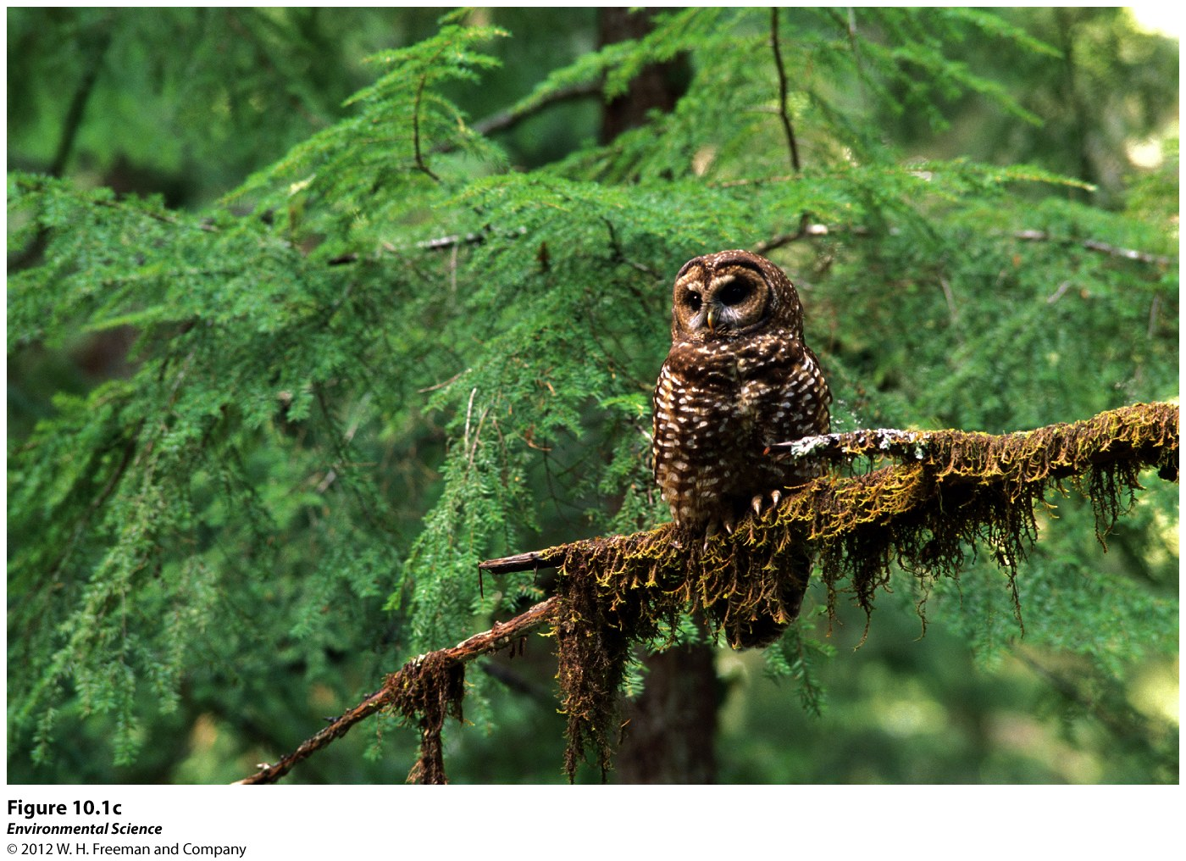

Slide 13
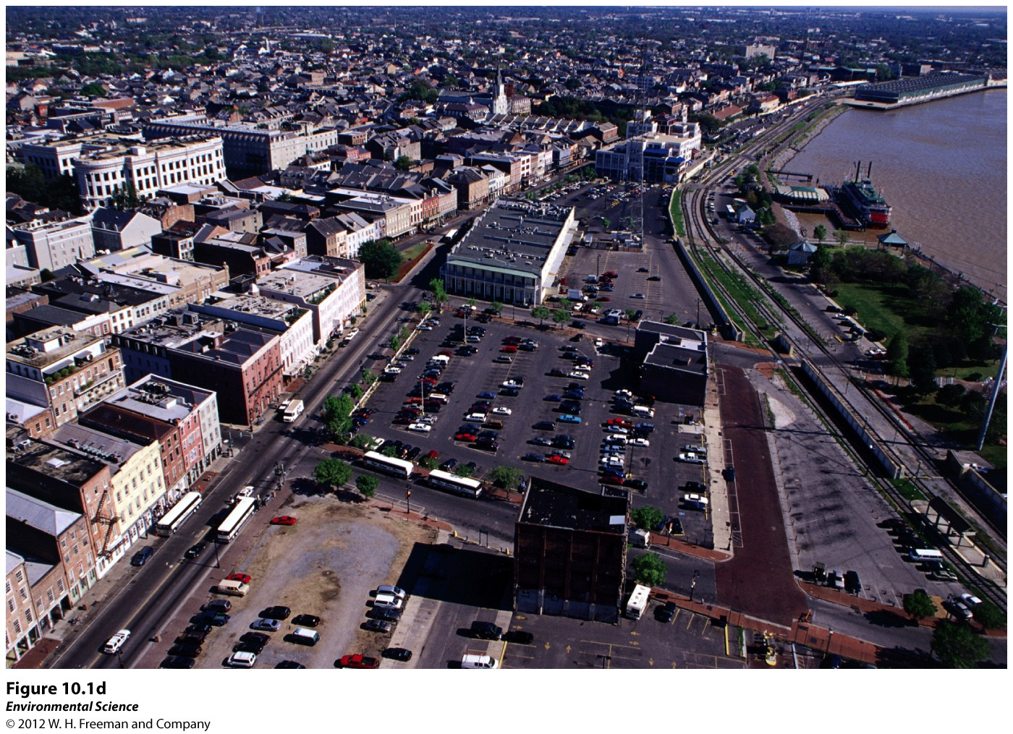

Slide 14
Tragedy of the Commons
Tendency of a shared, limited resource to become depleted because people act from self-interest for short term gain.
Water, air, and land could be considered “commons”.
Private ownership or regulation could solve the tragedy.

Slide 15
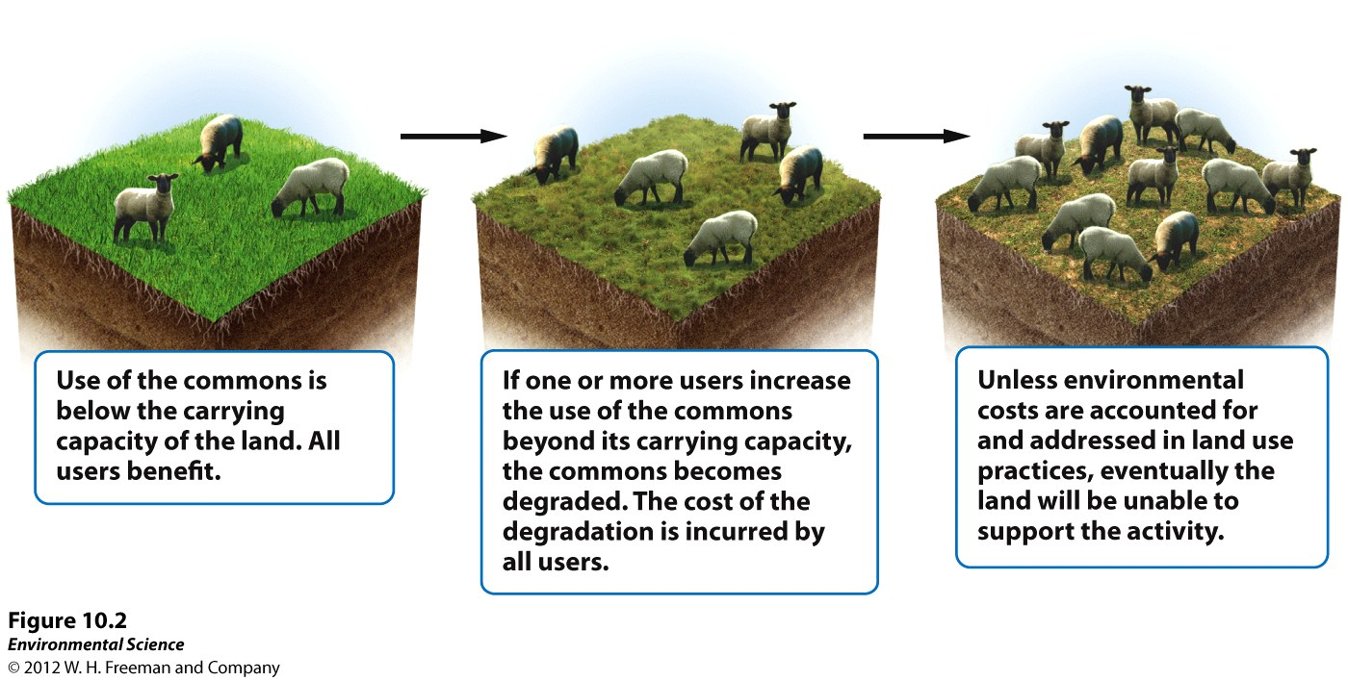

Slide 16
Externalities
The cost or benefit of a good or service that is not included in the purchase price of that good or service.

Slide 17
Maximum Sustainable Yield
The maximum amount that can be harvested without compromising the future availability of that resource.

Slide 18
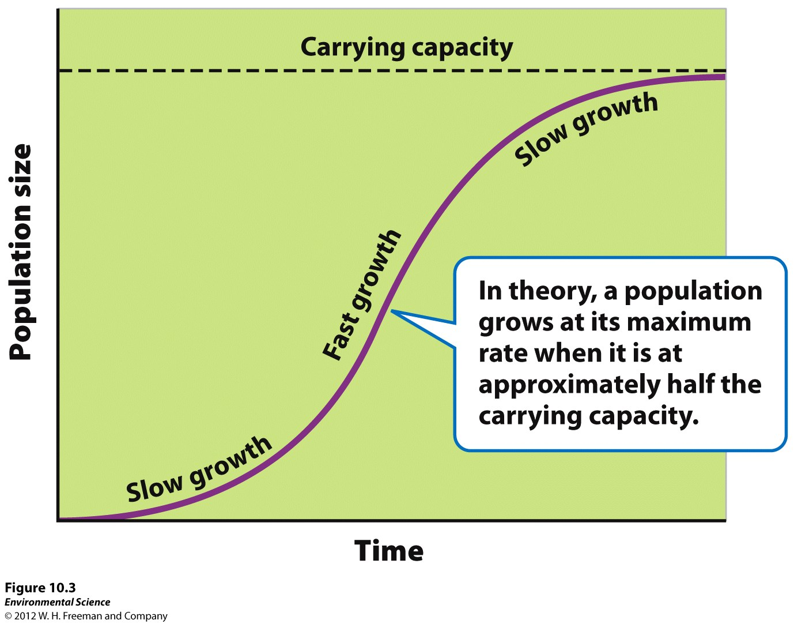

Slide 19
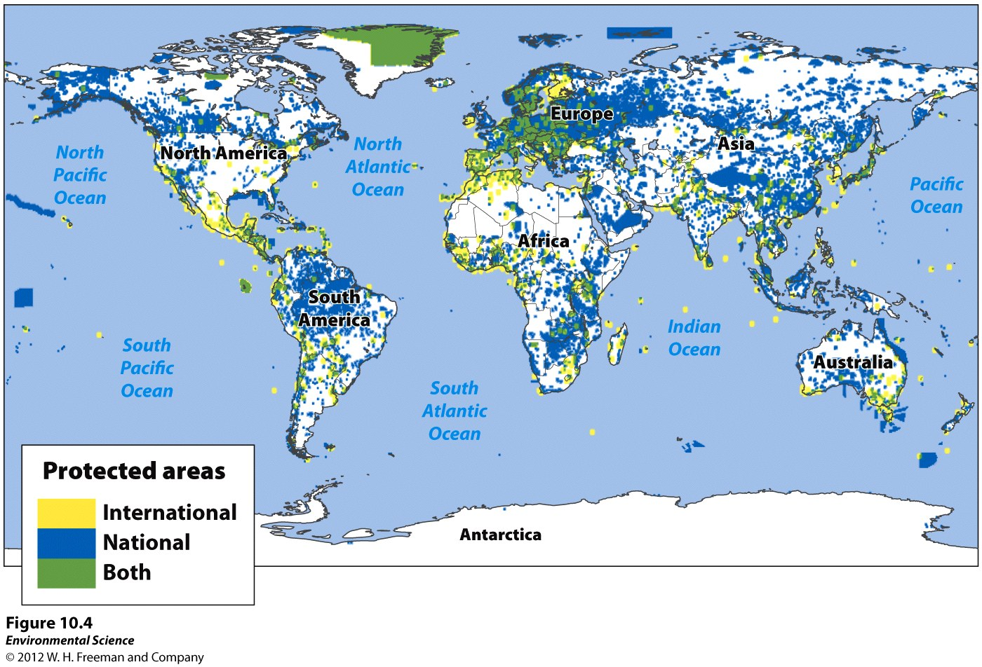
Public Lands are Classified According to Their Use
11% or 1/9 of the Earth’s land is protected in one way or another.

Slide 20
International Categories of Public Lands
National Parks
Managed Resource Protected Areas
Habitat/Species Management Areas
Strict Nature Reserves and Wilderness Areas
Protected Landscapes and Seascapes
National Monuments

Slide 21
Public Lands in the United States
42% of the land in the US is publically held.
Most of this land is found in the West and in Alaska.
Resource Conservation Ethic: people should maximize resource use based on the greatest good for everyone.

Slide 22
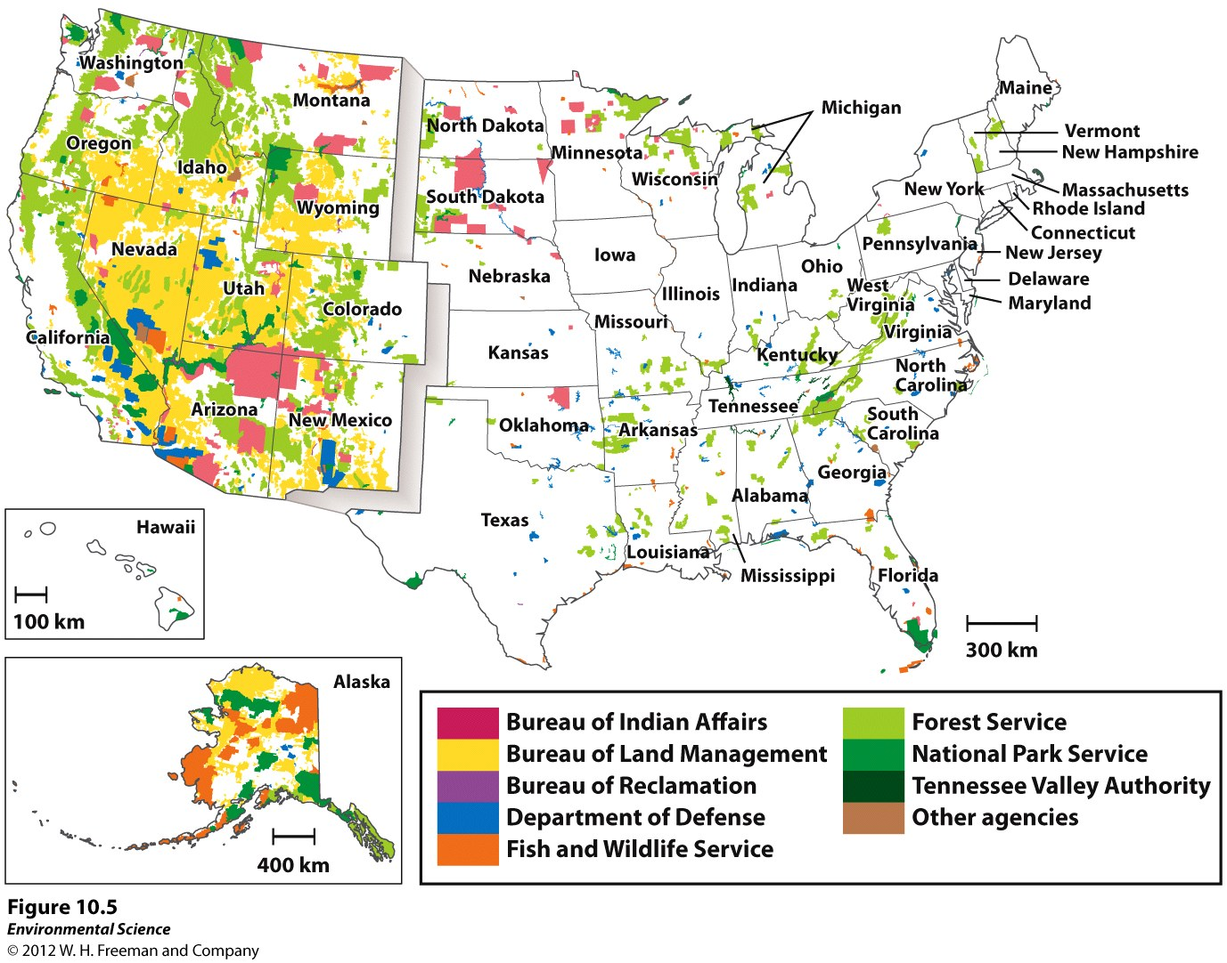

Slide 23
Land Use and Federal Agencies
Four Agencies:
The Bureau of Land Management (BLM)
The United States Forest Service (USFS)
The National Park Service (NPS)
The Fish and Wildlife Services (FWS)

Slide 24
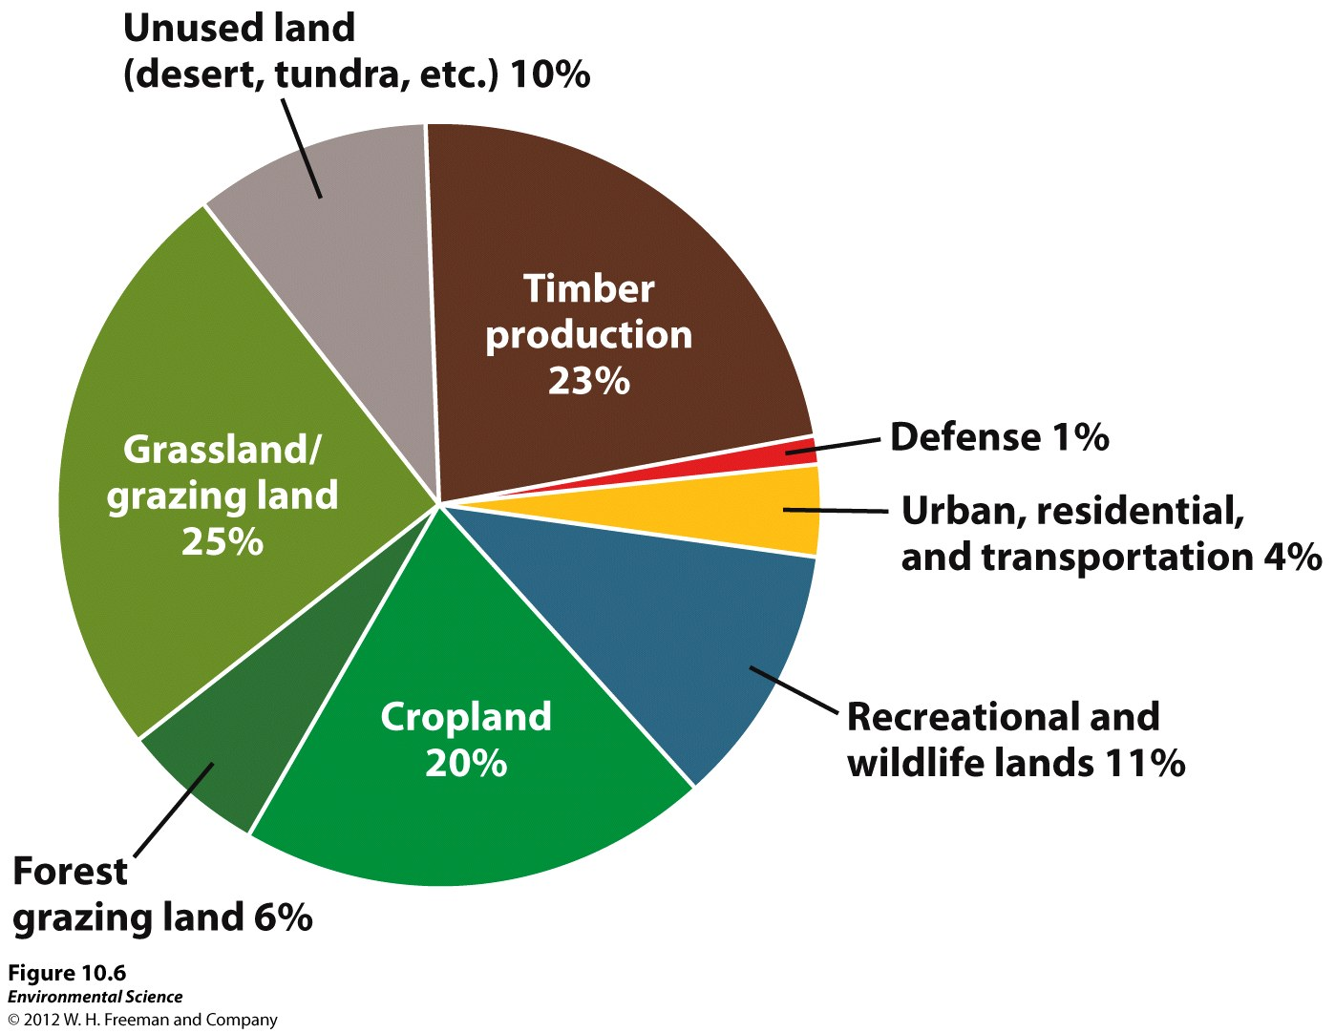

Slide 25
Typical Divisions of Public Land Uses
BLM lands: grazing, mining, timber harvesting, and recreation.
USFS lands: timber harvesting, grazing, and recreation.
NPS lands: recreation and conservation.
FWS lands: wildlife conservation, hunting, and recreation.

Slide 26
Land Management Practices
Rangelands
Dry, open, grasslands.
Used for cattle grazing.
Susceptible to fires and other environmental disturbances.
Taylor Grazing Act of 1934: passes to halt overgrazing.

Slide 27
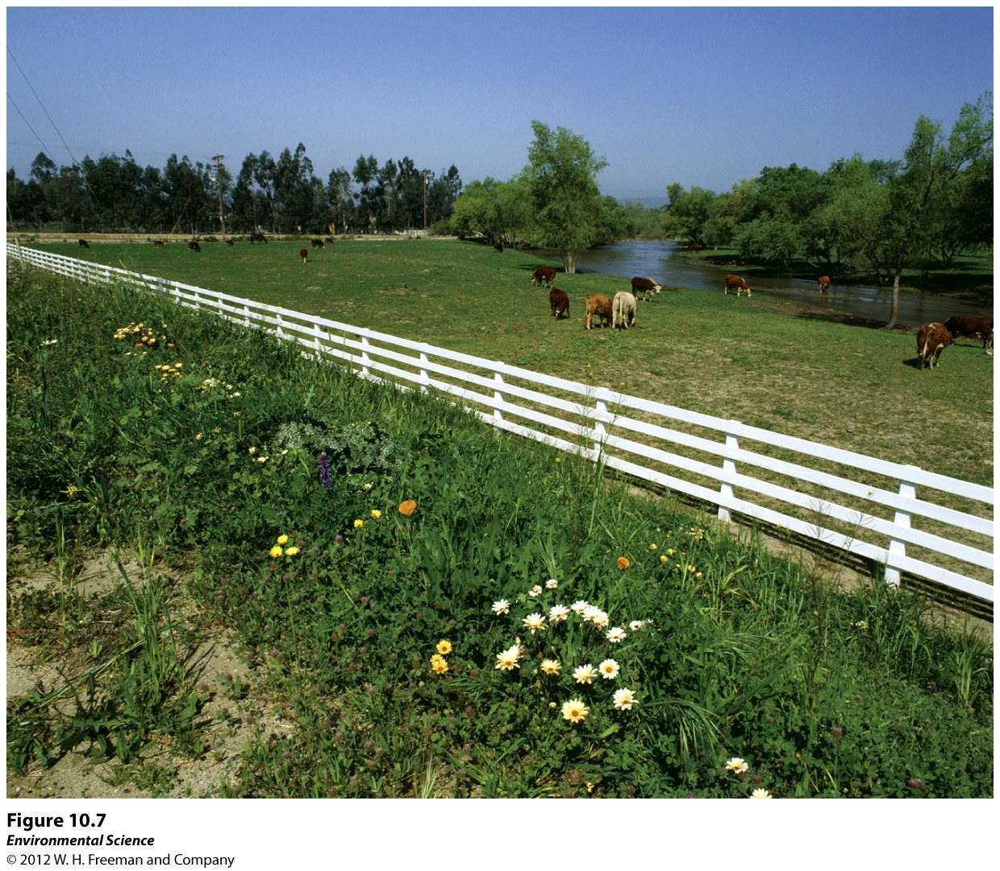

Slide 28
Forests
Dominated by tress and other woody vegetation.
73% of forests used for logging are privately owned.
Allowed to use federal lands for a royalty- a percentage of their revenues.

Slide 29
Harvesting Trees
Building roads into previously inaccessible forests paves the way for fragmentation, destruction, and degradation.
Figure 10-8

Slide 30
Timber Harvest Practices
Clear Cutting: removing all of the trees within an area.
Advantages:
All resulting trees (newly planted) are the same age.
A lot of direct sunlight for newly growing trees.

Slide 31
Disadvantages
Increases wind and water erosion.
Sediments get deposited to nearby streams.
Slopes subject to mudslides.
Increased sunlight to streams increases water temperatures and effects aquatic life.
Herbicides and fire used to clear out underbrush which effects natural habitats.

Slide 32
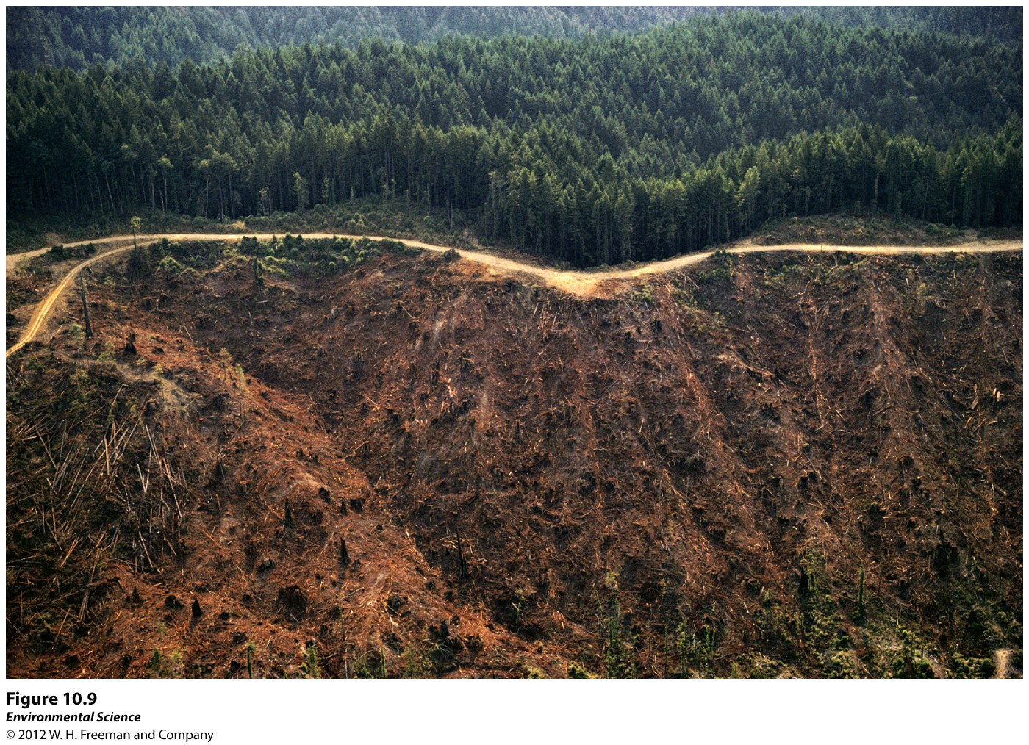

Slide 33
Selective Cutting
Removes single trees or relatively small numbers of trees from among many in a forest.
Negative impacts are still associated with timber harvesting (roads, soil compacting, etc).
Ecologically Sustainable Forestry: maintaining all species and keeping them as close to a natural state as possible.

Slide 34
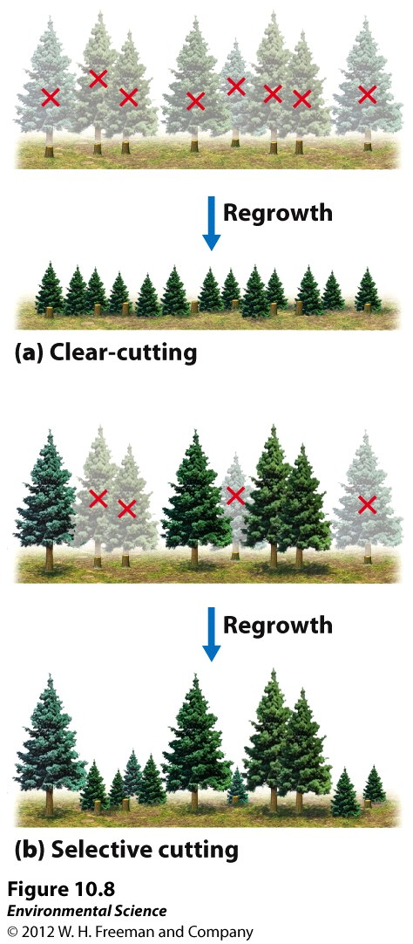

Slide 35
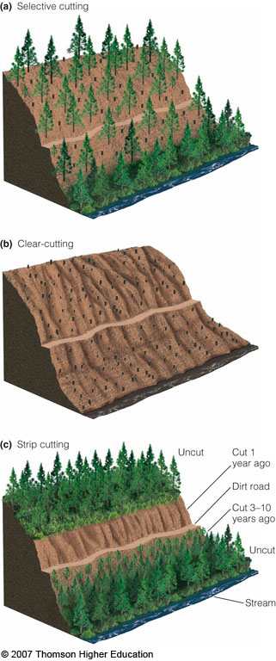
Harvesting Methods
Harvested individually from diverse forests (selective cutting)
Entire forest can be cut down (clear cutting)
Portion of forest harvested (strip/stand cutting)
Figure 10-9

Slide 36
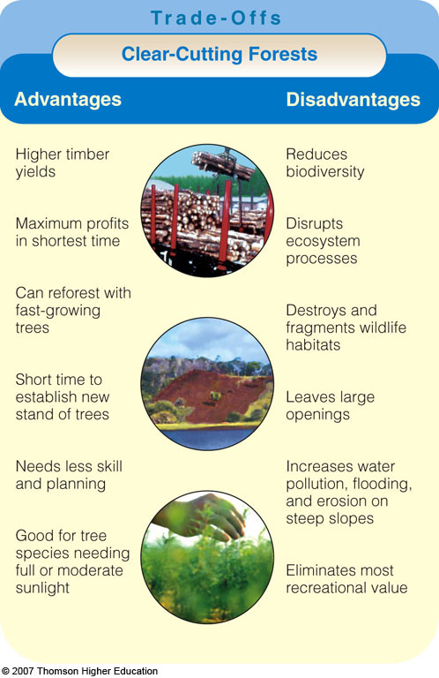
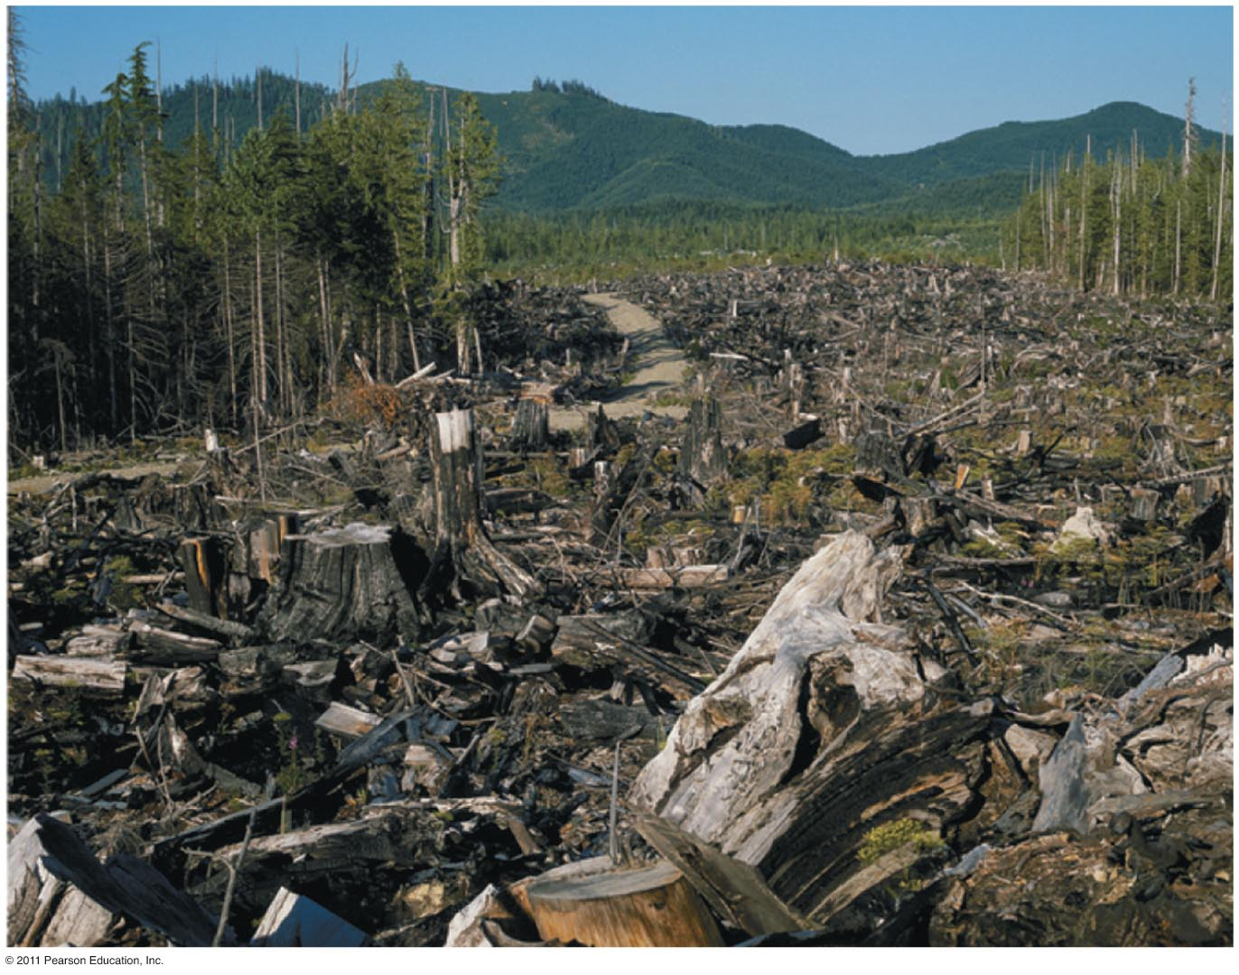
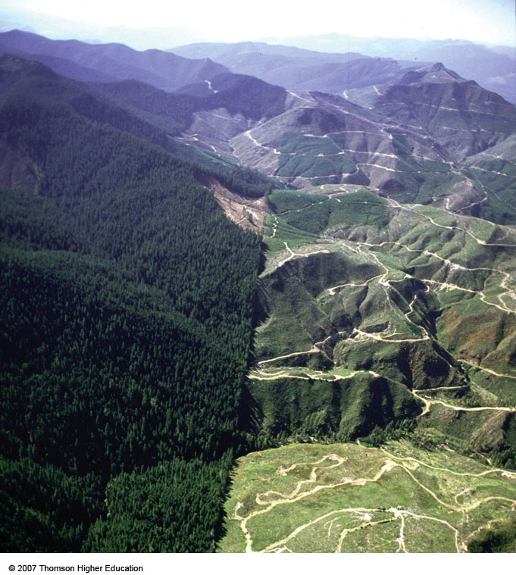
Clear-cutting
Clear-cutting destroys entire communities

Slide 37
Logging, Deforestation and Reforestation
Logging often replaces complex forest ecosystems with tree plantations: large areas typically planted with a single rapidly growing tree species.

Slide 38
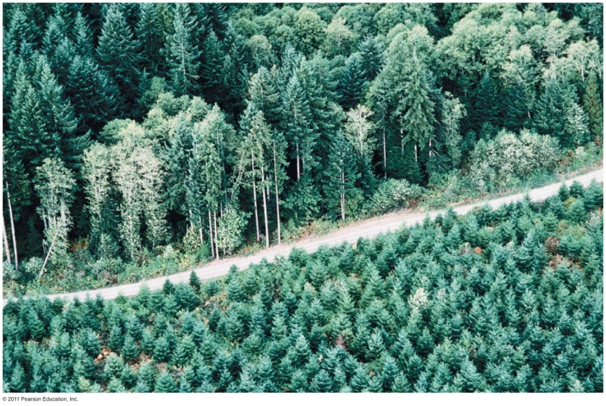
Plantation forestry
The timber industry focuses on timber plantations
Fast-growing, single-species monocultures
Often done after clear-cutting primary forest
Even-aged stands= all trees are the same age ☹
Rotation time = trees are cut after a certain time
***Tree plantations are crops, not ecologically functional forests***

Slide 39
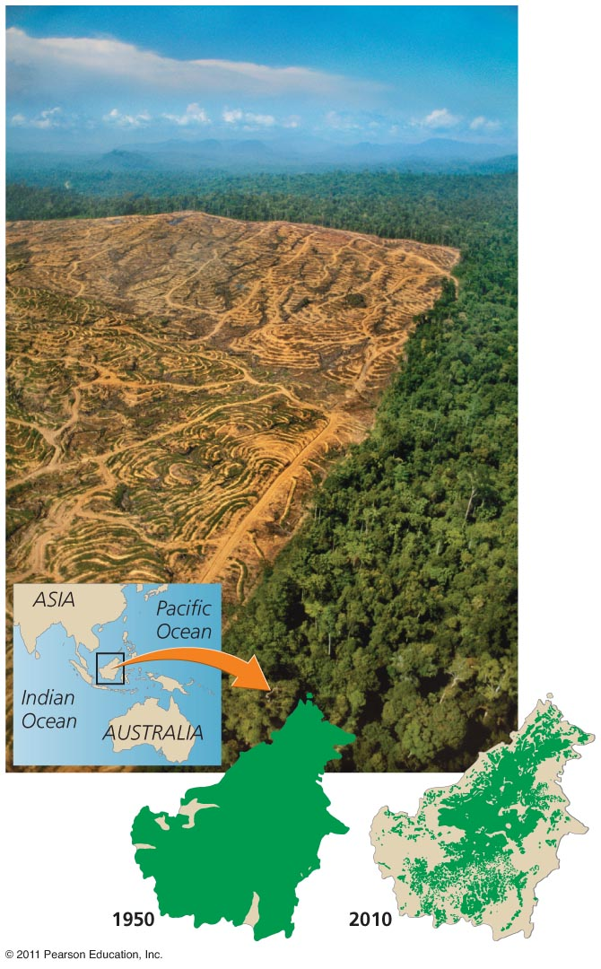
Palm oil plantations
Palm oil is used in snack foods, soaps, cosmetics, biofuel
Borneo (biggest island in Indonesia) has lost most of its forest cover
Clearing encourages further development and illegal logging

Slide 40
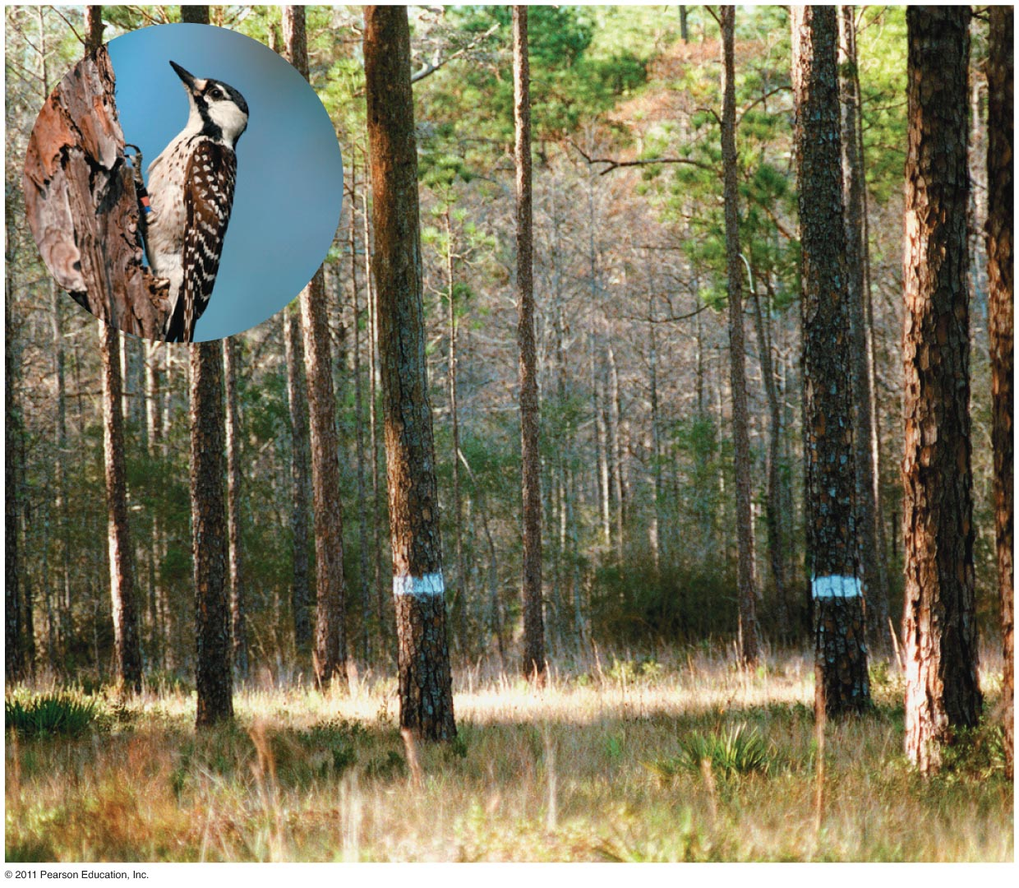
Sustainable Forestry
U.S. Forest Service programs:
Manage wildlife, non-game animals, endangered species
Push for ecosystem-based management
Sustainable cutting:
Selective cutting
Shelterwood/seed-tree cutting
Strip cutting
Certification

Slide 41
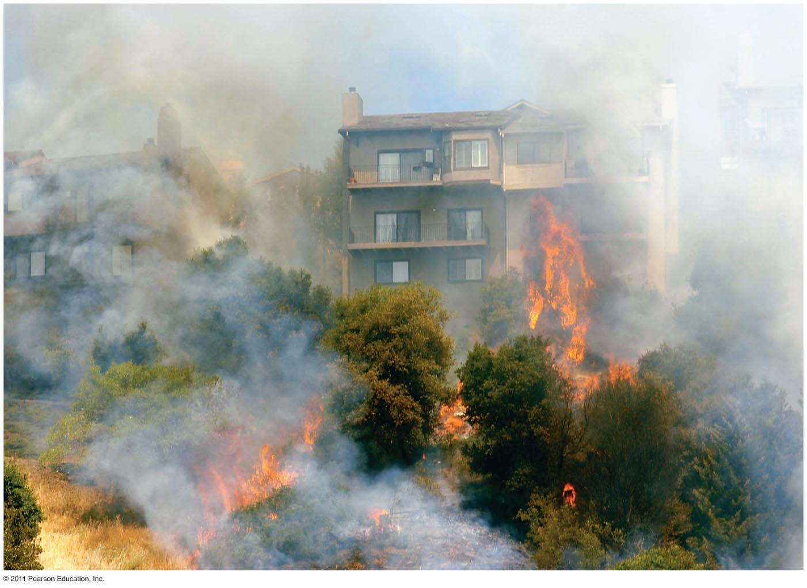
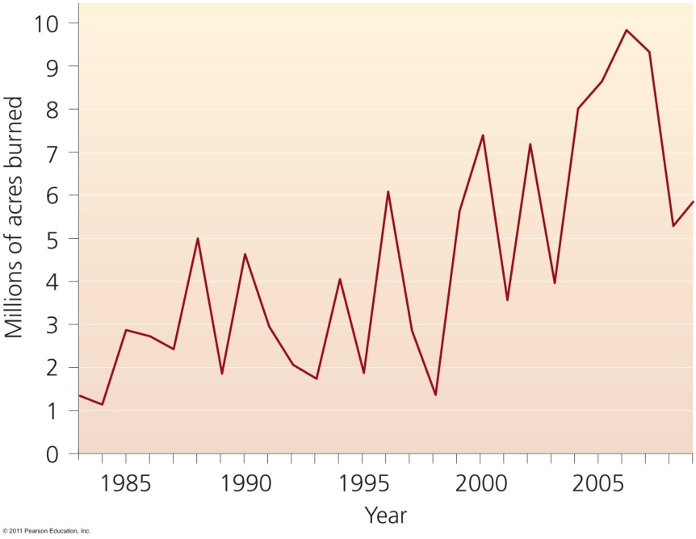
Fire policy also stirs controversy
For over 100 years, the Forest Service suppressed all fires
But many ecosystems depend on fires
Excess vegetation produces kindling for future fires
In the wildland-urban interface, housing developments that are near forests are vulnerable to forest fires
Catastrophic fires have become more numerous recently

Slide 42
Fire Management
Prescribed Burn: a fire is deliberately set under controlled conditions.
Help reduce the risk of uncontrolled natural fires.
Stimulate growth in particular seeds.
Clear out undergrowth and weeds.
Provides openings for early successional species.
Example: Yellowstone fire of 1988

Slide 43
Overview of Ecological Role of Fire in Forest Ecosystems
1. Reduces probability of catastrophic fire
2. Nutrient input into soils
3. Control of insect pests
4. Control of tree pathogens
Maintains species diversity
*Intermediate disturbance hypothesis
This project supported in part by the National Science Foundation. Opinions expressed are those of the authors and not necessarily those of the Foundation.
Notes:
Beginning in the 1960’s, the perception of fire as universally “bad” as well as the long-term value of fire suppression (“Smokey the Bear”) policy began to be questioned by scientists. Nearly 50 years later, we still have an incomplete understanding of the role of fire in ecosystems. However, we have learned that fire has both direct and indirect effects on all aspects of forest ecosystems. These effects are the focus of this discussion.
Role of Fire in Forest Ecosystems
1. reduces probability of catastrophic fire
2. nutrient input into soils
3. control of insect pests
4. control of tree pathogens
5. maintain species diversity

Slide 44
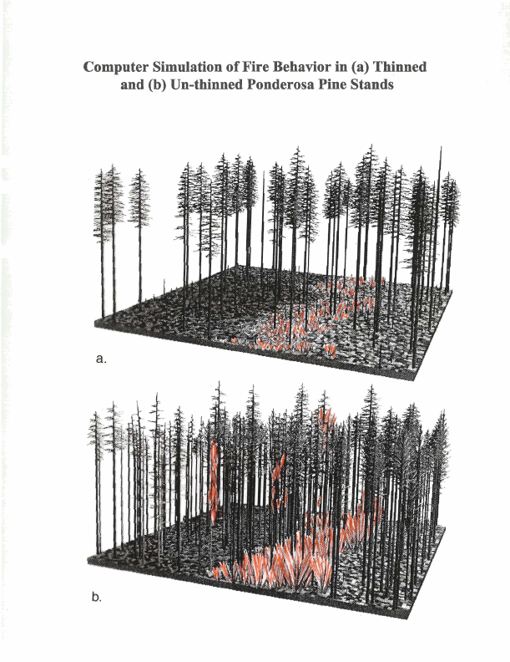
Fires reduces the probability of catastrophic fire
Historical (natural) fire regime
Altered with fire suppression
Increased tree density and ladder fuels → “Staircase effect”
Creates crown fires
Notes:
In many forest types, the fire regime (the historical frequency and intensity of natural fires) reduces fuels such that fires burn frequently and at low to moderate intensity. With fire suppression, tree density increases along with the abundance of ladder fuels, resulting in an increased probability of crown fires due to the “staircase effect.”

Slide 45
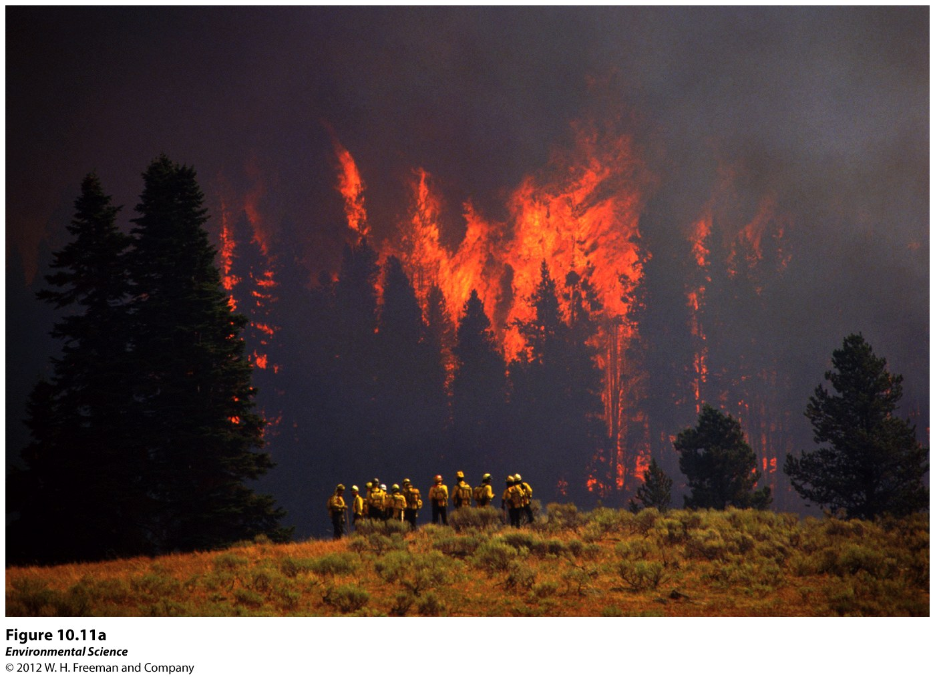

Slide 46
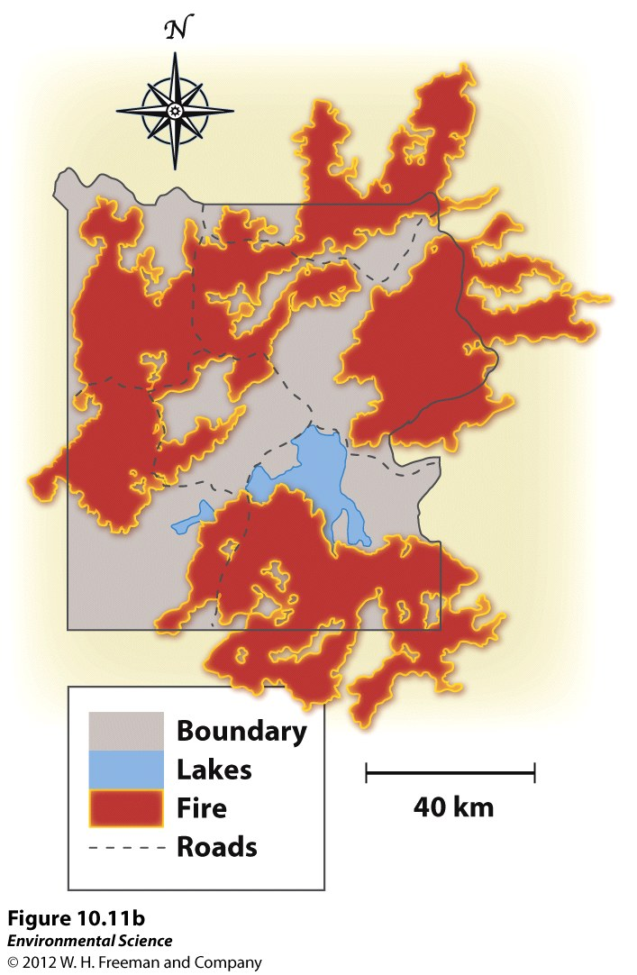

Slide 47
National Parks
First National Park: Yellowstone National Park 1872
Goals:
Conservation and protection of ecosystems.
Reducing human impacts is a challenge.
Victims of their popularity.
Protected from resource extraction and development (no logging)

Slide 48
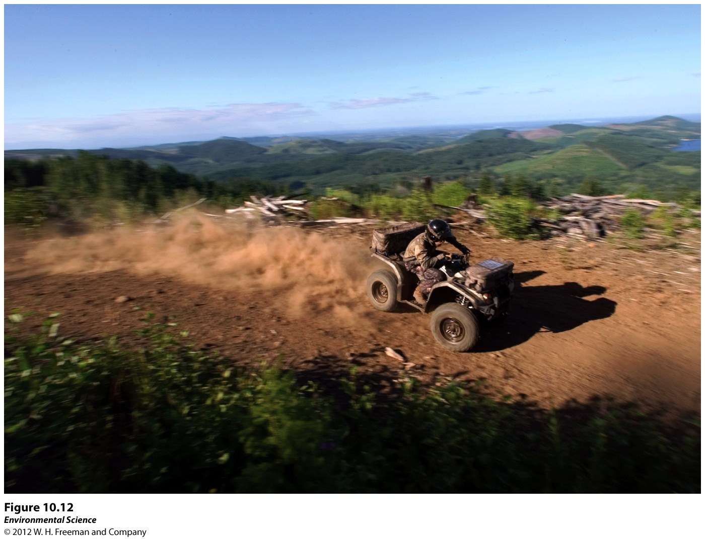

Slide 49
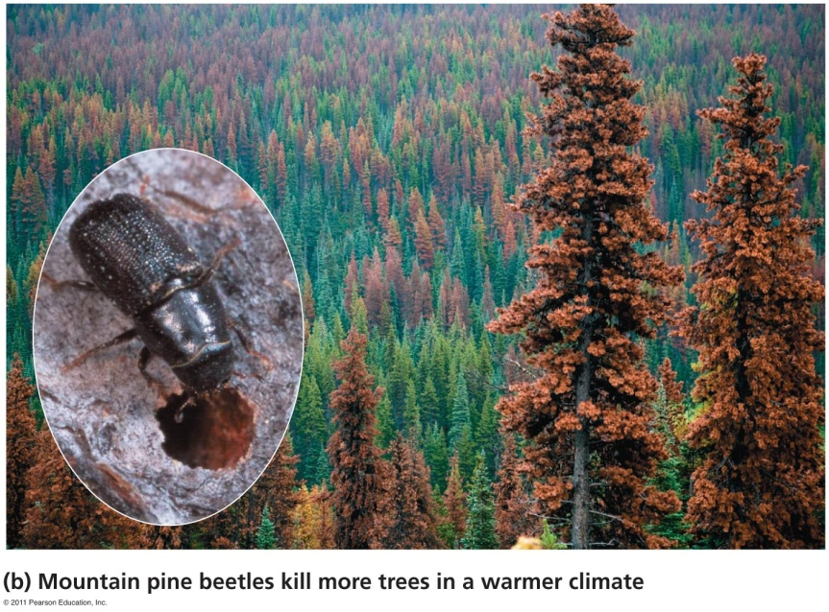
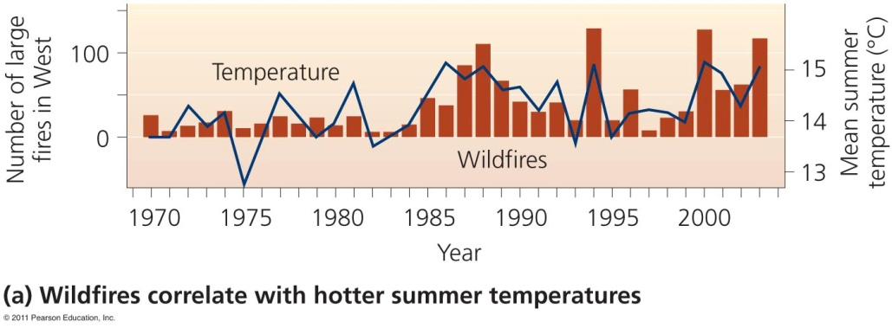
Climate change is altering forests
The U.S. is warming and getting drier and will get worse
Pests kill huge areas of trees, particularly plantations
Dead trees do not remove carbon dioxide
Intensifying climate change
Woodlands, shrublands. or grasslands may replace forests
Increased fires and pests destroy large areas of U.S. forests

Slide 50
Wildlife Refuges and Wilderness Areas
National Wildlife Refuges: only federal public lands manages for the primary purpose of protecting wildlife.
Natural Wilderness Areas: set aside with the intent of preserving large tracts of intact ecosystems.
Logging road building, and mining are all banned in these areas.

Slide 51
Federal Regulation of Land Use
National Environmental Policy Act (NEPA): an environmental assessment of all projects involving federal money or federal permits.
Creates an environmental regulatory process designed to ensure protection of the nation’s resources.

Slide 52
Residential Land Use is Expanding
Suburban: surround metropolitan centers and have low population densities compared with those urban areas.
Exurban: similar to suburban but are unconnected to any central city or densely populated area.

Slide 53
Urban Sprawl
Creation of urbanized areas that spread into rural areas and remove clear boundaries between the two.
Tends to occur at the edge of a city replacing farm land.

Slide 54
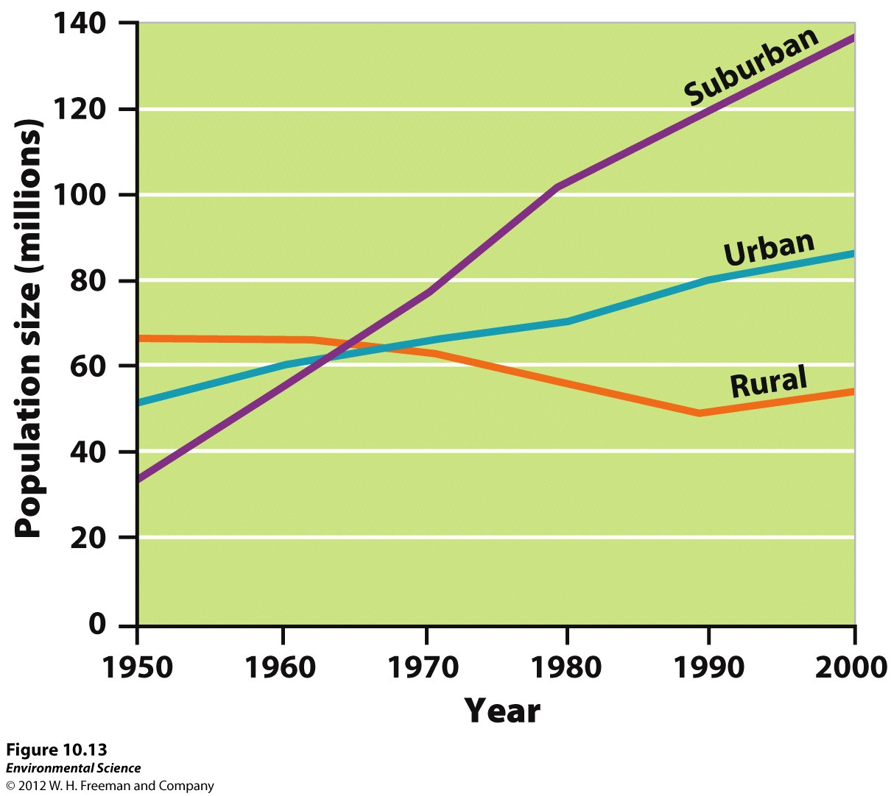

Slide 55
Causes and Effects of Sprawl
Four Main Causes:
Automobiles and Highway Construction
Easier to travel away from the city.
2. Living Costs
3. Urban Blight: the degradation of the built and social environments of the city that often accompanies and accelerates migration to the suburbs.

Slide 56
4. Government Policies
Highway Trust Fund: begun by the Jighway Revenue act of 1956
Pays for the building and maintenance of roads.
Induced Demand: an increase in the supply of a good causes demand to grow.
Zoning: Separates business and residential areas.

Slide 59
Smart Growth
Focuses on strategies that encourage the development of sustainable, healthy communities.
Mixed Land Uses.
Create a range of housing opportunities and choices.
Create walkable neighborhoods.
Encourage community and stakeholder collaboration in development.

Slide 60
5. Take advantage of compact building.
6. Foster distinctive attractive communities with a strong sense of place.
7. Preserve open space, farmland, natural beauty, and critical environmental areas.
8. Provide a variety of transportation choices.
9. Strengthen and direct development toward existing communities.

Slide 61
10. Make development decisions predictable, fair, and cost effective.

Slide 62
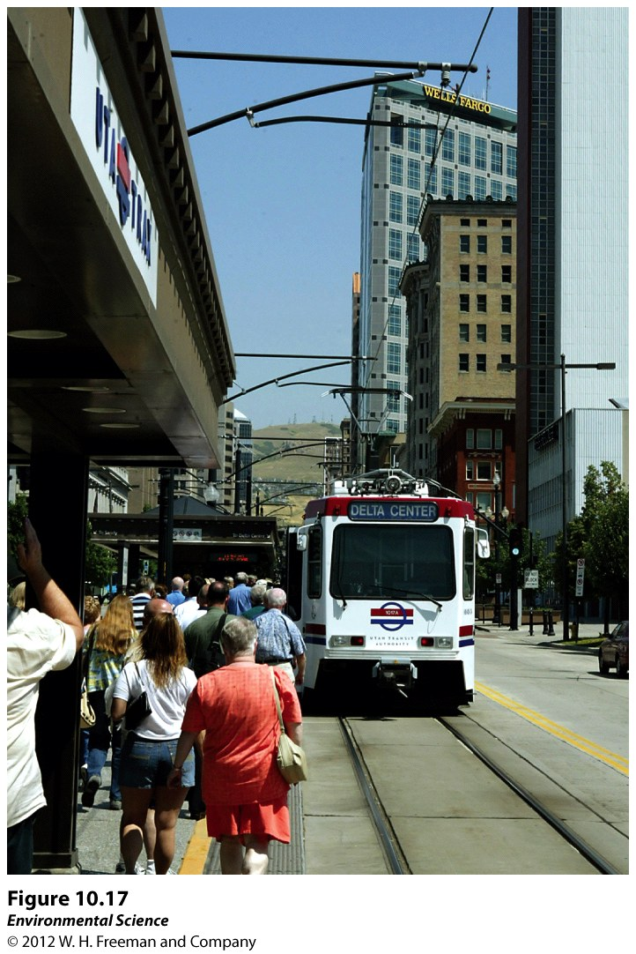

Slide 63
