Slide 1
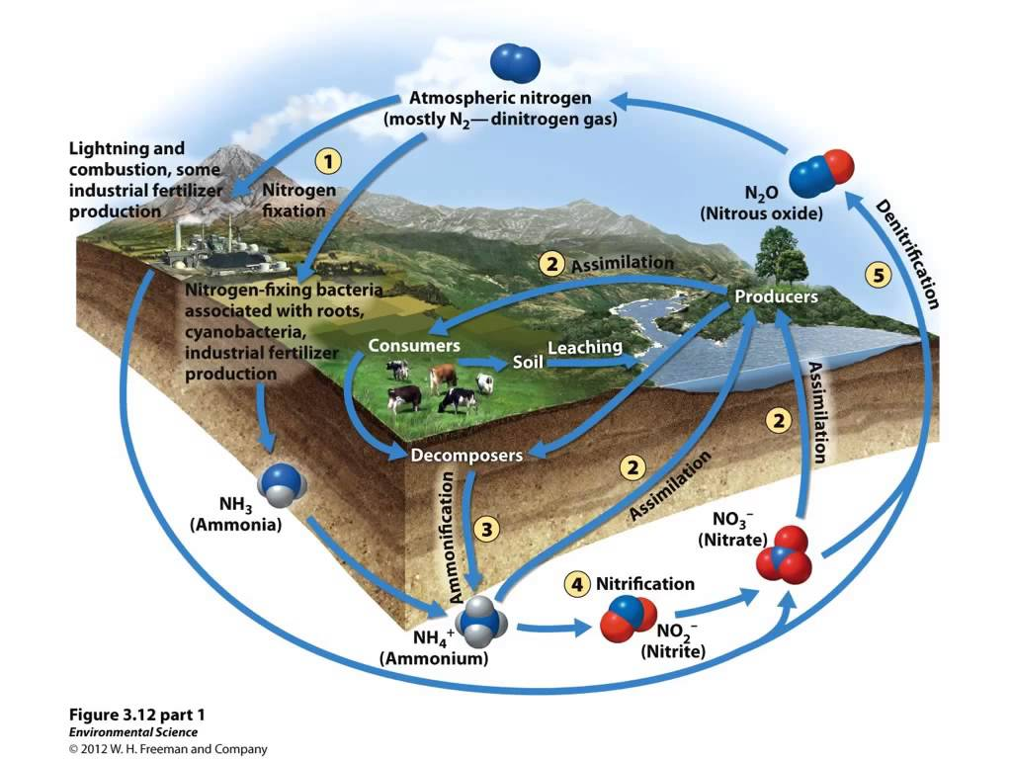
Nitrogen Cycle

Slide 2
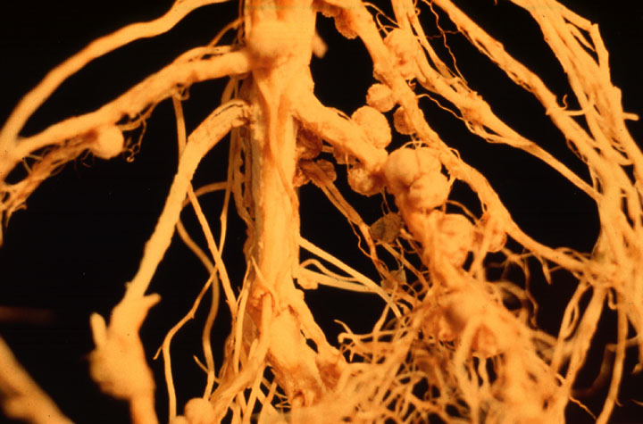

Slide 3
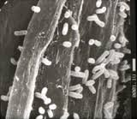
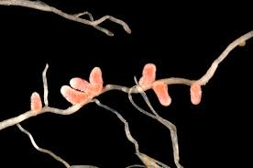

Slide 4
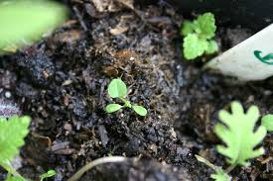
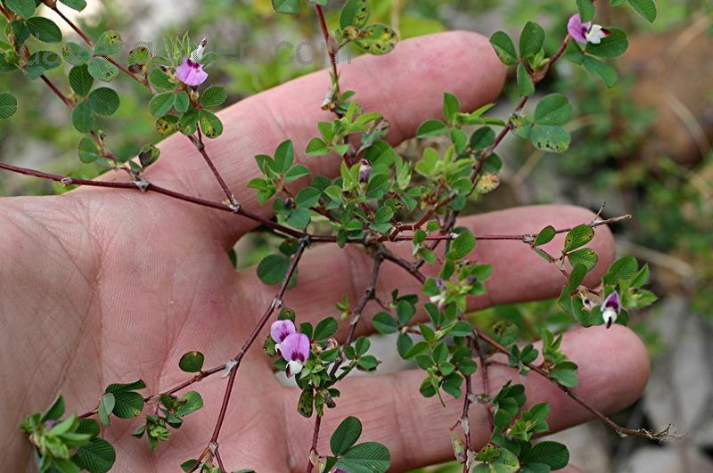

Slide 5
Nitrogen Cycle Lab Write Up Hints
SPECIFIC title.
Example: Analyzing the Effects of Bacteria Inoculation on the Growth of Clover Plants
B. Members
C. Primary Question for Investigation: Major goal of this experiment.

Slide 6
D. Hypothesis: which group of plants will have more growth (as a measure of number of leaves, number of nodules, root length, stem height, and biomass) and WHY!
E. Materials and Experimental Design: What did you do? How long did it last? What constraints did you utilize?
F. Data and Results: 1 table.

Slide 7
Analysis
4 questions. Be complete. Include the questions.

Slide 8
H. Conclusion/Discussion
Describe the experiment you performed.
Explain your results, what your hypothesis supported? Why or why not.
If not what were some possible sources of error?
Explain in detail the nitrogen cycle. Include in your discussion the purpose of fertilizer
Also discuss what happens when there is agricultural runoff and the nitrogen cycle is disrupted.

