Slide 1
Chapter 15 Part II

Slide 2
Acid Deposition: Much Less of Problem Than it Used to Be
All rain is naturally acidic.
AS CO₂ reacts with water it lowers the pH from 7.0 to 5.6.
Acid deposition refers to rain with a pH lower than 5.6.
Anthropogenic as well as natural causes.

Slide 3
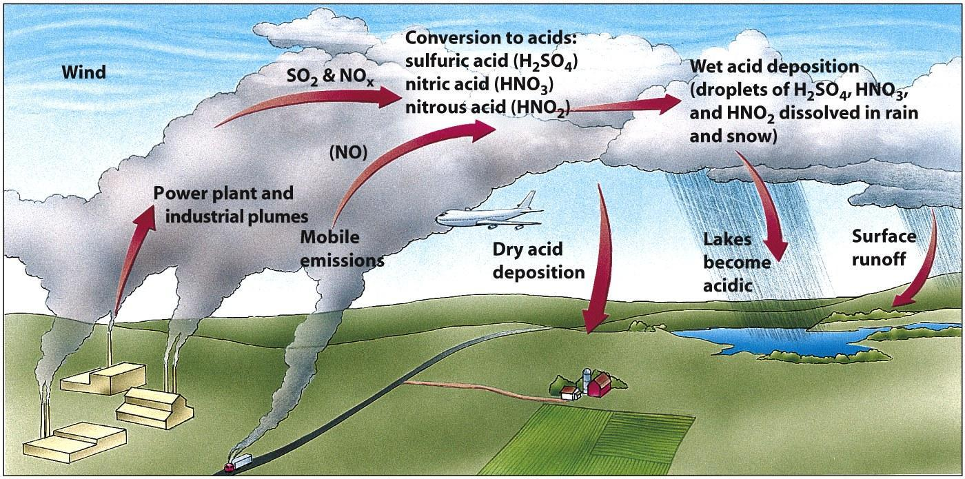
How Acid Deposition Develops

Slide 4
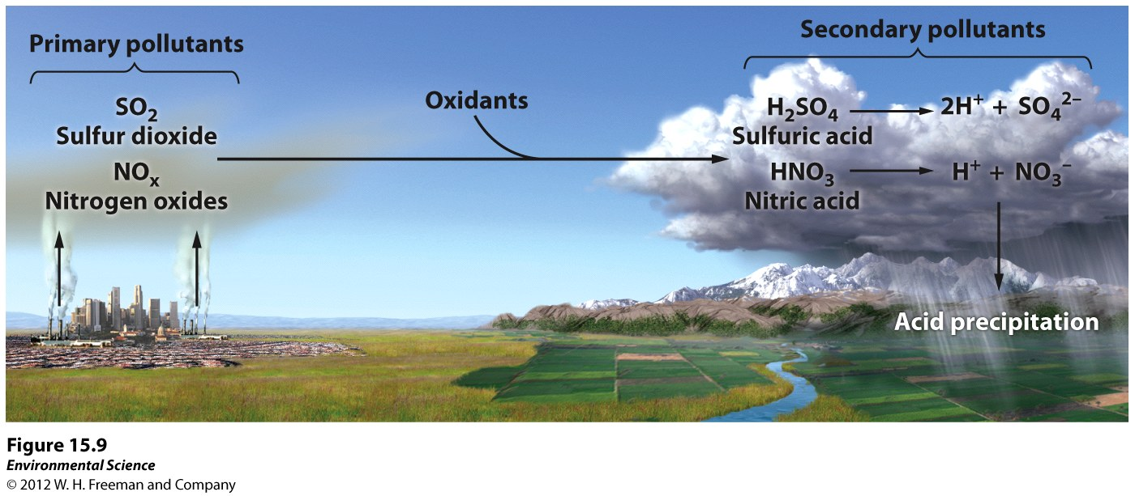

Slide 5
How Acid Deposition Forms and Travels
Nitrogen oxides and sulfur dioxides(primary pollutants) are released into the air.
With water and oxygen they are transformed into secondary pollutants nitric acid and sulfuric acid.
These break down further producing nitrate, sulfate and other inorganic pollutants.

Slide 6
Pollutants may travel several thousand kilometers.
Eventually washed out and deposited.
Has reduced since the Clean Air Act of 1970.

Slide 7
Effects of Acid Deposition
Greatly effects aquatic ecosystems.
Decreases species biodiversity.
Can lead to mobilization of metals.
Can effect food sources.
Does not really effect humans directly.
Can effect human built structures.

Slide 8
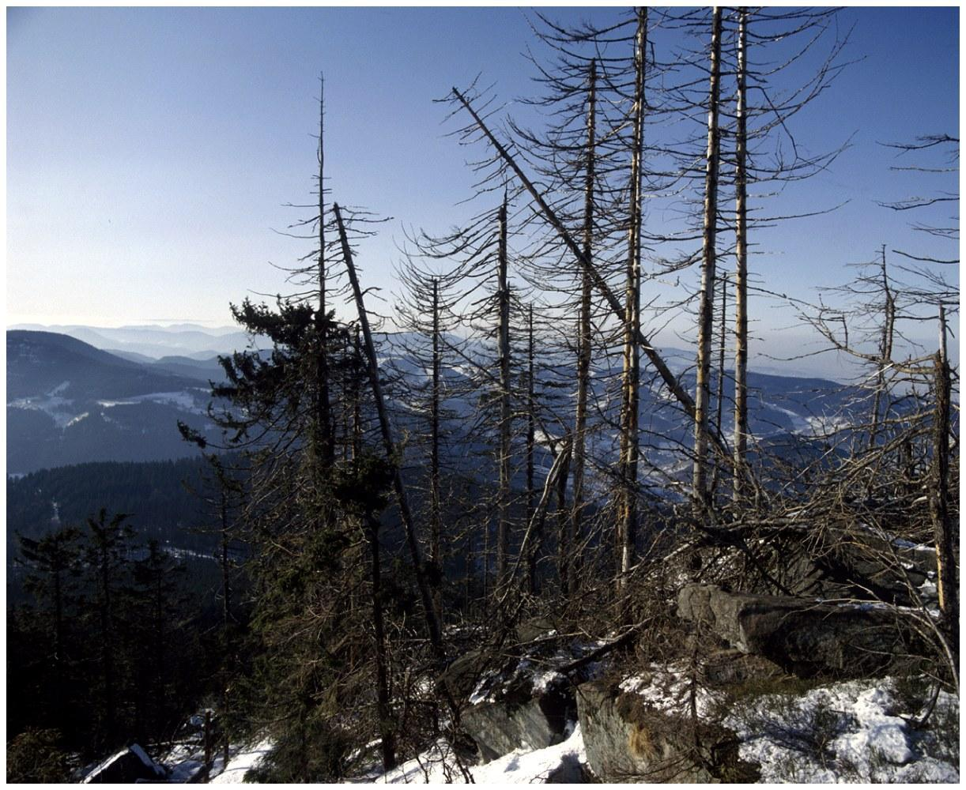
Effects of Acid Deposition
(1) Declining Aquatic Animal Populations
(2) Thin-shelled eggs prevent bird reproduction
Because calcium is unavailable in acidic soil
(3) Forest decline
Ex: Black forest in Germany (50% is destroyed)

Slide 9
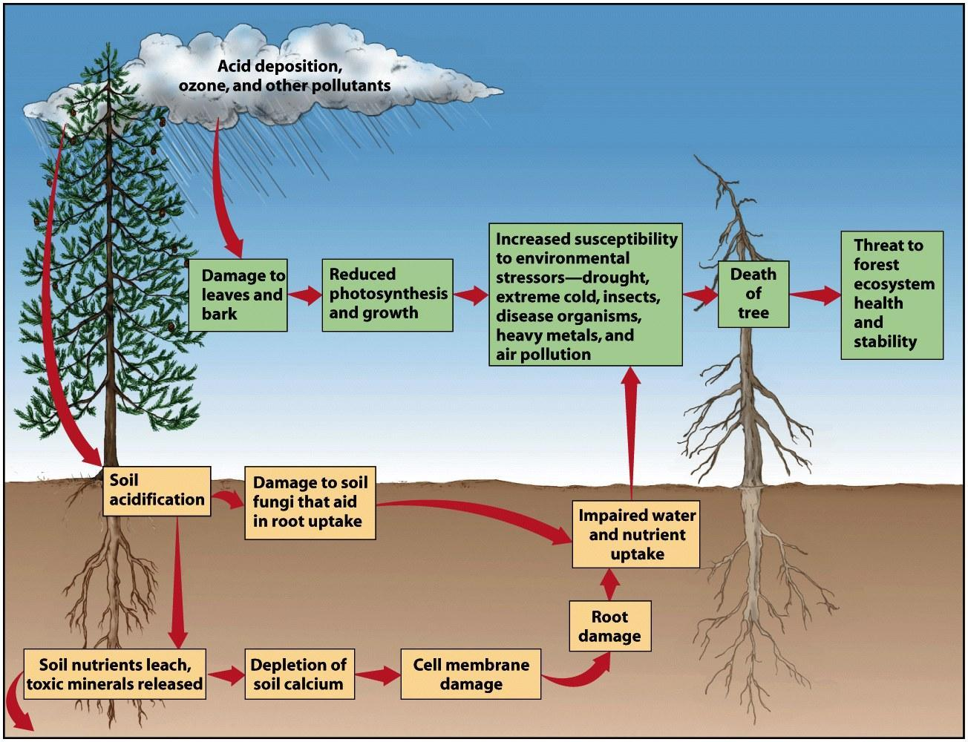

Slide 10
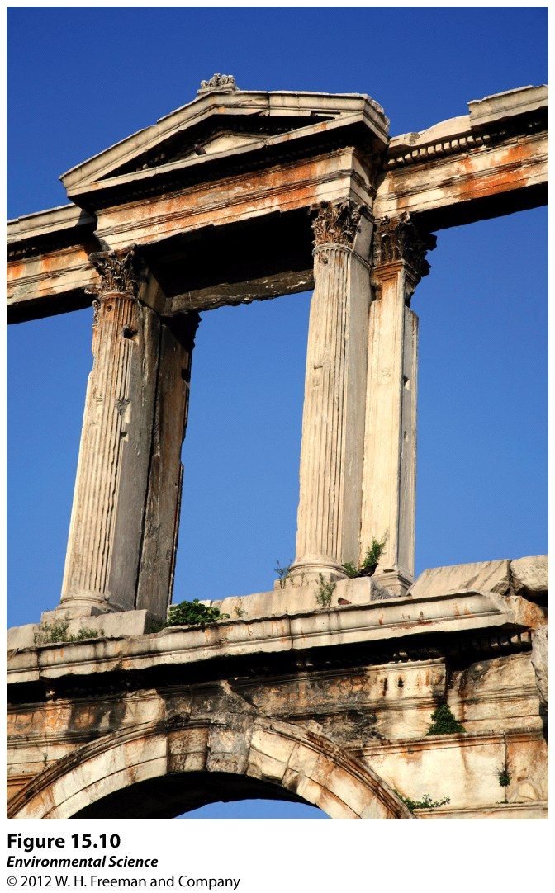

Slide 11
Pollution Control: Prevention, Technology and Innovation
The best =s avoid them in the first place!
Low sulfur coal or oil is the best by far.
Alternative energy sources!?

Slide 12
Controlling Air Pollution
How successful has the Clean Air Act been?
What are some specific technologies to reduce emissions from cars, power plants, etc?

Slide 13
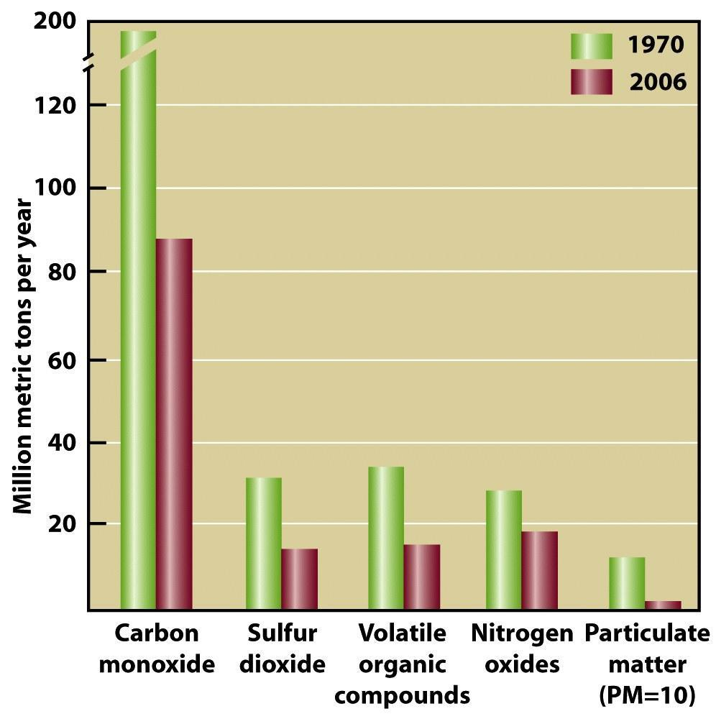
The Clean Air Act is Working!

Slide 14
Control of Sulfur and Nitrogen Oxide Emissions
Removal of sulfur dioxide from coal exhaust during combustion by fluidized bed combustion.
Heated calcium carbonate absorbs sulfur dioxide and produces calcium sulfate.
Catalytic Converters: reduces nitrogen oxide and carbon monoxide emissions.

Slide 15
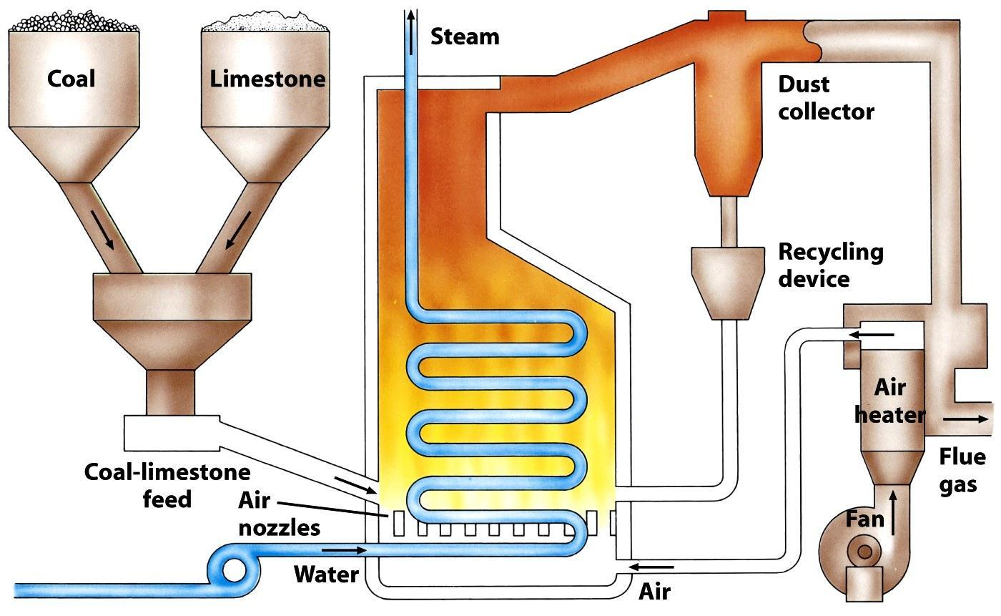
“Fluidized Bed Combustion” technology
Mix coal with limestone before burning to neutralize SO₂ before it is emitted

Slide 16
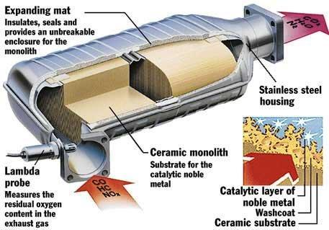
Catalytic Converters (reduce NO_{X} from cars)

Slide 17
Control of Particulate Matter
Gravitational Settling.
Fabric filters.
Baghouse Filter: removes 100% of particulate matter.
Electrostatic precipitators: electric charge can make particles coalesce so they can be removed.
Scrubber: particles are scrubbed by water droplets.
All require the use of more fuel and result in more carbon dioxide release.

Slide 18
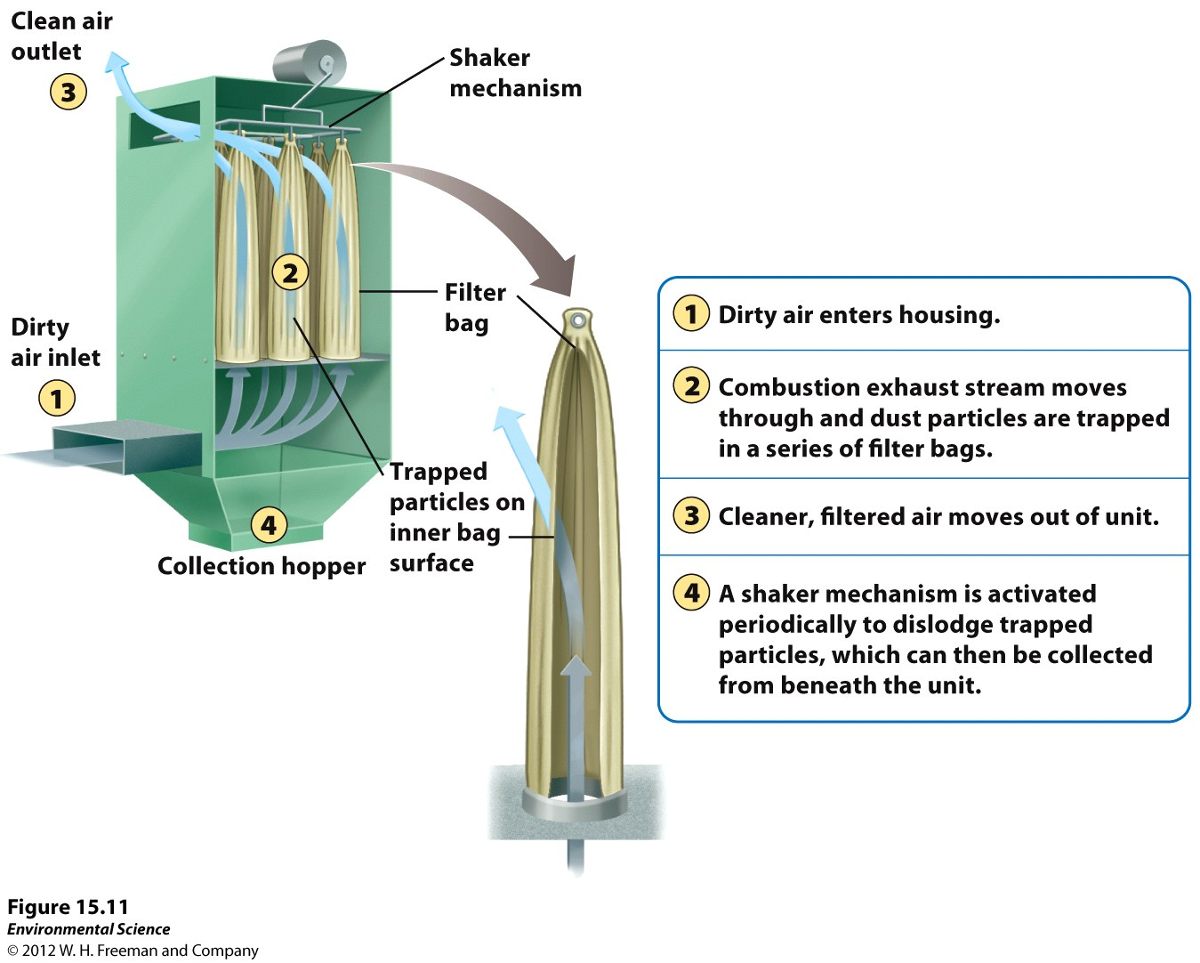
The Baghouse Filter

Slide 19
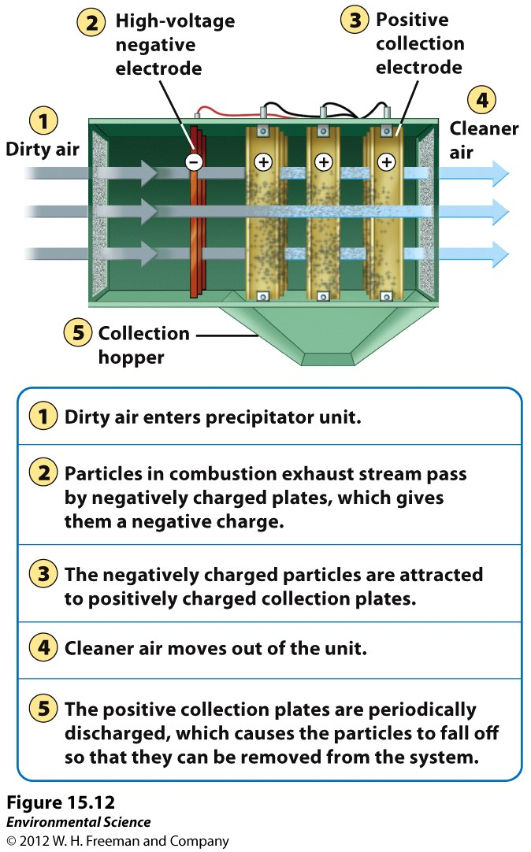
Electrostatic Precipitator

Slide 20
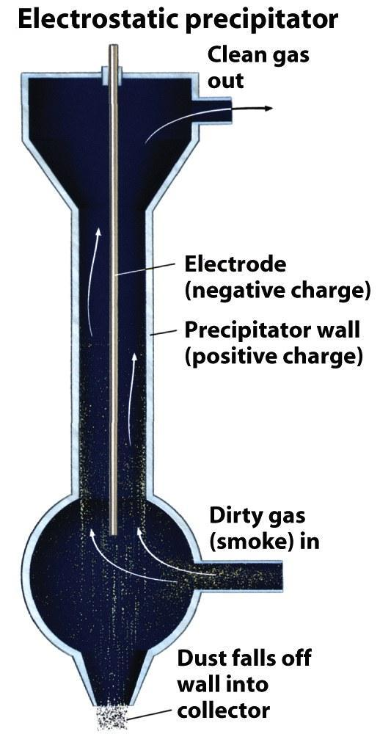
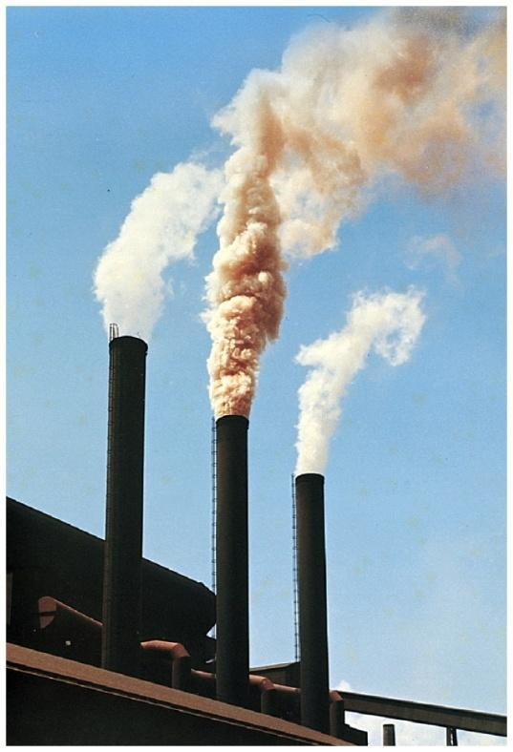
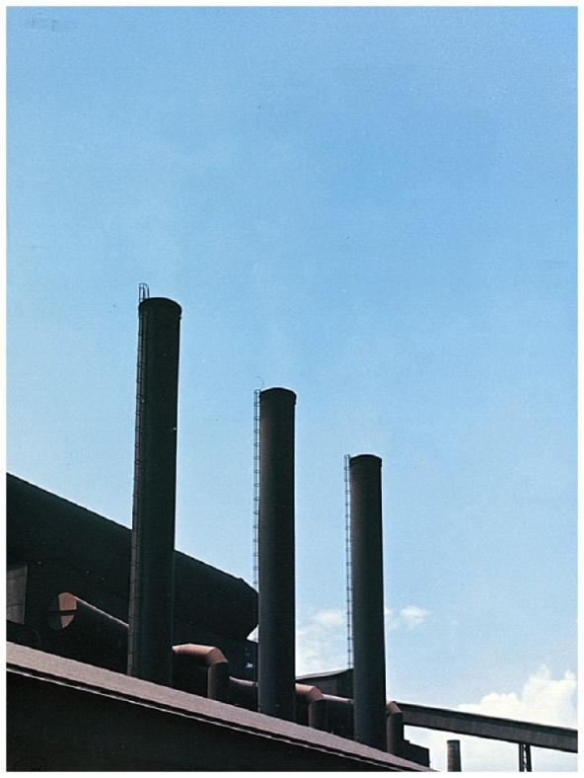
Controlling Particulate Matter
Without Electrostatic precipitator
With Electrostatic precipitator

Slide 21
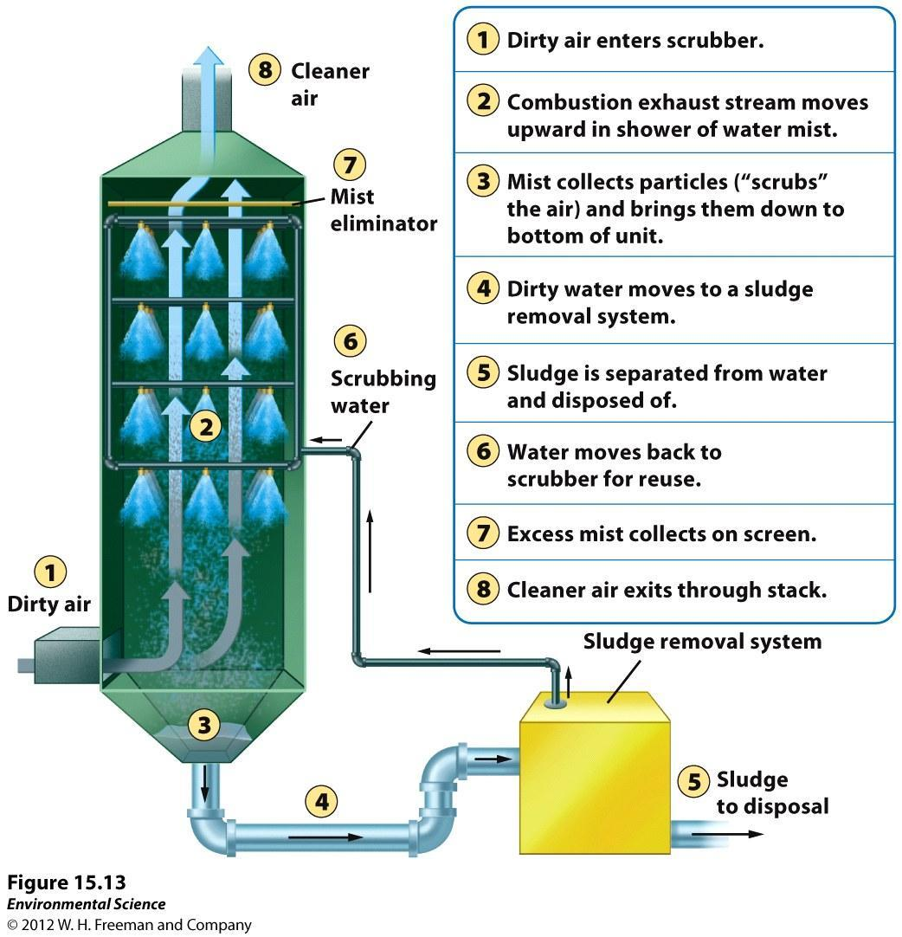
Scrubbers
Capture PM in a “mist” after combustion

Slide 22
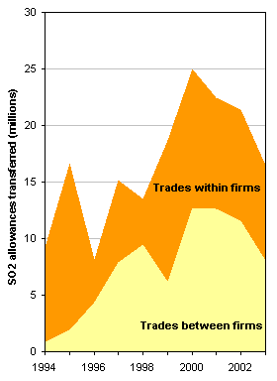
Permits for Pollution Control
Let’s turn the right to pollute into a commodity
Set a number of allowances and buy and sell them in a free-market system
SO₂ permit auction/trading:
23.5 million tonnes → 10.3 million tonnes from 1982 to 2008

Slide 23
Smog Reduction
Have to reduce primary pollutants (VOCs) because the presence of these leads to the production of Ozone(secondary pollutant) which is the main component of photochemical smog.

Slide 24
Ozone
Where is the “Ozone Hole”?
What effects does ozone depletion have?
What substances cause ozone depletion?
Will the ozone layer recover?

Slide 25
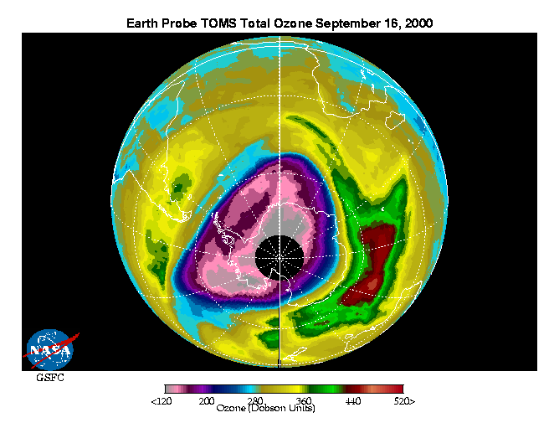

Slide 26
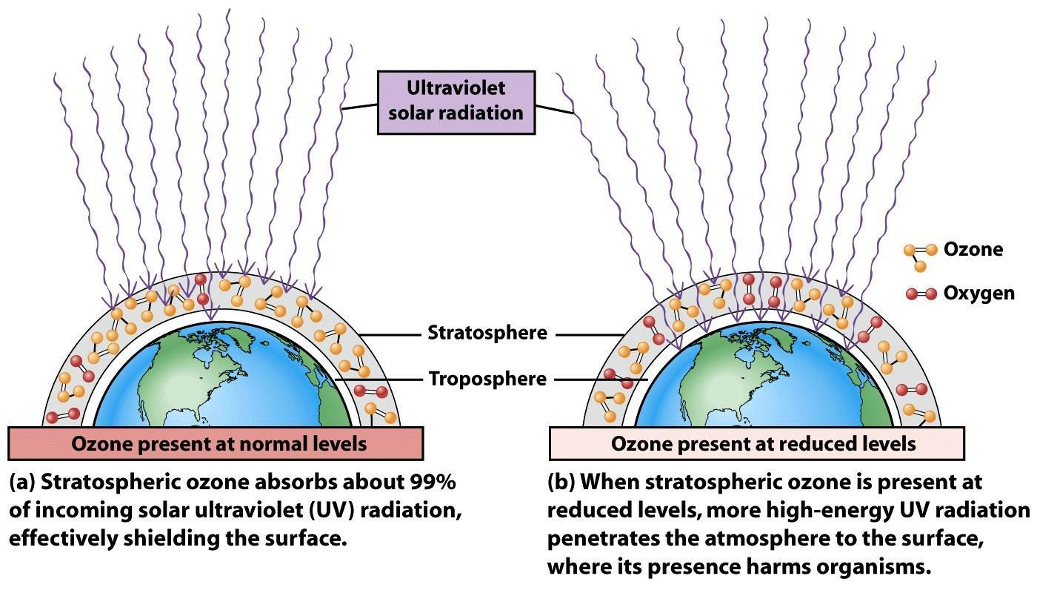

Slide 27
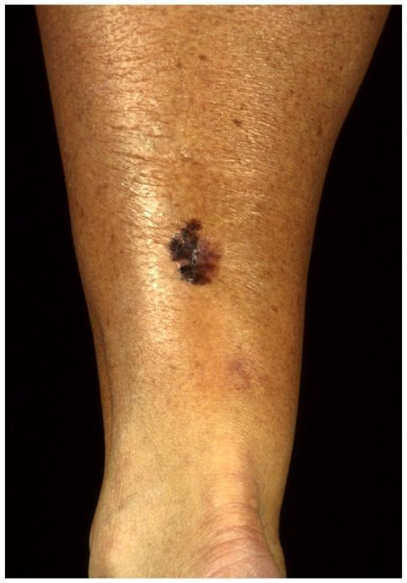
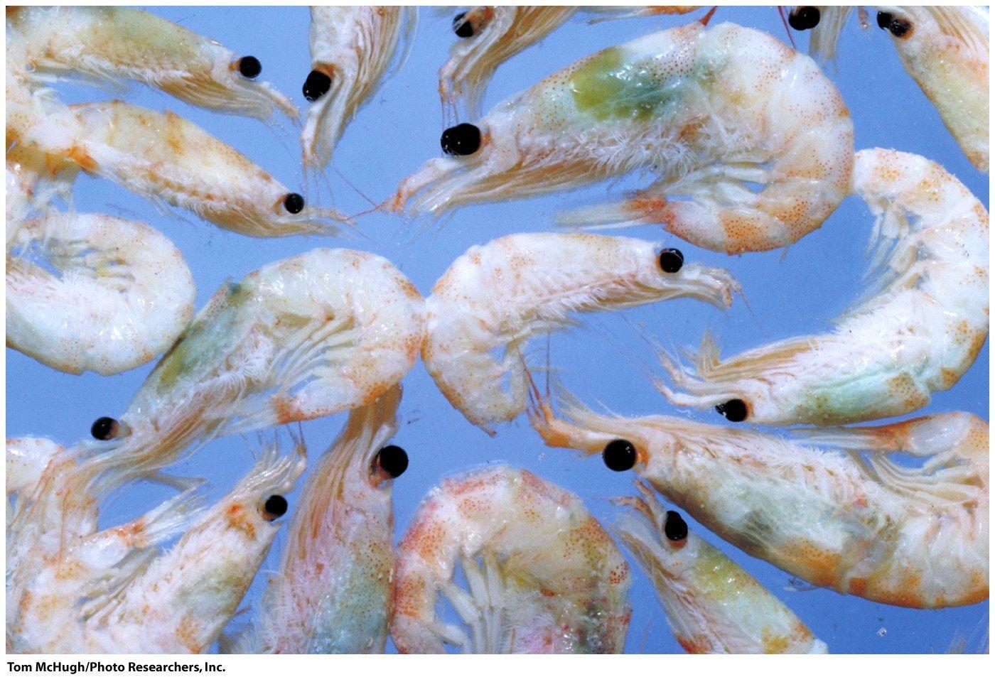
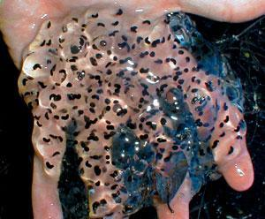
Increased UV-so what?
marine phytoplankton (food webs)
amphibian populations
skin cancer (melanoma)
Cataracts
damage to crops & forests

Slide 28
Stratospheric Ozone Layer: Protection from Ultraviolet and Solar Radiation
Benefit of Stratospheric Ozone
UV spectrum: UV-A, UV-B, and UV-C
UV-A: passes through atmosphere and possibly initiates skin cancer.
UV-B, UV-C: can cause cancer but are absorbed by ozone.

Slide 29
UV-C Radiation breaks bonds holding together the oxygen molecule:
O₂ + UV-C -----→ 2O
O₂ + O ---------→ O₃
O₃ + UV-B or UV-C ---→ O₂ and O
Ozone the only one to absorb UV-B
Remember this is all in the stratosphere!!

Slide 30
Chlorofluorocarbons (CFCs): come from aerosols, refrigeration, air conditioning, making Styrofoam, etc.
O₃ + Cl -------→ CIO + O₂
ClO + O ------→ Cl +O₂
Ends up:
O₃ + O ----→ 2O₂
Chlorine can catalyze many (100,000) ozone molecules before it leaves the stratosphere.

Slide 31
Nitrogen oxides, bromines, and carbon tetrachlorides can are anthropocentric compounds that can destroy stratospheric ozone.

Slide 32
Depletion of the Ozone Layer
Noticed in the mid-1980s that the ozone over Antarctica and the Artic was depleting.
This Ozone hole was seasonal: August through November in the Southern Hemisphere (Antarctica).

Slide 33
Efforts to Reduce Ozone Depletion
1987 Montreal Protocol on Substances that Deplete the Ozone Layer.
Goal was to decrease the CFCs.
Slow process but has been proven to be successful.
Number of skin cancers should decrease as well.

Slide 34
Indoor Air Pollution
Causes more deaths every year compared to outdoor air pollution.
Developing Countries
Cooking and heating homes with biomass, coal, and little ventilation.
Increases risk of acute respiratory infections, pneumonia, bronchitis, and cancer.
Results in 1.6 million deaths per year, 56% occur among children less than 5 yrs old.

Slide 35
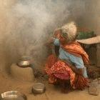
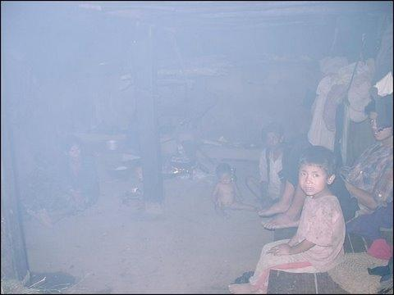
Developing Nations’ Indoor Air Pollution:
Wood, Dung, Coal to heat and cook
Women & Children at risk
PM & CO pollutants

Slide 36
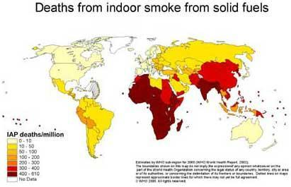
Indoor Air and Developing Nations

Slide 37
Developed Countries
People spend a lot of time in their homes.
Homes are more tightly insulated.
More materials made out of plastics and oils.

Slide 38
Most common indoor air pollutants in Developed Countries:
Radon (product of Uranium decay; enters basements)
cigarette smoke
carbon monoxide
nitrogen dioxide
formaldehyde (a VOC from glues and furniture)
pesticides
lead
cleaning solvents
ozone and asbestos

Slide 39
Asbestos
Long, thin, fibrous, silicate mineral with insulating properties.
Can cause lung cancer and respiratory diseases.
Carbon Monoxide
Malfunction of gas heaters.
Colorless, odorless.
Binds to hemoglobin better than oxygen, causes death.

Slide 40
Radon
Radon-222 is a radioactive gas that occurs from the decay of uranium.
Occurs in granite and underlying bedrock.
Can attach to dust particles.
2nd leading cause of lung cancer.

Slide 41
VOCS in Home Products
Found in glues and paints.
Formaldehyde found in carpets and cabinets.
Detergents, dry cleaning fluids, deodorizers, and solvents contain VOCS are harmful if inhaled.

Slide 42
Sick Building Syndrome
Newer buildings are sealed to prevent energy loss in heating and air conditioning.
New buildings often contain synthetic materials, glues, or solvents that have not completely aired out.

