Slide 1
Chapter 4 Review Quiz
What are the five processes that determine climate?
A)Unequal heating of the Earth by the Sun.
Albedo
Variation in Sun’s angle: more atmosphere to go through
Angle of incidence: direct rays vs angle

Slide 2
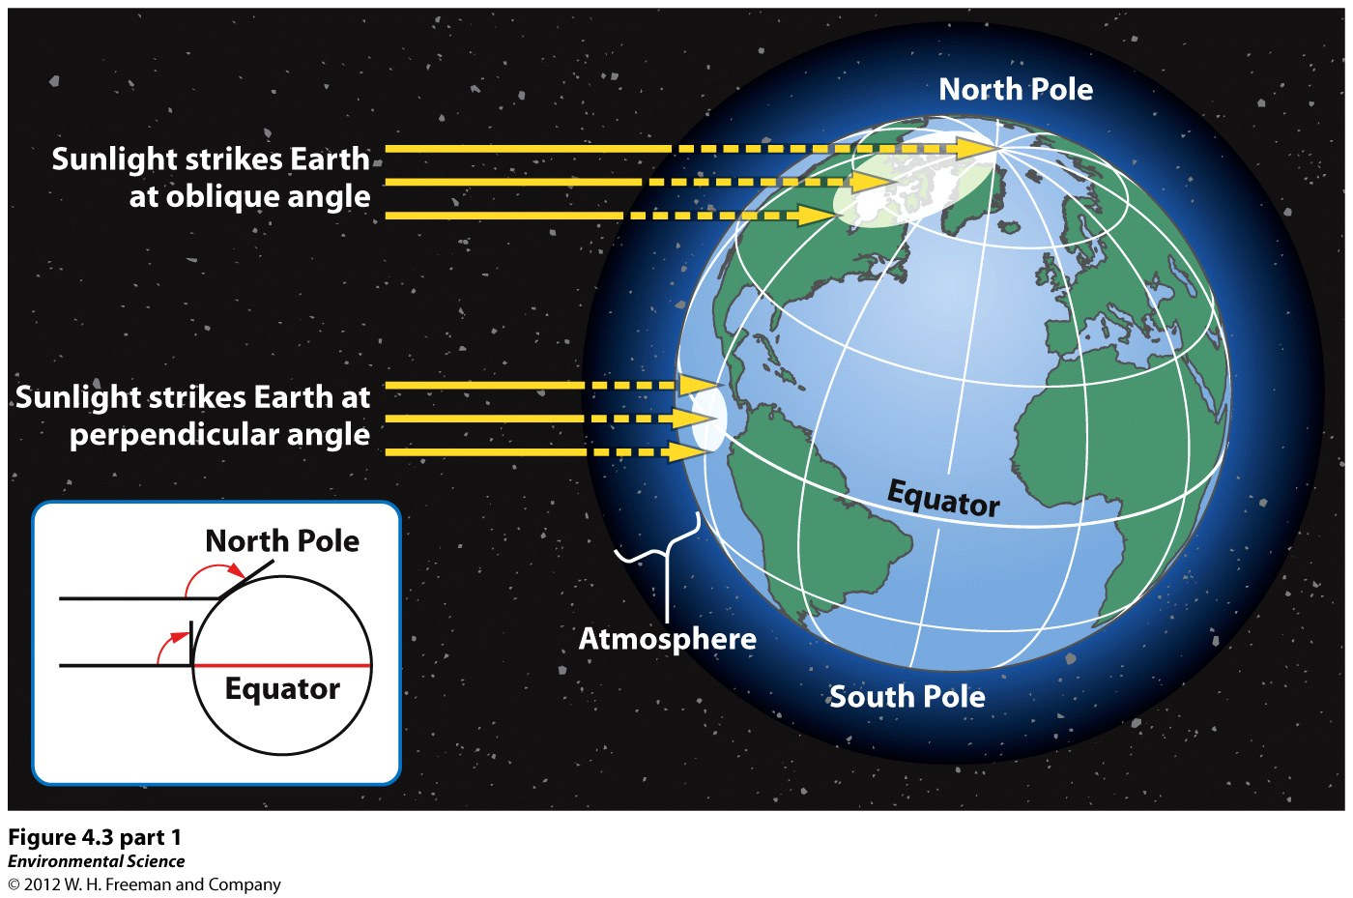

Slide 3
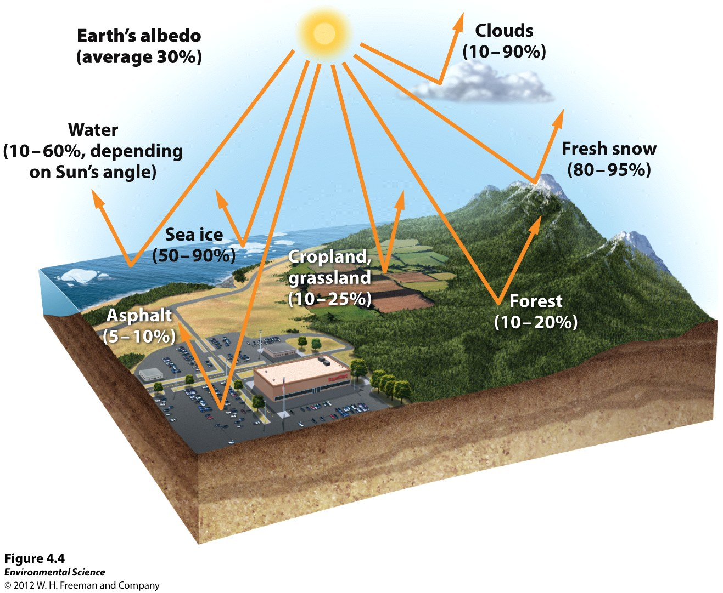

Slide 4
B) Atmospheric Convection Currents
Hadley Cells
Polar Cells
C) Earth’s Rotation and Coriolis Effect
D) Ocean Currents
E) Orbit on Tilted Axis
Seasons
Variation in temperatures over the sphere

Slide 5
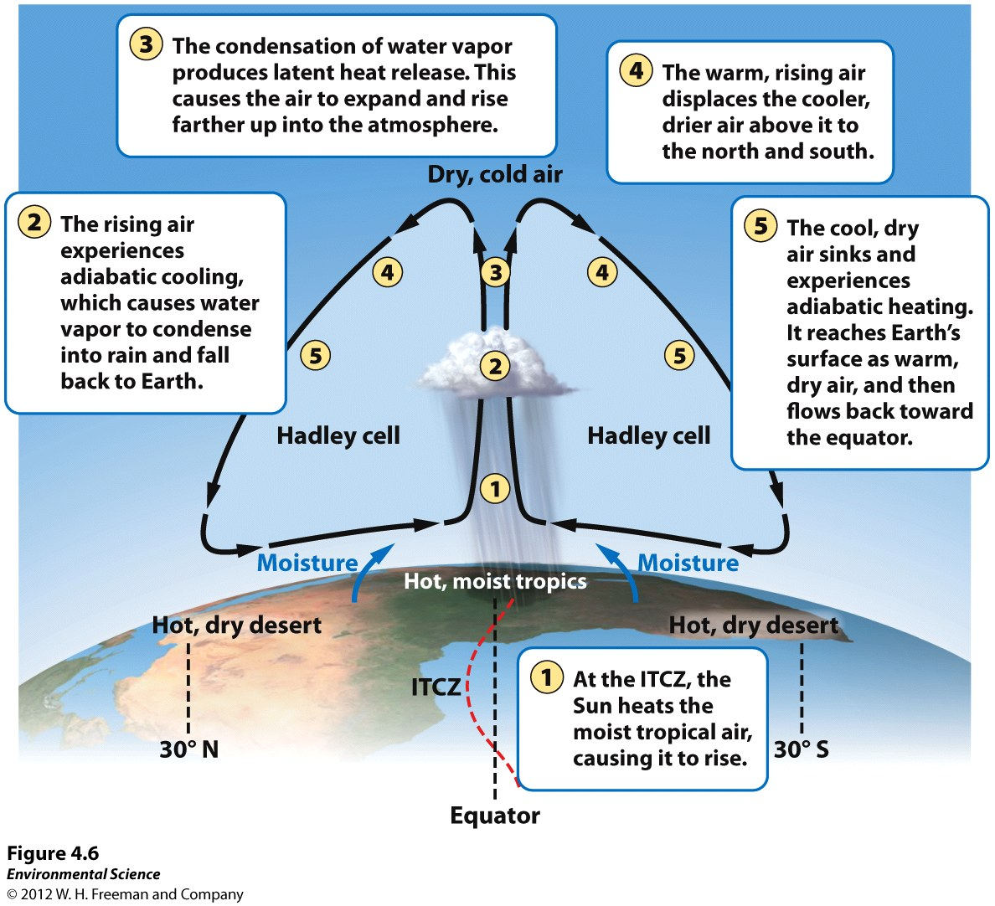

Slide 6
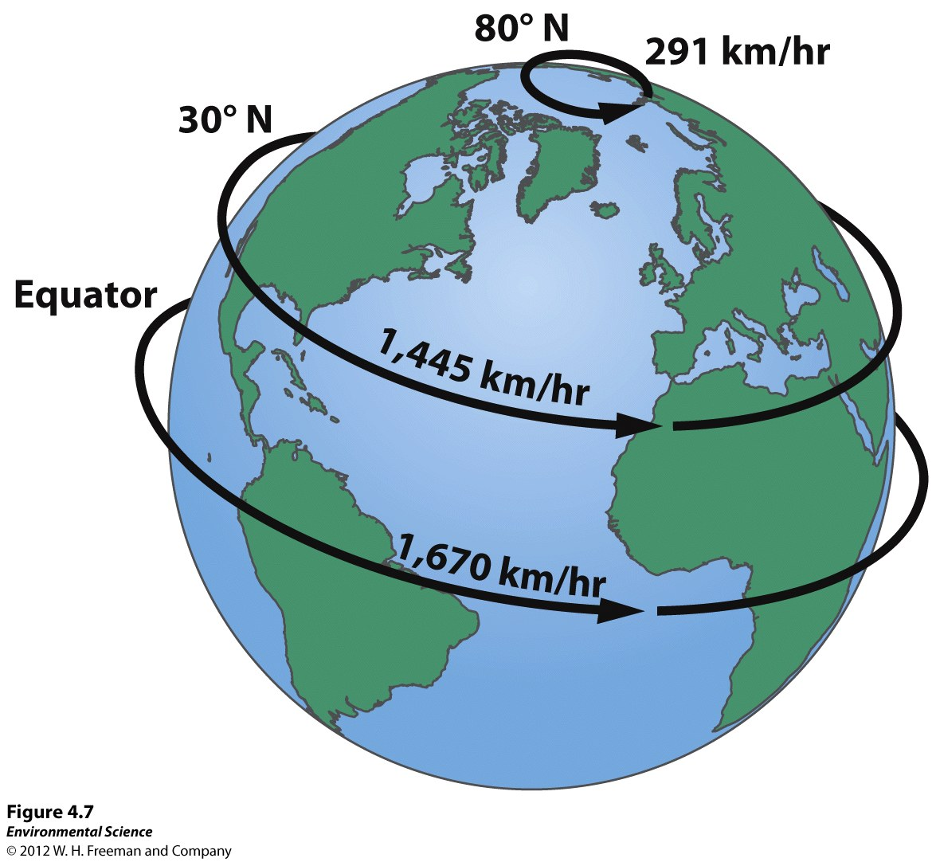

Slide 7
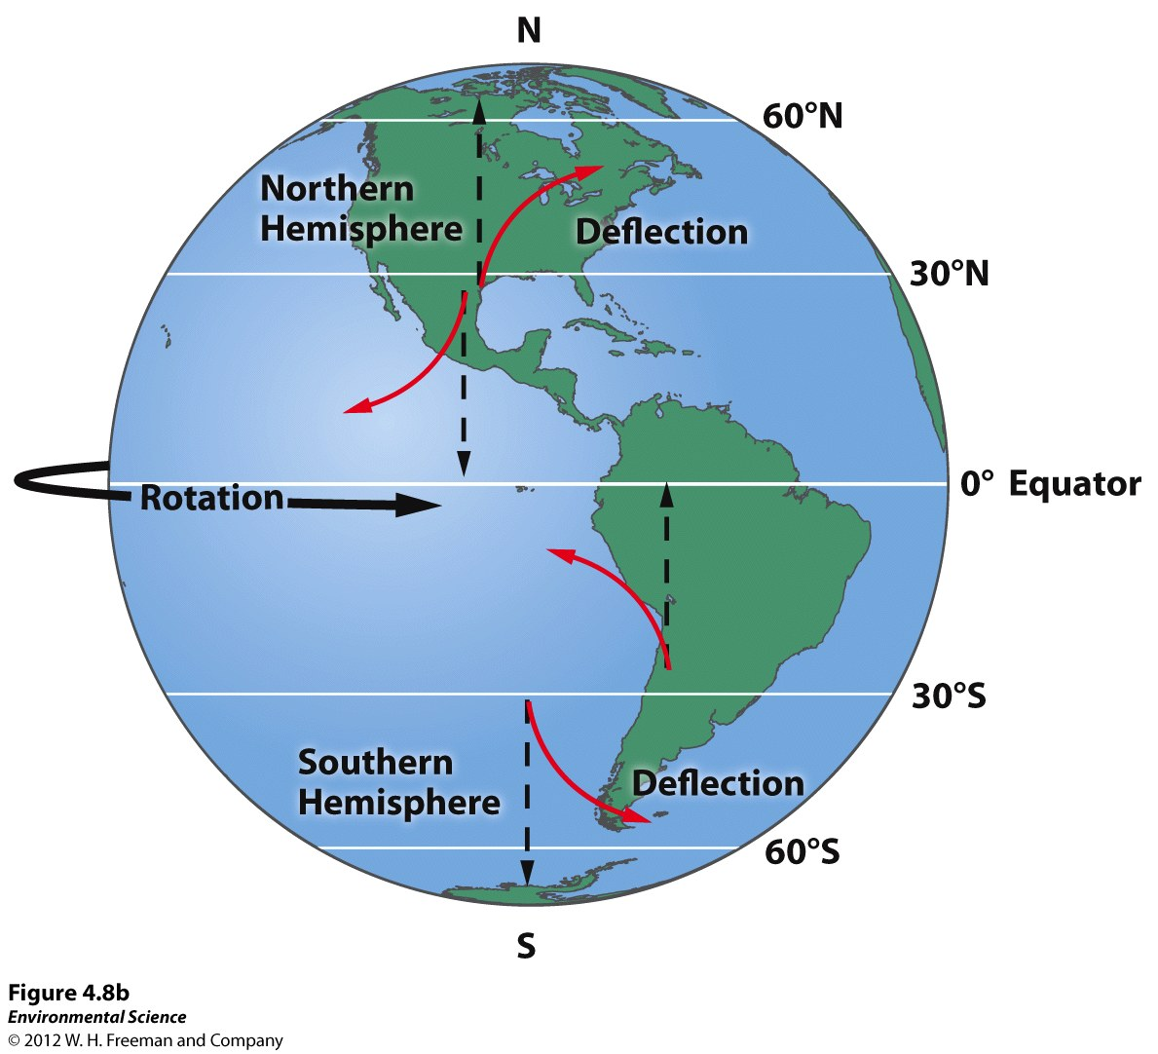

Slide 8
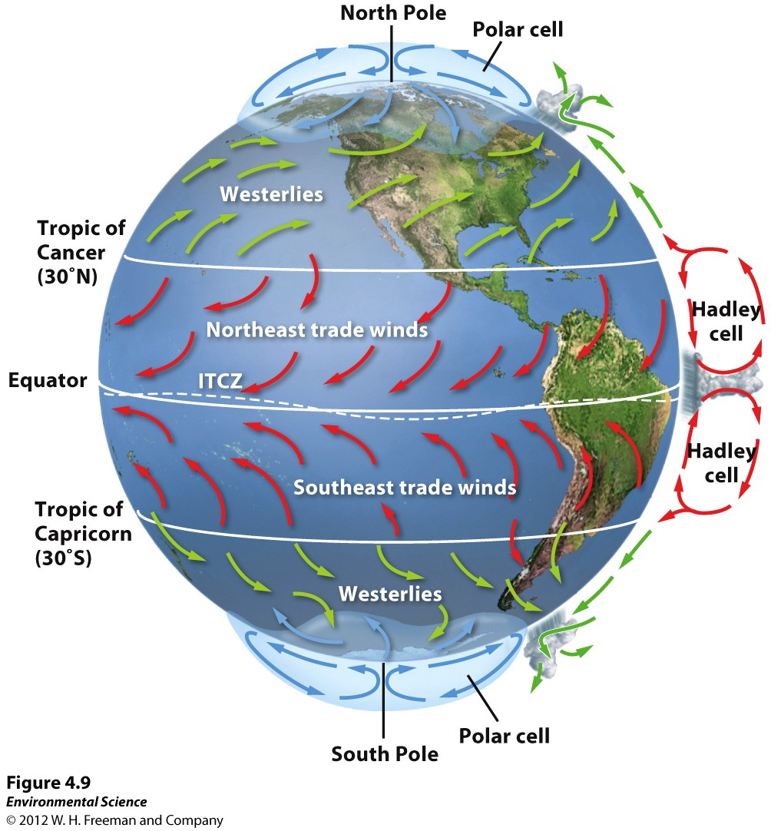

Slide 9
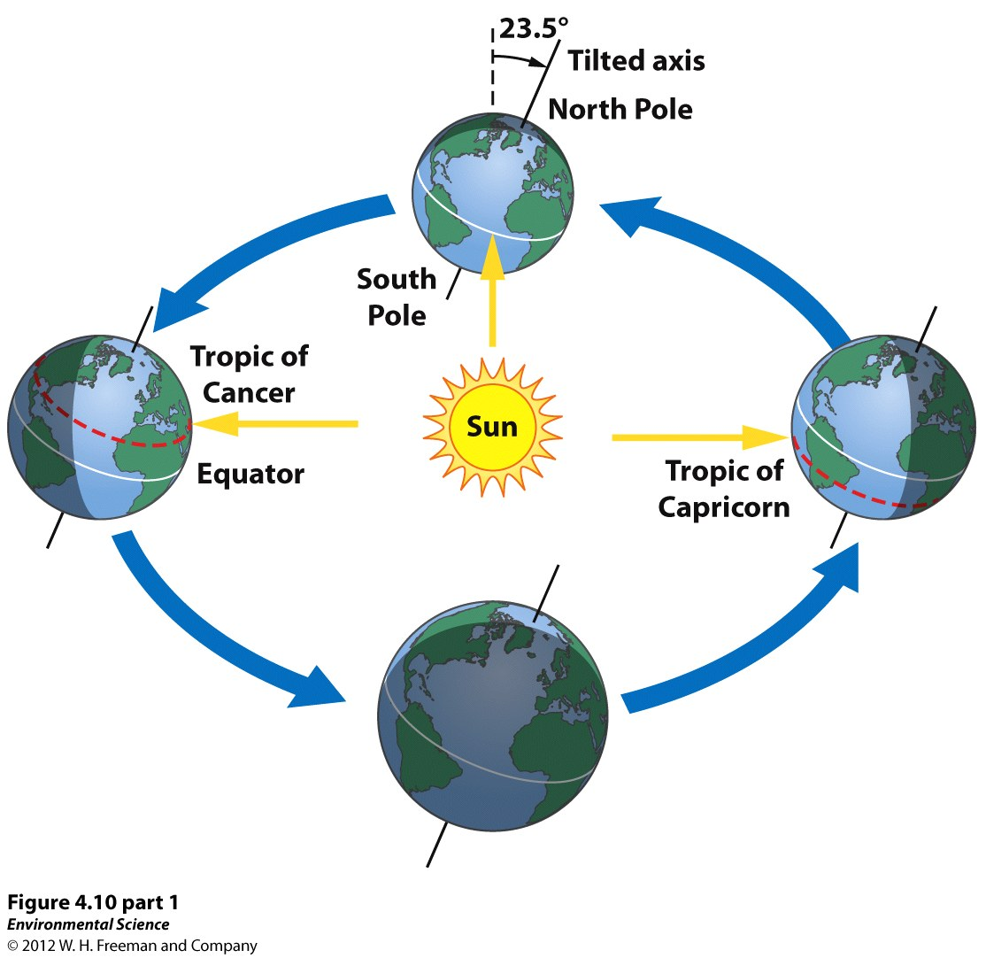

Slide 10
2. What three phenomena cause wind patterns worldwide?
Coriolis Effect
Convection Currents
Mixing of air currents on the mid-latitudes

Slide 13
3. Summarize how the Earth’s oceans help regulate temperature on the planet.
Gyres: large circulation- redistributes heat
Currents diverge- deep cold water rises as the warm water moves past
Thermohaline Circulation: dense salty water sinks
El Nino Southern Oscillation (ENSO)

Slide 14
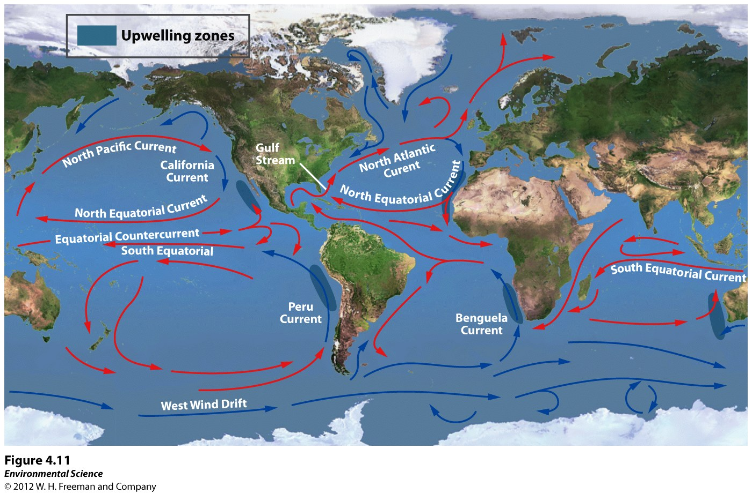

Slide 15
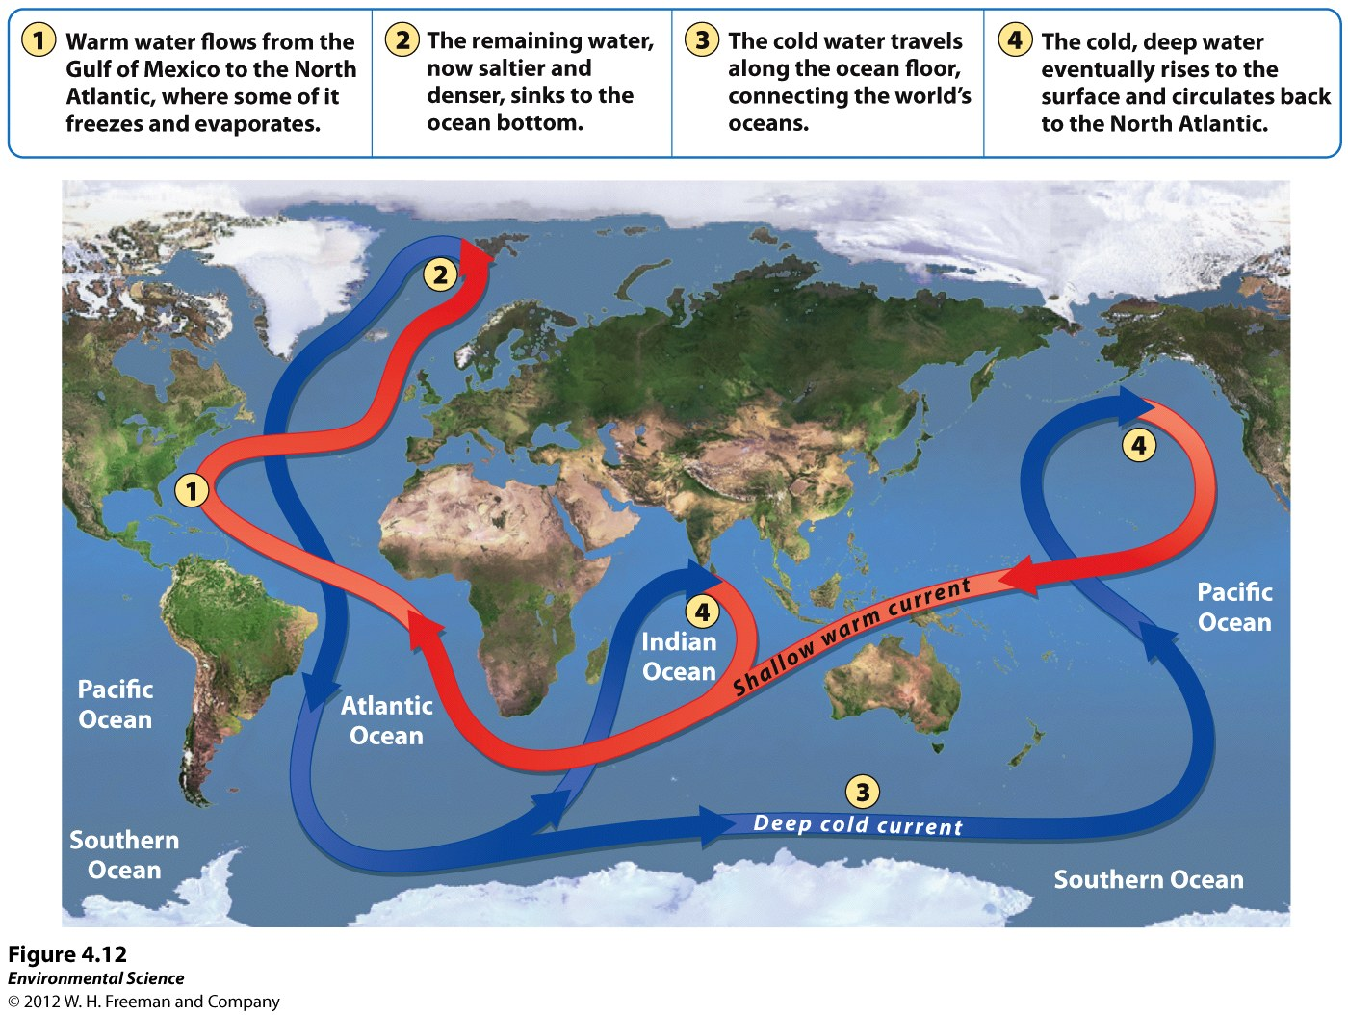

Slide 16
4. Define climate and explain how it differs from weather.
Climate: average weather over a long period of time. Temperature and precipitation within an area over several decades.
Weather: day to day conditions.

Slide 17
5. List the five layers of the atmosphere.
Troposphere: weather
Stratosphere: Ozone: protects us from UV light (95% of the harmful rays from reaching us)
Mesosphere:
Thermosphere: Blocks X rays
Exosphere: Aurora Borealis

Slide 18
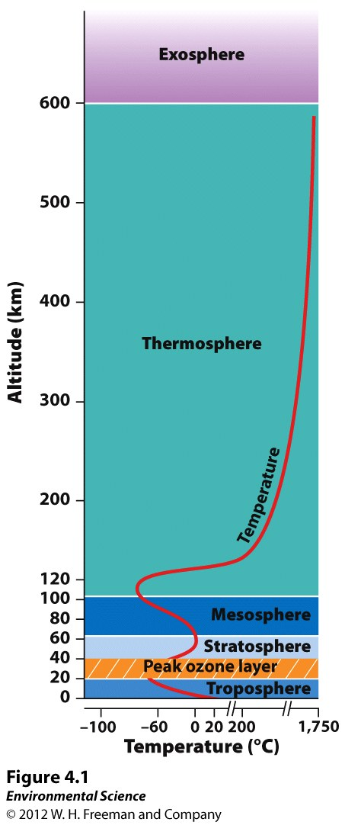

Slide 19
6. Why are there deserts both 30 N and 30 S latitude??
Hadley Cells

Slide 21
7. Explain why the equator and the tropic are on average much warmer than the poles.
Direct sunlight at the tropics!

Slide 22
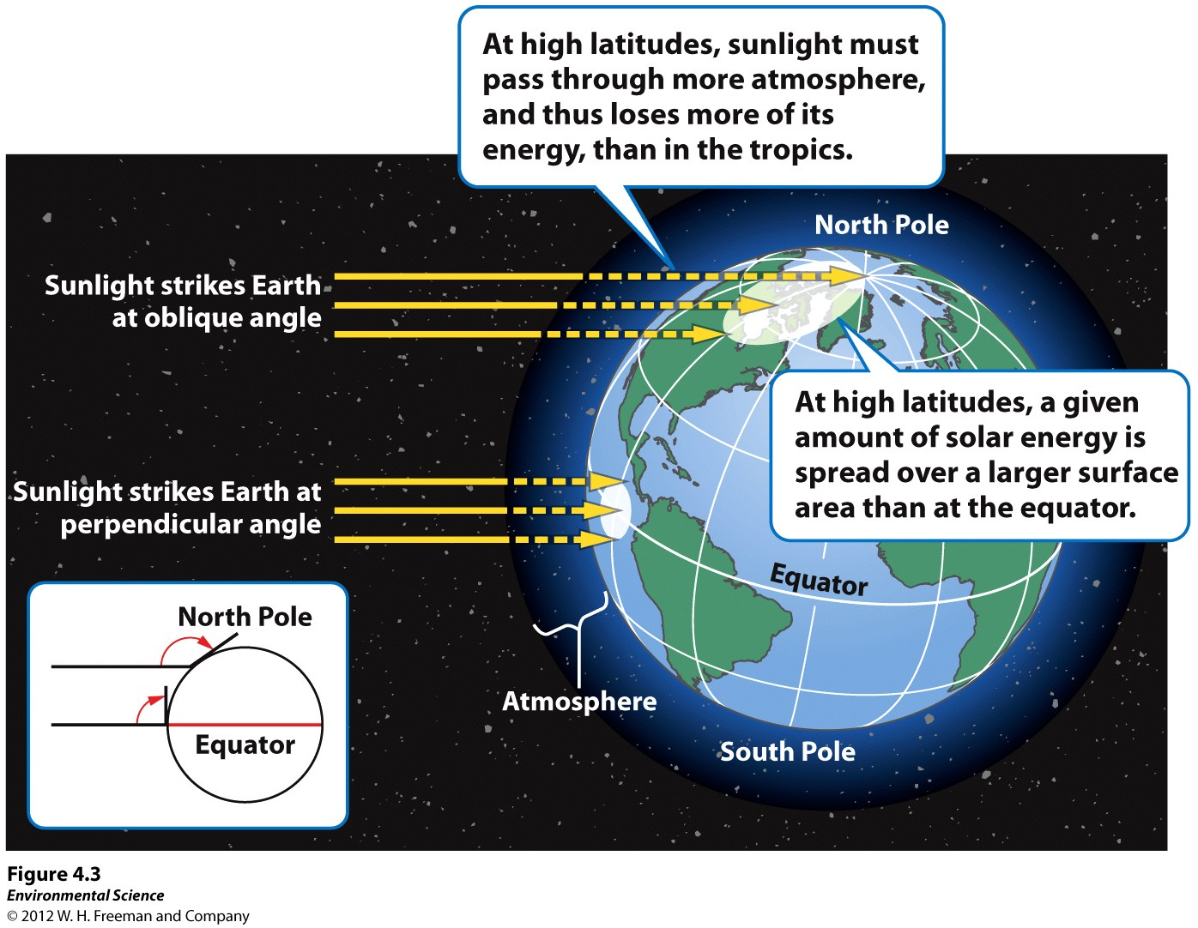

Slide 23
8. List 3 factors that contribute to the unequal heating of the Earth.
Tilt of the Earth, angle in which sunlight hits
Surface area variation
Albedo

Slide 24
9. Define albedo. What type of surfaces have high albedo, low albedo. How does the melting of the polar ice caps contribute to increasing temperatures?
Albedo: reflectivity of something.
High: snow, ice, sand.
Low: black soil, pavement, dark green vegetation, open water.
Melting of polar ice caps: less reflection hence increased temps.

Slide 26
10. What four properties of air influence its movement around the world?
Density: Warm air is LESS dense therefore rises. Cool air sinks.
Water Vapor Capacity: warm air can hold more water vapor than cold air.
Adiabatic Cooling/Heating: As air rises, the pressure lowers. Allows molecules to move further apart and cools the temp of the air.
Latent Heat Release: when water evaporates a tiny amount of energy is stored. Will be released when condensation occurs.

Slide 28
11. Explain the Coriolis Effect.
Coriolis Effect: the apparent curvature of an object traveling long distances.
North: air masses appear to curve clockwise.
South: air masses appear to curve counterclockwise.
Earth travels faster at the equator!!

Slide 30
12. What effect does the Earth’s tilt have on climate? What does the Earth’s tilt produce?
More direct rays in particular areas (tropics)
Produces seasons.

Slide 32
13. Explain the general trend of thermohaline circulation.
Warm surface winds create vertical currents in the ocean.
Warm, fresher water moves along the surface and cold, saltier water moves deep beneath the surface.

Slide 34
14. Explain gyres and upwelling. How do these effect the terrestrial temperatures?
Gyres: Large scale ocean currents. Driven by temperature, winds and gravity.
Surface currents flow horizontally great distances across the globe curving.
Equatorial ocean currents carry warm water to cooler regions.
Cool water currents carry water from high latitude regions or from deep in the ocean.

Slide 35
Upwelling: Cold water that comes up from the ocean floor and is rich in nutrients.

Slide 37
15. Describe the conditions of an ENSO (ElNino-Southern Oscillation).
Weakening of the trade winds.
Suppresses upwelling along the coast of South America.
Creates rainstorms and floods in generally dry regions (S Cal)
Causes drought and fire in regions that are typically moist (S Africa and Southeast Asia).

Slide 38
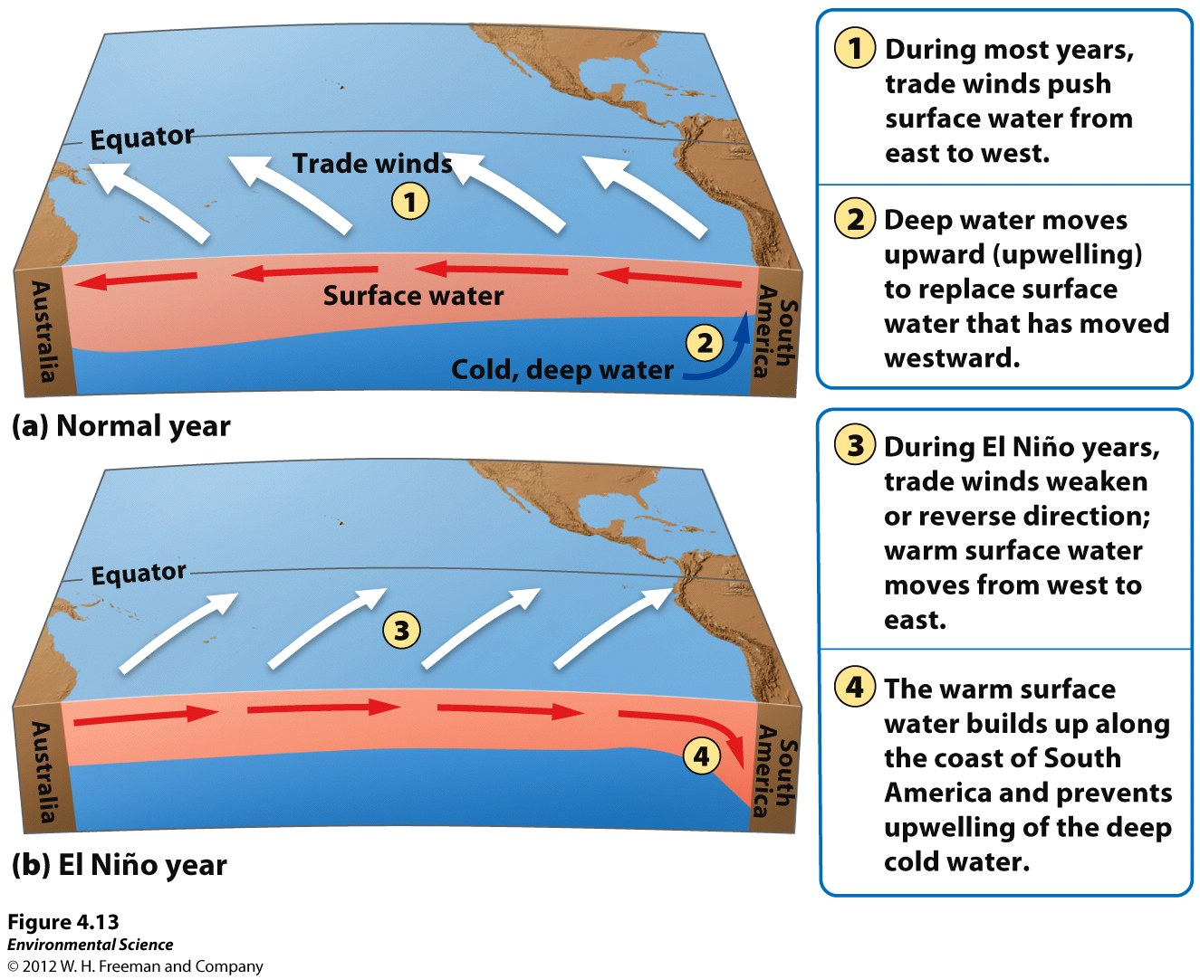

Slide 39
What factors directly determine the type of biome?
Temperature
Precipitation
Type of soil
Flora and fauna

Slide 40
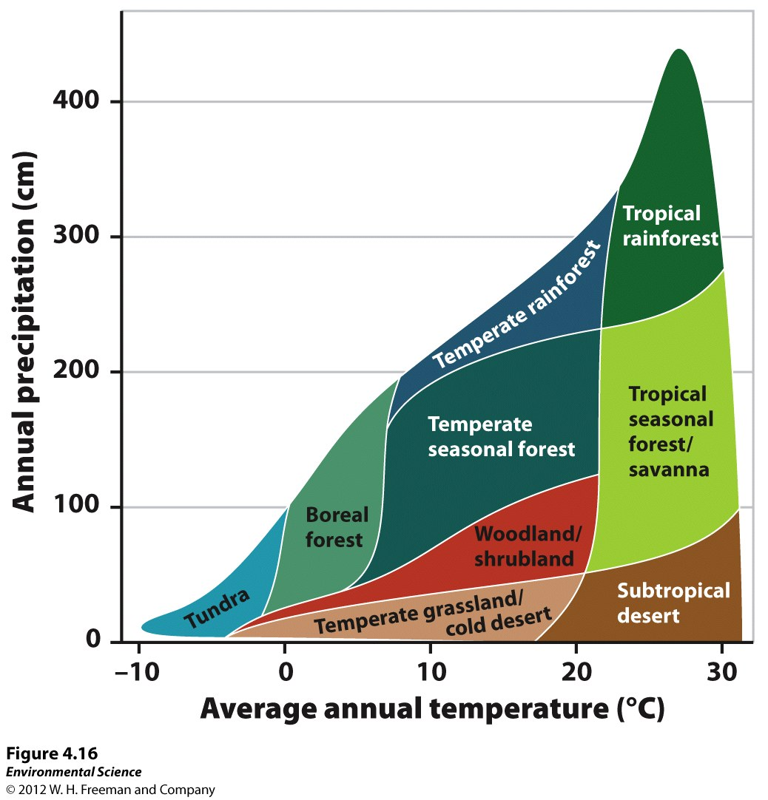

Slide 41
17. How are aquatic biomes catergorized?
Salinity
Depth
Water Flow

