Slide 1
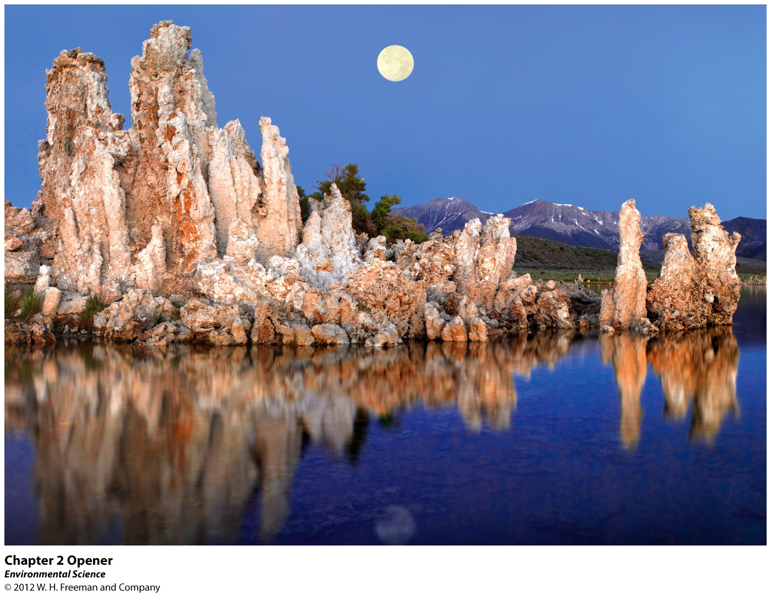
Chapter 2
Environmental Systems

Slide 3
Earth is a Single Interconnected System
All Environmental Systems Consist of Matter
Matter: occupies space and has mass.
Mass: measure of the amount of matter it contains.

Slide 4
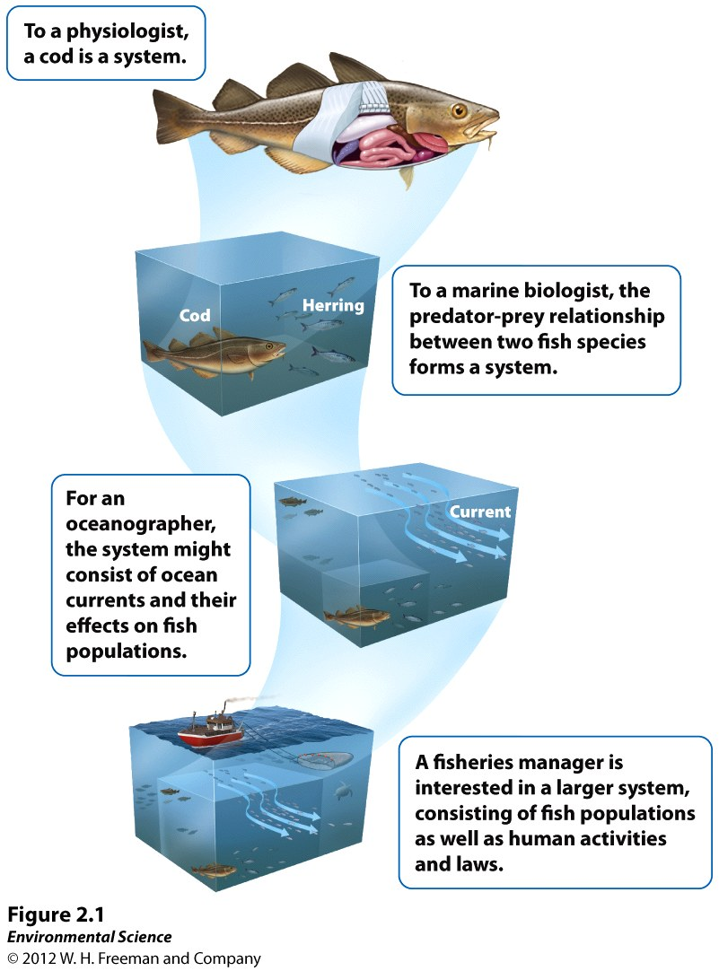

Slide 5
Atoms and Molecules
Atom: smallest particle that can contain the chemical properties of an element. Composed of electrons, neutrons, and protons.
Element: composed of atoms that cannot be broken down further.
Atomic Number: number of protons in the atom’s nucleus.
Mass Number: total number of protons and neutrons in an element.

Slide 6
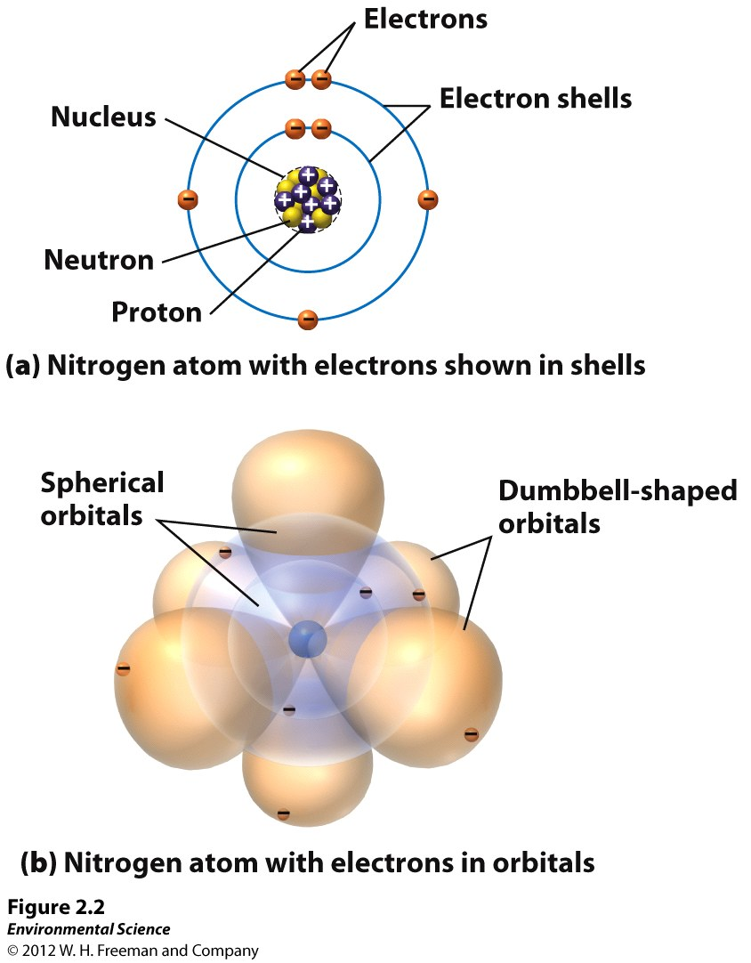

Slide 7
Radioactivity
Isotopes: An atom with the same number of protons but the number of neutrons varies.
Radioactive Decay: spontaneous release of material from the nucleus.
Half Life: the time it takes for one-half of the original radioactive parent atoms to decay.

Slide 8
Chemical Bonds
Covalent Bonds: Share electrons.
Ionic Bonds: Transfers electrons therefore becomes charged.
Hydrogen Bonds: Bonds between molecules that have hydrogen bonds.
Polar Molecule: One side is more positive while the other is more negative.

Slide 9
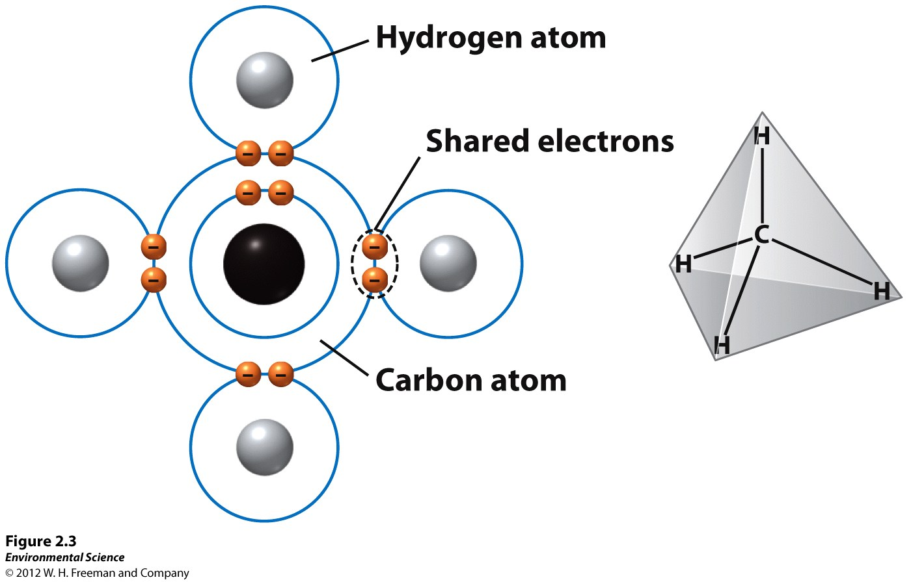

Slide 10
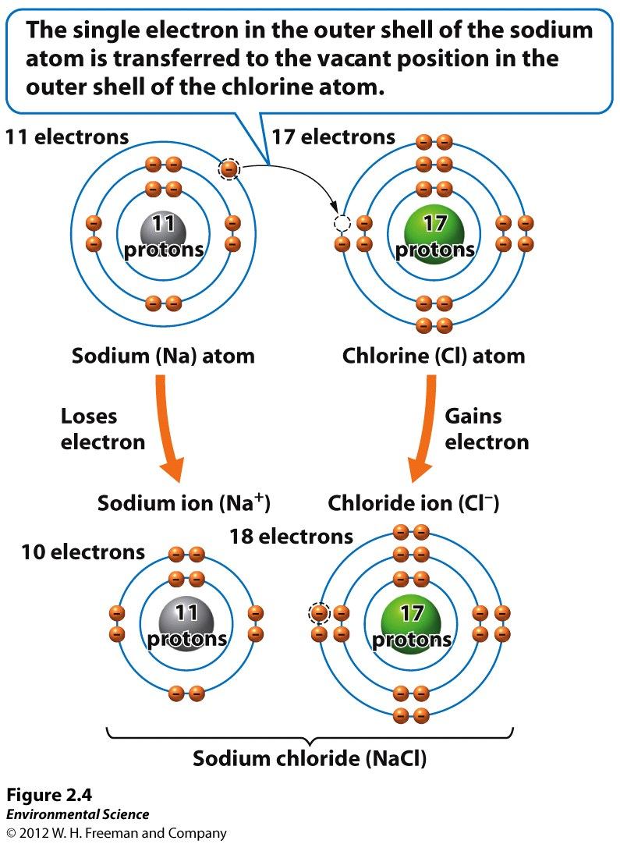

Slide 11
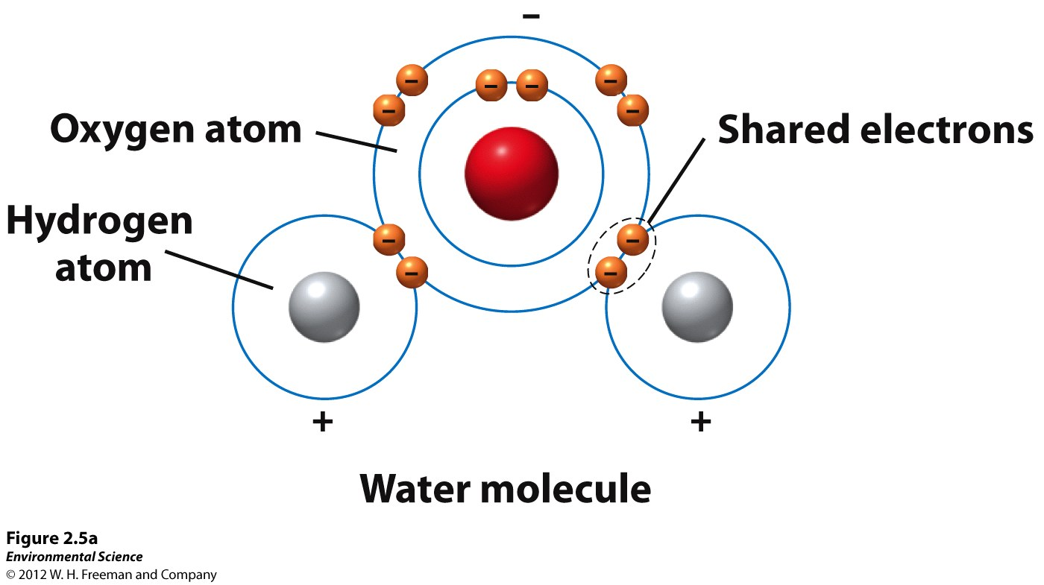

Slide 12
Properties of Water
Cohesion: water sticks to itself.
Adhesion: water sticks to other things.
Surface Tension: cohesion of water at the surface.
Capillary Action: adhesion of water to a surface is stronger than to itself.
Boiling and Freezing: expands upon freezing, takes a lot of energy to break the bonds and boil.
Universal Solvent

Slide 13
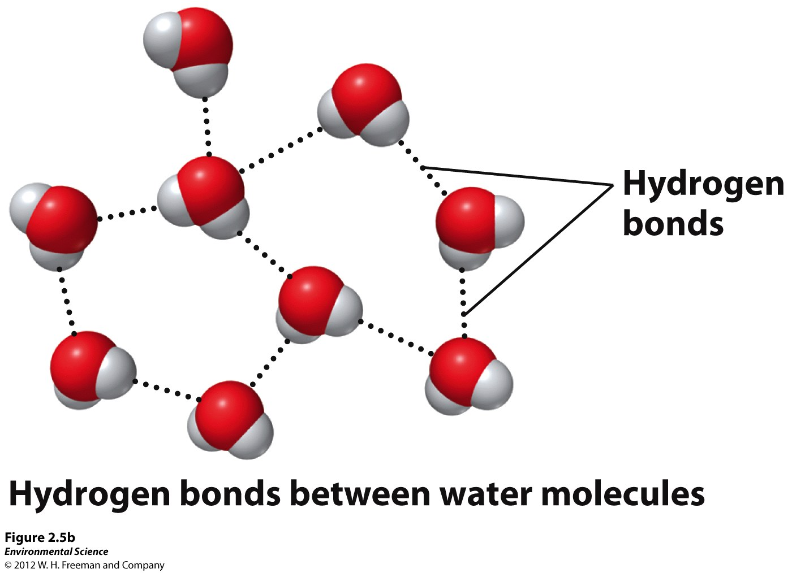

Slide 14
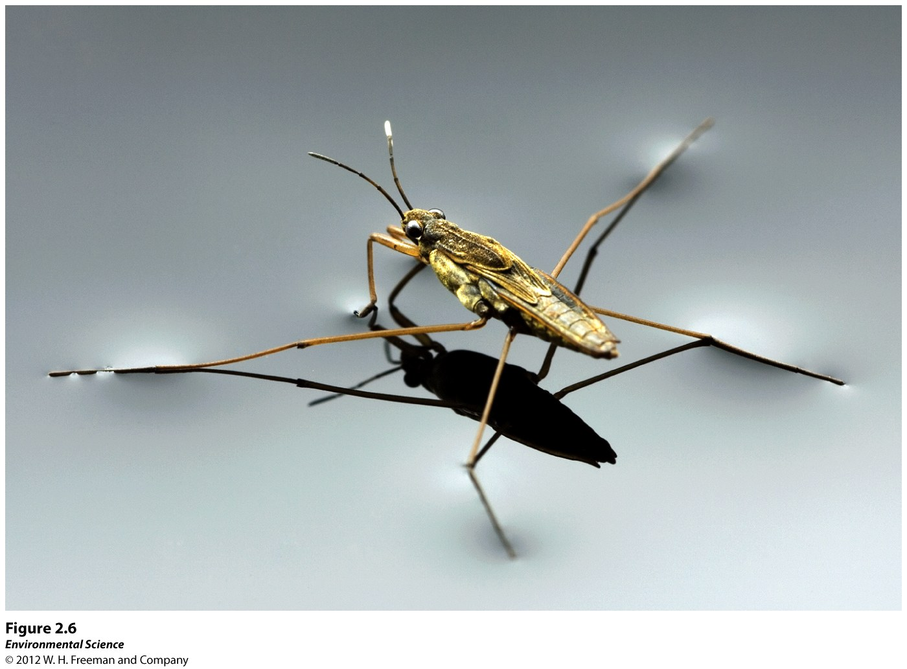

Slide 15
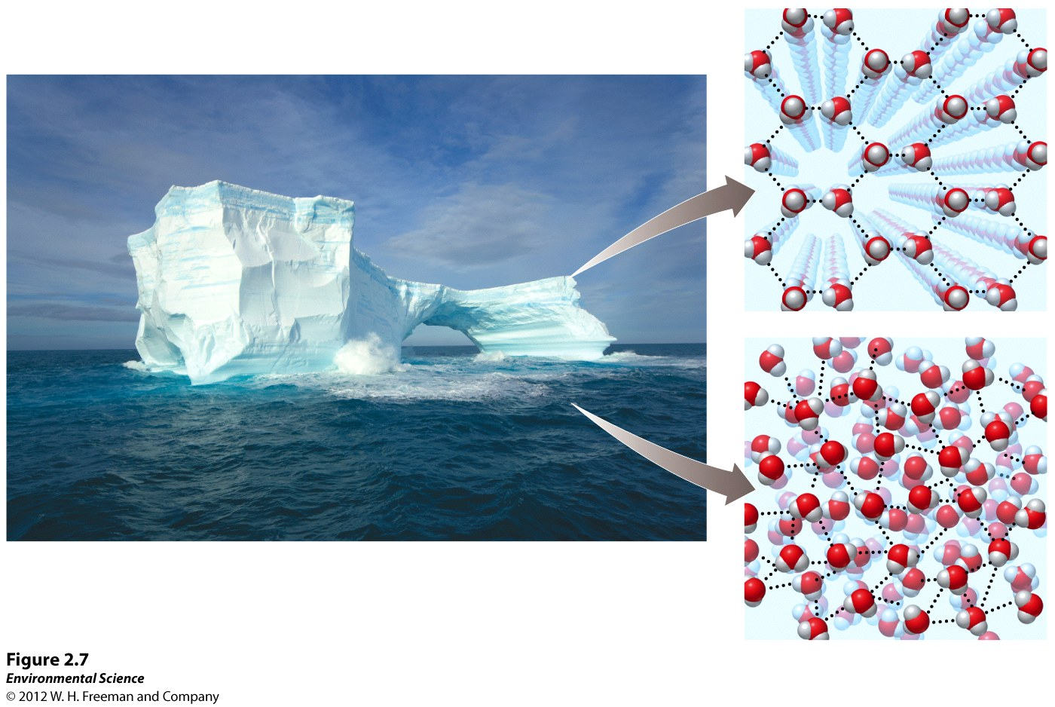

Slide 16
Acids, Bases and pH
Acid: contributes hydrogen ions.
Base: contributes hydroxide ions.
Important Acids:
Nitric Acid: (HNO₃)
Sulfuric Acid: (H₂SO₄)
Important Bases:
Sodium Hydroxide: (NaOH)
Calcium Hydroxide: (Ca(OH)₂)

Slide 17
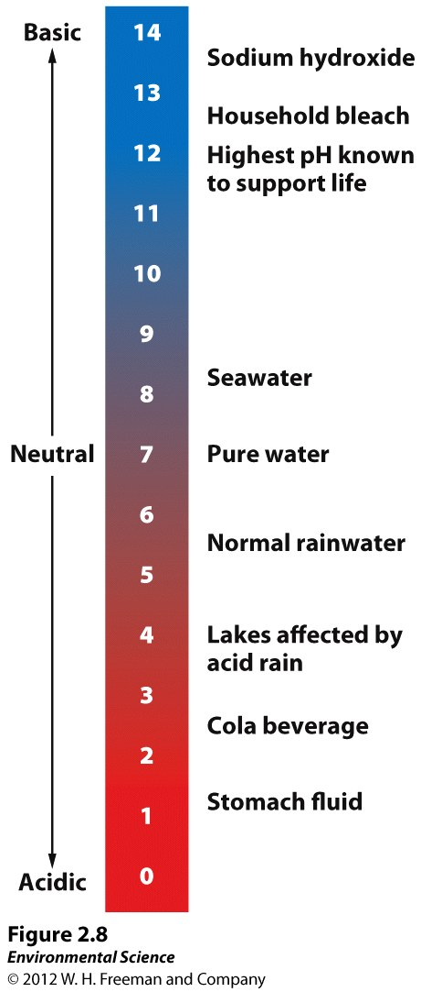

Slide 18
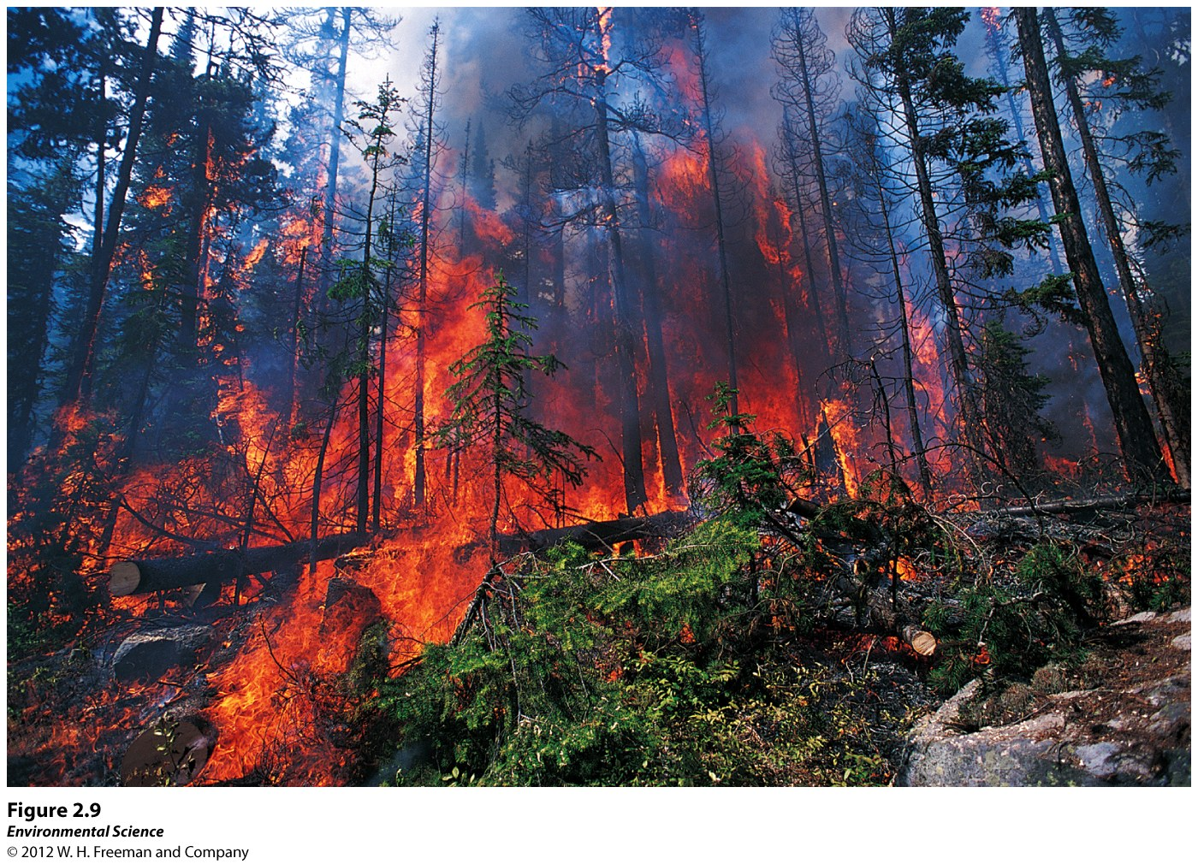
Conservation of Matter
Matter cannot be created or destroyed; it can only change form.

Slide 19
Biological Molecules and Cells
Inorganic Molecules:
Do not contain carbon.
Do contain carbon but bound to other elements other than hydrogen (CO₂).
Organic Molecules:
a) Have carbon-carbon and carbon-hydrogen bonds.

Slide 20
Organic Macromolecules
Carbohydrates: sugars, starch
Proteins: long chains of amino acids
Nucleic Acids: DNA, RNA
Lipids: fats, waxes, and steriods
Cells!!

Slide 21
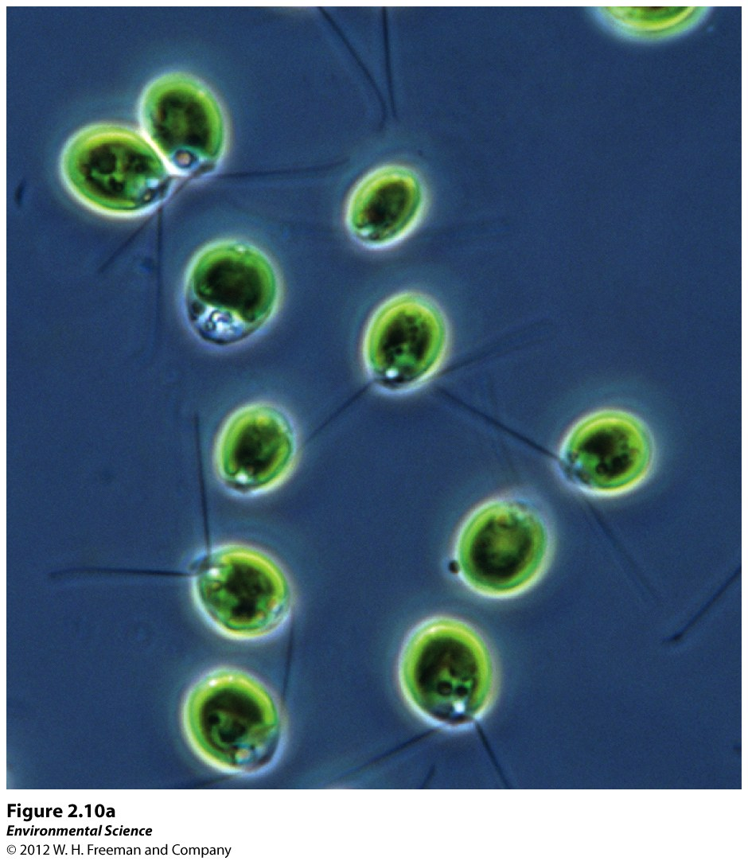

Slide 22
Energy In Environmental Systems
Energy: the ability to do work.
Most energy on Earth derives from the SUN!
The sun emits Electromagnetic Radiation.

Slide 23
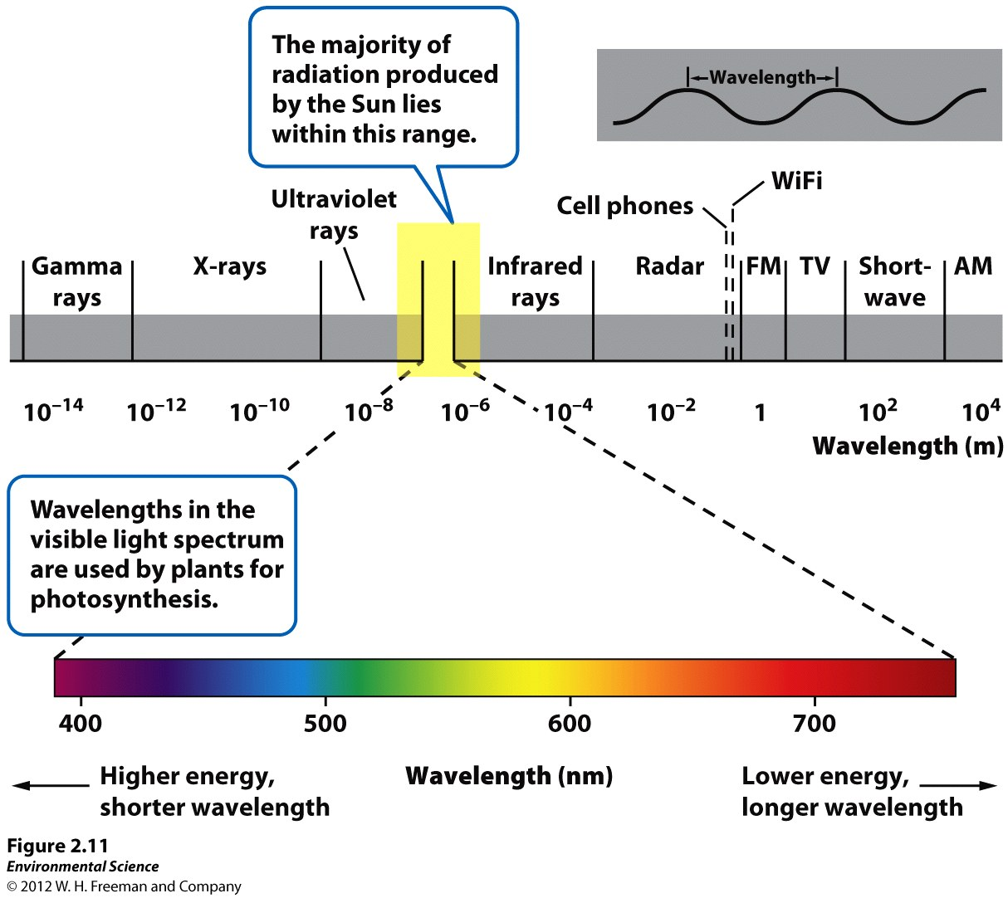

Slide 24
Forms of Energy
Energy is measured in joules.
Energy: the ability to do work.
Power: rate at which work is done.
Kinetic Energy: energy of motion.
Potential Energy: energy stored but not released.
Chemical Energy: potential energy in chemical bonds.

Slide 25
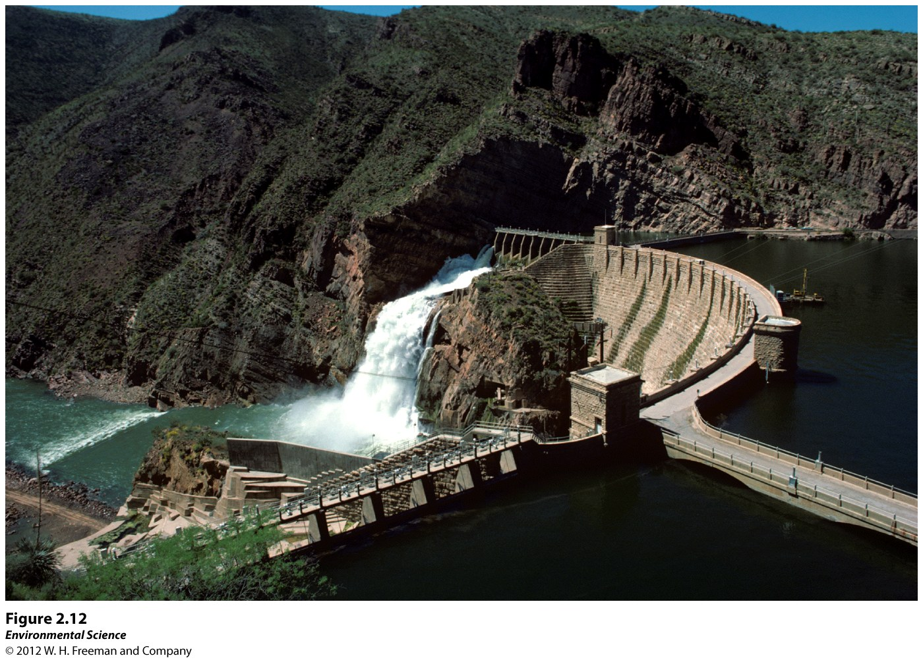

Slide 27
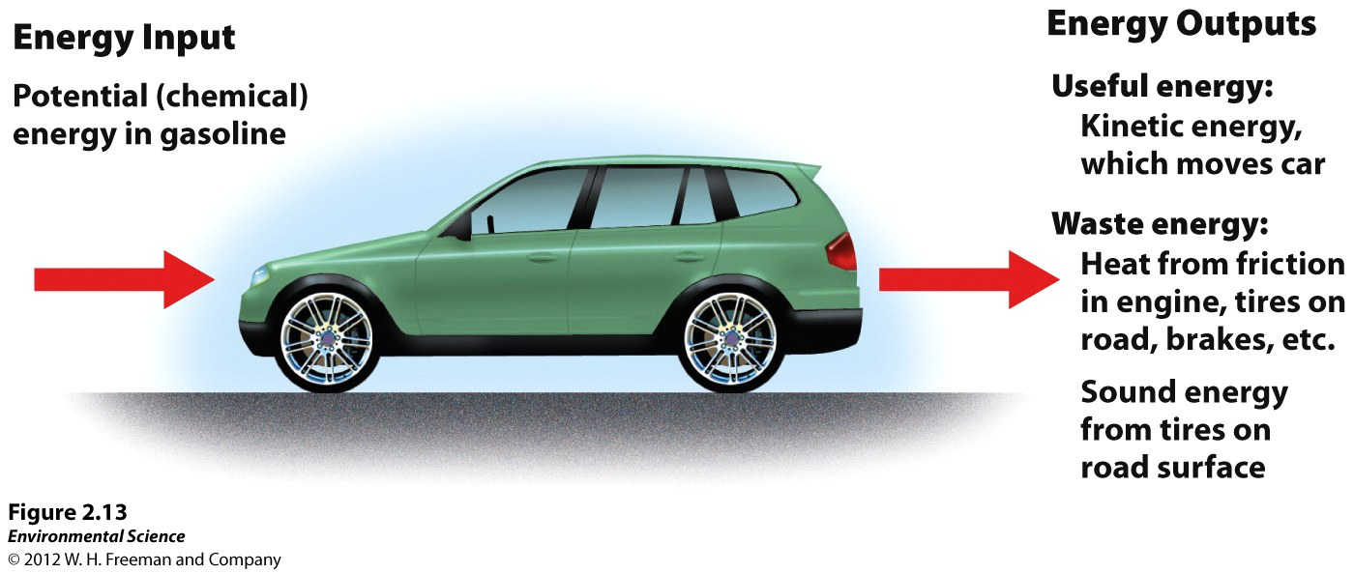
First Law of Thermodynamics: Energy is Conserved
Energy is neither created nor destroyed.

Slide 28
Second Law of Thermodynamics
When energy is transformed, the quantity of energy remains the same but its ability to do work diminishes.
Energy Efficiency: the ratio of the amount of work that is done to the total amount of energy that is introduced into the system.
Energy Quality: the ease at which an energy source can be used for work.
Wood vs Gasoline

Slide 29
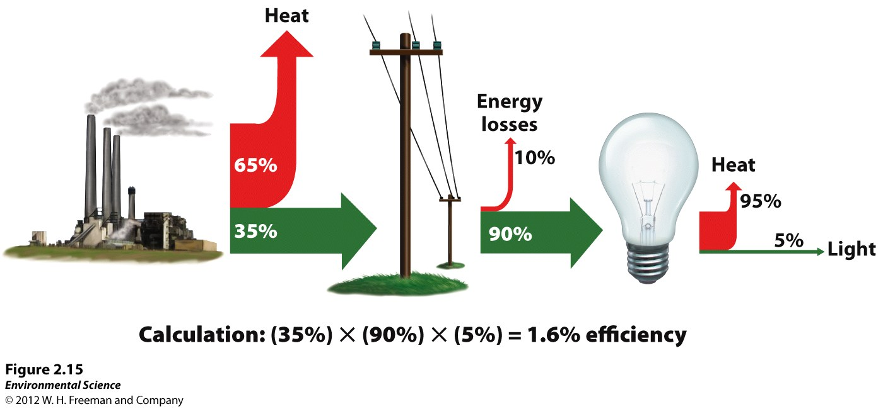

Slide 30
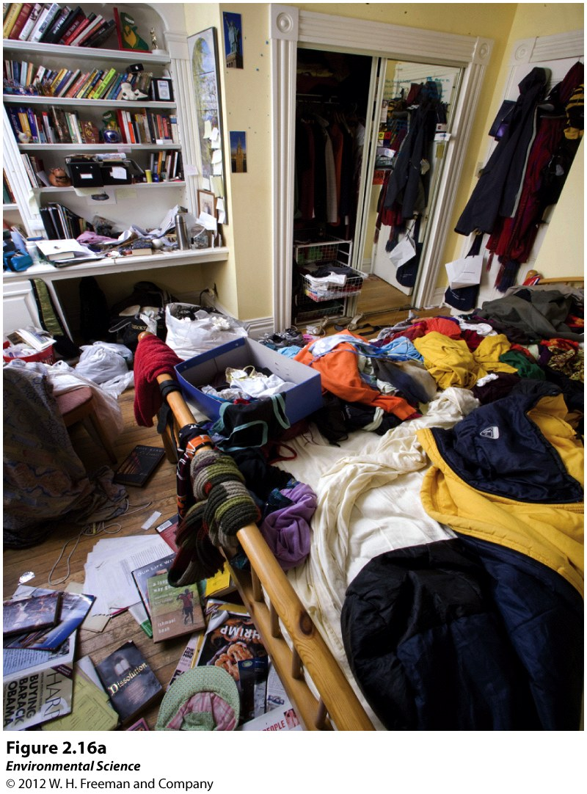
Entropy: all systems move towards randomness than towards order.

Slide 31
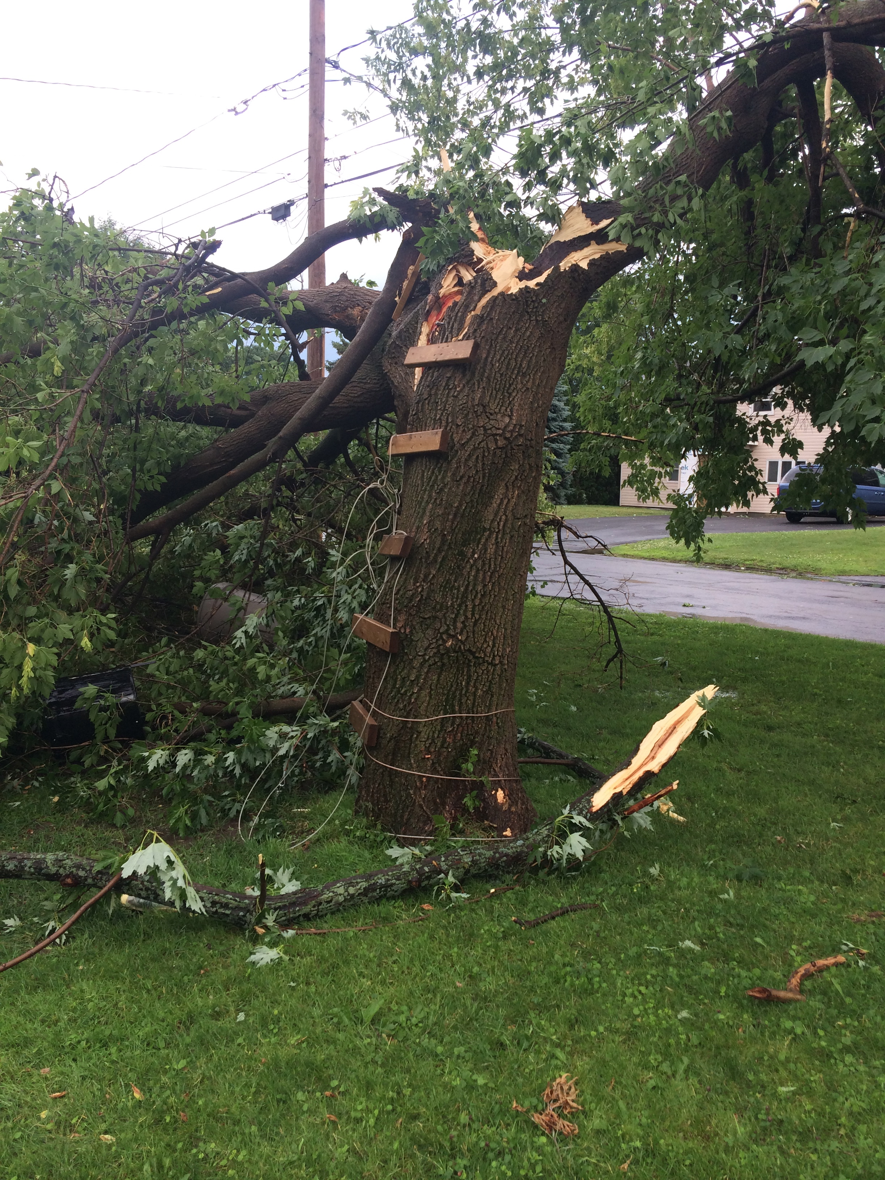
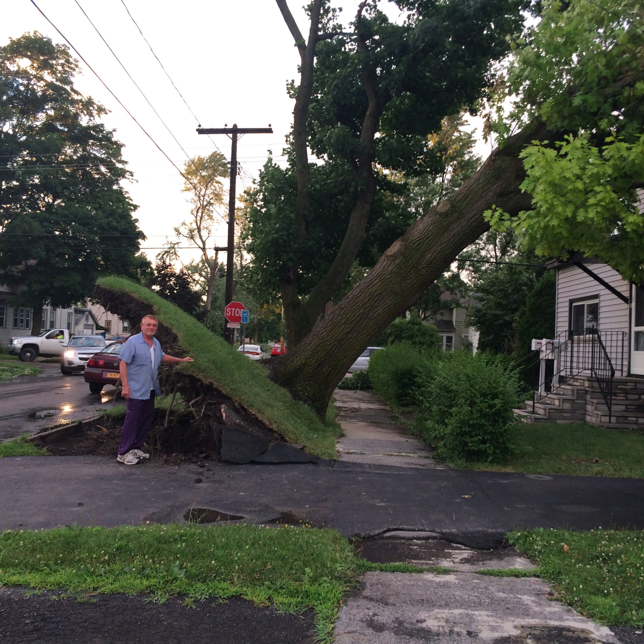

Slide 32
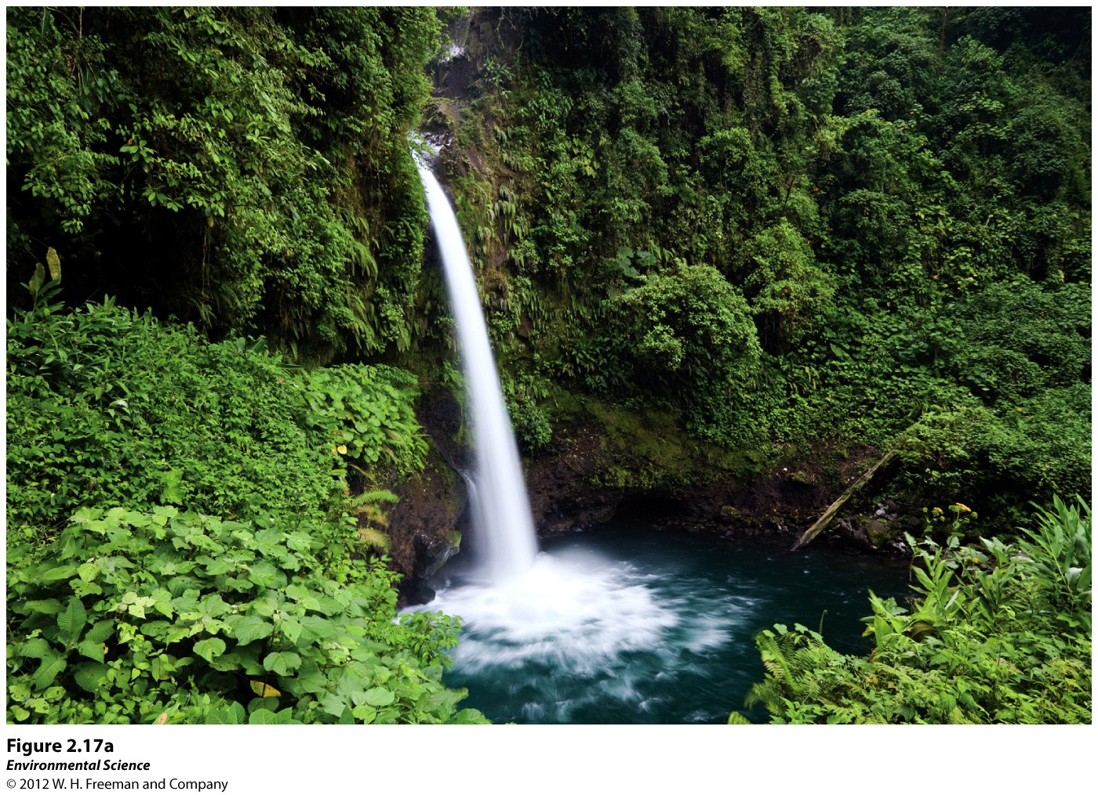
The form and amount of energy available in an environment determines what kind of organisms can live there!

Slide 33
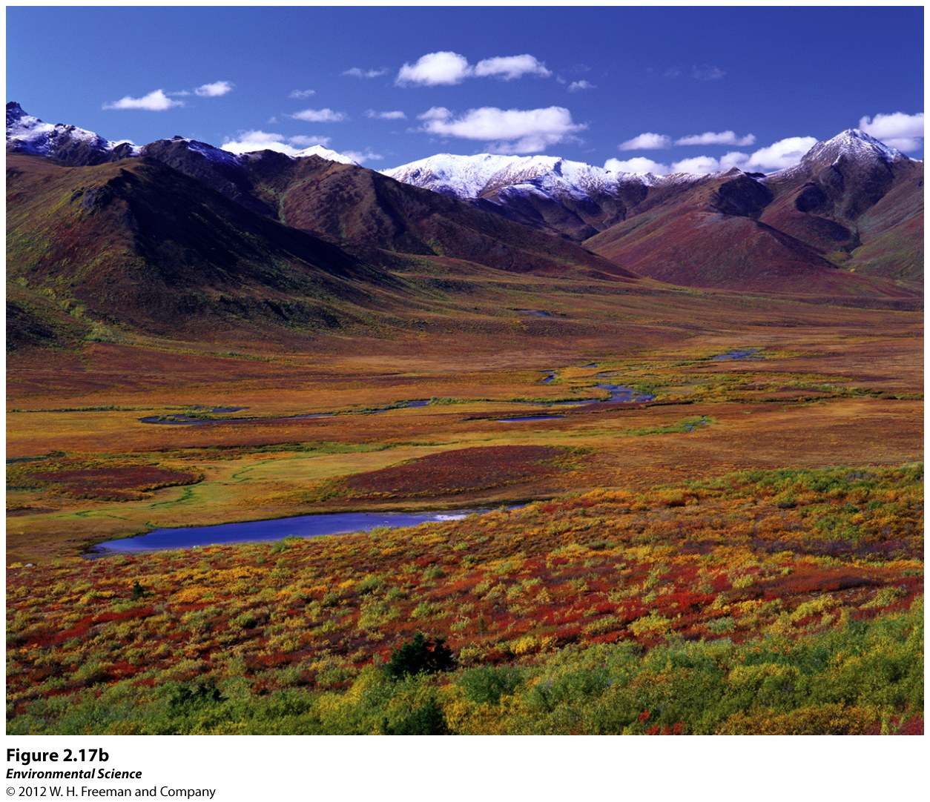

Slide 34
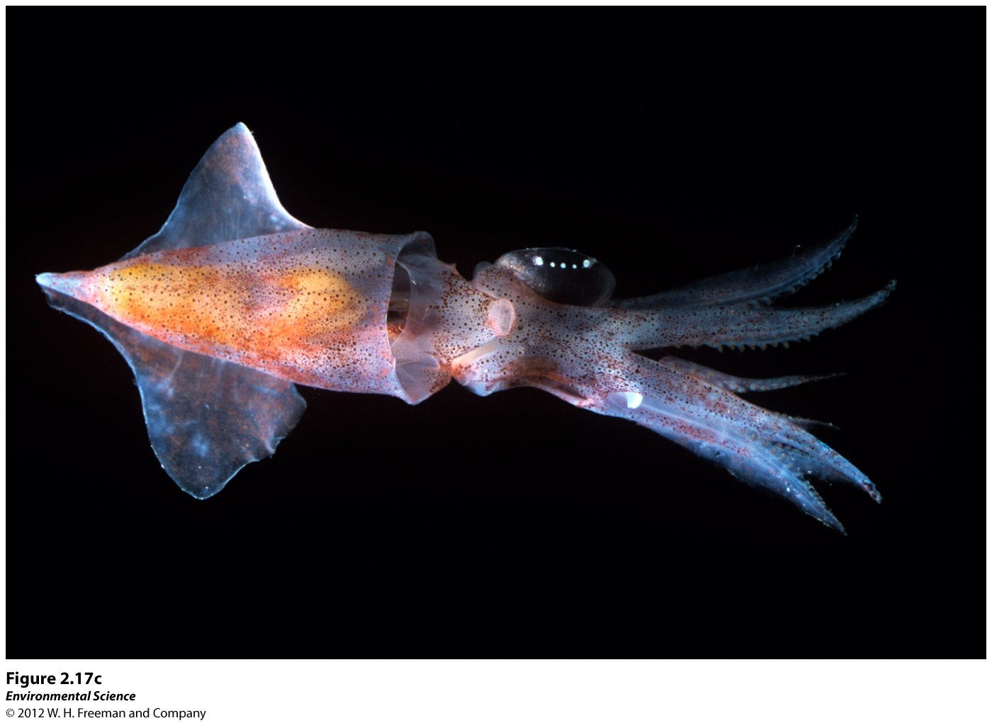

Slide 35
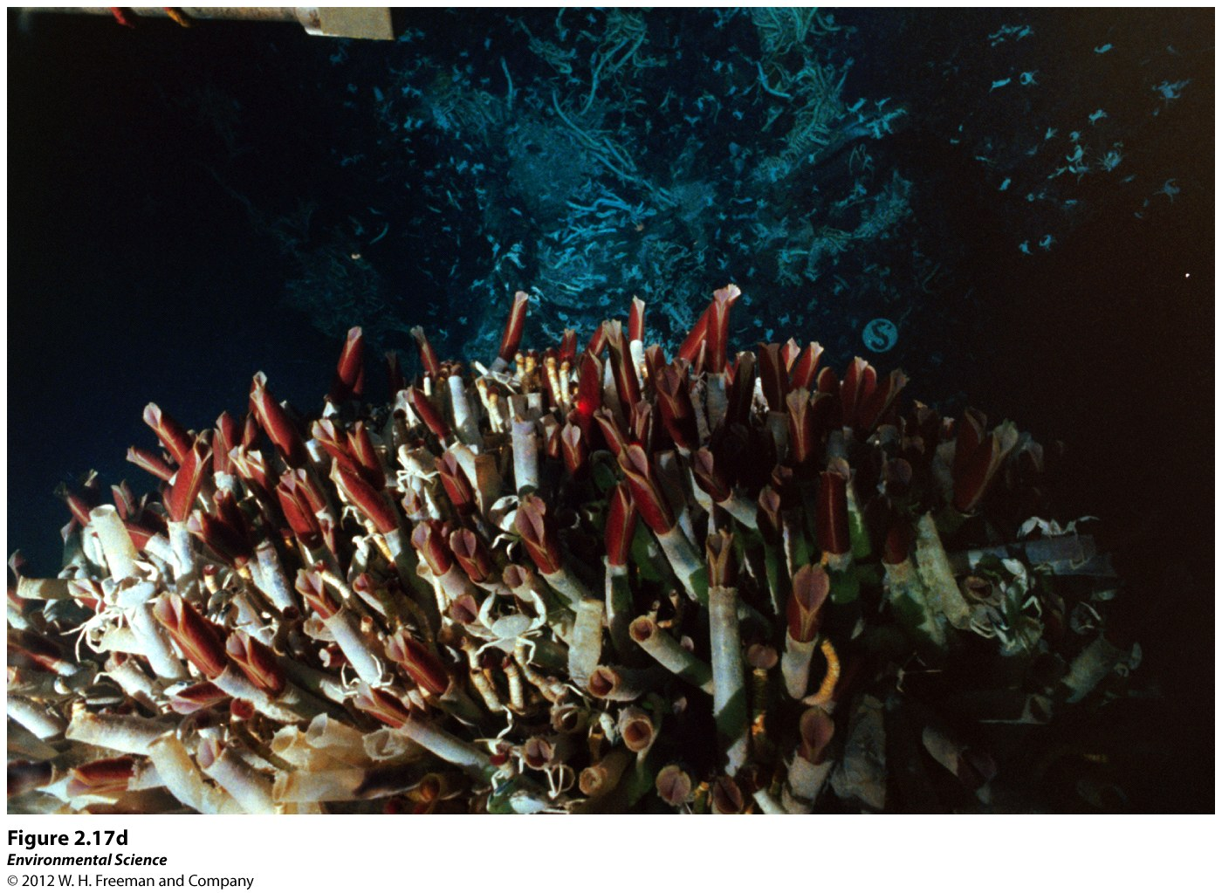

Slide 36
Systems Analysis Shows How Matter and Energy Flow in the Environment
Open System: exchanges of matter or energy occur across system boundaries.
Closed Systems: matter and energy exchanges across system boundaries do not occur.

Slide 37
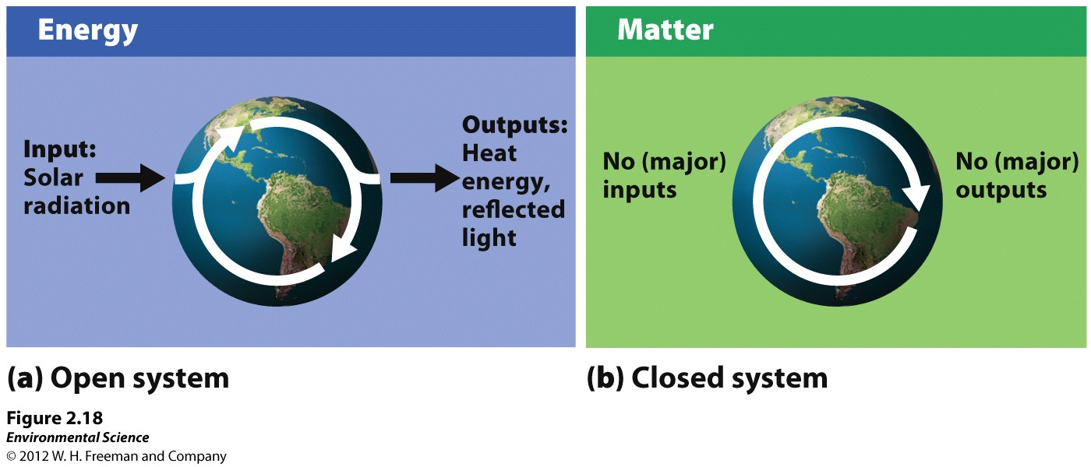

Slide 38
Feedbacks
Feedback: Adjustments in input or output rates caused by changes to a system. Attempts to get a system back to a “steady state”.
Negative Feedback Loop: a system responds to a change by returning to its original state (decreases the rate at which it is changing, resists change).
Positive Feedback Loop: a system amplifies due to a change.

Slide 39
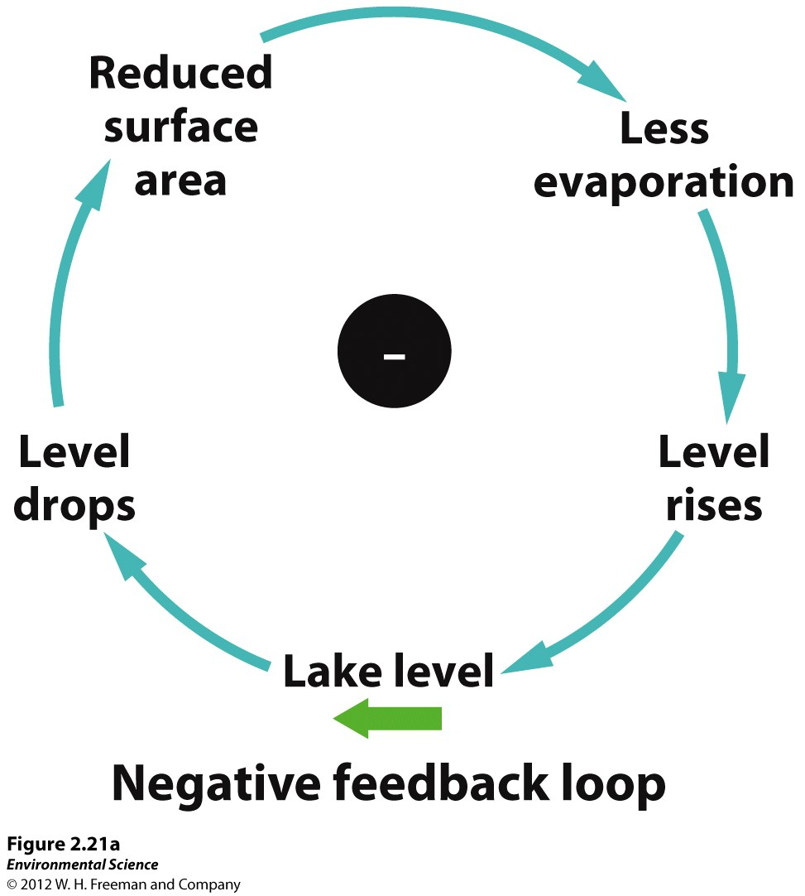

Slide 40
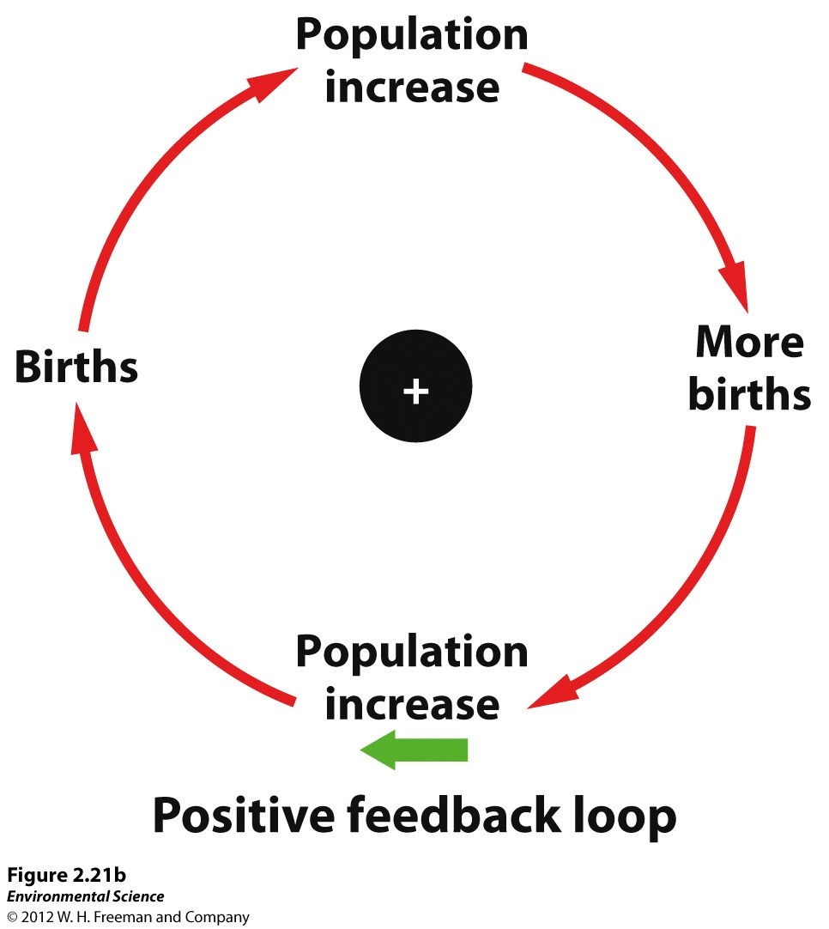

Slide 41
Natural Systems Change Across Space and Over Time
Over the history of the Earth small natural changes have large effects on complex systems.
Human activities have increased both the pace and intensity of these natural environmental changes.

Slide 42
