Slide 2
Biological Oxygen Demand Lab Write Up Hints
Title: Describe what we are doing in the lab (think of the IV and the DV).
Group Member’s names.
Primary question for investigation: why are we doing this lab.
Hypothesis: what do you think will happen to the oxygen gas as the amount of biodegradable material increases and WHY do you think that will happen?

Slide 3
E. Experimental Design: Include a full materials list and a description of the steps.
Data/Results: Copy in the data chart.
Graph the milk concentration vs. the total time for color change.
1 table, 1 graph

Slide 4
G. Answer the 15 questions. Make sure to include the question (re-write, type or cut and paste).
H. Conclusion/Discussion: Write a paragraph that addresses the purpose, hypothesis, and predictions of the lab. How is the amount of dissolved oxygen affected by the amount of biodegradable material in the water? Was your hypothesis supported or not supported by the results? Were your predictions correct? What do the results mean? Describe the evidence you obtained that supports your conclusion.

Slide 6
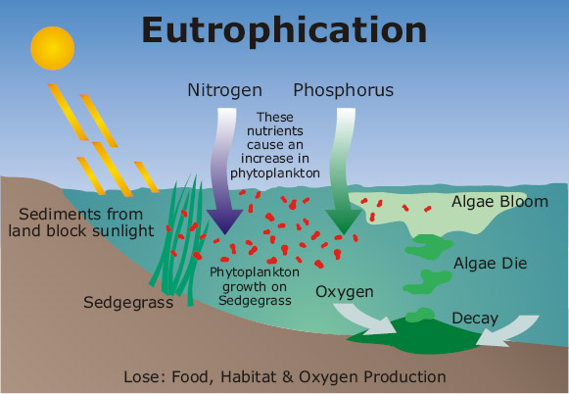

Slide 7
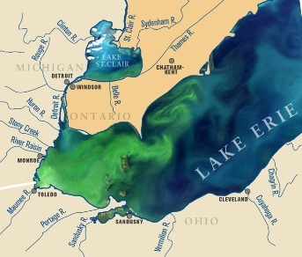

Slide 8
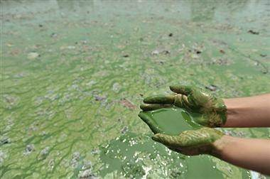

Slide 9
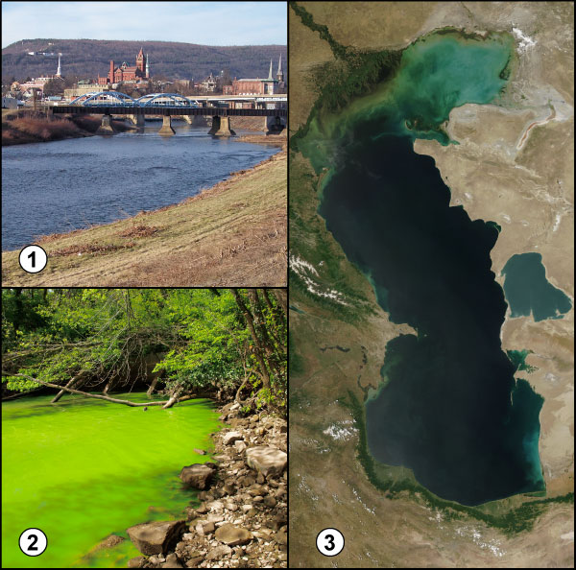

Slide 10
