Slide 1
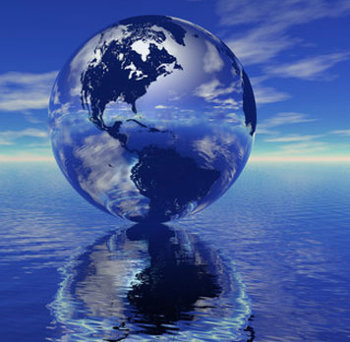
Chapter 9: Water Resources

Slide 2
Dams and Salmon on the Klamath River
Klamath River runs 250 miles from southern Oregon to northern California.
Once contained the 3rd largest salmon fishery on the West Coast.
In the early 1900s two large lakes were drained and turned into farmland.
4 hydroelectric dams were build between 1908 and 1962.
Presented a problem to migratory salmon and warmed the water above the dams.

Slide 3
In 1977 the Coho salmon was given protection under the US Endangered Species Act.
The river could not go under a certain level therefore this challenged farmers.
In 2002 the salmon suffered a major die-off due to warm waters, algal blooms, and disease.
Agreement with fisheries, farmers, and hydroelectric company was met and the damn is scheduled to be removed by 2020.

Slide 4
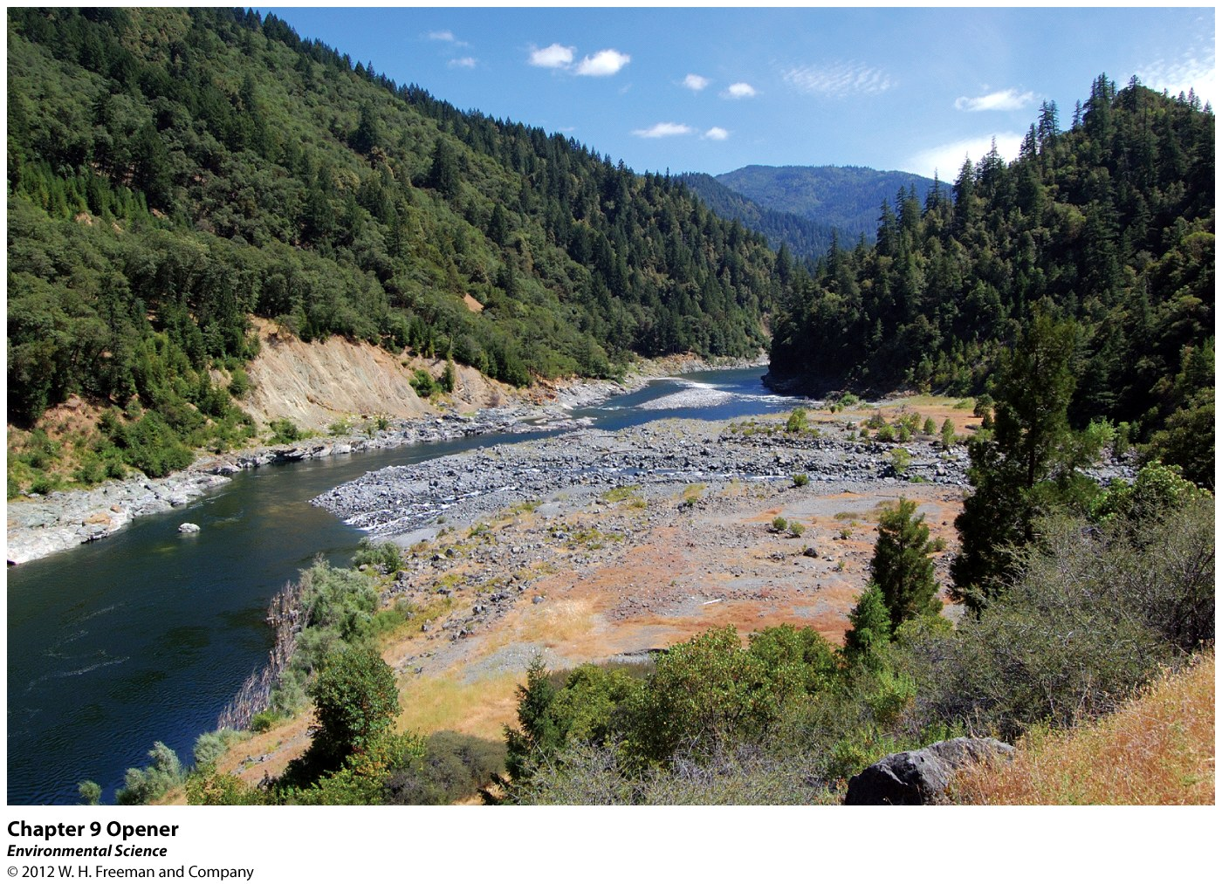

Slide 5
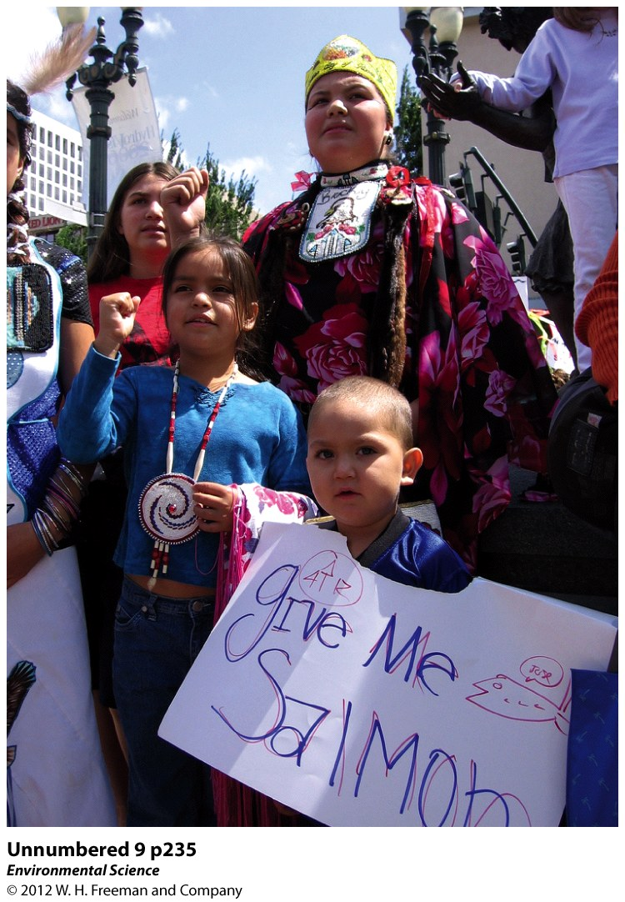

Slide 6
Water is Abundant, But Usable Water is Rare
Nearly 70% of the Earth is covered with water.
97% in the oceans.
3% is freshwater.
¼ is underground.
The rest is frozen in glaciers!!

Slide 7
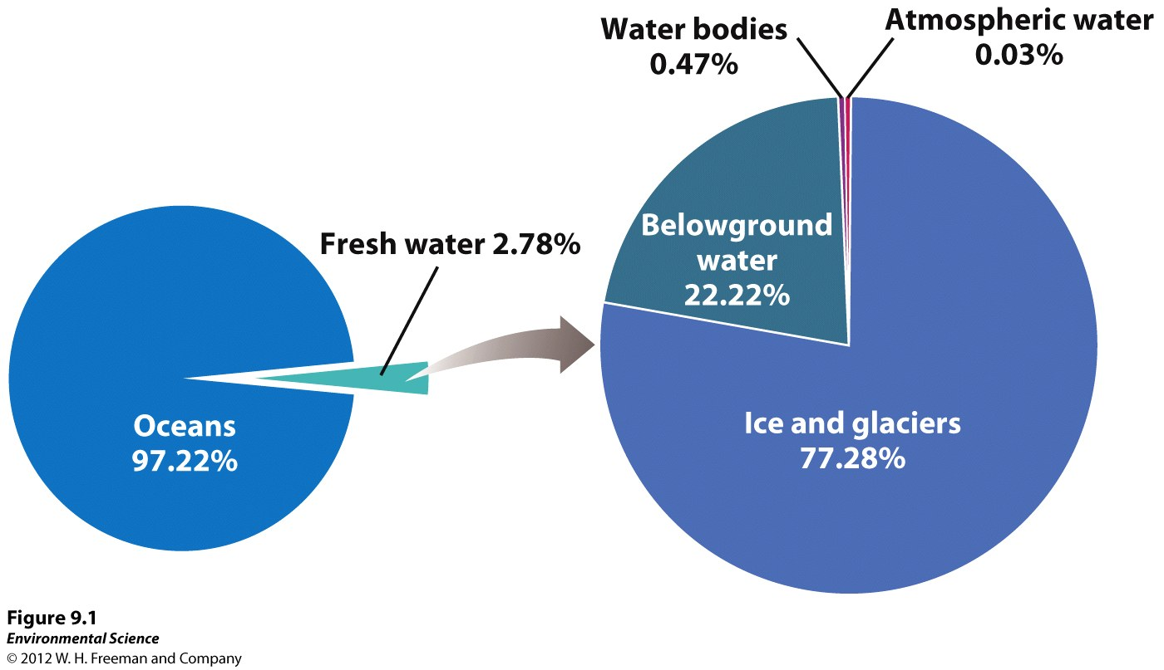

Slide 8
Groundwater
Aquifer: water found underground in the tiny spaces between rock and sediment.
Unconfined Aquifer: water can flow in and out, recharged often.
Confined Aquifer: water remains inside, less anthropogenic influence.
Water Table: the uppermost level at which the water in a given area fully saturates the rock or soil (surface of the groundwater).

Slide 9
Springs: water from aquifers percolate up to the ground surface.
Artesian Well: enough pressure from the surrounding rock to cause the water to rise.
Ogallala Aquifer: largest confined aquifer in the US. Found in the midwest.
Rapid pumping of a deep well can cause adjacent, shallower wells to go dry.

Slide 10
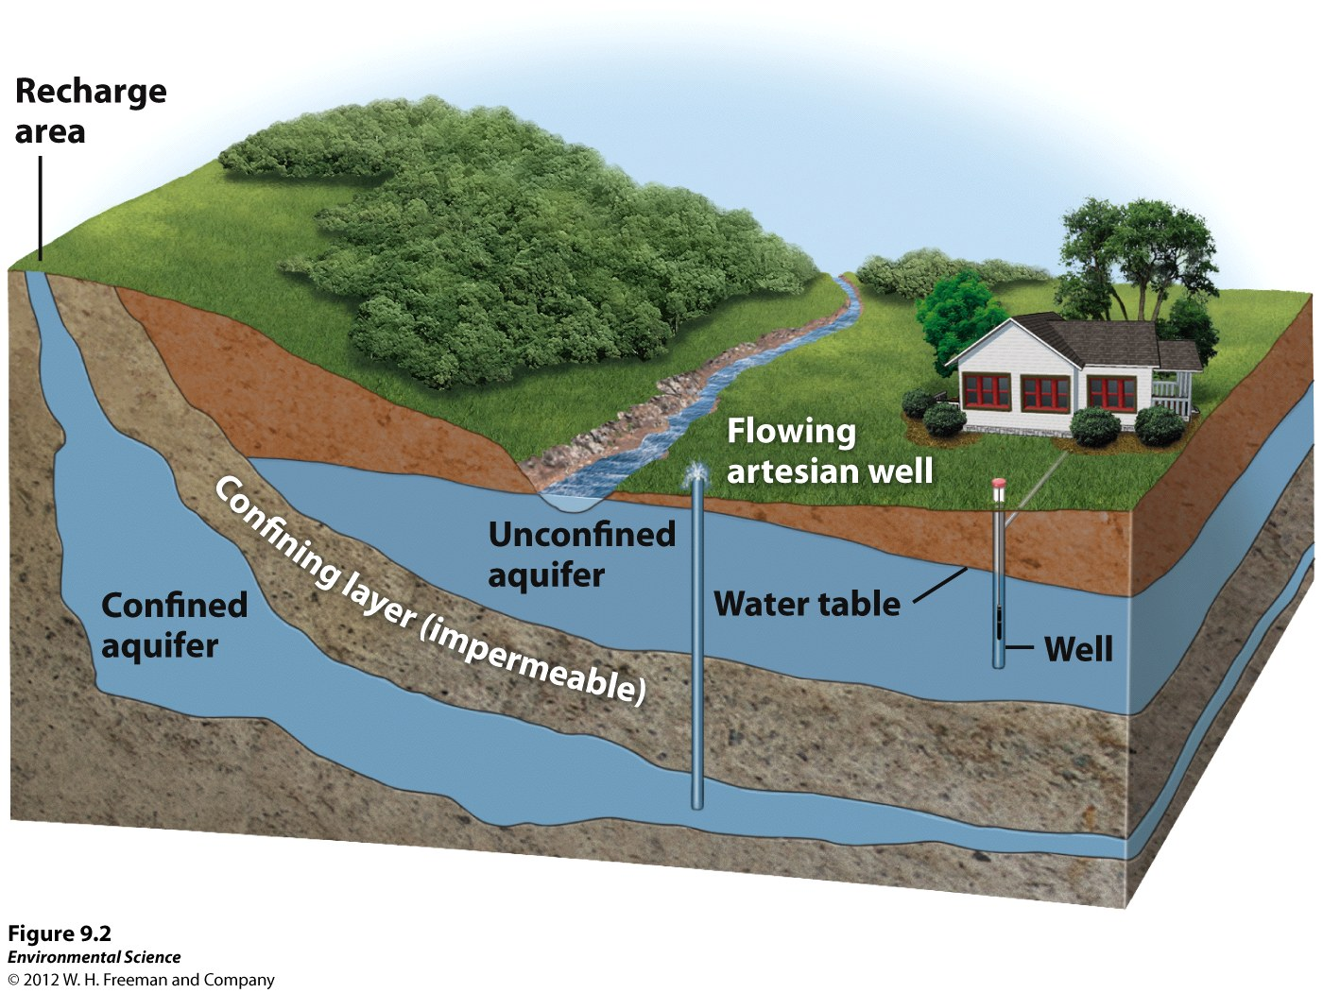

Slide 11
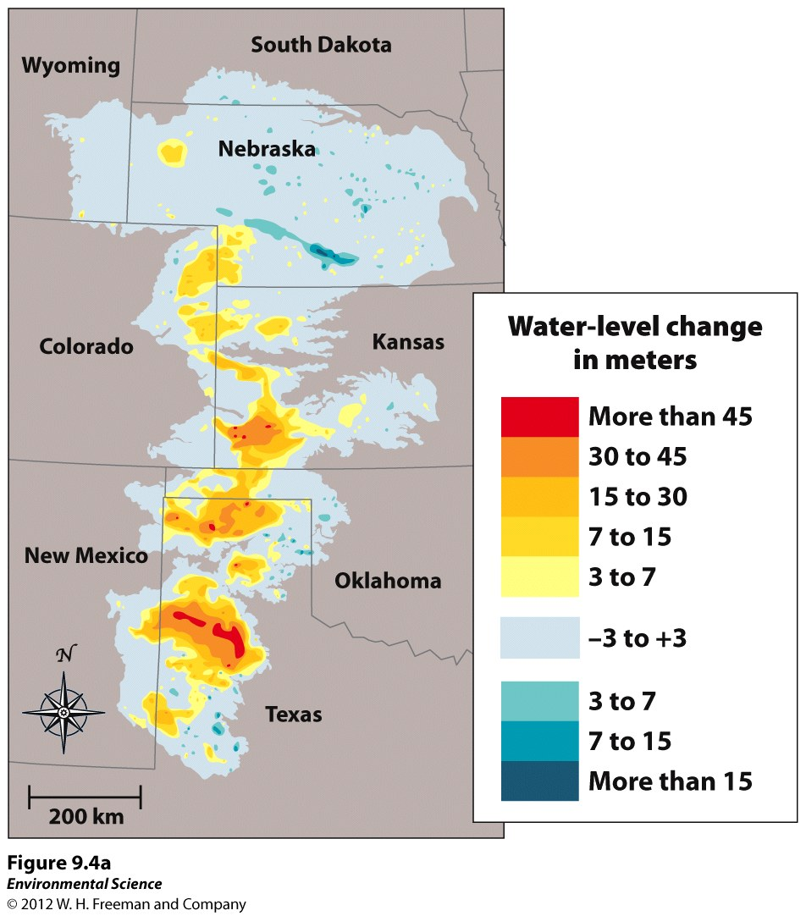

Slide 12
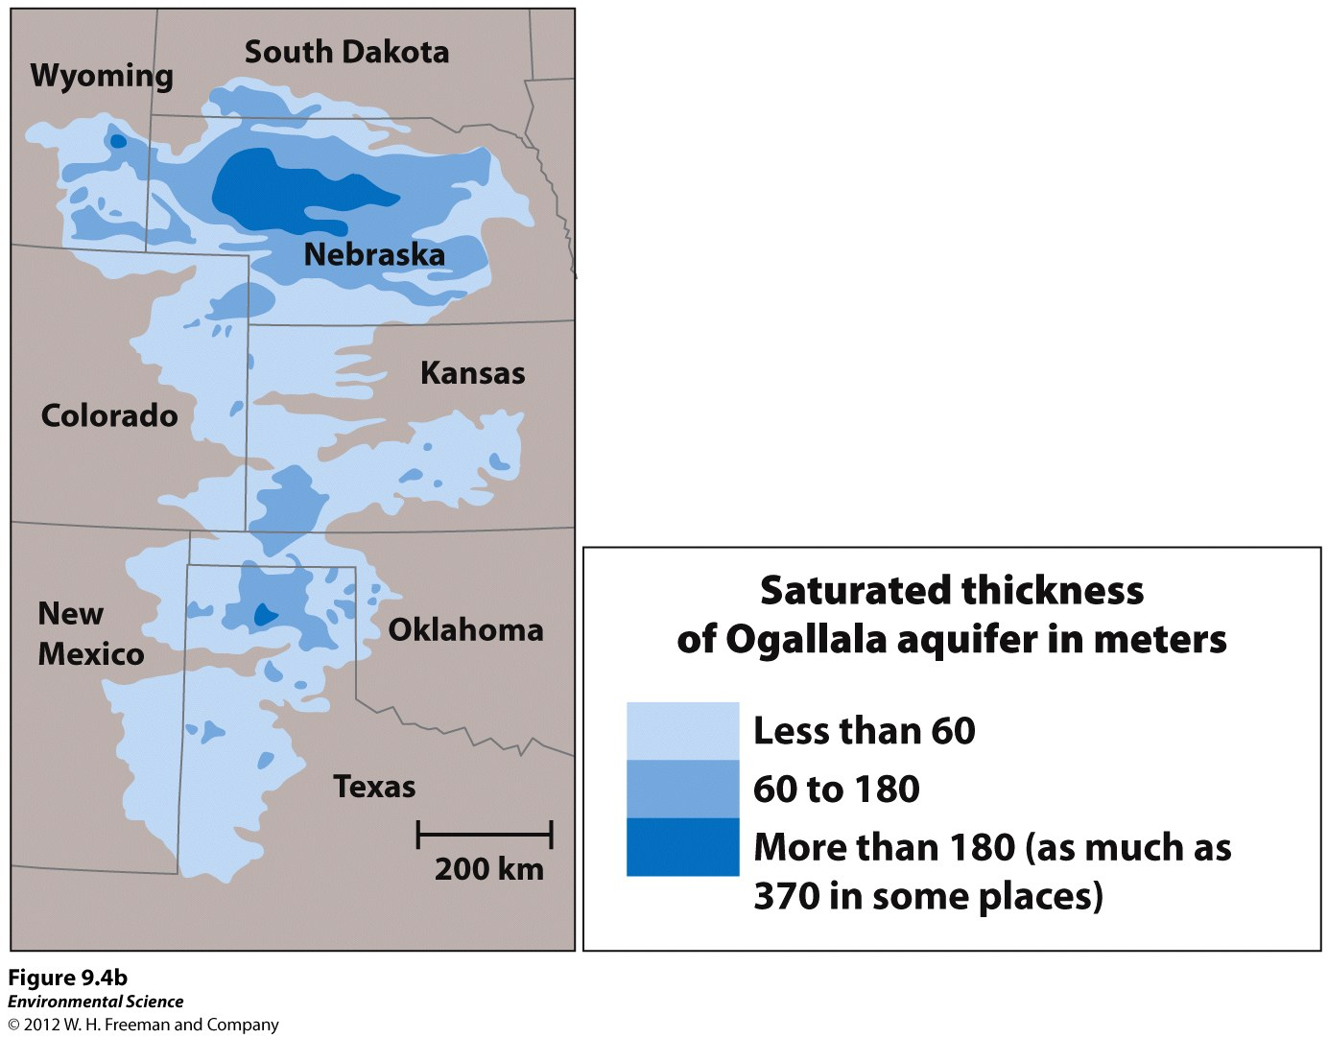

Slide 13
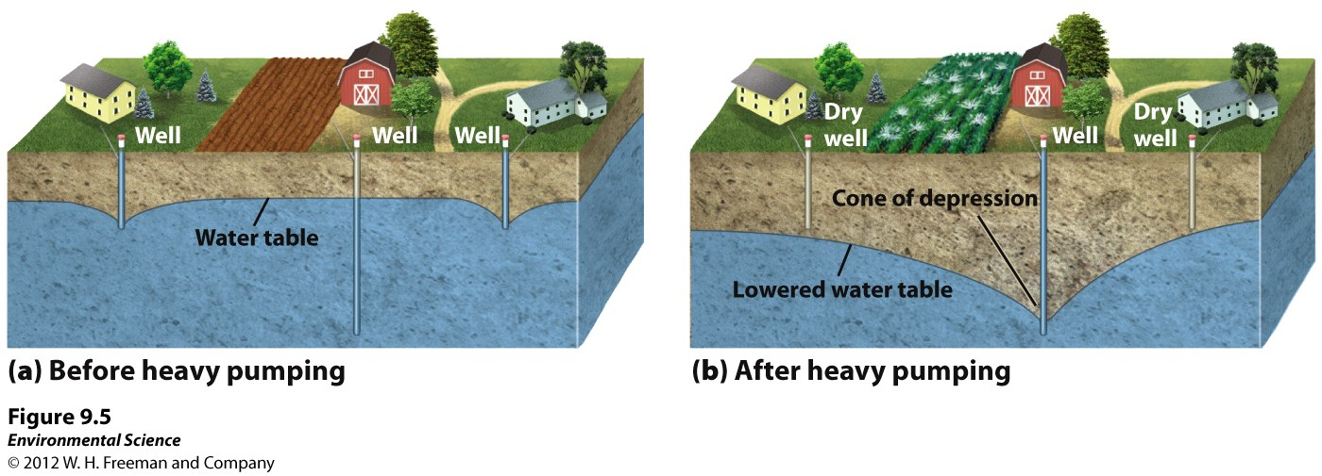

Slide 14
Saltwater Intrusion
Adjacent ocean water dips into wells as a result of over pumping.

Slide 15
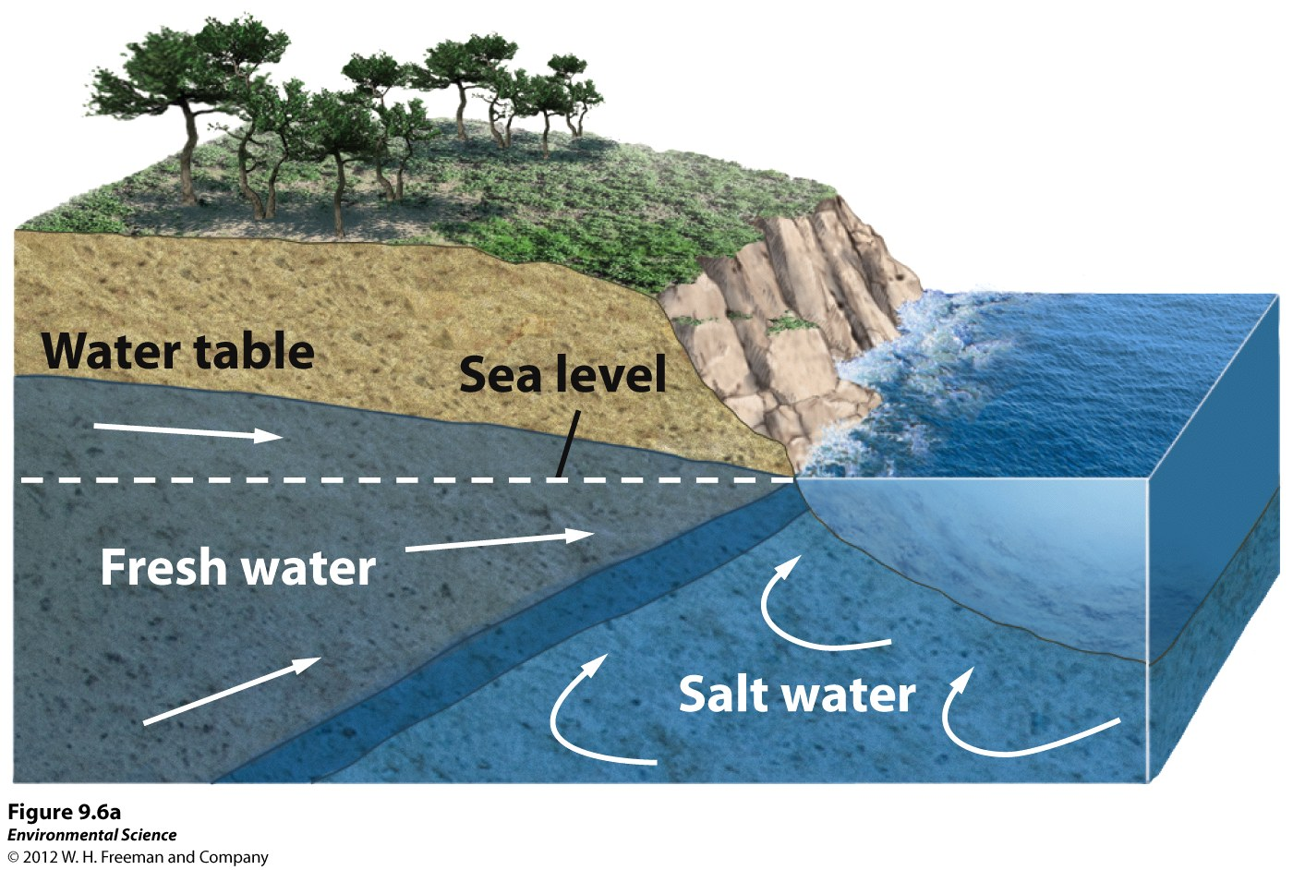

Slide 16
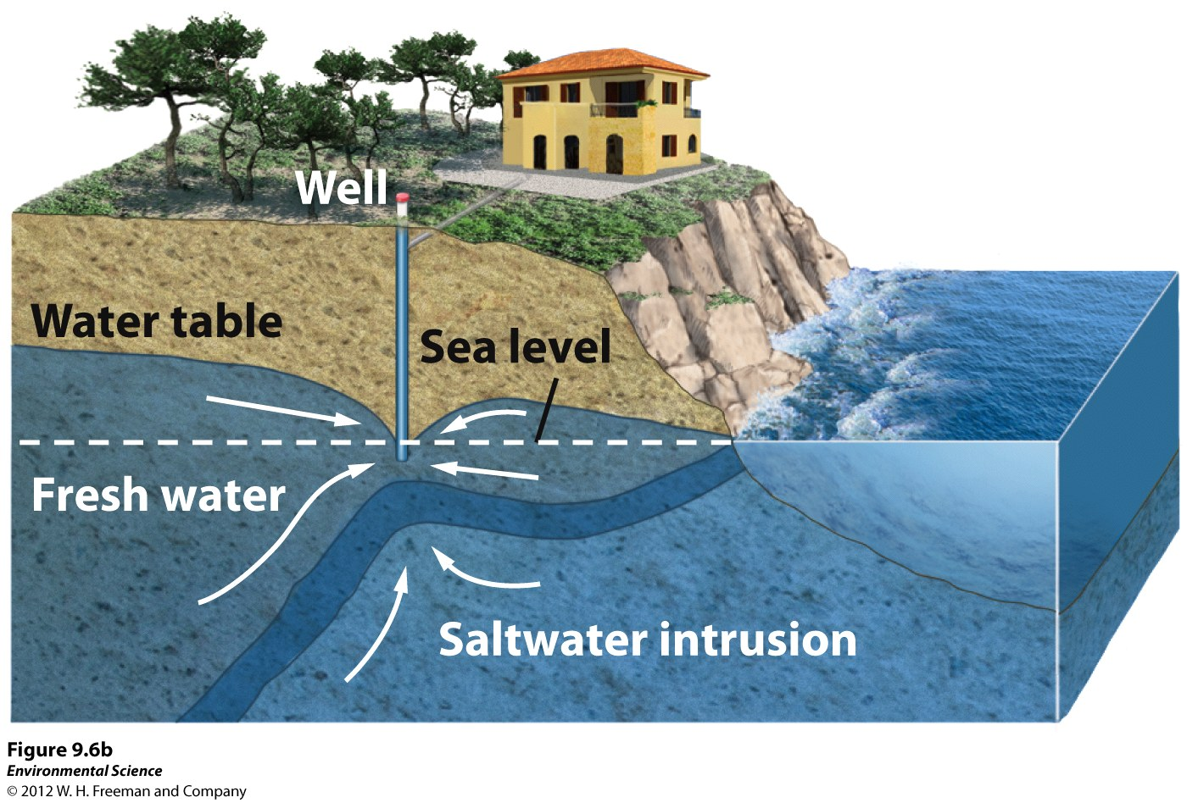

Slide 17
Surface Water
Rivers, ponds, lakes, and wetlands.
Largest River by Volume: Amazon in South America, Congo in Africa, and the Yangtze in China.
Floodplain: where excess water spreads to land adjacent to the water source.

Slide 18
Lakes
Formed by depressions in the landscape, tectonic activity, and glaciation.

Slide 19
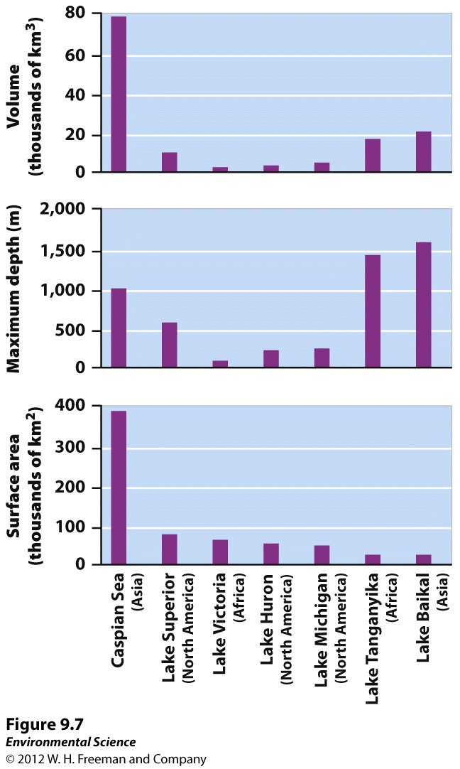

Slide 20
Lakes Classified by Level of Productivity
Oligotrophic: Lacking nutrients, low productivity.
Mesotrophic: moderate amount of productivity.
Eutrophic: High level of productivity.
Wetlands: swamps, mangroves, bogs and marshes can absorb and store excess water(flood reduction).
Everglades in FL and the Pantanal in South America are the largest!!

Slide 21
Atmospheric Water
Contains only a small % of water on Earth.
Important for global distribution.
Agriculture, livestock and nutrient cycling depend on water.
When the soil dries and hardens the water can run off of it.

Slide 22
Wheat fields are more susceptible to erosion compared to native plants.
In the US in 1935 a prolonged drought caused a decade of crop failures.
“The Dust Bowl” caused major disruption to the Great Plains.

Slide 23
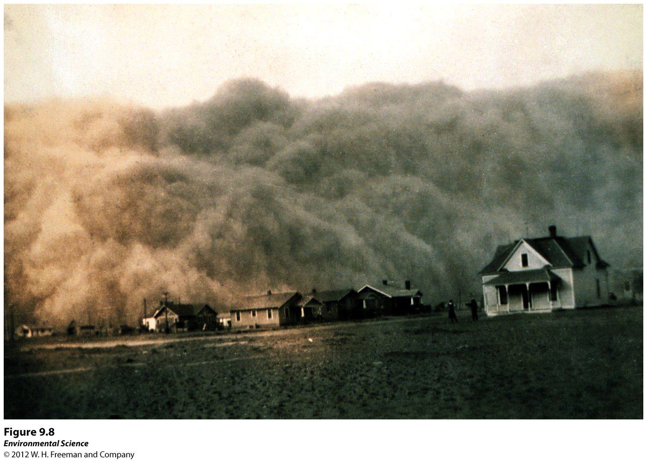

Slide 24
Additionally, impermeable surfaces such as pavement or buildings do not allow water penetration therefore water runs off into lakes and streams.
Flooding can lead to property damage as well as loss of human and animal lives.

Slide 25
Humans Alter the Availability of Water
Levees
An enlarged bank build up on each side of the river.
Mississippi has the largest system of levees in the world.

Slide 26
Disadvantages
Natural floodwaters no longer add to the fertility to the floodplains.
Sediments get deposited where the river meets the ocean.
Levees prevent flooding in one area but increase it in another.
Encourages development on the floodplains, yet these areas still flood.
Hurricane Katrina in 2005: nearly 50 levees were toppled.

Slide 27
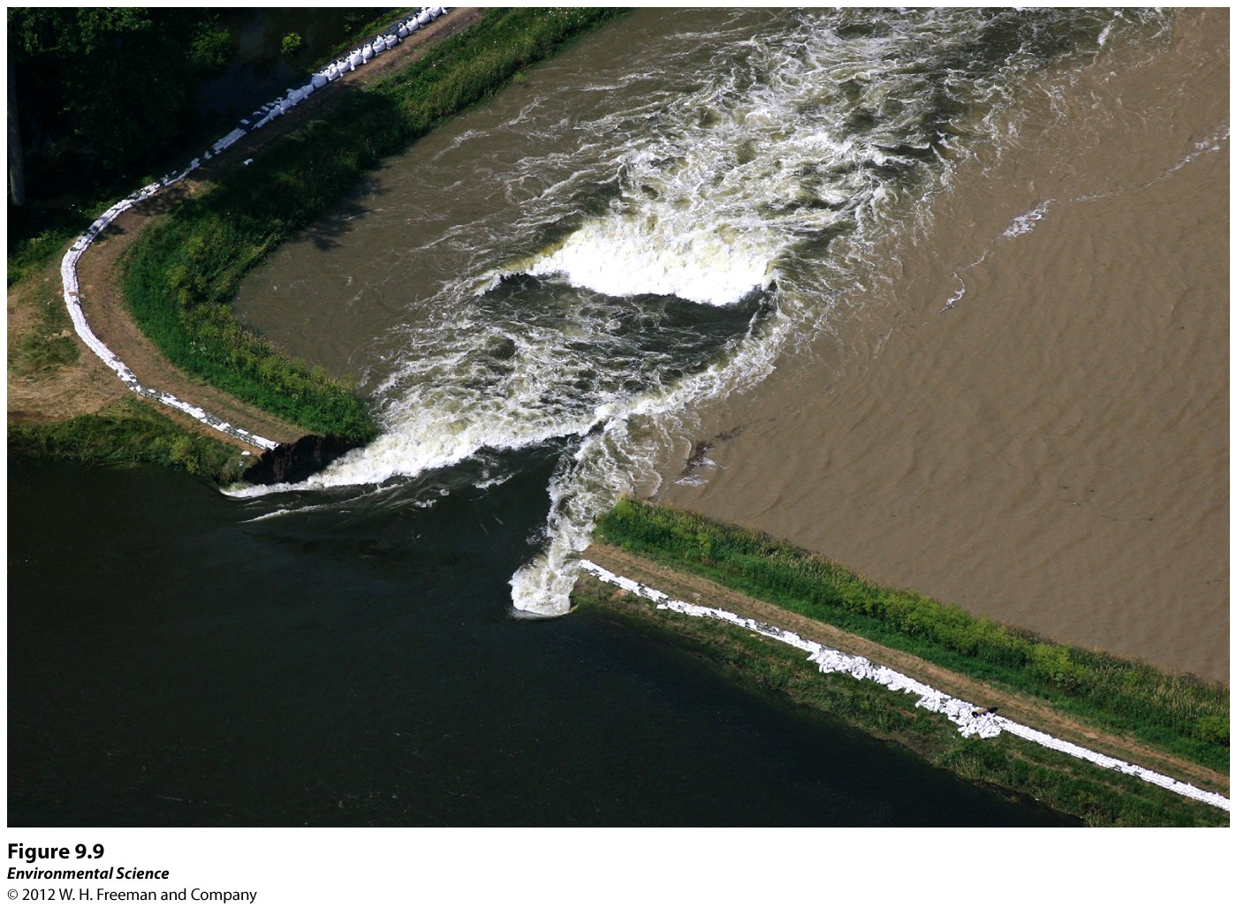

Slide 28
2. Dikes
Similar to levees but are built to prevent ocean water from flooding adjacent land.
Netherlands is below sea level so has an extensive system of dikes.

Slide 29
3. Dams
Barrier across water.
Water is stored behind a damn in large body of water called a reservoir.
Built for human consumption, generation of electricity, flood control, and recreation.
82, 642 dams in the US.
Only 3% of the dams in the US were built for hydroelectric power, 18% for flood control, 38% for human recreation.

Slide 30
Disadvantages
Large amount of materials and energy to build.
Displaces people.
Disrupts natural seasonal flooding.
Interrupts the natural flow of water.
Heavily displaces migratory fish such as salmon.
Fish Ladders have been added to alleviate this problem.

Slide 31
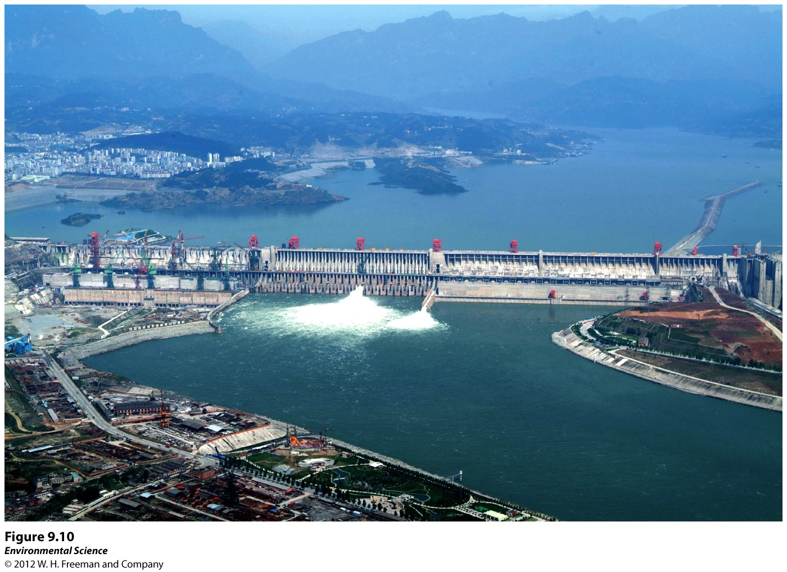

Slide 32
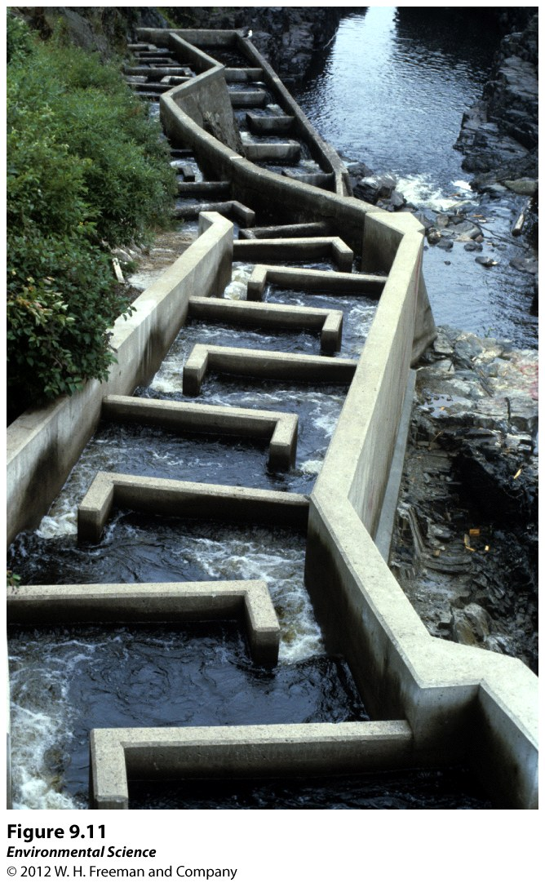

Slide 33
3. Aqueducts
Canals or ditches used to carry water from one location to another.
Old aqueducts are very inefficient.
Both LA and NYC depend on aqueducts for water.

Slide 34
Disadvantages
A lot of time, money and resources to construct.
Disturbs natural habitats, fragments!
Less water flowing to where it naturally was.
Ocean water will flow into river mouths that have less water flow due to aqueducts.

Slide 35
Example:
In the 1950s the Soviet Union diverted two rivers decreasing freshwater input into the Aral Sea.
Salinity of the lake increased destroying fish populations.
Split the Aral Sea into two different bodies of water.
Effected erosion rates and local climates.

Slide 36
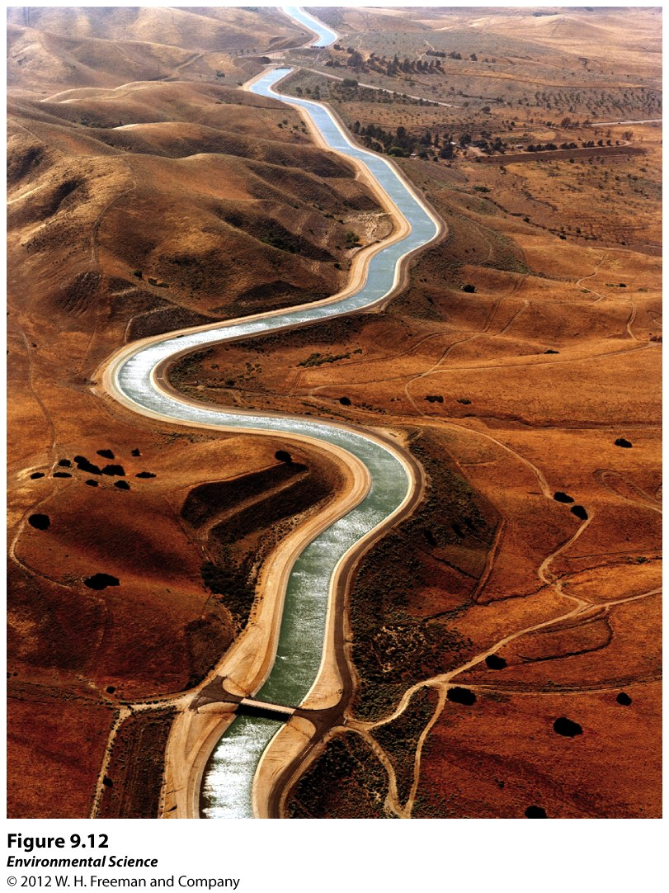

Slide 37
Desalination
Removing the salt from salt water.
Countries of the Middle East produce 50% of the world’s desalinated water.
2 Technologies

Slide 38
Distillation
Heat is used to boil water which leaves salt behind as it evaporates.
Steam is captured and condensed, yielding pure water.
A great deal of energy is required to boil the water and condense it.

Slide 39
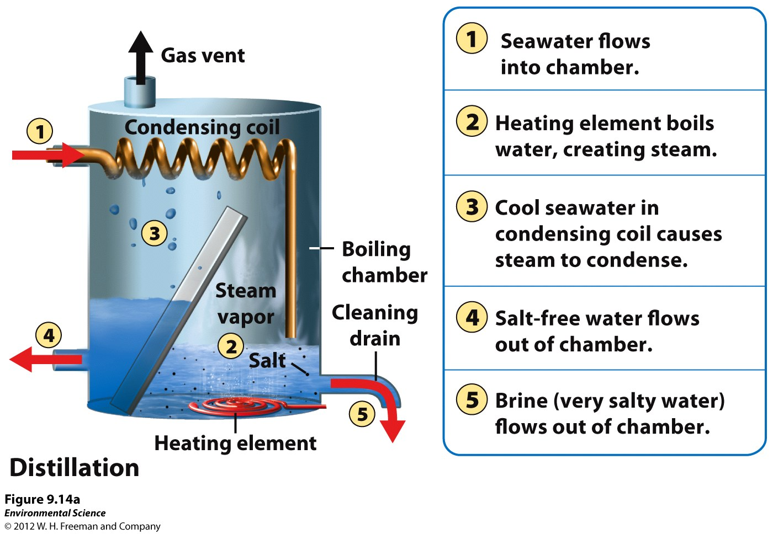

Slide 40
2. Reverse Osmosis
Water is forced through a think semipermeable membrane at high pressure.
More efficient and less costly than distillation.
The left over, the brine, has a very high salt concentration and cannot be deposited on land or in bodies of water.
The Middle East and North Africa have very little drinking water available.

Slide 41
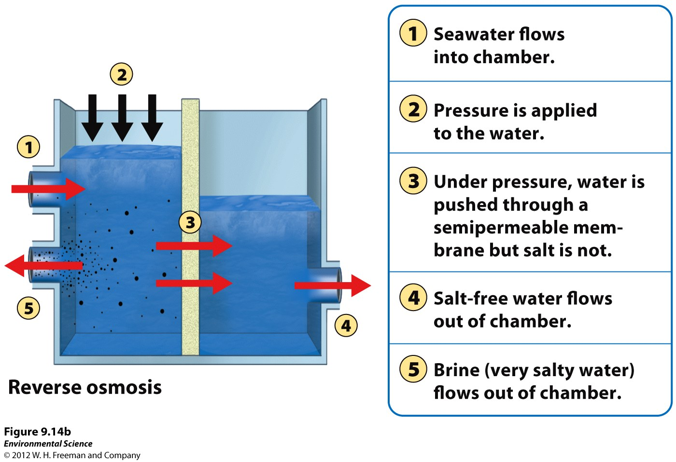

Slide 42
Water Use By Humans
70% of the world’s water is used for agriculture.
30% is split between industrial and household uses.
Water usage varies greatly among countries.

Slide 43
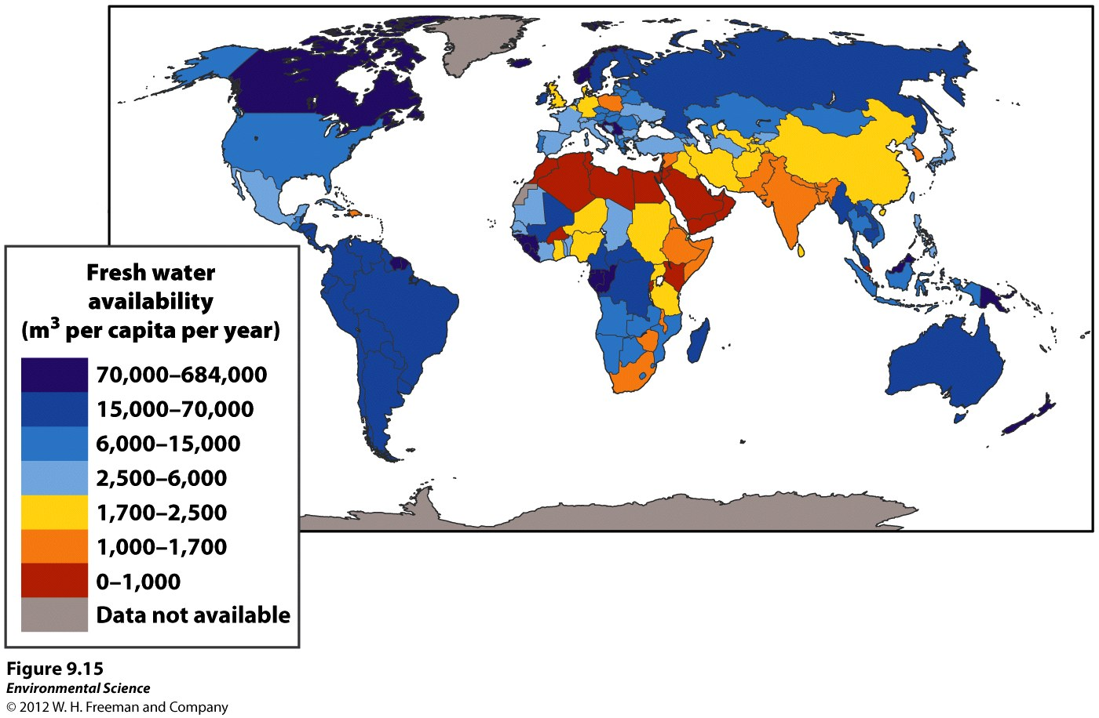

Slide 44
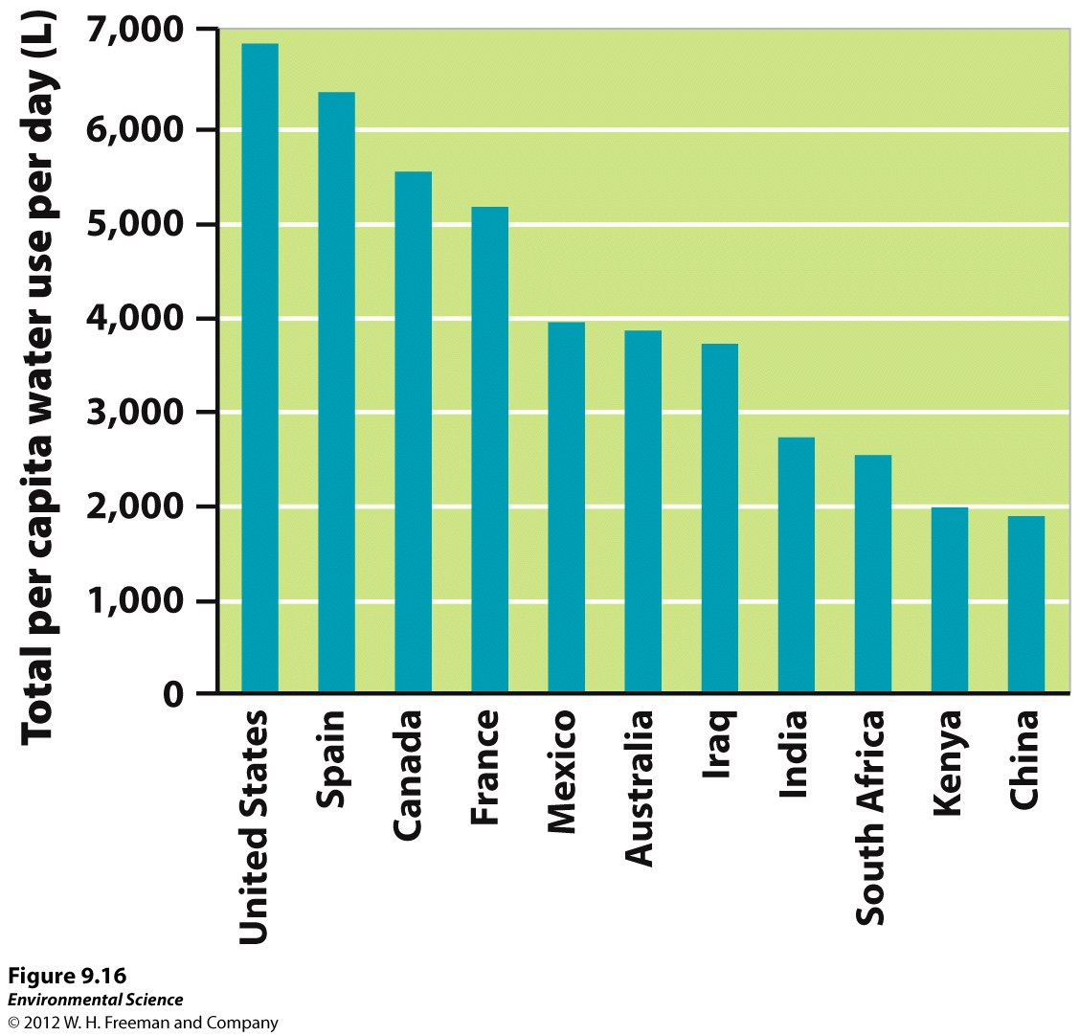

Slide 45
1. Agriculture
Production of one metric ton of grain (1000 Kg or 2200 lbs) requires more than 1 million liters of water.
India, China, US, and Pakistan account for more than half of the irrigated land in the world.
Producing 1 Kg of beef requires 11x more water than producing 1 Kg of wheat.

Slide 46
Irrigation
Greatest potential for water conservation.
Furrow Irrigation
Easy and inexpensive.
Trenches or furrows are dug along side of the crops.
65% efficient

Slide 48
2. Flood Irrigation
Flooding the entire field letting the water soak in.
More disruptive to plant growth.
70-80% efficiency.

Slide 49
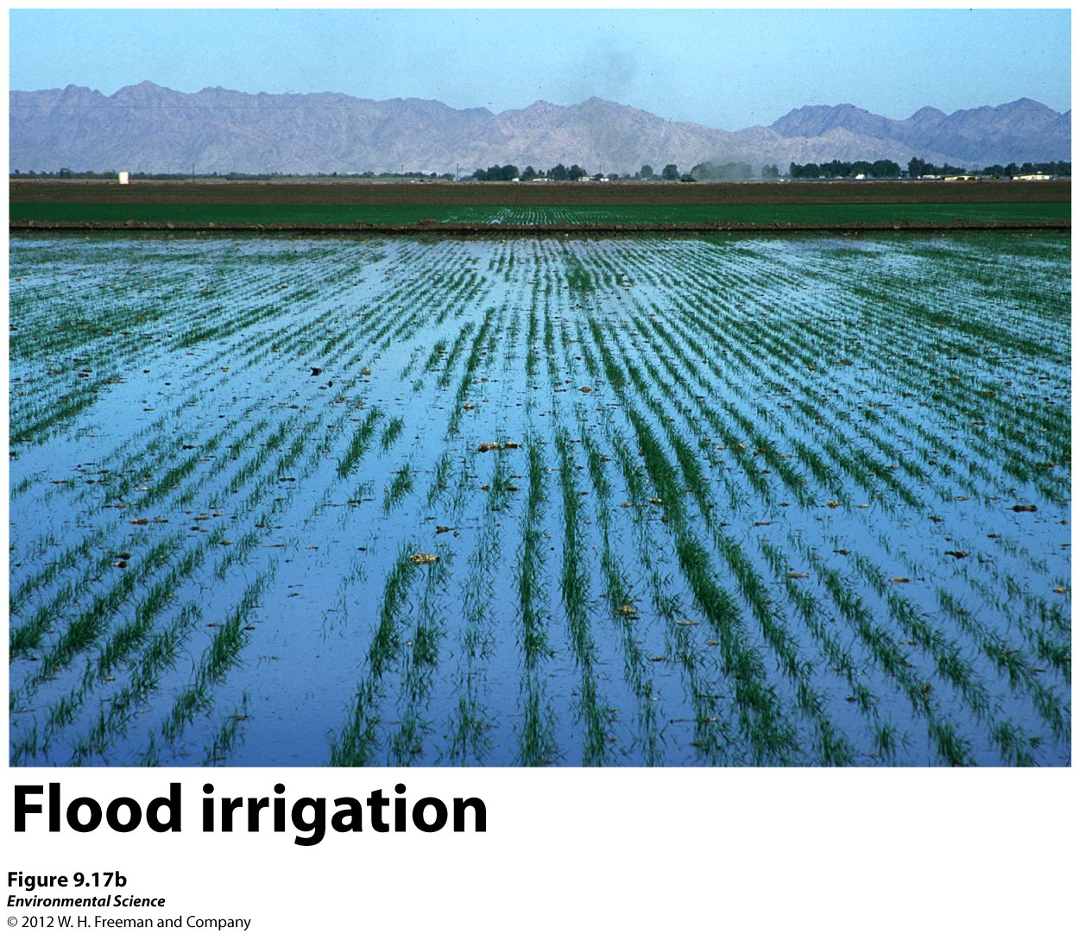

Slide 50
3. Spray Irrigation
More expensive.
Uses energy.
Water pumped from a well and sprayed out.
70-95% efficiency.

Slide 51
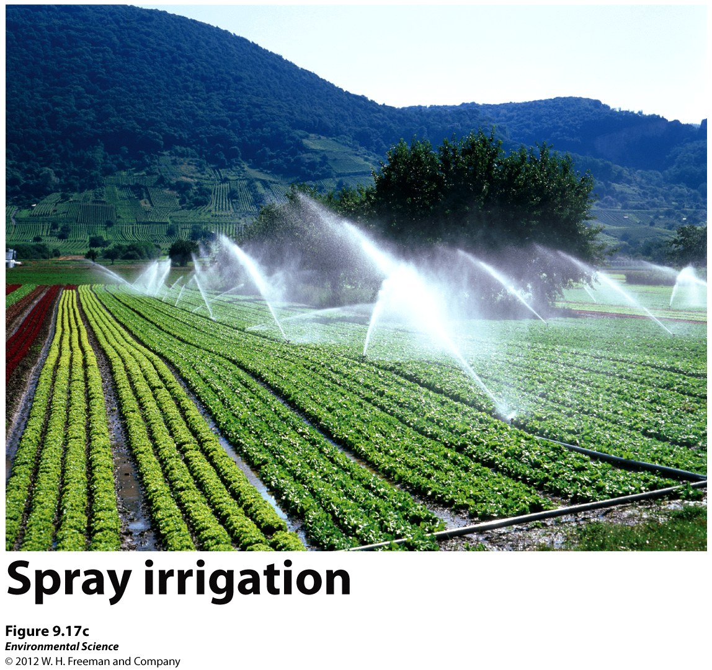

Slide 52
4. Drip Irrigation
Slowly dripping hose.
Reduces weed growth by no surface watering.
Over 95% efficient.

Slide 54
Hydroponic Agriculture
Growing crops in a greenhouse with no soil, just a nutrient rich solution.
Uses up to 95% less water.
Can grow every season of the year, uses little to no pesticides.

Slide 55
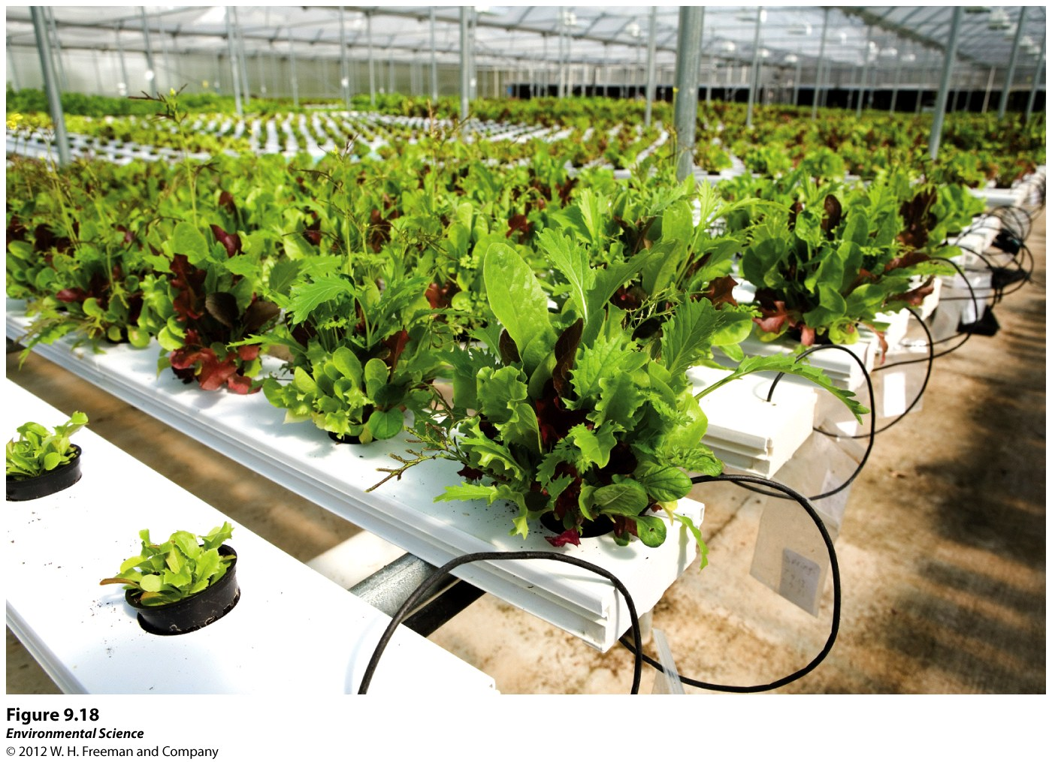

Slide 56
2. Industry
Generating electricity, cooling machinery, and refining metals and paper.
In the US ½ goes towards generating electricity.
Thermoelectric power plants use heat to convert the water into steam which turns turbines.
Large cooling towers are necessary to condense and cool the liquids therefore a large fraction is lost to the atmosphere.

Slide 57
Refining paper, and metals requires the use of water.
A Kg of paper requires 33 gallons (125 L) of water to manufacture.

Slide 58
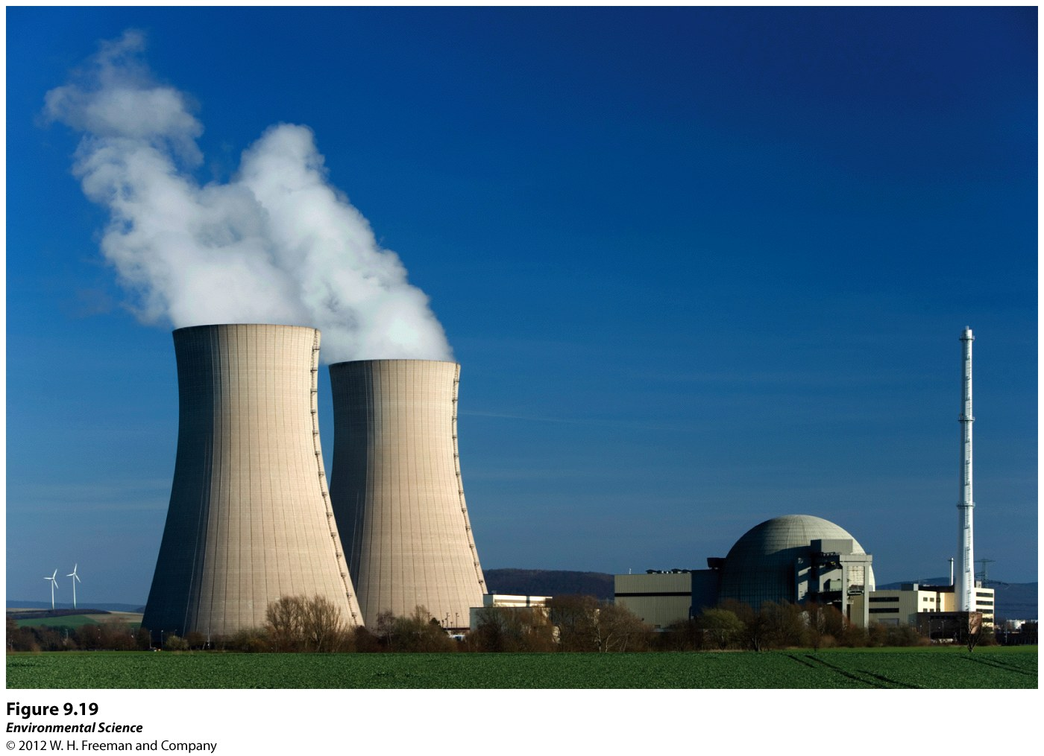

Slide 59
3. Households
10% of all water used in the US is used in homes.
Varies dramatically among nations.
In the US:
41% is used for flushing toilets.
33% is used for bathing.
21% is used for laundry
5% for cooking and drinking.
Outdoor use varies greatly by state.

Slide 60
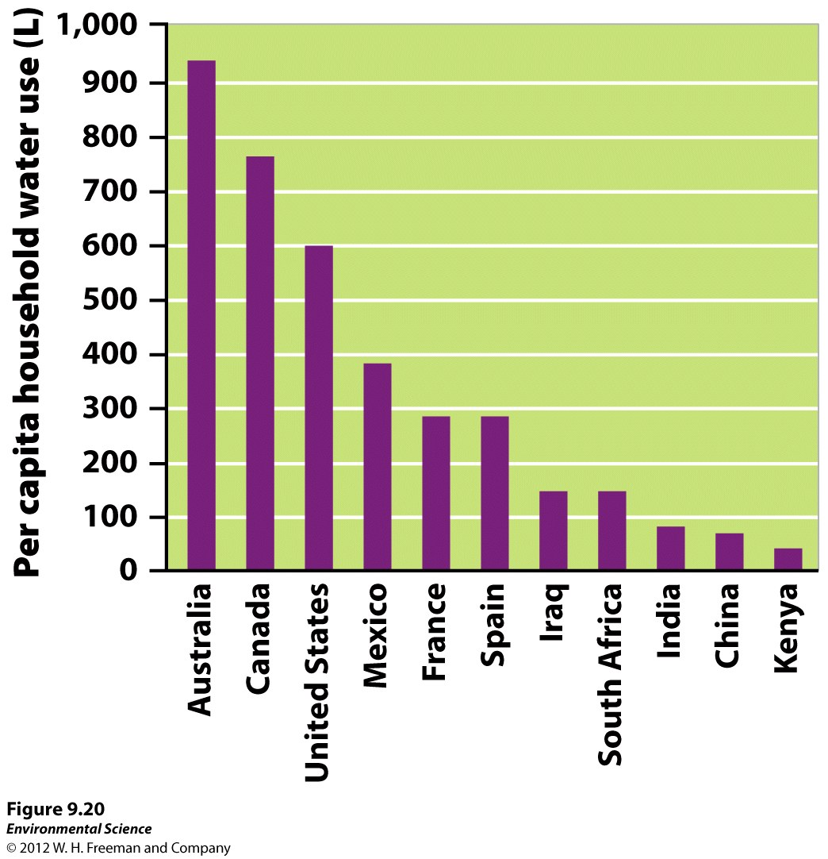

Slide 61
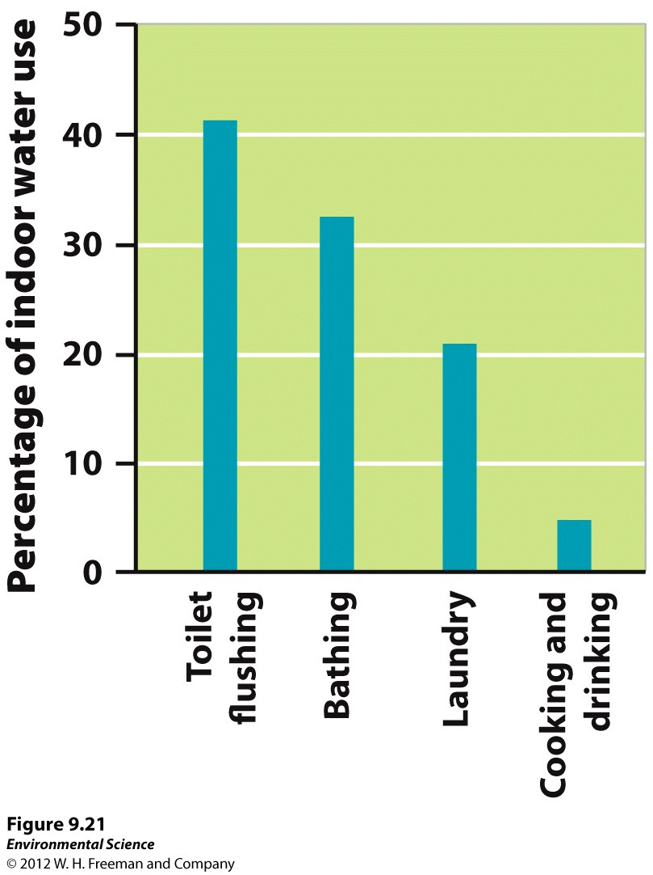

Slide 62
Worldwide
1 billion people (15% of the world’s population) lack access to clean drinking water.
Every year 1.8 million dies of diarrheal diseases related to contaminated water.
About 5000 people die a day due to lack of clean water.
Poor conditions in developing nations do not provide safeguards that ensure the availability of clean drinking water.

Slide 63
The Future of Water
Water Ownership
Although areas may have rights to water use, no one truly owns the water.
In 1981 Chile initiated a free-market system of water distribution.

Slide 64
Water Conservation
Water reducing toilets.
Water reducing shower heads.
Water-efficient native landscapes.
Recycling water after industrial use.
Improved gutter systems.
Gray Water: wastewater from baths, showers, bathroom sinks, and washing machines.
Using gray water for flushing the toliet.

Slide 65
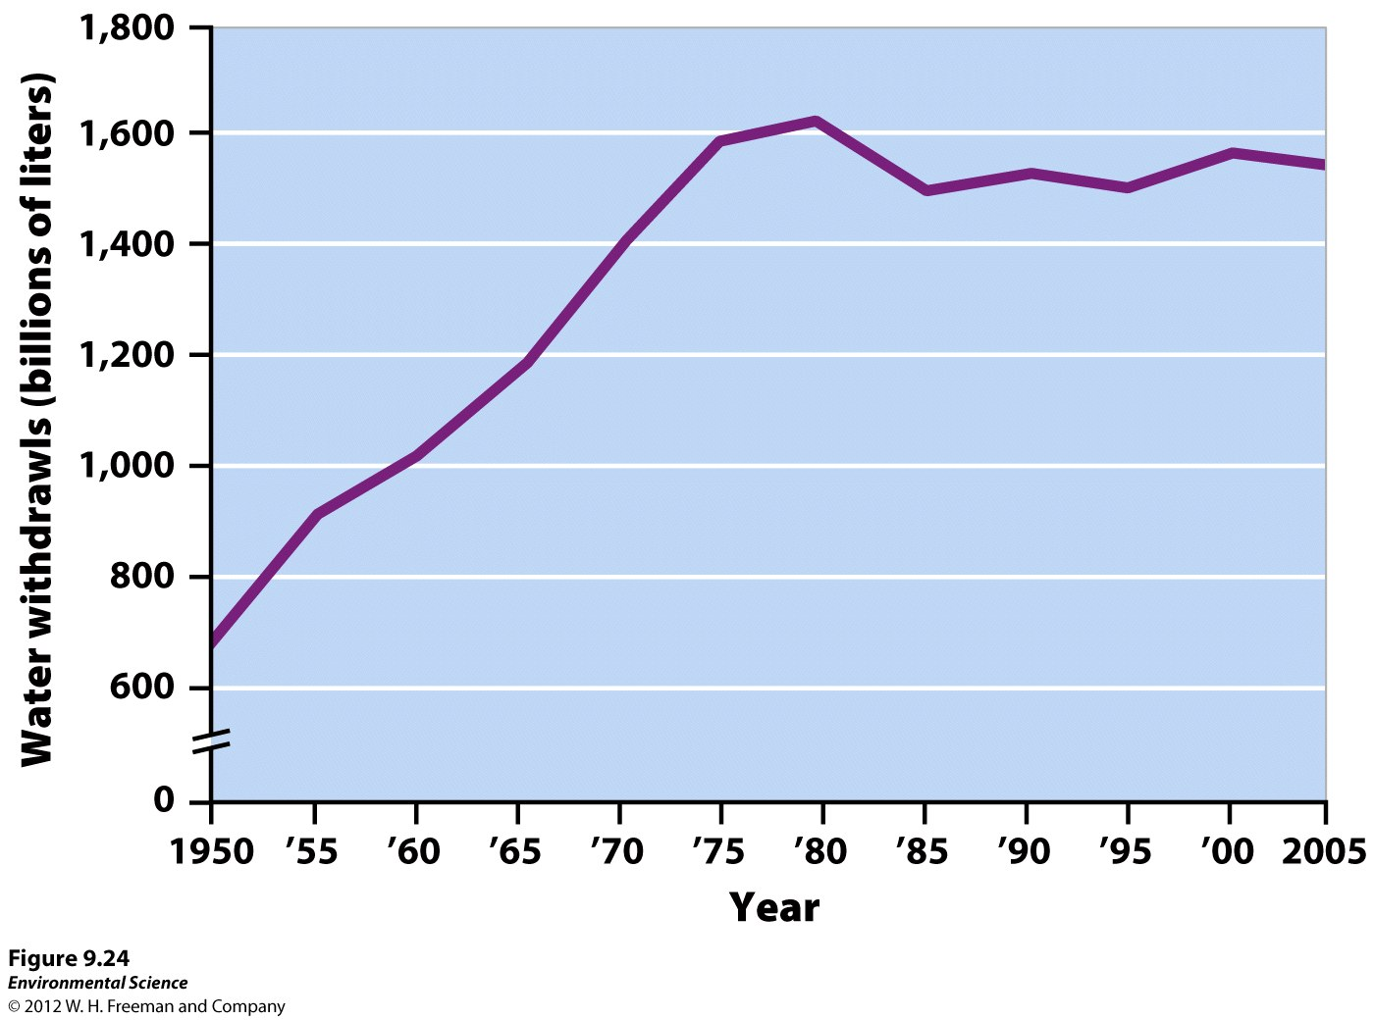

Slide 66
