Slide 1
The Human Population
The Environmental Implications of China’s Growing Population
China has 20% of the world’s population (1.3 billion)
Currently the largest emitter of CO₂
1970s started the 1 child per family policy
Population may start to decline by 2040
Beginning to improve conditions
Other nations pose a risk

Slide 2
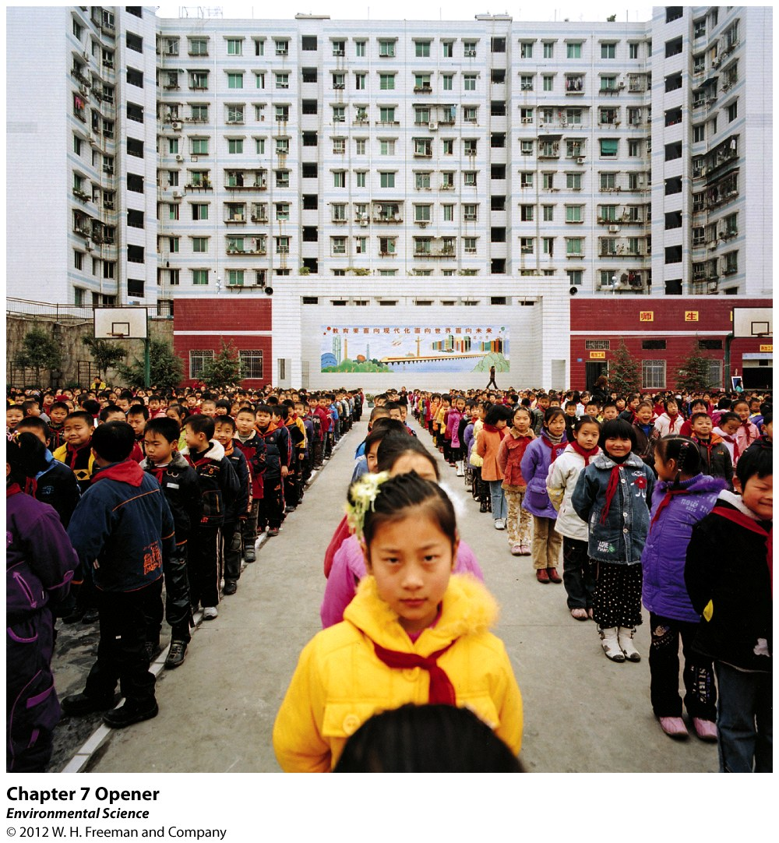

Slide 3
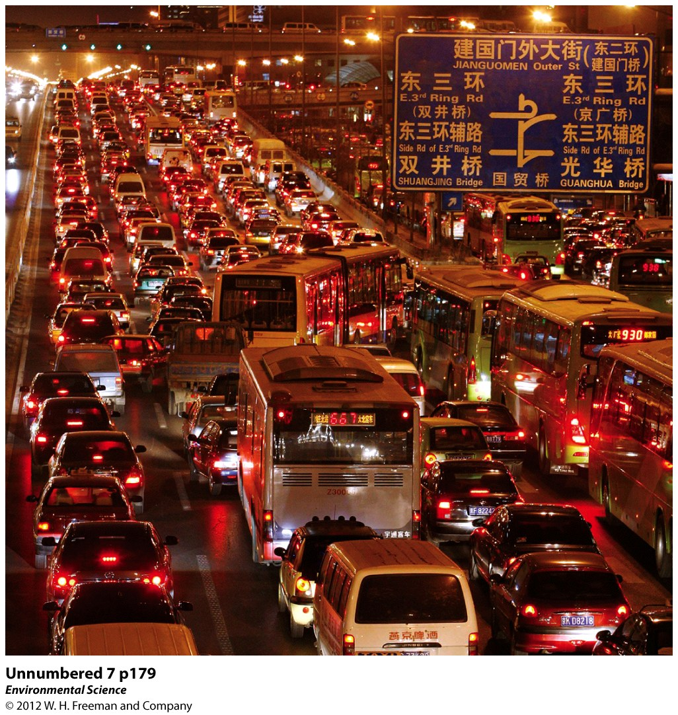

Slide 4
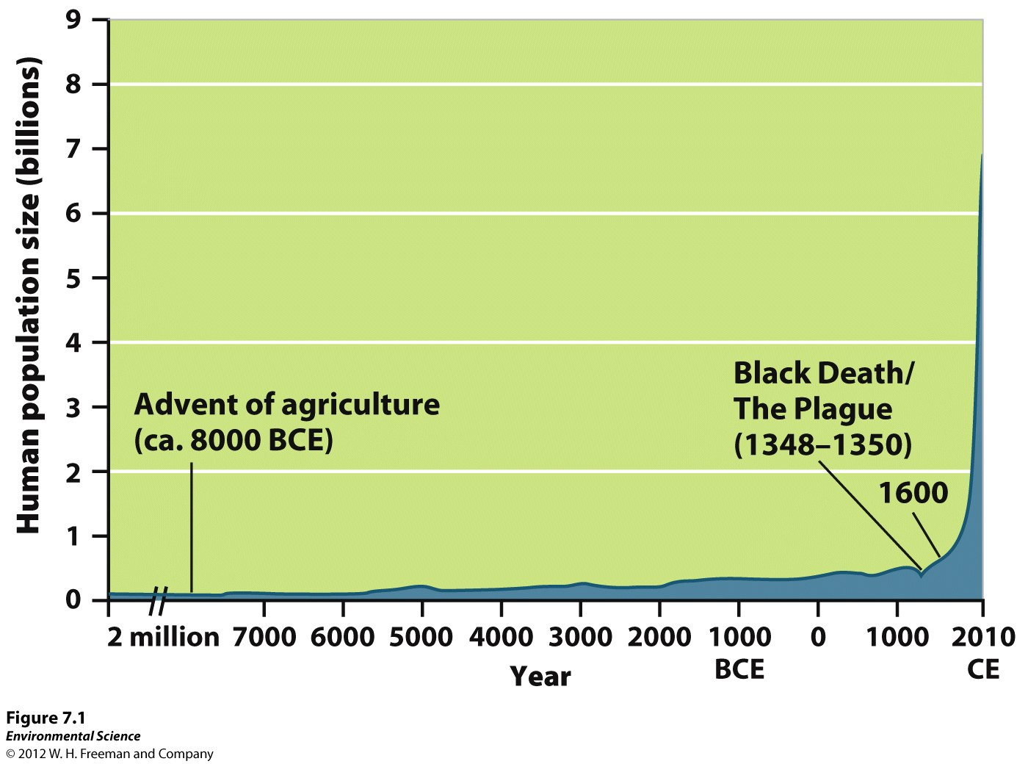
Earth’s Carrying Capacity
Global population increases roughly 1 million people per day.
Food deficit vs. ongoing improvements!?

Slide 5
Factors that Drive Human Population Growth
Demography: study of human populations and population trends.
Immigration: coming into a population.
Emigration: leaving a population.

Slide 6
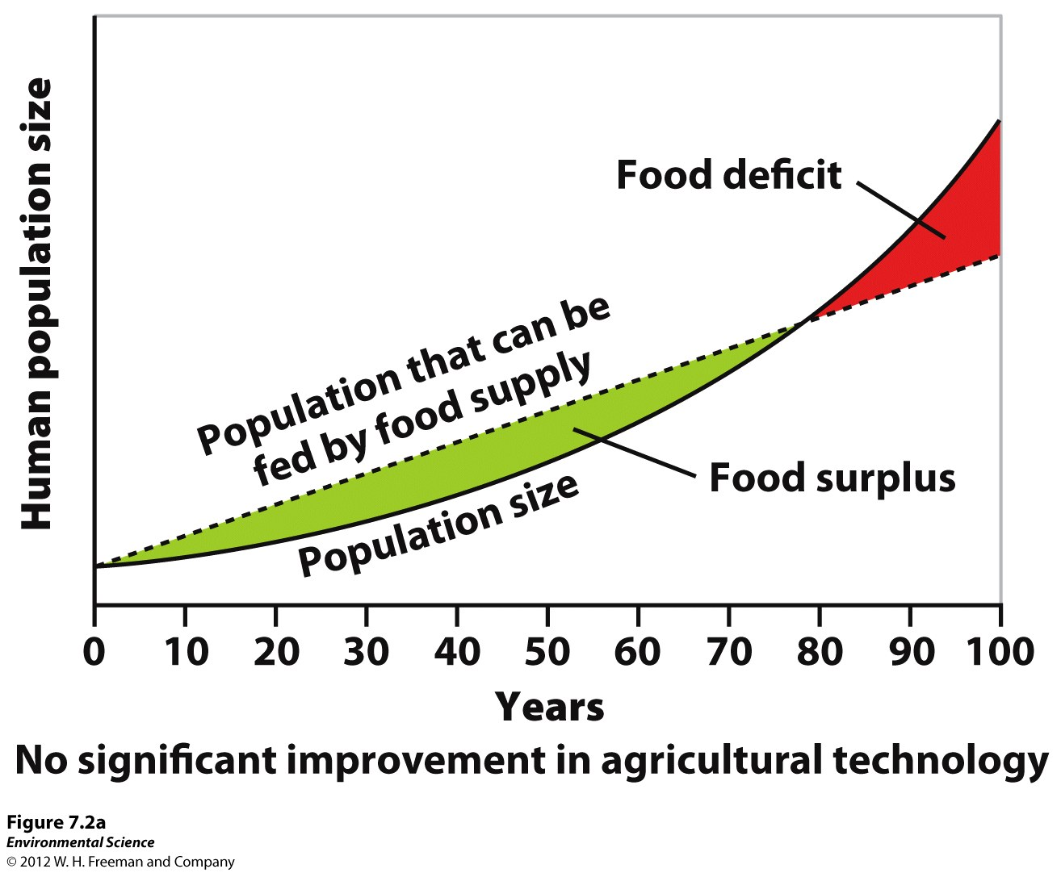

Slide 7
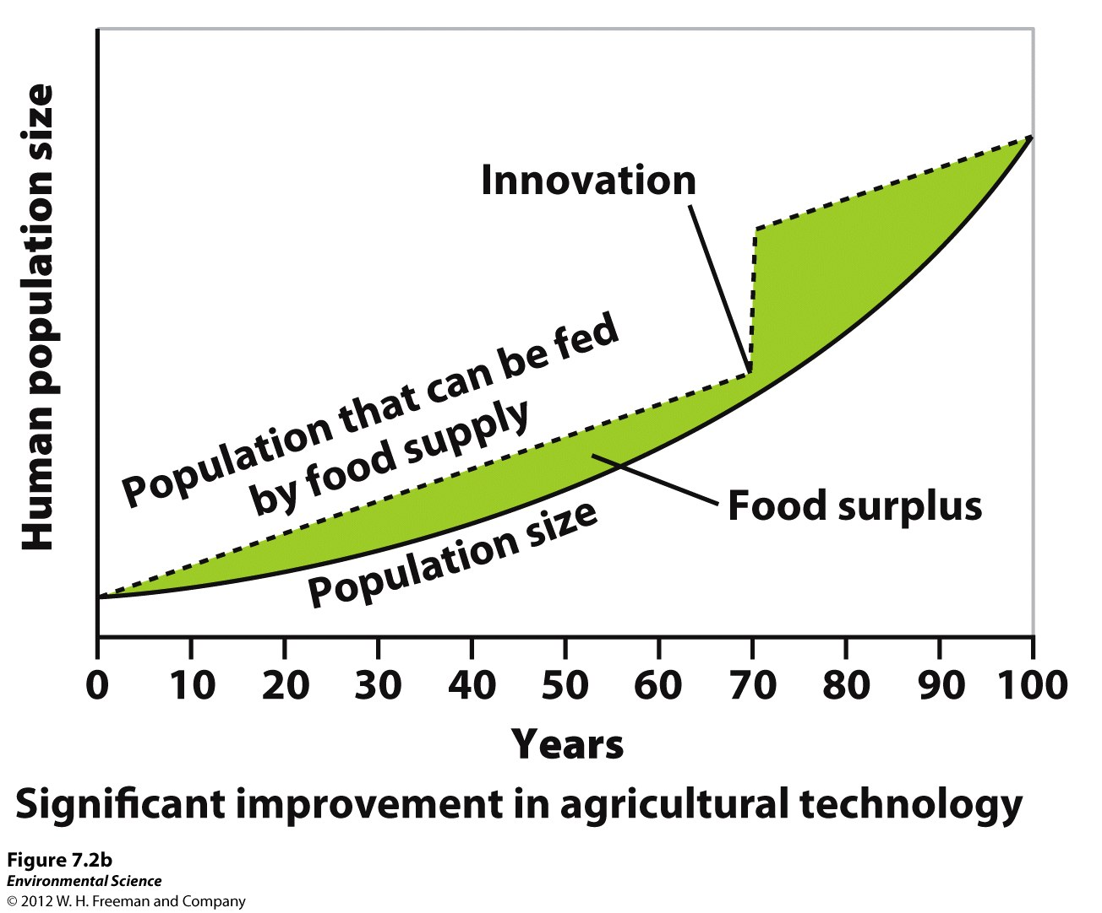

Slide 8
Changes In Population Size
Crude Birth Rate (CBR): Number of births per 1000 people per year.
Crude Death Rate (CDR): Number of deaths per 1000 people per year.

Slide 10
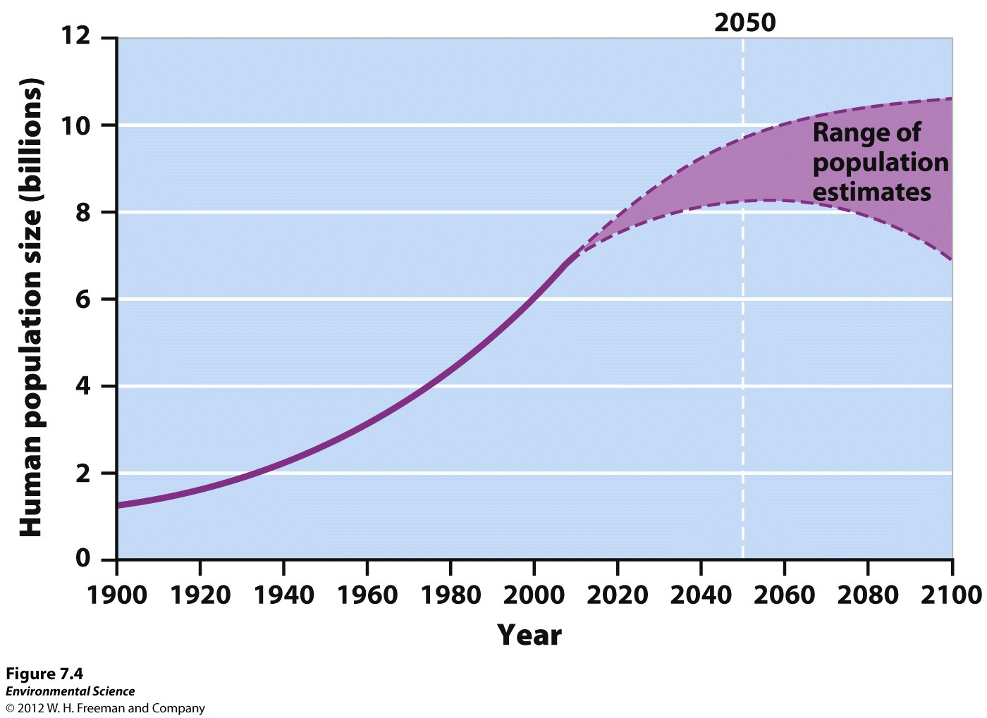

Slide 11
Doubling Time: the number of years it takes for a population to double.
The Rule of 70: tells you the number of years it takes for a population to double.
Doubling Time(years) =s 70/Growth Rate
This occurs regardless of the population size!

Slide 12
Fertility
Total Fertility Rate (TFR): estimate of the average number of children that each woman in a population will bear.
Replacement-Level Fertility: requirement to offset the average number of deaths in a populations of the current population size remains the same.

Slide 13
Life Expectancy
The average number of years that an infant is expected to live.
Specific for country.
Specific for year.
Infant/Child Mortality:
Infant: deaths under 1 year old.
Child: deaths under 5 years old.

Slide 14
Predictor of health care, food supply, drinking water, sanitation, and prenatal care.
US: 6.6
France and Sweden: 2.5, 3.6
Liberia: 99
Bolivia: 50
Varies within each country as well.

Slide 15
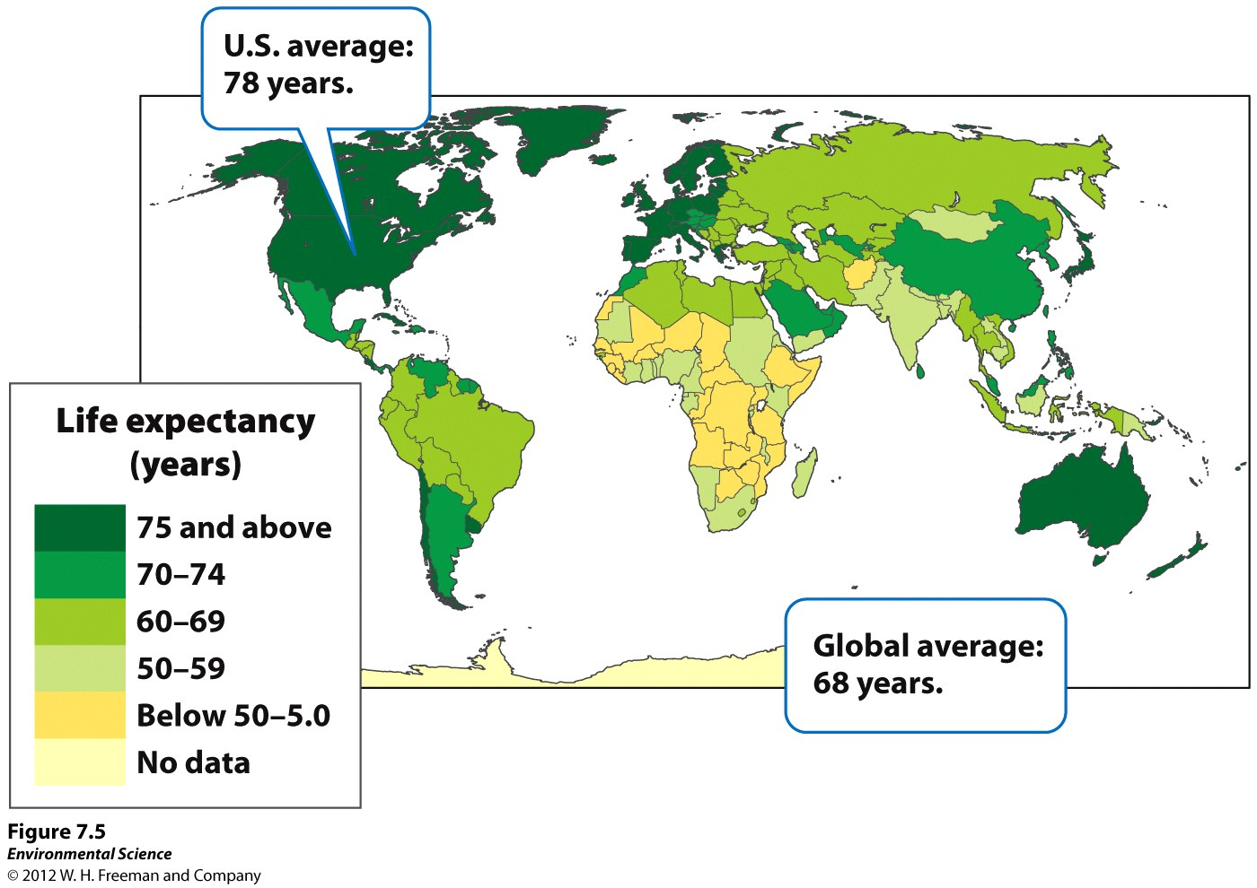

Slide 16
Aging and Disease
Second largest killer to heart disease.
Tuberculosis and malaria were responsible for the most amount of deaths.
HIV has taken its place.

Slide 17
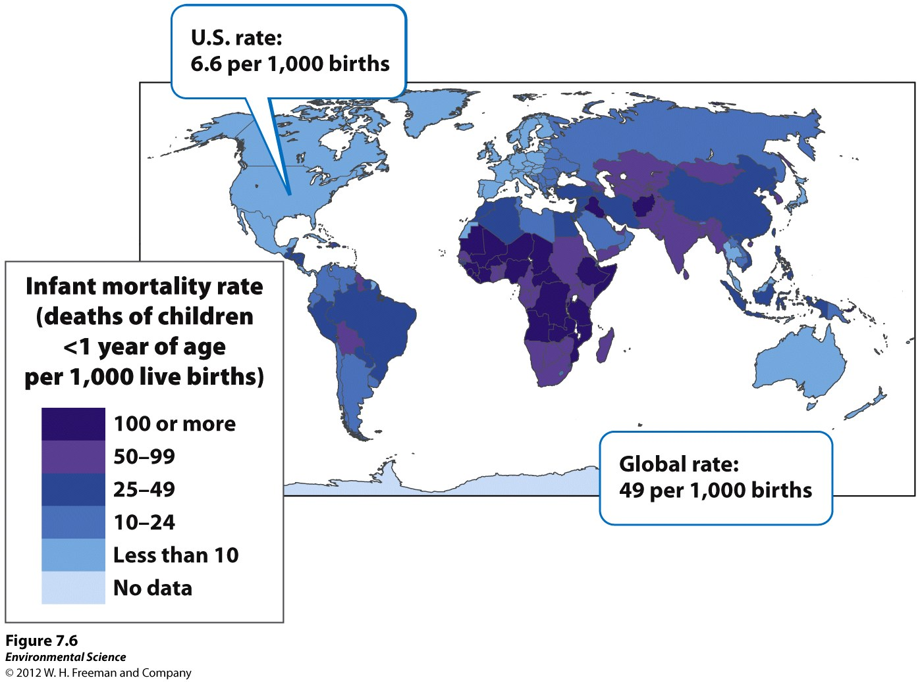

Slide 18
AIDS and HIV
Responsible for the for the greatest amount of human deaths.
Affects humans in their reproductive years.
Most prominent in Africa.

Slide 19
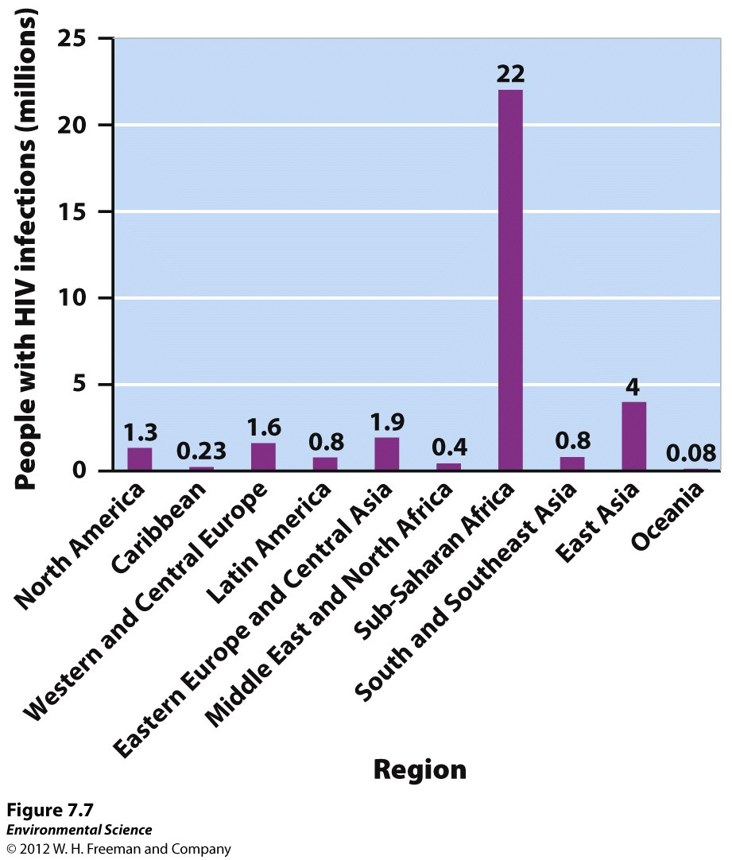

Slide 20
Age Structure
Age Structure Diagrams: how its members are distributed across age ranges.
3 Types
1. Population Pyramid: Many young people, wide at the bottom.
Example: India

Slide 21
2. Has little difference between the number of individuals in younger age groups and older age groups.
Slow growth or approaching no growth.
Example: USA, Canada

Slide 22
3. Greater number of older people than younger people.
Example: Italy, Germany, and Russia

Slide 23
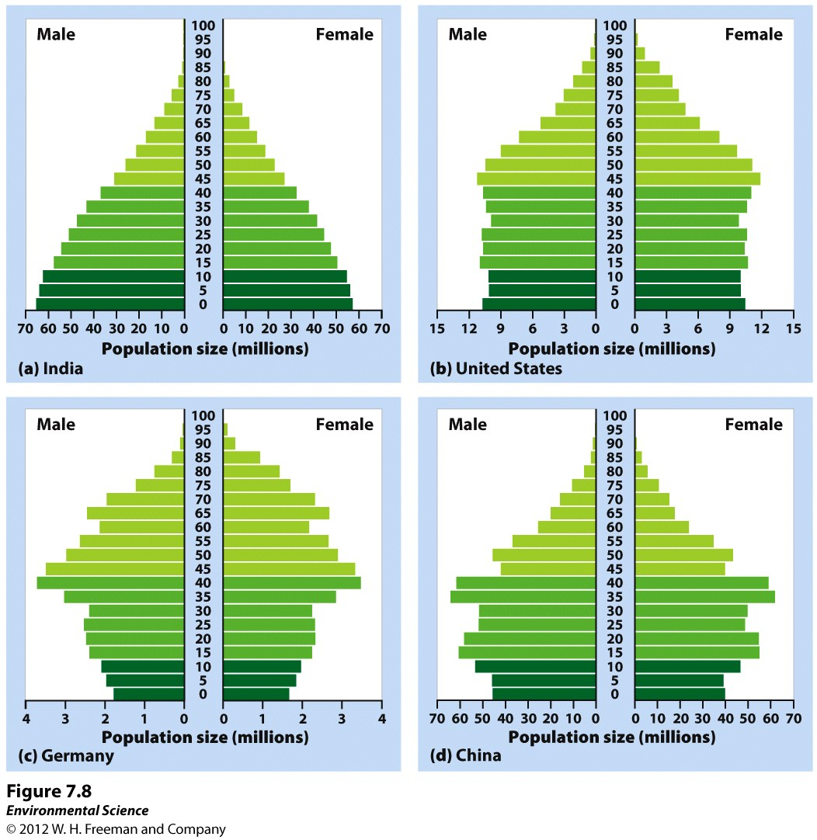

Slide 24
Migration
Net Migration Rate: Difference between immigration and emigration in a given year per 1, 000 people.

Slide 25
Demographic Transition
As a country moves from a subsistence economy to industrialization and increased affluence, it undergoes a predictable shift in population growth.

Slide 26
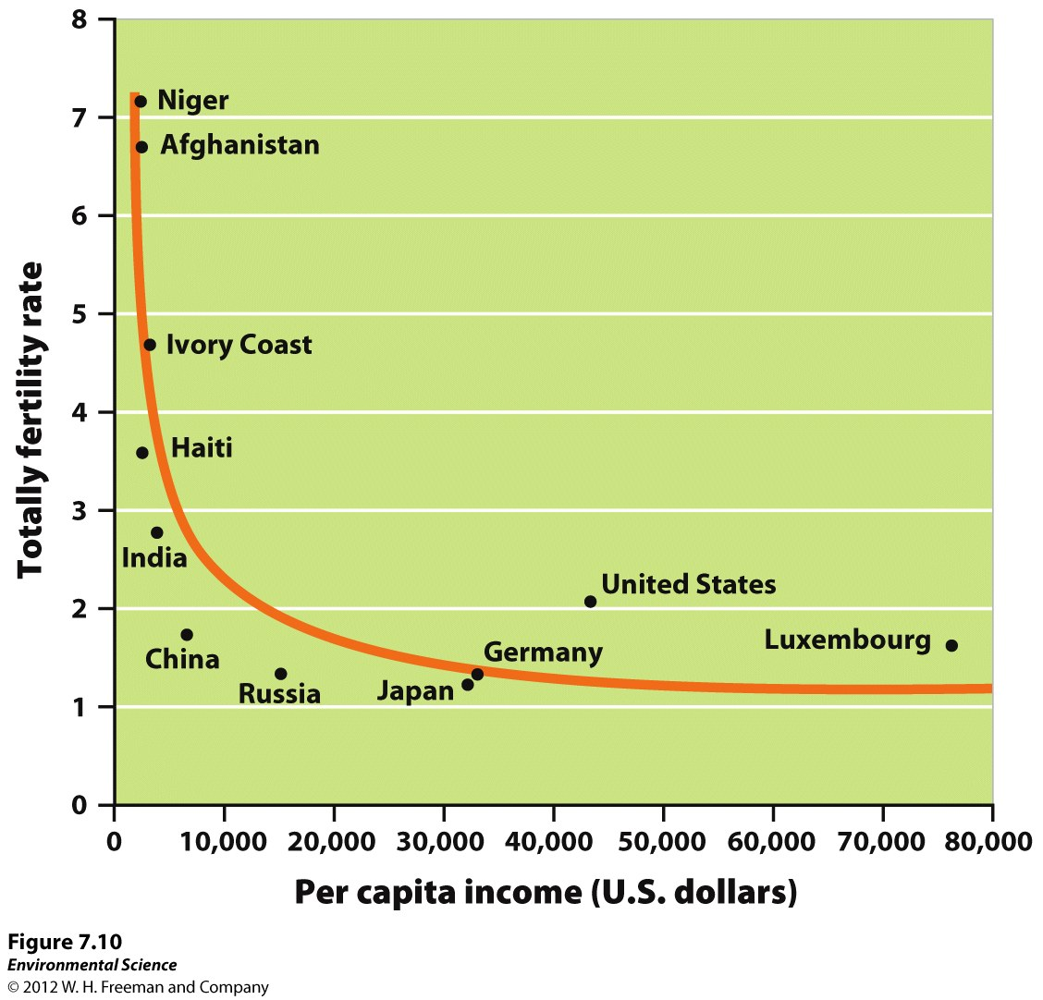

Slide 27
4 Phases
Slow Population Growth: population nearly in a steady state.
Countries that have not modernized.
2. Rapid Population Growth: Death rate declines as birth rate increases.
3. Stable Population Growth: Birth and death rates decrease.
4. Declining Population Growth: fewer young, more old.

Slide 28
Family Planning
Regulation of the number or the spacing of offspring through the use of birth control.
The more education, the less children people tend to have.

Slide 29
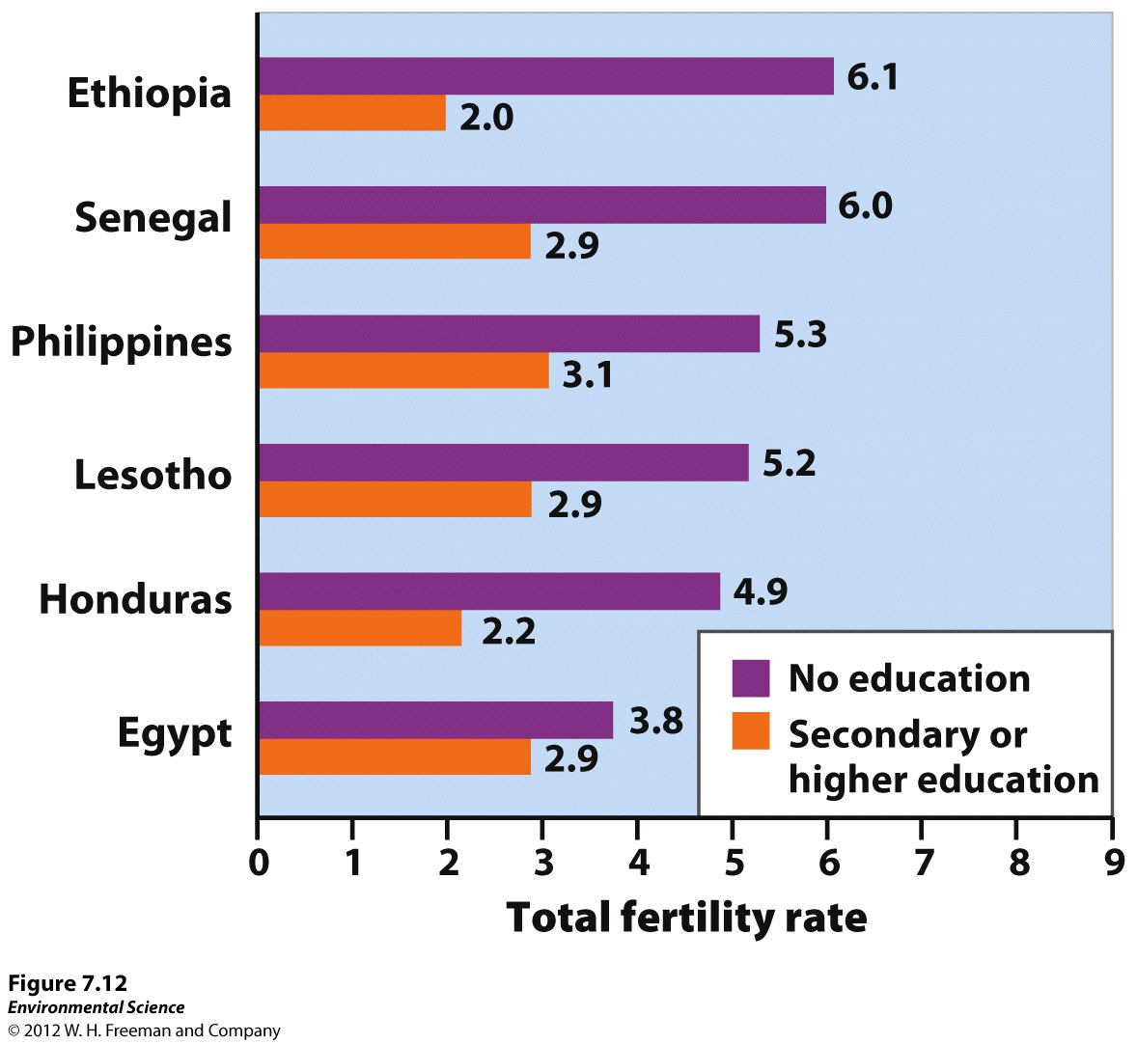

Slide 30
Population Size and Consumption Interact to Influence the Environment

Slide 31
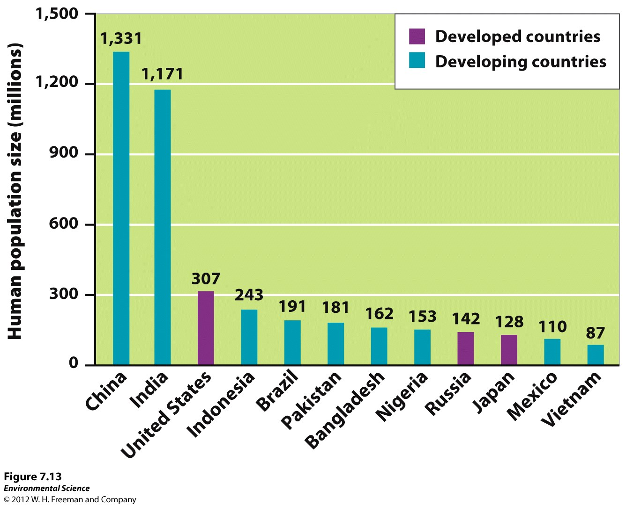

Slide 32
Economic Development
9 of the 12 most populous nations on Earth are developing countries.
5.6 billion people live in developing countries and only 1.3 billion live in developed.
Developed country #s have leveled off while developing county numbers have increased.
Calculating per capita ecological footprint for a country provides a way to measure the effect of affluence.
Affluence: money, goods property.

Slide 33
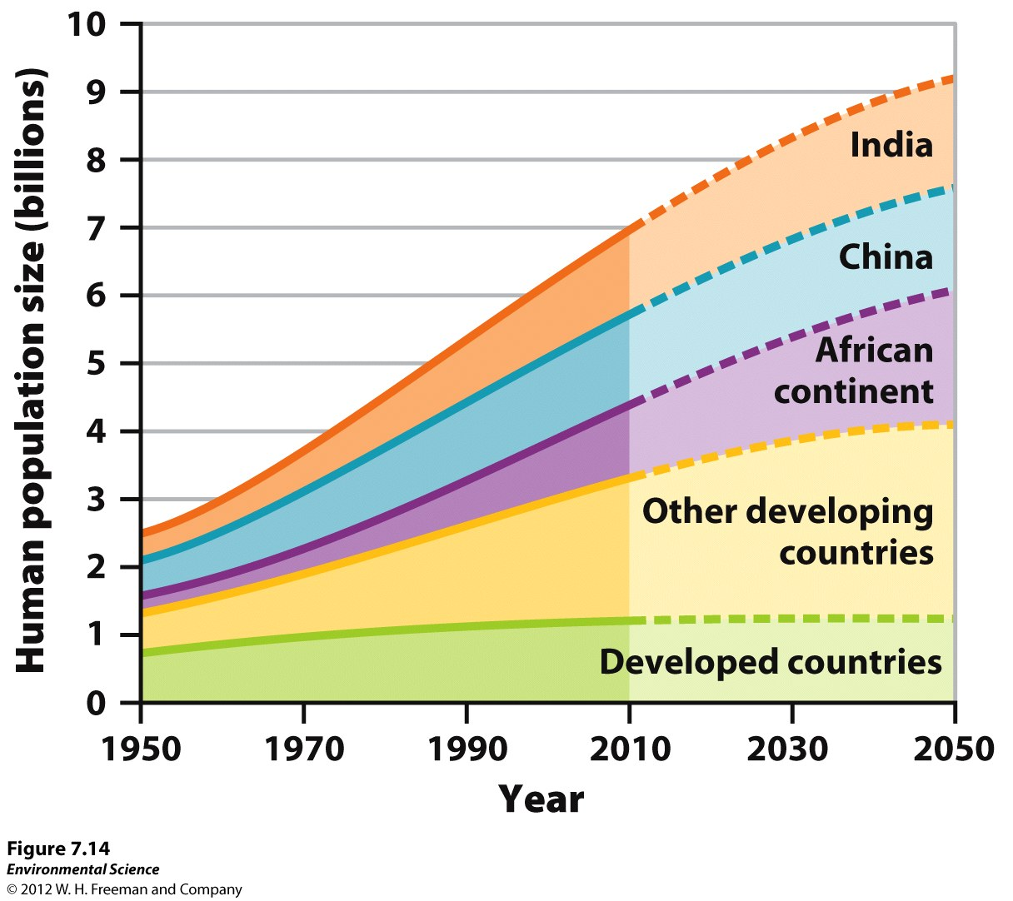

Slide 34
IPAT Equation
Impact = Population x Affluence x Technology
Population: amount of people.
Affluence: the more affluence, the higher the environmental impact.
Technology: Destructive technology..difficult to measure.

Slide 36
Local, Global, and Urban Impacts
Local Impacts: typical of rural, agriculturally based societies.
Typically land and woody biomass.
Results in erosion, soil degradation and habitat loss.
May increase yield or productivity through fertilization, irrigation, and extending growing time.

Slide 37
Global Impacts: typical of affluent or urban societies that tend to focus on industrial production and high technology.
Conversion of land to agriculture reduces the uptake of atmospheric carbon dioxide by plants which affects the global carbon cycle.
Use of fertilizers made from fossil fuels increases the release of greenhouse gases into the atmosphere.
Transporting food requires the use of fossil fuels.
Building suburbs often means replacing natural areas with lawns and asphalt.

Slide 38
Urban Impacts
Urban populations represent ½ of the human population, but consume ¾ of the Earth’s resources.
Urban Area: 386 people per square kilometer (1,000 people per square mile).
NYC: most densely populated city in the US.
Mumbai, India: most densely populated city in the world.

Slide 39
More than 75% of the people in developed countries live in urban areas.
Of the 20 largest cities in the world, 16 are in developing countries.
While urban areas produce greater amounts of solid waste, pollution, and carbon dioxide emissions than suburban or rural areas, they tend to have smaller per capita ecological footprints.

Slide 40
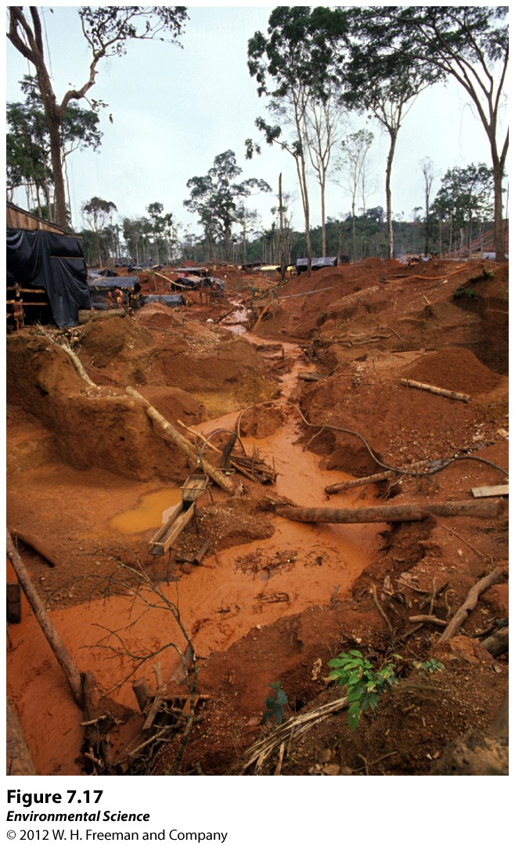

Slide 41
The Impact of Affluence
Gross Domestic Product (GDP): the value of all products and services produced in a year in that country.
Low GDP =s low pollution.
Gaining GDP =s gaining pollution.
High GDP=s may reach a turning point.

Slide 42
